Slide 1

CAP
Cryptographic Analysis Program
Shift Cipher Analysis Help Presentation
Press Enter or click on your mouse button to continue

Slide 2

Breaking the Shift Cipher
A shift cipher is easy to break by a brute force attack
Try all 25 possible shifts on the ciphertext
  One of them will produce plaintext
CAP will do this for you (see the next slide)

Slide 3
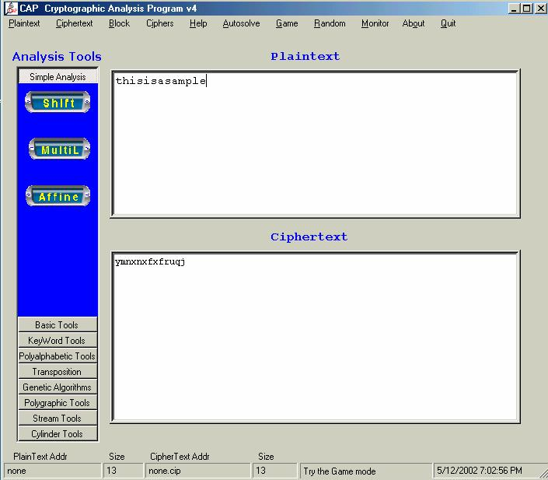
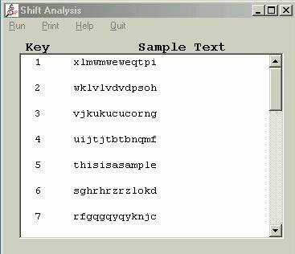
Using CAP
CAP try all 25 shifts and report the results
Select
Run
Select
Shift
Enter the
ciphertext

