Slide 1

CAP
Cryptographic Analysis Program
Breaking a Column Transposition Help Presentation
Press Enter or click on your mouse button to continue

Slide 2

Breaking Transpositions
There are three tasks involved in breaking a column transposition cipher:
  Find possible rectangle sizes
  Select the correct rectangle
  Find the column order

Slide 3
Possible Rectangles
The first step in analyzing a column transposition is determining the number of columns
  in a completely filled transposition, the number of characters is the product of the number of rows and the number of columns
  so, factor the number of characters to determine possible row and column sizes

Slide 4
Which Rectangle?
Since the factors only supply possible column sizes - test each possibility by doing a vowel count
  any line of plaintext should contain about 40% vowels
  So, count the vowels in each row of each possible rectangle
  the one with the best match to 40% is the best choice for the actual rectangle

Slide 5
Letter Affinity
Once the rectangle size is determined, the column order must be discovered
  Advantage is taken of all the characteristics of the plaintext language
First, in all languages there are certain letters usually of medium or low frequency which combine with other letters to form diagrams of high frequency
  H (medium frequency) combines with T to form TH (highest frequency)
  H combines with C (medium frequency) to form CH
  V (low frequency) combines with E to form VE (medium frequency in military text)

Slide 6
Example Rules
When there is an H, attempts should be made to combine it with a T or a C
A V should be combined first with an E
A K should be combined first with a C

Slide 7
Pilot Letters
Second, there is usually in every language at least one letter which can be followed by only certain other letters forming an obligatory sequence or invariable digraph
  Q is always followed by U
  J can only be followed by a vowel
  X can be preceded only by a vowel and except at the end of a word can only be succeeded by a vowel or C, H, P, T
Letters such as these with limited affinity are called pilot letters

Slide 8
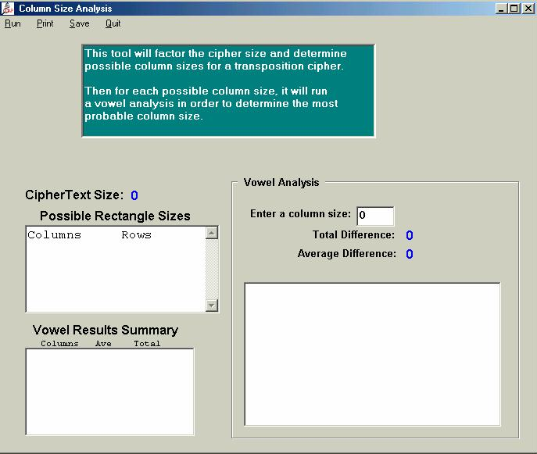
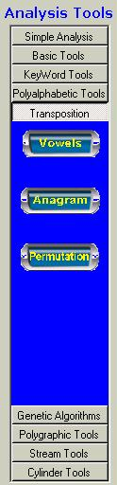
Column Size in CAP
CAP will determine both possible column sizes and run a vowel analysis of each column:

Slide 9
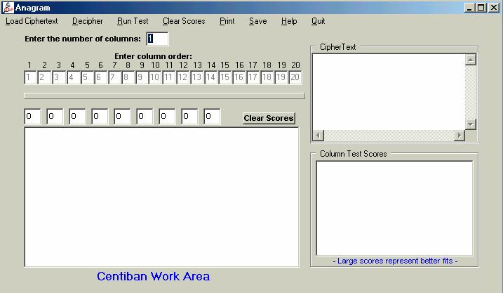
Anagramming in CAP
CAP provides a tool to aid in the anagramming process

