Slide 1

CAP
Cryptographic Analysis Program
Breaking a Double Column Transposition Cipher Help Presentation
Press Enter or click on your mouse button to continue

Slide 2

Cryptanalysis of a DT
A weakness of the double column transposition cipher lies in the use of the same pair of keys on several plaintext messages all of the same size.
For example, if the following 4 messages between Bob and Alice were intercepted:
etmai atecb bsbnq xivjb eecqu heikn oxlct sedwn oowqq
texda aqmue caeon ioox
panbt tjliu eeyhq xotbi dttqy dwbml bxooa oweal hoaqp
nexbh tqaut iekau wocx
monat rtwle bocoq xhofb aurqe oxino oxlir defar uhoqe
mexbn nqttn cgwoo rtox
awsbe lymtt ernrq xtnei olfqt lebne uxorb okorl ocmqf
iexru oqwhe oogao aacx

Slide 3
Process
Place all 4 messages “in depth” – that is one on top of the other
  Treat it as a large anagramming problem
etmai atecb bsbnq xivjb eecqu heikn oxlct sedwn oowqq texda aqmue caeon ioox
panbt tjliu eeyhq xotbi dttqy dwbml bxooa oweal hoaqp nexbh tqaut iekau wocx
monat rtwle bocoq xhofb aurqe oxino oxlir defar uhoqe mexbn nqttn cgwoo rtox
awsbe lymtt ernrq xtnei olfqt lebne uxorb okorl ocmqf iexru oqwhe oogao aacx
Columns of “x” should all go to the end

Slide 4
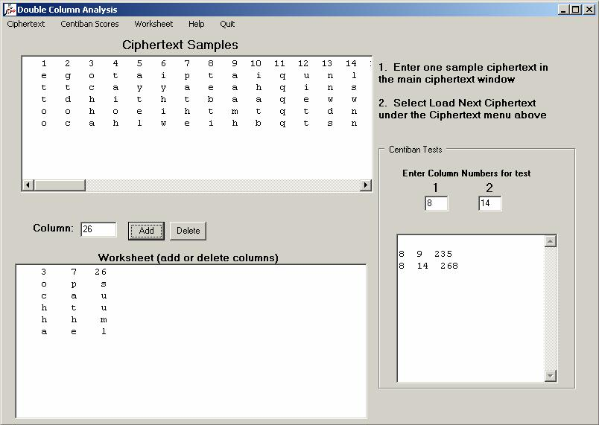
Using CAP
CAP provides a special anagramming tool for Double Column Transpositions:

