Slide 1

CAP
Cryptographic Analysis Program
Double Column Transposition Cipher Help Presentation
Press Enter or click on your mouse button to continue

Slide 2

Concept
A double column transposition cipher works just as the name implies.
  The plaintext is enciphered using a column transposition and then the resulting ciphertext is enciphered again using a column transposition.
  The keyword may the same for transpositions or it may be different.
  The result is hopefully, a thorough mixing of the positions of the plaintext letters.

Slide 3
Example
Encipher the phrase “encryption algorithms” twice:
1st using the keyword next: 2-1-4-3
2nd using the keyword image: 4-5-1-3-2
1
2
3
4
1
2
3
4
5
N
P
N
O
H
E
N
C
R
N
P
N
O
H
E
N
C
R
E
Y
O
G
T
Y
T
I
E
Y
O
G
T
Y
P
T
I
P
O
G
I
R
H
T
S
M
N
E
R
C
N
R
I
L
I
S
O
A
L
R
I
L
I
S
O
N
A
L
C
T
A
R
M
N
O
L
A
P
Y
I
T
G
O
R
I
C
T
A
R
M
G
O
R
I
T
H
T
H
M
S
M
S

Slide 4
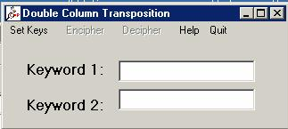
Using CAP
CAP will implement a double column transposition:

