Slide 1

CAP
Cryptographic Analysis Program
Permutation Cipher Help Presentation
Press Enter or click on your mouse button to continue

Slide 2

Permutation Cipher
Break the plaintext up into groups of a fixed size, d
  define a permutation of the integers 1 to d called f
  within each block, permute the letters according to f
  the key is (d,f)
For example, let d = 5 and let f be given by:
1
3
g e t t h e b a l l
2
4
3
1
t
h
g
e
t
a
l
e
b
l
4
5
5
2

Slide 3
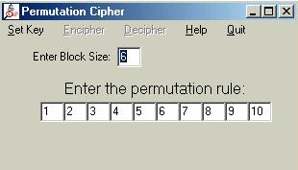
Using CAP
Select Permutation under the cipher menu

