Slide 1

CAP
Cryptographic Analysis Program
ADFGVX Help Presentation
Press Enter or click on your mouse button to continue

Slide 2

The ADFGVX Cipher System
This cipher involves to operations
  A substitution
  Followed by a transposition
The substitution involves a 6 x 6 square where the rows and columns are labeled by the letters ADFGVX
  These letters were selected because they are easy to distinguish as Morse code
The transposition is a simple column transposition based on a key word

Slide 3
Matrix
26 letters and 10 digits are entered into a 6 x 6 matrix using a keyword
A D F G V X
A
D
F
G
V
X
Keyword: when2go93
w h e n 2 g
Enter the keyword and then
fill in the rest of the matrix
using the unused letters and
numbers in order
O 9 3 a b c
d f i j k l
m p q r s t
u v x y z 0
1 4 5 6 7 8

Slide 4
Substitution
Each letter and number in the plaintext is replaced by the letters on the column and row headings of the matrix
A D F G V X
A
D
F
G
V
X
w h e n 2 g
O 9 3 a b c
Plaintext: n e x t
Ciphertext: AG AF VF GX
d f i j k l
m p q r s t
u v x y z 0
1 4 5 6 7 8

Slide 5
Transposition
Using a column transposition with a keyword, the ciphertext is written in rows and then read in columns in a specified order
1 2 3 4 5 6
A F A G G V
X G F X D X
V A A D X X
F G D G X G
A F G A V G
Read down columns in order
3 – 6 - 1- 2 – 5 - 4
AFADG VXXGG AXVFA
FGAGF GDXXV GXDGA

Slide 6
Column Key
The key for a column transposition is the number of columns and the order in which they are selected both of which are determined by a keyword
For example, the keyword “general” defines a column transposition with 7 columns because it has 7 letters
To define the order of columns assign each letter a number based on its order in the alphabet
g e n e r a l
4
2
6
3
7
1
5

Slide 7
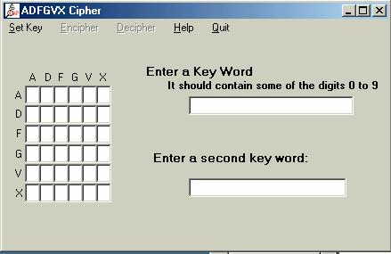
Using CAP
Select ADFGVX cipher from the cipher menu
First keyword sets up the matrix
Second keyword sets up column transformation

