Slide 1

CAP
Cryptographic Analysis Program
Keyword Cryptanalysis Help Presentation
Press Enter or click on your mouse button to continue

Slide 2

Basic Cryptanalysis
The most basic observation of cryptanalysis is that every letter of a language has a personality of its own
  if every plaintext t is changed to a ciphertext m, then in the ciphertext, m assumes the personality of t
  to the trained observer, the personality of a letter gives away its identity
Some of these personality characteristics are:
  frequency of occurrence
  contact with other letters
  position within words

Slide 3
Standard English Frequency Groups
High Frequency Group
  E T A O N I R S H
Medium Frequency Group
  D L U C M
Low Frequency Group
  P F Y W G B V
Rare Group
  J K Q X Z
There is usually a sharp break
between the high and medium groups. That is, H is usually 6% and D is usually 4%
SO: look for the break between the high and medium group

Slide 4
Single Frequency Reasoning
Things to look for in a frequency report
  If there are hills and valleys similar to standard English then the cipher is most likely a substitution, so:
    Find the break between high frequency and medium frequency (look for a 2% drop between two letters)
    The most frequent letter is probably “e” or at least “t” or “a”

Slide 5
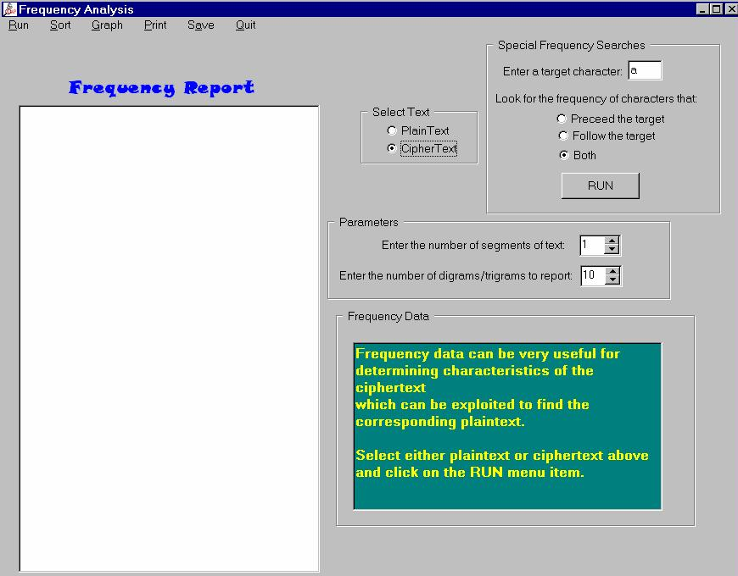
CAP Frequency Analysis
Since it is one of the most useful tools in cryptanalysis, CAP provides a frequency analysis window
  Select Frequency under the Basic Tools

Slide 6
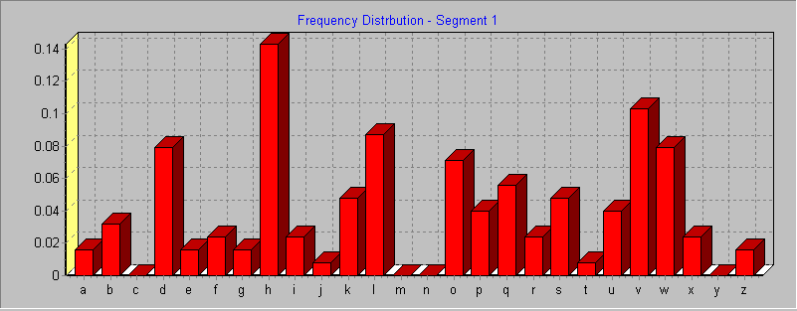
Frequency Graph
CAP will display the frequency in a graph
  Select the Graph menu and click on show

Slide 7
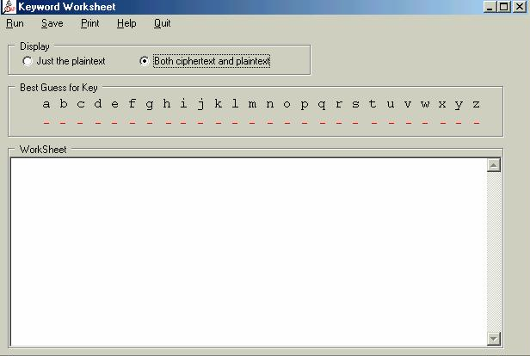
Keyword Worksheet
when you have some possible substitutions test them using the keyword worksheet to manually look for words

