Slide 1

CAP
Cryptographic Analysis Program
Hill Cipher Help Presentation
Press Enter or click on your mouse button to continue

Slide 2

Hill Cipher
Another polygraphic cipher was developed by the mathematician Lester Hill in 1929 - called the Hill Cipher
It takes m successive plaintext letters and substitutes for them m ciphertext letters

Slide 3
Hill Process
Each character is assigned a numerical value
  a = 0, b = 1, . . ., z = 25
for m = 3 the transformation of p₁p₂p₃ to c₁c₂c₃ is given by 3 equations:
c₁ = (k₁₁p₁ + k₁₂p₂ + k₁₃p₃) mod 26
c₂ = (k₂₁p₁ + k₂₂p₂ + k₂₃p₃) mod 26
c₃ = (k₃₁p₁ + k₃₂p₂ + k₃₃p₃) mod 26
KEY

Slide 4
Hill Matrix
The Hill cipher is really a matrix multiplication system
  The enciphering key is an n x n matrix, M
  The deciphering key is M⁻¹
For example, if n = 3 one possible key is:
M = ( )
M⁻¹ = ( )
17 17 5
21 18 21
2 2 19
4 9 15
15 17 6
24 0 17
(
)
17 17 5
21 18 21
2 2 19
(
) = ( ) mod 26
Encrypt ‘n o w’
13
14
22
23
20
4
13 14 22
x u e

Slide 5
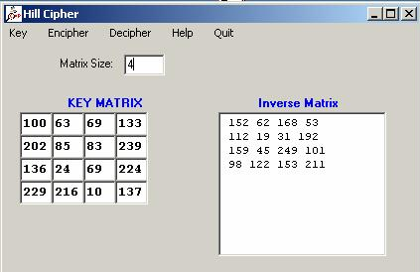
Using CAP
CAP will create a Hill cipher for groups of 2 to 6 characters
CAP will generate a matrix for you or you can load one
First, enter the group size – which is the same as the matrix size

