Slide 1

CAP
Cryptographic Analysis Program
A Simple Shift Cipher Help Presentation
Press Enter or click on your mouse button to continue

Slide 2
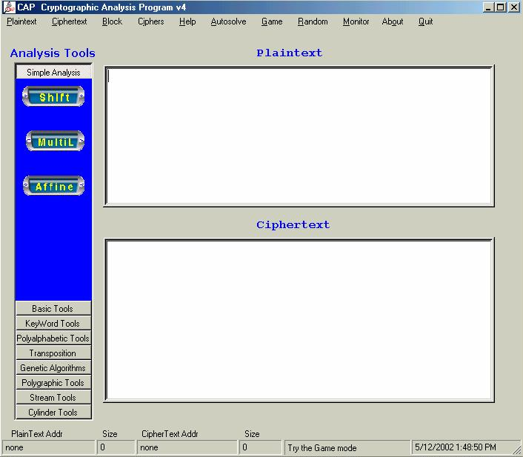
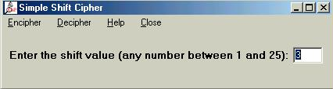

Shift Cipher
CAP will encipher/decipher using a simple shift system
Enter the plaintext
This is a sample
Select Simple Shift
under the Ciphers Menu
ymnxnxfxfruqz
Enter shift value
Select Encipher

