Slide 1

CAP
Cryptographic Analysis Program
Rotor Cipher Help Presentation
Press Enter or click on your mouse button to continue

Slide 2

Rotor Cipher
A rotor or wired codewheel is a building block of a variety of polyalphabetic systems
A rotor is a disk with electrical contacts, one for each letter of the alphabet around the side
The internal path of the wires defines a monoalphabetic substitution

Slide 3
Multiple Rotors
Several rotors are connected and rotated at different rates
EXAMPLE
1
2
1
2
A goes to B
A
A
Now,
A goes to E
A
E
B
B
B
A
Rotate 2
by one
C
C
C
B
D
D
D
C
E
E
E
D

Slide 4
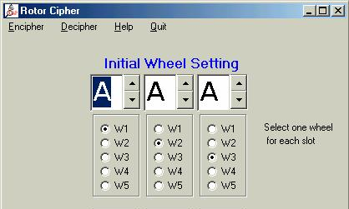
Rotors in CAP
CAP provides a rotor type cipher
  Select Rotor under the cipher menu

