Slide 1

CAP
Cryptographic Analysis Program
Identifying Playfair Help Presentation
Press Enter or click on your mouse button to continue

Slide 2

Is it a Playfair Cipher?
There are several characteristics of Playfair ciphertext that can be useful in identifying it as a Playfair system
  Since it is a substitution system, the rare consonants j, k, q, x, and z will appear in higher frequencies than plaintext and digraphs containing these consonants will appear more frequently
  There are an even number of letters in the ciphertext
  When the ciphertext is broken up into digrams, doubled letters such as SS, EE, MM, . . . will not appear.

Slide 3
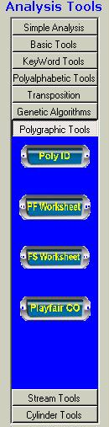
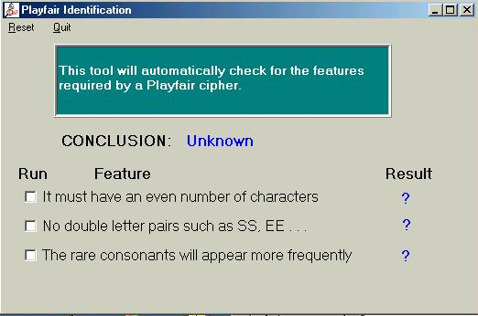
Using CAP
CAP will help in the process of identifying a Playfair (or other polygraphic) system
Select
PolyID

