Slide 1

CAP
Cryptographic Analysis Program
Affine Cipher Help Presentation
Press Enter or click on your mouse button to continue

Slide 2

The Affine Cipher System
The affine cipher is another version of a substitution cipher
  Each letter is assigned a number
    A = 0, B = 1, . . ., Z = 25
    Two numbers are selected (a, b) between 0 and 25 such that the gcd(a,26) = 1
  Let p and c represent letters (p,c are numbers between 0 and 26) where p is a plaintext letter and c is a ciphertext letter then:
c = ap + b mod 26
p = a⁻¹(c - b) mod 26

Slide 3
Affine Example
Select the key (a,b) = (7, 3)
  gcd(7,26) = 1
  7⁻¹ mod 26 = 15 (since 7 x 15 = 105 and 105 mod 26 = 1)
The general encipher/decipher equations are:
c = 7p + 3 mod 26
“hot” is 7 14 19
c(h) = 7*7 + 3 mod 26 = 52 mod 26 = 0 = a
c(o) = 7*14 + 3 mod 26 = 98 mod 26 = 23 = x
c(t) = 7*19 + 3 mod 26 = 133 mod 26 = 6 = g

Slide 4
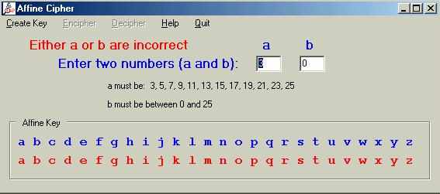
Affine Cipher in CAP
Select the Affine option under the cipher menu . . .
This will set up your key
Error message if you fail to select the correct key numbers
Enter the two numbers

