Slide 1

CAP
Cryptographic Analysis Program
Breaking Autokey-Plaintext Help Presentation
Press Enter or click on your mouse button to continue

Slide 2

Breaking the Autokey-Plaintext
This is not as easy to break as the autokey-ciphertext but . . .
A Kasiski-like method exists to determine the “group length”
  The group-length is the actual keyword length but since the keyword is not repeated, the group-length describes the length of segments of the running key
  These segments define the distance between a plaintext letter being enciphered and becoming a key letter

Slide 3
Group Length
For example, if the keyword is “alice” a possible cipher structure could be given by
5
t
a l i c e t h i s i s a n e x
t
t h i s i s a n e x a m p l e
t is enciphered
t is a key letter

Slide 4
Finding the Group Length
It is possible to discover the group length from the ciphertext
  Assume the group length is 5 then every plaintext letter will be enciphered by the letter 5 positions to its left and in turn will encipher the letter 5 positions to its right.
  Since plaintext has a lot of repeated characters there will be an unusually large number of identical letters separated by the group length
Example
Key: . . . R . . . S
Plaintext: . . . S . . . R
Ciphertext: . . . J . . . J
There is a good
chance that this
kind of event will
occur
S
S
R
Group length

Slide 5
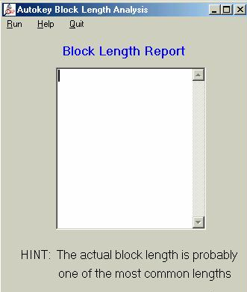
Procedure
Find the distances between all letter repetitions
The most common distances are strong candidates for the group-length
CAP will automatically calculate these distances:

Slide 6
Using the Group Length
Knowledge of the group length reveals how the plaintext is divided into segments.
  If the group length is 5, then the first segment consists of every 5th letter beginning with the first letter
We know the encipher chain for this segment, for example:
a l i c e t h i s i s a n e x
t h i s i s a n e x a m p l e
t
s
a
t s q u m l h v w f s m c p b

Slide 7
Brute Force Attack
We can use a brute force attack because each segment is defined by its beginning character (which is from the key word)
For example:
Guess
Ciphertext (known) Key character (unknown) plaintext (unknown)
a
t
t ? ?
t
t
s
l ? ?
a
s ? ?
s
s
Try all 26 guesses
Use a low frequency
character test

