Slide 1

CAP
Cryptographic Analysis Program
Breaking the Vigenere Cipher Help Presentation
Press Enter or click on your mouse button to continue

Slide 2

Breaking Vigenere
For more than 300 years cryptanalysts worked on the problem of breaking a polyalphabetic cipher (like the V-cipher)
In 1863, a Polish Infantry officer, Friedrich W. Kasiski, published a short book (95 pages) which changed the nature of cryptography
  He had found a simple solution to the polyalphabetic ciphers
  He died in 1881 without realizing that he had started a revolution in cryptography

Slide 3
Repetitions
Kasiski’s breakthrough was the observation that:
The conjuction of a repeated portion of
the key with a repetition in the plaintext
produces a repetition in the ciphertext.
So, the size of the keyword can be determined by the
nature of repeated ciphertext character strings.

Slide 4
Example
Given the keyword RUN and some plaintext:
R U N R U N R U N R U N R U N R U N R U N R U N R U N
t o b e o r n o t t o b e t h a t i s t h e q u e s t
K I O V I E E I G K I O V N U R N V J N U V K H V M G
9 characters
6 characters
Find repeated ciphertext
Count the number of characters between the repetitions
NOTE: each time the key RUNR engages the repeated
plaintext to be, the repeated ciphertext KIOV is
produced

Slide 5
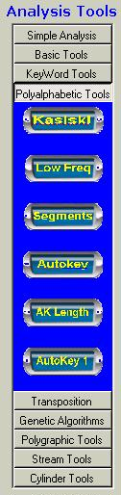
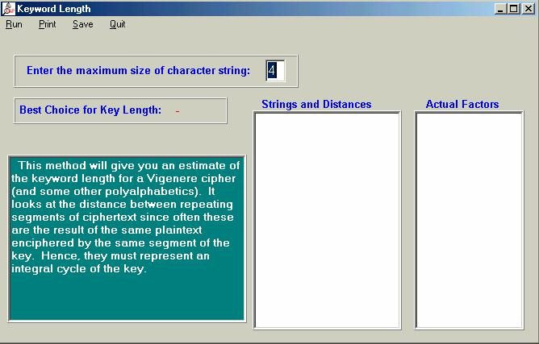
Using CAP
CAP will perform this test automatically – select Kasiski Method under the polyalphabetic menu

Slide 6
Next Step
once the keyword size is known it is possible to discover the keyword
  create copies of the target ciphertext in columns where each column is shifted by one position in the alphabet.
the low frequency letters (j,k,q,x,z) should have a combined frequency
of about 2%
any column in which these letters appear more frequently is rejected
A column with the correct frequency is a candidate for the plaintext

Slide 7
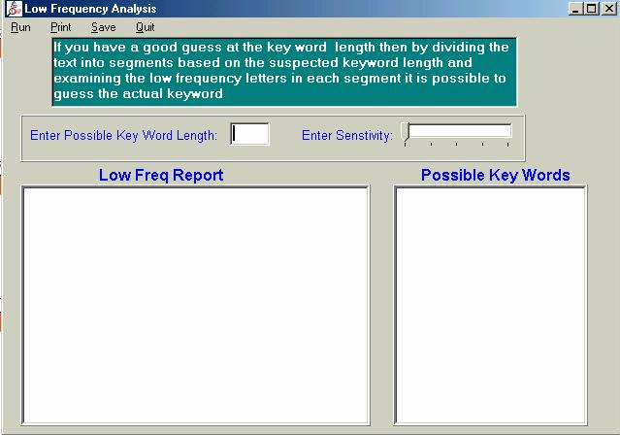
Using CAP
CAP provides a low frequency analysis tool:

