Slide 1

CAP
Cryptographic Analysis Program
Breaking a Hill Cipher Help Presentation
Press Enter or click on your mouse button to continue

Slide 2

Breaking Hill
The Hill cipher is highly resistant to a ciphertext only attack.
  In fact, the larger the matrix, the more resistant the cipher becomes.
However, it is easy to break using a known plaintext attack.
  The process is much like the method used to break an affine cipher in that the known plaintext/ciphertext group is used to set up a system of equations which when solved will reveal the key.

Slide 3
Theory
We know the ciphertext matrix was created by multiplying the plaintext matrix by the key matrix or:
So, the key matrix can be recovered if we know the inverse of the plaintext matrix:
C = MK
K = M⁻¹C
Process: Find the inverse of
the known plaintext, multiply
it times a segment of ciphertext,
and check the resulting key

Slide 4
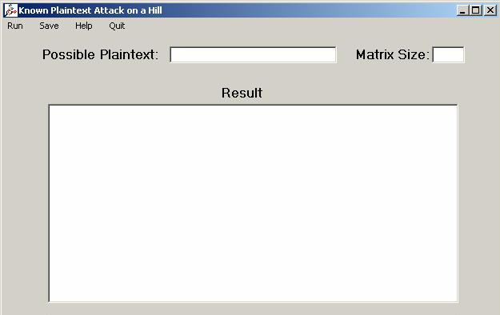
Using CAP
Breaking a Hill cipher by hand is very time consuming however CAP will automate the process
Enter a possible
plaintext segment
Enter your best
guess for the size
Try the possible
keys until one
works

