Slide 1

CAP
Cryptographic Analysis Program
Breaking a Permutation Cipher Help Presentation
Press Enter or click on your mouse button to continue

Slide 2
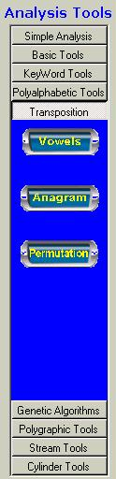
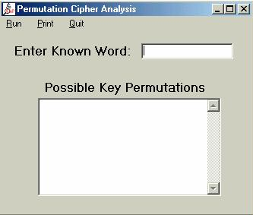

Using CAP
A known word attack can match the word with the ciphertext to discover the permutation
Enter Possible
Word
Select
Permutation

