Slide 1

CAP
Cryptographic Analysis Program
Playfair Cipher Help Presentation
Press Enter or click on your mouse button to continue

Slide 2

Playfair Cipher
Playfair is a polygraphic method designed to invalidate single frequency analysis
  the key is a 5 x 5 matrix of letters (j is not used) arranged by a keyword
  For example, if the keyword is harpsicord, the matrix key is:
H
A
R
P
S
I
C
O
D
B
NOTE: the second R in harpsicord is
not used
E
F
G
K
L
M
N
Q
T
U
V
W
X
Y
Z

Slide 3
Playfair Rules
All text is preprocessed
  j’s are replaced with i’s
  a null letter such as q is placed between any identical pairs of letters so that “tt” becomes “tqt”
  if the plaintext has an odd number of letters, the null letter is added on to the end
The ciphertext is produced by looking at each pair of letters in the plaintext (m₁ and m₂)
  if m₁ and m₂ are in the same row in the key matrix, then they are replaced by the characters to their right
  if m₁ and m₂ are in the same column then they are replaced by the letters below them
  if m₁ and m₂ are in different rows and columns then they are replaced by the letters found on the other two corners of a rectangle formed by m₁ and m₂

Slide 4
Rule One
Using the keyword array formed from “software”
  the plaintext letter pair: “RE” becomes “EB”
  Note: the rows circle back on
  themselves so the letter pair
  “LQ” becomes “ML”
S
O
F
T
W
R
E
A
R
E
B
E
B
C
D
G
H
I
K
L
Q
L
M
L
M
N
P
Q
U
V
X
Y
Z

Slide 5
Rule Two
Again using the keyword array formed from “software”
  the plaintext letter pair “AL” becomes “DU”
  since the columns circle back
  on themselves, the letter
  pair “TY” becomes “BT”
T
S
O
F
T
T
W
A
B
A
R
E
B
C
D
D
G
H
I
K
L
L
M
N
P
Q
U
Y
U
V
X
Y
Z

Slide 6
Rule Three
Using the keyword array formed from “software”
  the letter pair “OP” forms two corners of an imaginary rectangle
  so it is replaced by the
  characters on the other
  corners “TM”
S
O
T
O
F
T
W
A
R
E
B
C
D
G
H
I
K
L
M
P
M
N
P
Q
U
V
X
Y
Z

Slide 7
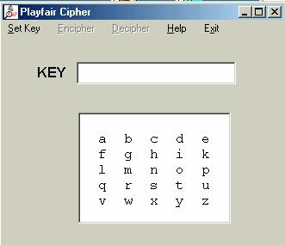
Using CAP
CAP will implement playfair:
Set Key
Enter
Keyword

