Slide 1
Evaluating MetaHipMer De Bruijn Local Assembly on GPUs MHM2: Electric GPU
Noam Benson-Tilsen
14 February 2025

Slide 2
L. M. Lindsey, N. Ding, J. Deslippe and M. Awan, "Performance Modeling and Analysis of a de Bruijn Graph Based Local Assembly Kernel on Multiple Vendor GPUs," SC24-W: Workshops of the International Conference for High Performance Computing, Networking, Storage and Analysis, Atlanta, GA, USA, 2024, pp. 1092-1105, doi: 10.1109/SCW63240.2024.00150.

Slide 3
Contents
Background
MetaHipMer assembly
Local assembly phase
GPUs
Performance comparison

Slide 4
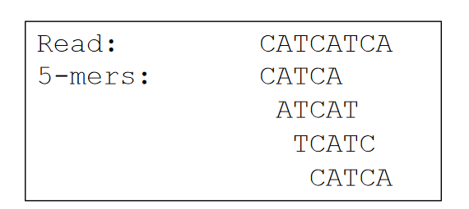
Terminology
Metagenomics — Heterogeneous samples directly from environment
De novo assembly — Construct genomes from samples without referent
Nucleotide — {A, C, G, T}
Read — Partial DNA sequence
k-mer — Length-k subsequence of a read
Contig — Partial genome, reconstructed from reads

Slide 5
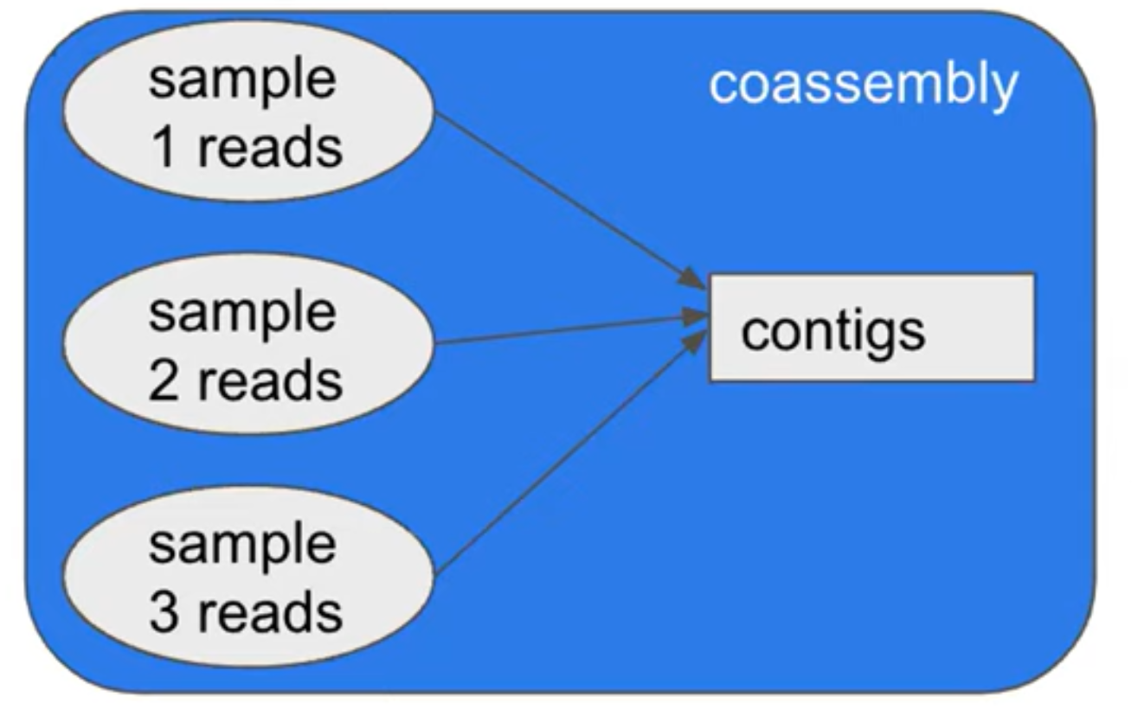
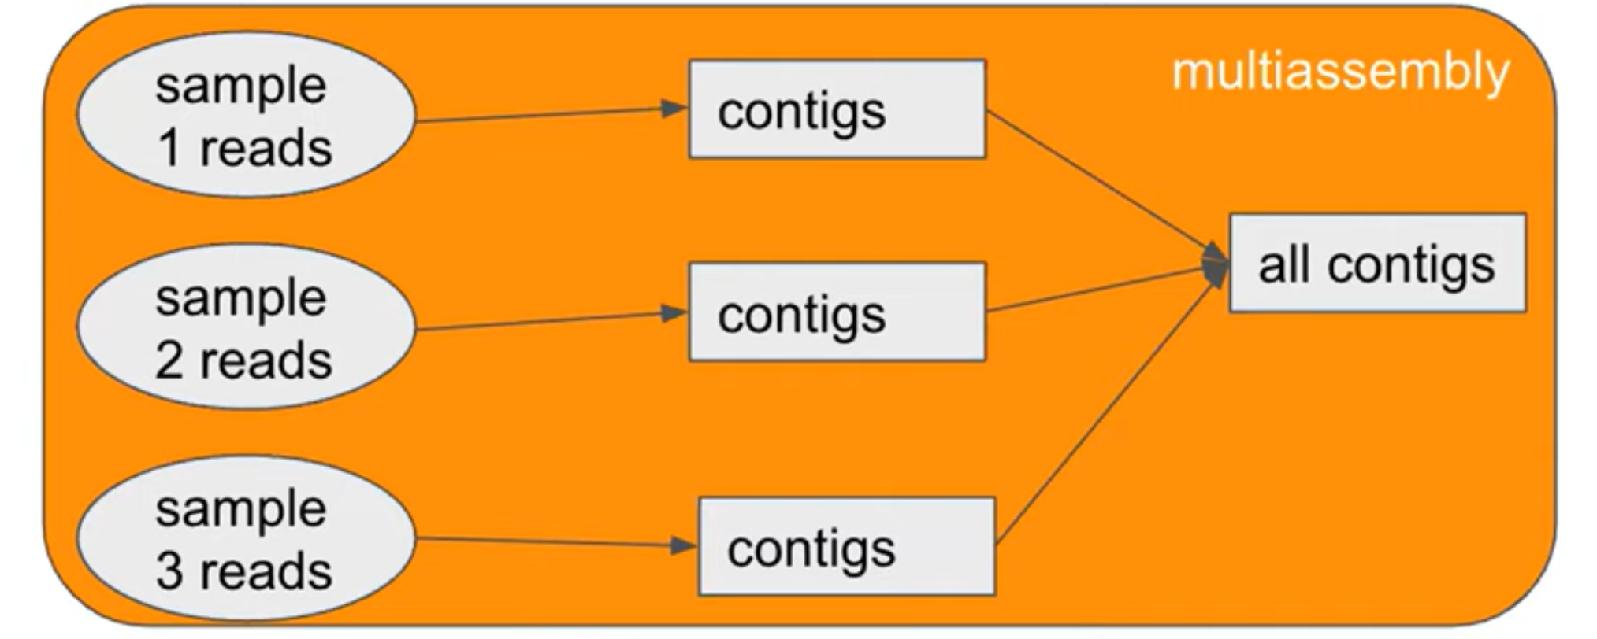
MetaHipMer (MHM)
Metagenomics
10³ to 10⁵ genomes from direct heterogeneous environment samples
No referents, unknown number of distinct genomes
Goal
Parallel de novo genome coassembly
Superior to multi-assembly
But more memory intensive

Slide 6
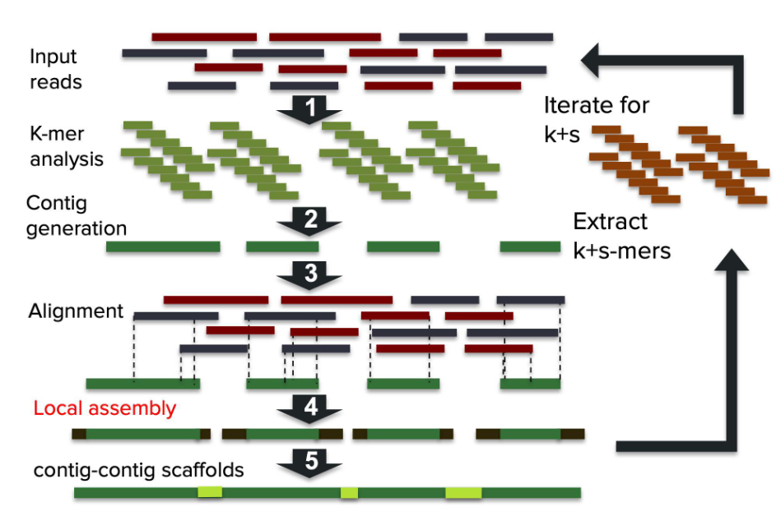
MHM assembly pipeline [1]
Obtain reads from environment
Analyze k-mers
Count, quality
Bloom filter for erroneous k-mers
De Bruijn 1: Generate contigs
Alignment: Find candidates reads for each contig
Local assembly: Extend contigs as much as possible
Scaffolding: Connect contigs as much as possible

Slide 7
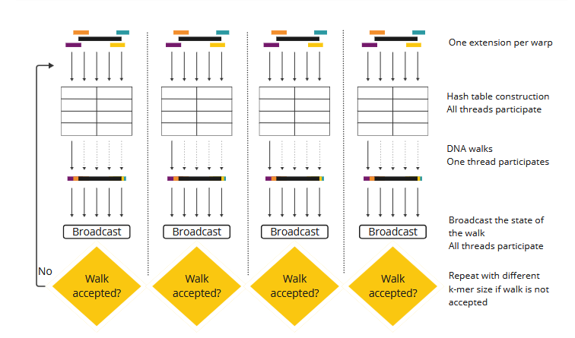
Local assembly module
Input
Output
Contig
k-mer hash table construction
DNA walk
Extend contig by traversing some graph
Want to extend
Using reads that align
Contig
set<Read>
Extended
Notes:
Left and right contigs

Slide 8
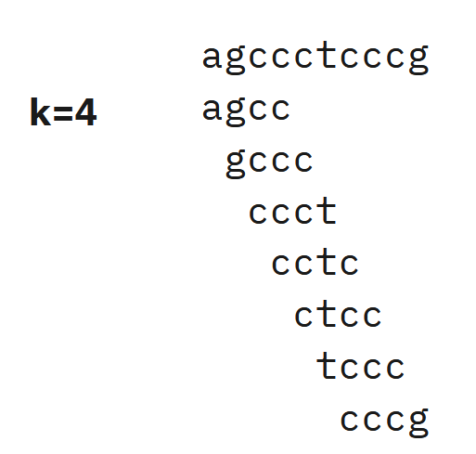
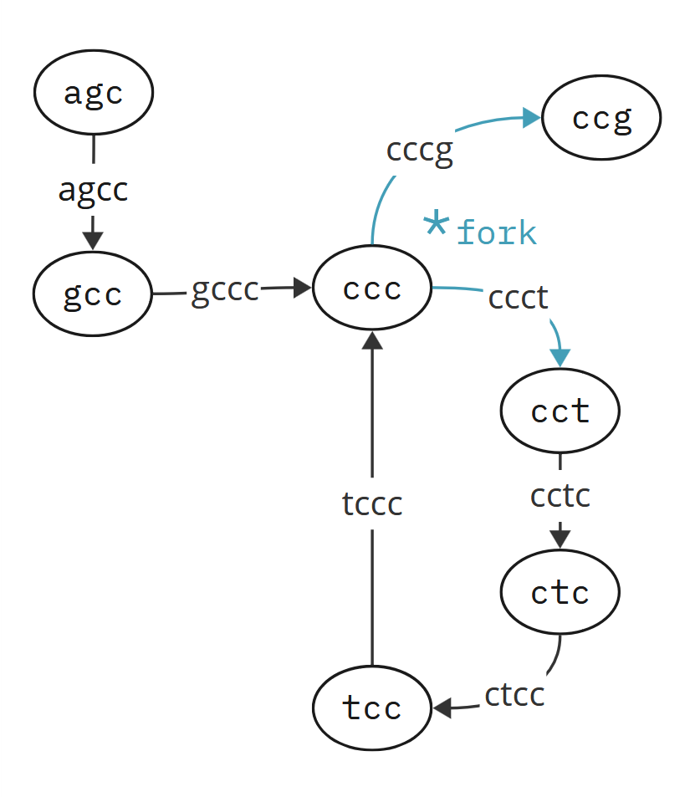
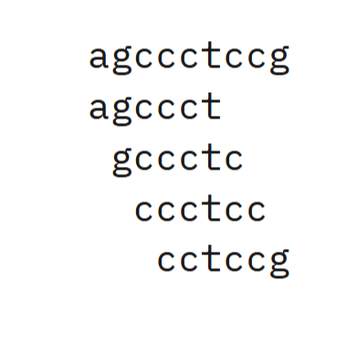
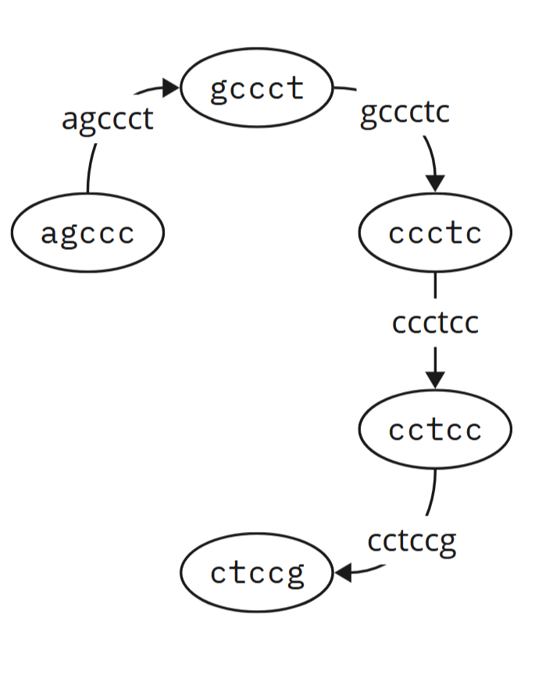
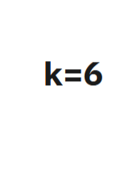
De Bruijn graph
Vertices: (k – 1)-mers
Edges
Incoming: Prefix
Outgoing: Suffix

Slide 9
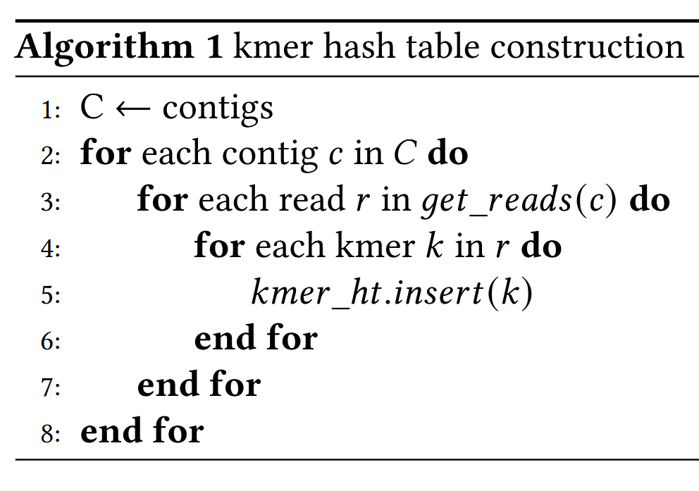
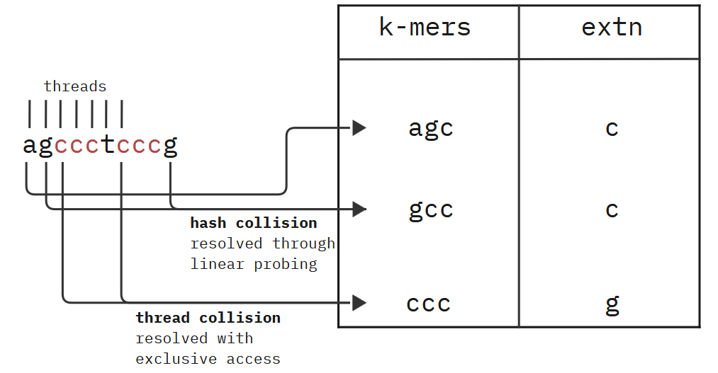
Local assembly module
Represent de Bruijn graph with adjacency list
map<k-mer, Extension>
nucleotide, quality, count
Notes:
Left and right contigs

Slide 10
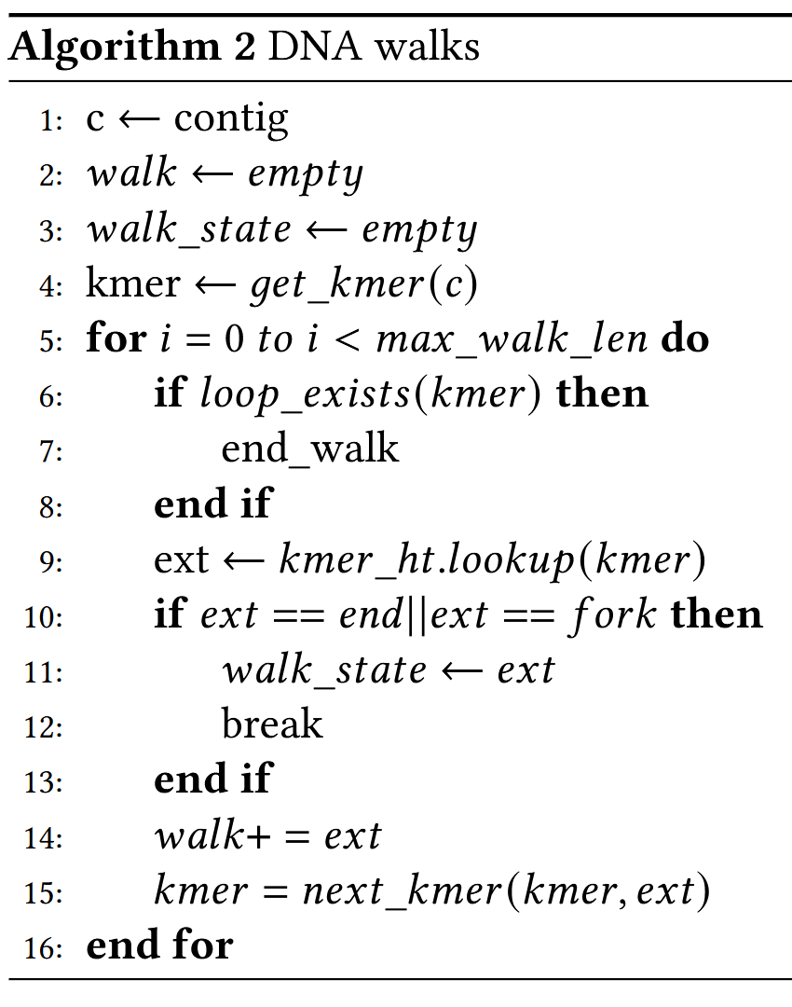
Local assembly module
DNA walk
Extend contigs by traversing de Bruijn graph
(hash table)
Repeat for varying values of k until termination
condition is met
Notes:
Left and right contigs

Slide 11
Local assembly module
DNA walk
Extend contigs by traversing de Bruijn graph
(hash table)
Repeat for varying values of k until termination
condition is met
Notes:
Left and right contigs

Slide 12
Local assembly module
DNA walk
Extend contigs by traversing de Bruijn graph
(hash table)
Repeat for varying values of k until termination
condition is met
Notes:
Left and right contigs

Slide 13
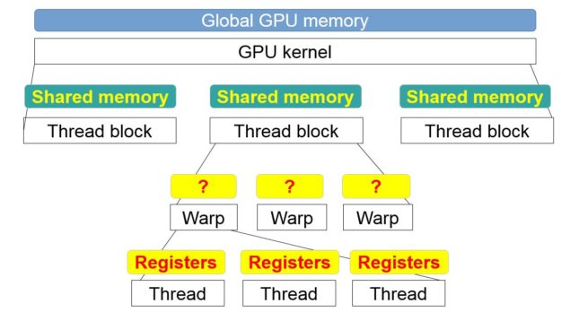
CUDA
NVIDIA’s parallel computing platform
Exposes API to write general-purpose code for GPUs
Developer writes GPU kernels that are run in parallel
Streaming multiprocessors (SMs)
Each with n streaming processors (SPs)
Each SM is assigned thread blocks
Thread blocks have threads with fast shared memory
Threads in a block are divided into warps
Warps: Direct register transfer, lockstep execution

Slide 14
Local assembly on GPUs
~30% of MHM is spent in local assembly
MHM2 offloads local assembly to GPU
Irregular memory access
Dynamic data structures (hash tables, vectors, strings)

Slide 15
Local assembly module
One assembly per warp
Parallel hash table construction
Serial DNA walk
Notes:
Left and right contigs

Slide 16
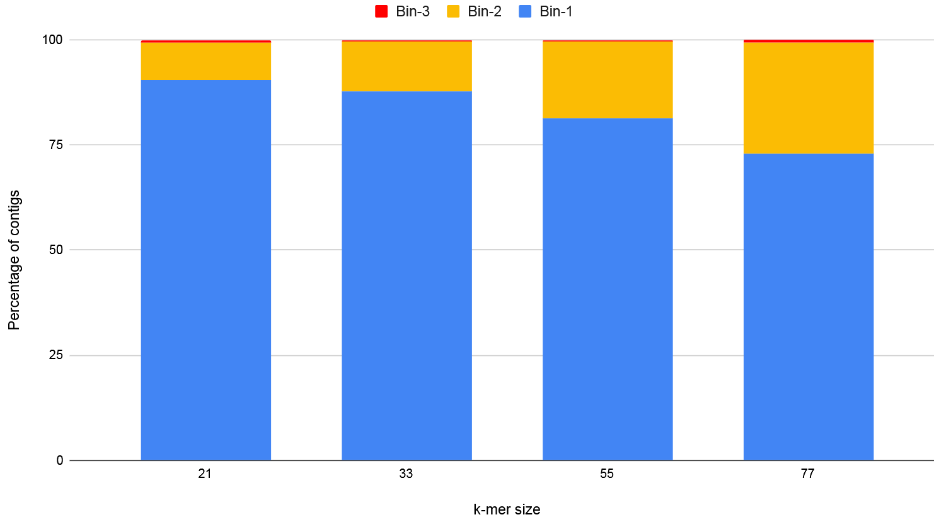
Local assembly on GPUs
Contig binning
Partition by number of candidate reads
Empirical observation to determine
bin predicates
Allocate extension and loop-detection tables for each contig
No need for dynamic allocation
Limitation: DNA walk inherently serial

Slide 17
Local assembly on GPUs
Hash collisions
Multiple k-mers have the same hash value
linear probing
Thread collisions
Threads in a warp contend for a hash value
Atomic compare and swap
Synchronize with __match_any_sync

Slide 18
HIP and SYCL
HIP
Heterogeneous-computing Interface for Portability
AMD’s API for portability between NVIDIA and AMD GPUs
SYCL
System-wide Compute Language
Programming model and API including support targeting Intel GPUs

Slide 19
Performance evaluation
CUDA
Used in original MHM/MHM2 implementations
HIP and SYCL
Automatic migration with hipify/SYCLOMATIC
Variable thread subgroup sizes
Different atomics/synchronization primitives

Slide 20
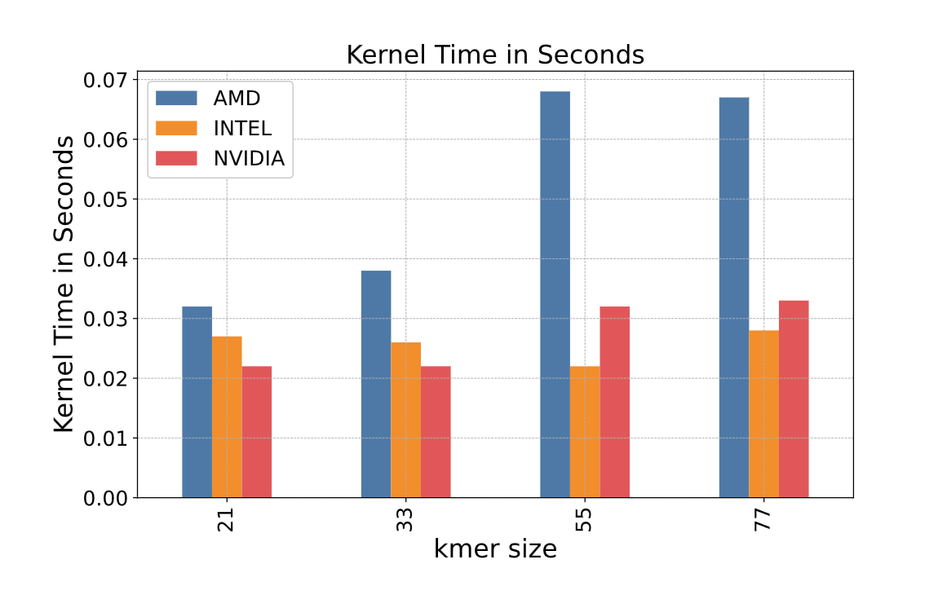
Performance

Slide 21
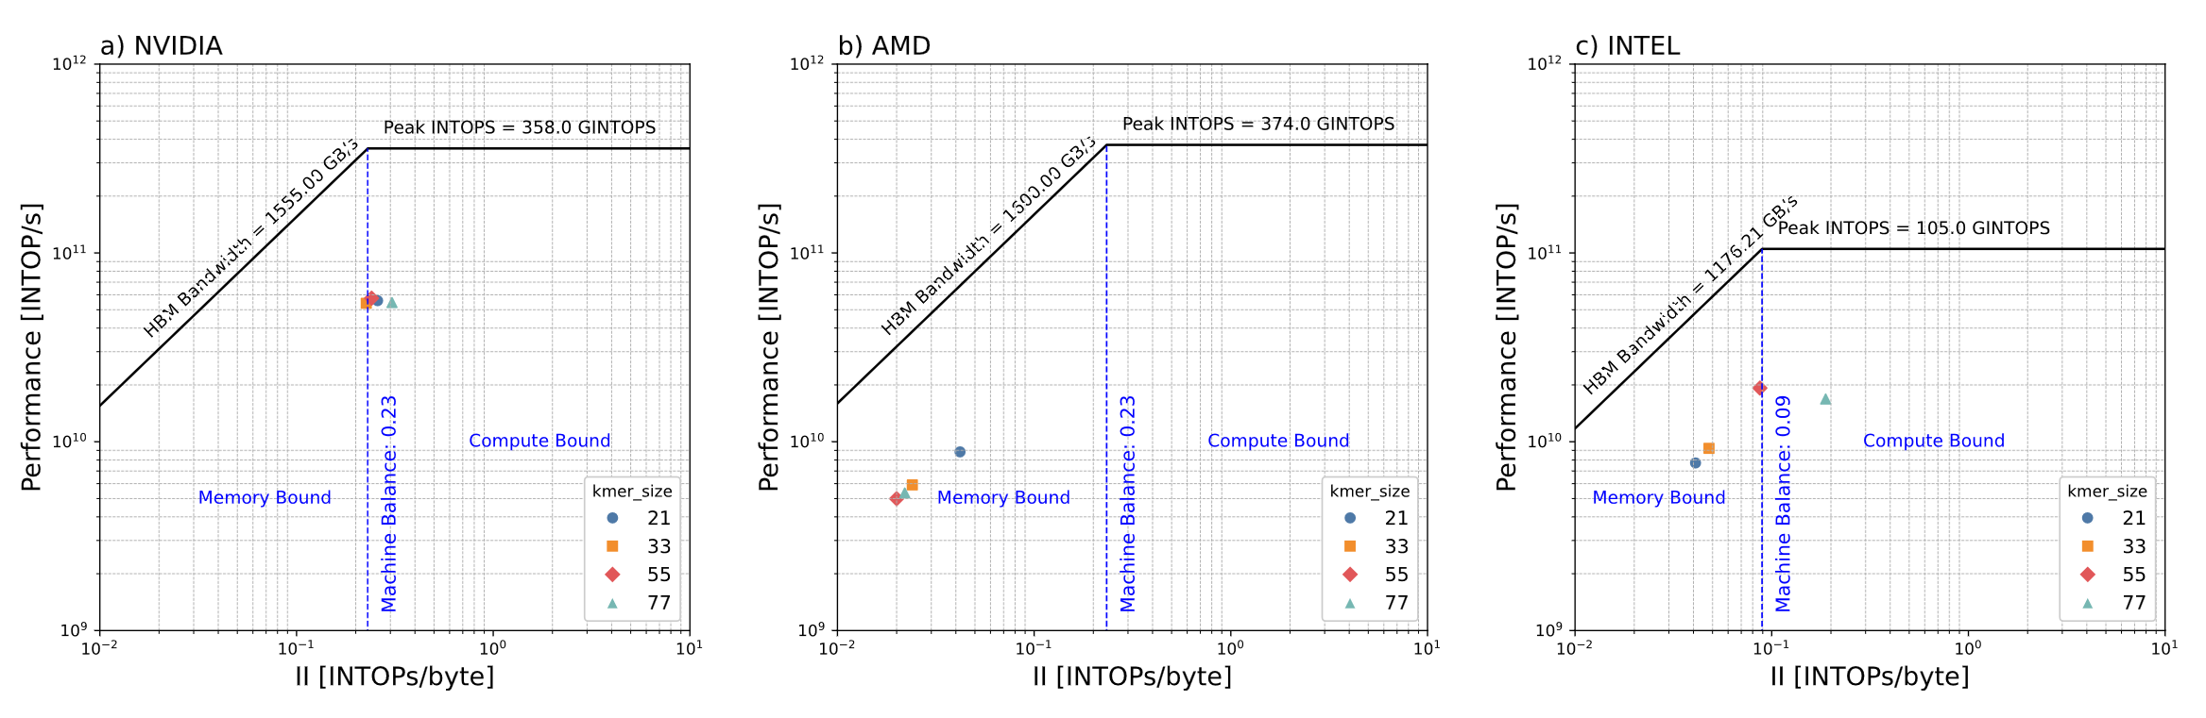
Performance
Operations per second
(performance)
Peak performance
Operations per memory access
Peak memory bandwidth times intensity (ops/byte)
Notes:
Closer to top right, the better
Better performance, not limited by memory bandwidth

Slide 22
Performance

Slide 23
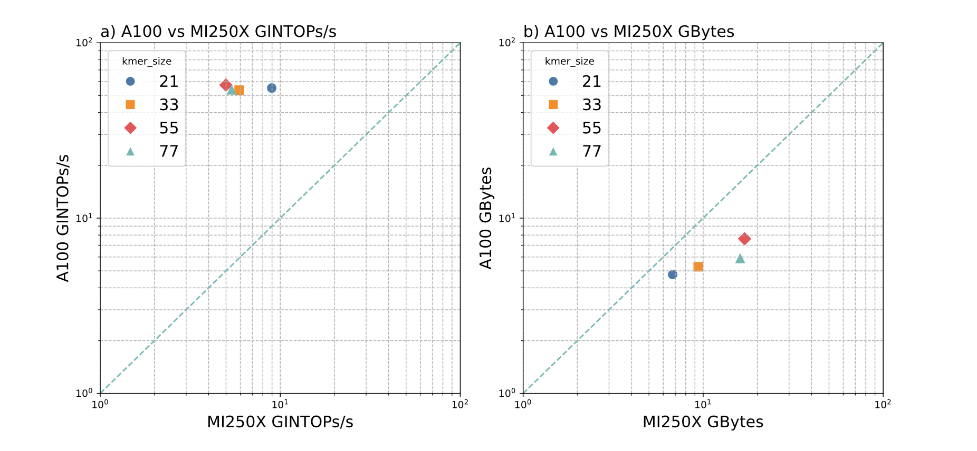
Performance
Notes:
Smaller cache AMD

Slide 24
More
L. M. Lindsey, N. Ding, J. Deslippe and M. Awan, "Performance Modeling and Analysis of a de Bruijn Graph Based Local Assembly Kernel on Multiple Vendor GPUs," SC24-W: Workshops of the International Conference for High Performance Computing, Networking, Storage and Analysis, Atlanta, GA, USA, 2024, pp. 1092-1105, doi: 10.1109/SCW63240.2024.00150.
Muaaz Gul Awan, Steven Hofmeyr, Rob Egan, Nan Ding, Aydin Buluc, Jack Deslippe, Leonid Oliker and Katherine Yelick. 2021. Accelerating Large Scale de novo Metagenome Assembly Using GPUs. In The International Conference for High Performance Computing, Networking, Storage and Analysis (SC ’21), November 14–19, 2021, St. Louis, MO, USA. ACM, New York, NY, USA, 10 pages. https://doi.org/10.1145/3458817.3476212.

