Slide 1
Boolean thinking and network motifs
Daniel Cook
September 07, 2018
Remy, E., Mossé, B., & Thieffry, D. (2016). Boolean Dynamics of Compound Regulatory circuits. In Dynamics of Mathematical Models in Biology (pp. 43-53). Springer, Cham.

Slide 2

What is a Boolean model?
Boolean consists of:
Nodes that can take on values of 0 or 1
Directed logical edges connecting nodes
Similar to a directed graph
, with logic!
A simple Boolean model
Model states
Transition rule: If A, then B
A B State
1 0 10
0 1 01
0 0 00
Inital condition
A
B
Transitions
Attractor

Slide 3
Types of Boolean (logic) relationships
Schematic
Logic
Rule
A
C
OR
C = A or B
B
A
C
AND
C = A and B
B
A
C
NOT
C = NOT A or ~A

Slide 4
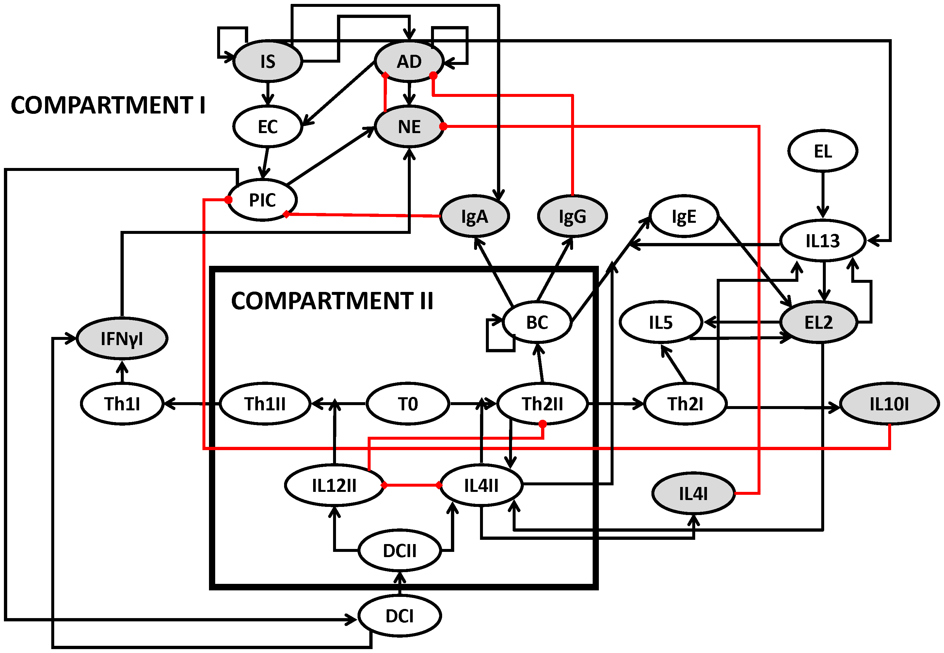
More complex Boolean models
Innate and adaptive immunity
Thakar, Juilee, et al. "Network model of immune responses reveals key effectors to single and co-infection dynamics by a respiratory bacterium and a gastrointestinal helminth." PLoS computational biology 8.1 (2012): e1002345.

Slide 5
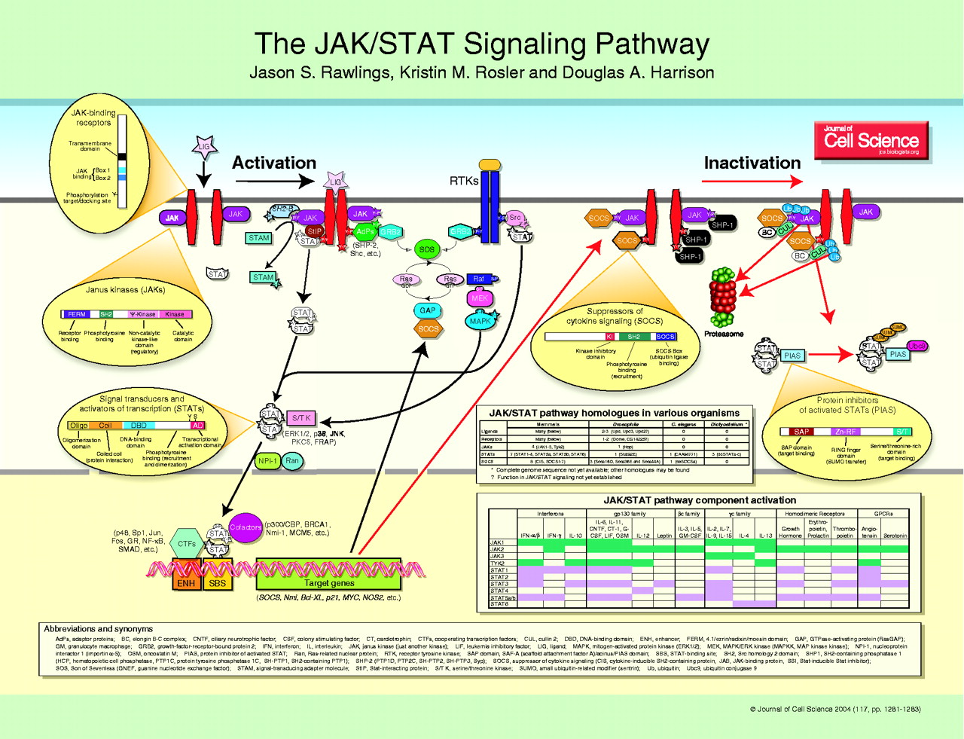
How is this helpful?
Thinking through a model prior to simulation or equation construction
A
C
B

Slide 6
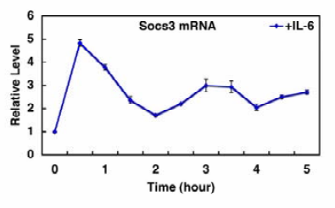
How is this helpful?
Thinking through a model prior to simulation or equation construction
Transition rules:
If A, then B
If B, then C
If C, then NOT B
If A and NOT C, then B
If B, then C
States
100
110
A
111
C
101
B
Yoshiura, Shigeki, et al. "Ultradian oscillations of Stat, Smad, and Hes1 expression in response to serum." PNAS 104.27 (2007): 11292-11297.

Slide 7
An example: ApoCIII and TG
States
A
B
D
2⁴ possible
TG
CIII
FC3
TG-C3
C
A = A and ~C
B = B
C = A and B
D = B

Slide 8
An example: ApoCIII and TG
States
1100
A
B
D
TG
CIII
FC3
TG-C3
C
A = A and ~C
B = B
C = A and B
D = B

Slide 9
An example: ApoCIII and TG
States
1100
A
B
D
1111
TG
CIII
FC3
TG-C3
C
A = A and ~C
B = B
C = A and B
D = B

Slide 10
An example: ApoCIII and TG
States
1100
A
B
D
1111
TG
CIII
FC3
0111
TG-C3
C
A = A and ~C
B = B
C = A and B
D = B

Slide 11
An example: ApoCIII and TG
States
1100
A
B
D
1111
TG
CIII
FC3
0111
0101
TG-C3
Attractor
C
A = A and ~C
B = B
C = A and B
D = B

Slide 12
An example: ApoCIII and TG
States
1100
A
B
D
1111
TG
CIII
FC3
0111
0101
TG-C3
1000
C
A = A and ~C
B = B
C = A and B
D = B

Slide 13
An example: ApoCIII and TG
States
1100
A
B
D
1111
TG
CIII
FC3
0111
0101
TG-C3
1000
C
0100
A = A and ~C
B = B
C = A and B
D = B
0101

Slide 14
An example: ApoCIII and TG
States
Garden of Eden states
B
D
1100
A
TG
CIII
FC3
1110
1111
0111
0110
1001
TG-C3
0101
1000
0100
C
Basin of attraction
A = A and ~C
B = B
C = A and B
D = B
0000
0100
1011
0001
0011
1010
An attractor can also be a limit cycle.

Slide 15
Boolean dynamics of network motifs
Motif
Definition
Properties
A
B
Bistable switch / Positive circuit
Bistability
Differentiation
A
C
Negative circuit / Oscillator
Periodic behavior
Biological cycles
B
B
Coherent feedforward motif
Filtering of transient signals
A
C
B
Incoherent feedforward motif
Generation of pulses
A
C

Slide 16
Why is this useful for us?
Metabolic networks are Boolean networks
Potential to simulate metabolic dynamics without kinetic parameters
Potential to find limit cycles, attractors, and basins of attraction for metabolism
Potential for use in controllability analyses
Consider:
ATP[c] + CoA[c] + acetate[c] => AMP[c] + PPi[c] + acetyl-CoA[c]
acetyl-CoA[c] = ATP[c] and CoA[c] and acetate[c]

Slide 17
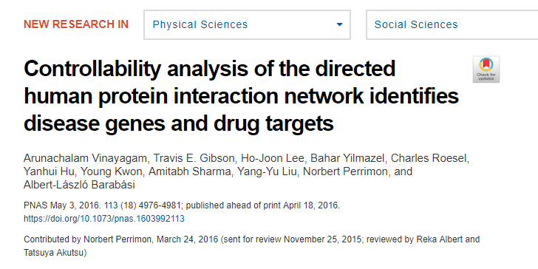
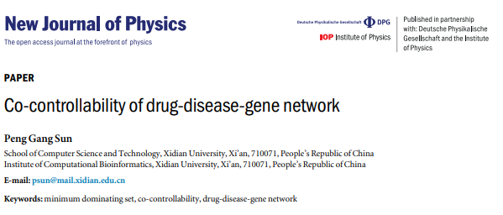
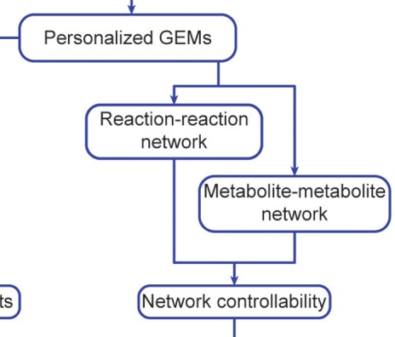

A note on controllability
Figure 1

Slide 18
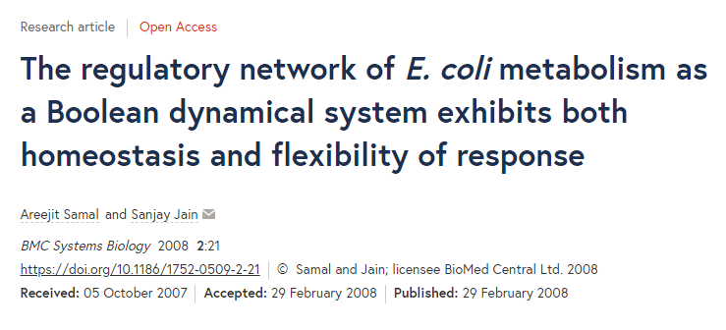
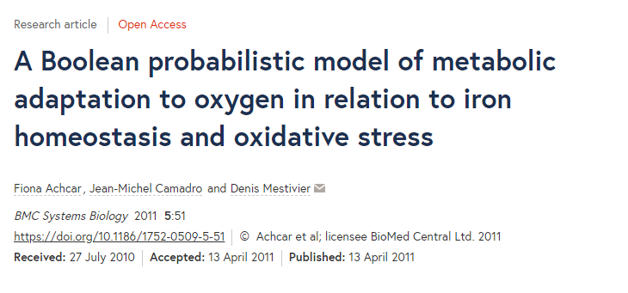
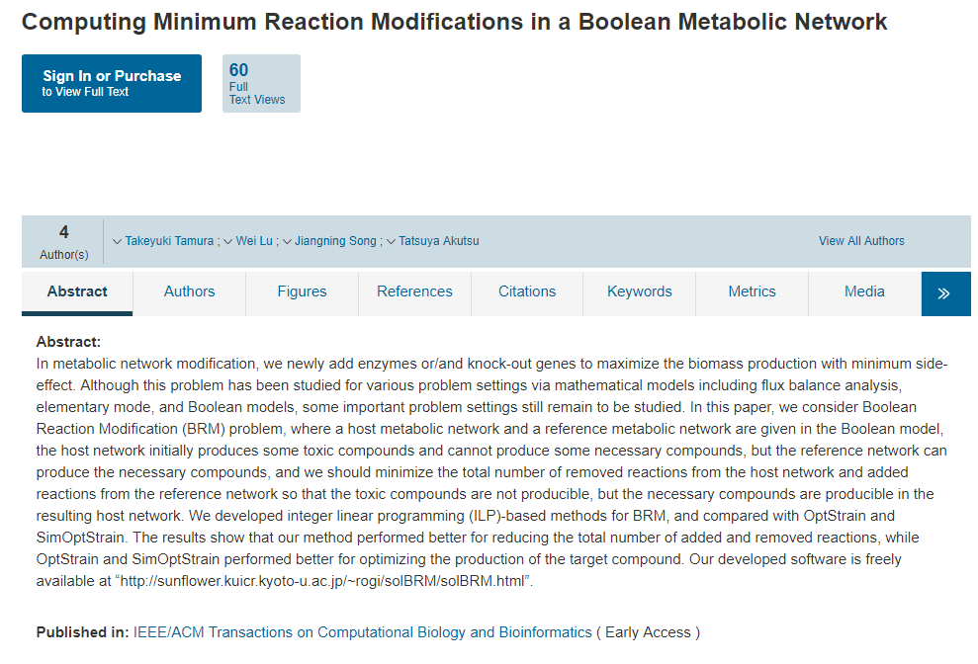

Has anyone made a GEM Boolean?
YES

Slide 19
What can you do new with Boolean modeling?

