Slide 1
Introducing a New Product
Vegan or vegetarian restaurants in Toronto

Slide 2
Long-term Goal
This project will help the people willing to open a vegan or vegetarian restaurant in Toronto by providing them the area names where there is a deficit of vegan or vegetarian restaurant.

Slide 3
Vegan or vegetarian diet is the latest trend in restaurant industry.
As the inclination of people towards plant based diet is increasing, the demand for vegan or vegetarian restaurants is rising.
There are few vegan or vegetarian restaurants available but there is still a big void to fill. This project will help bridge this gap.

Slide 4
Data
In this project we will use the Foursquare location data to search for vegan or vegetarian restaurants in Toronto.
We will then get different boroughs of Toronto using the data from Wikipedia.

Slide 5
Result
Borough | Number Of Restaurants
Central Toronto | 8
Downtown Toronto | 21
East Toronto | 15
East York | 12
Etobicoke | 7
Mississauga | 5
North York | 91
Queen's Park | 34
Scarborough | 8
West Toronto | 30
York | 41

Slide 6
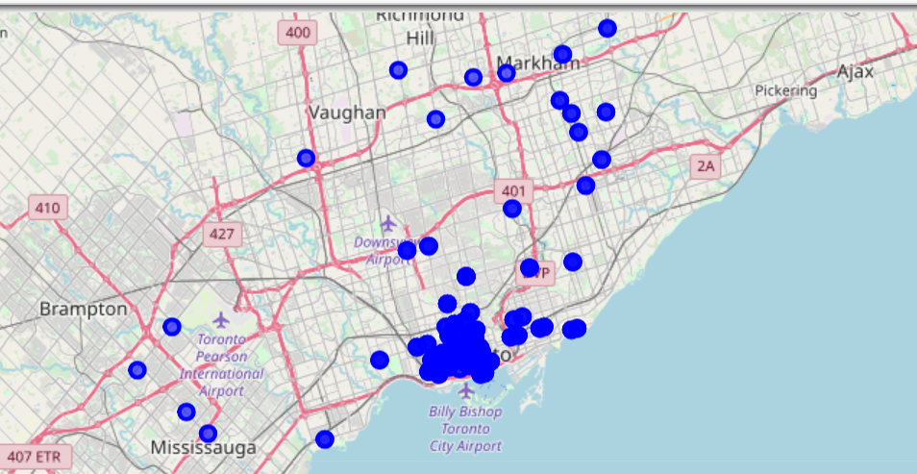
Map

Slide 7
THANK YOU

