Slide 1
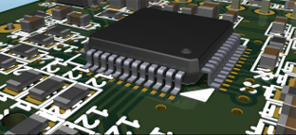

KiCad - 3D Viewer
Component materials reference list
(for 3D component model artists)
Mario Luzeiro
mrluzeiro@ua.pt
10 February 2016
http://kicad-pcb.org/
This work is licensed under a Creative Commons Attribution-ShareAlike 4.0 International License.

Slide 2
On this document it is proposed a list of materials to apply in 3D models components to be used in the KiCad 3D Viewer.
The ambientIntensity was calculated as following:
  ambientIntensity =
  (0.212671 * amb.r + 0.71516 * amb.g + 0.072169 * amb.b) /
  (0.212671 * dif.r + 0.71516 * dif.g + 0.072169 * dif.b)
The specularColor was calculated as following:
  specularColor = picked specular - diffuse

Slide 3
It is presented the VRML 2 material definition in the following format:
If using other file format, please consult the format specification on how this values should be applied / converted.
material DEF MATERIAL_NAME Material {
ambientIntensity 0.000
diffuseColor 0.000 0.000 0.000
specularColor 0.000 0.000 0.000
emissiveColor 0.0 0.0 0.0
shininess 0.00
transparency 0.0
}

Slide 4
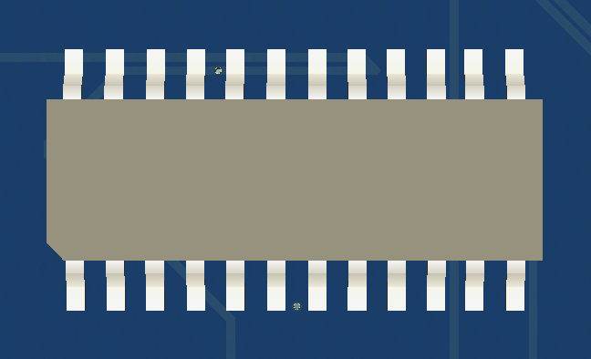
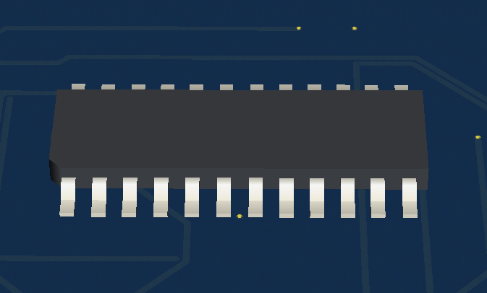
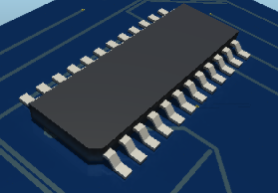
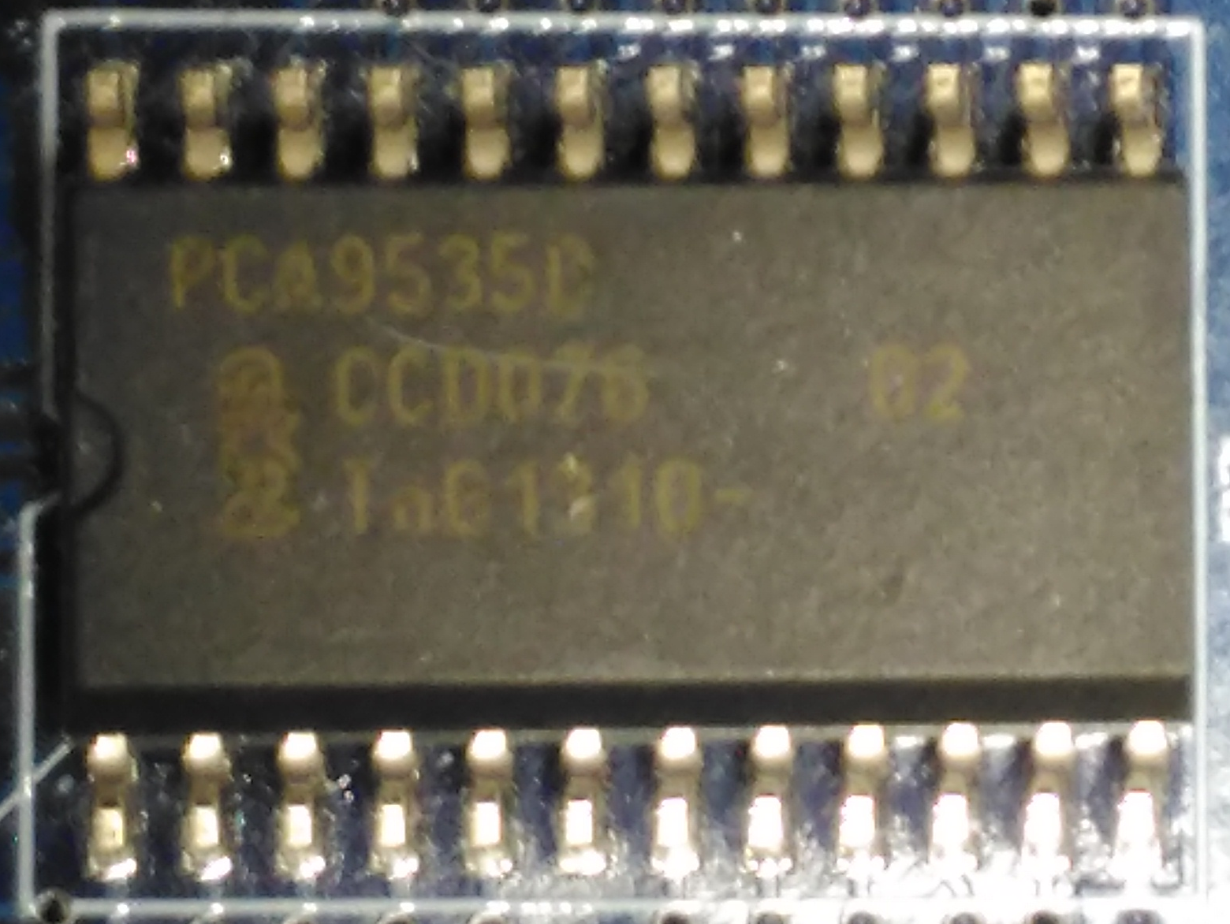
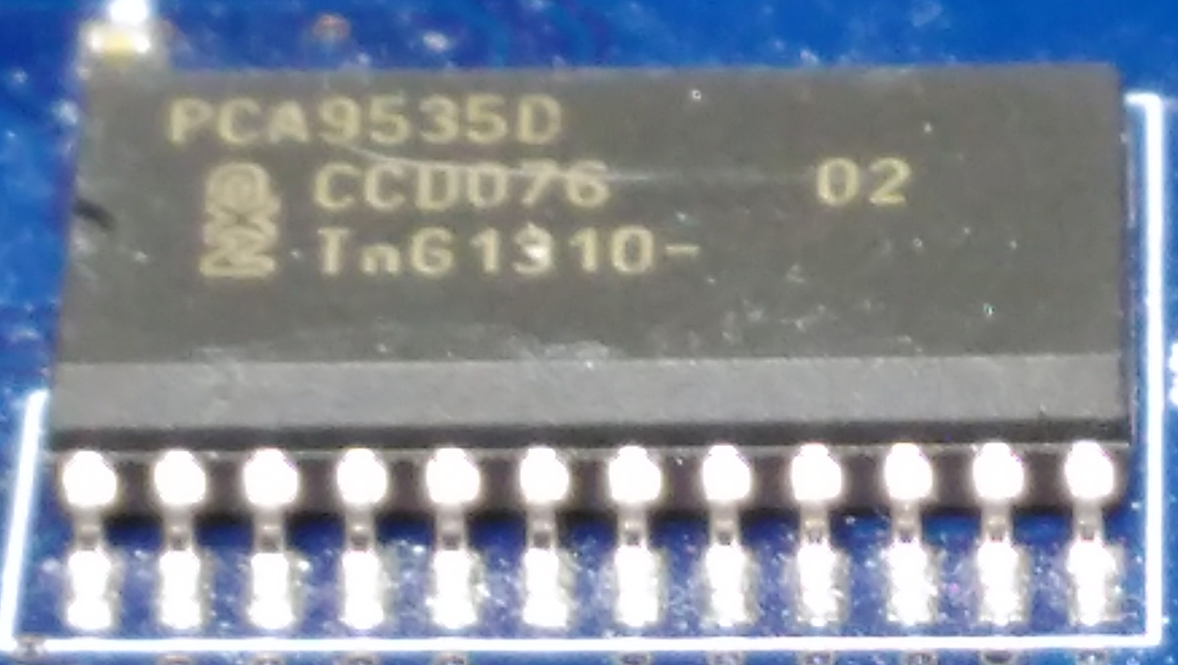
IC-BODY-EPOXY-01
AMBIENT | DIFFUSE | SPECULAR | SHININESS
11 11 11 | 64 67 72 | 81 72 45
0.043 0.043 0.043 | 0.250 0.262 0.281 | 0.316 0.281 0.176 | 0.25
material DEF IC-BODY-EPOXY-01 Material {
ambientIntensity 0.117
diffuseColor 0.250 0.262 0.281
specularColor 0.316 0.281 0.176
emissiveColor 0.0 0.0 0.0
shininess 0.25
transparency 0.0
}
Greyish epoxy, low reflections

Slide 5
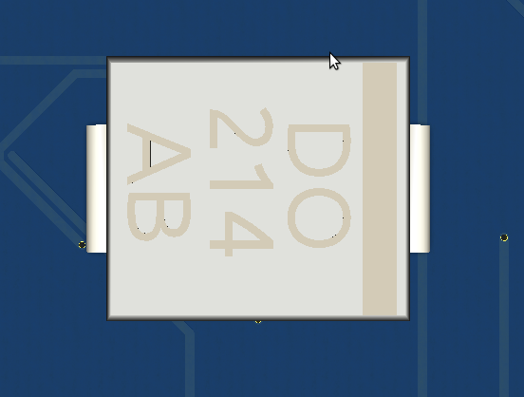
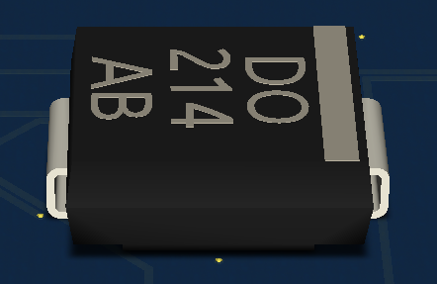
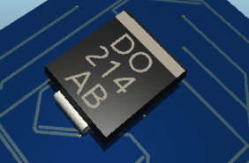
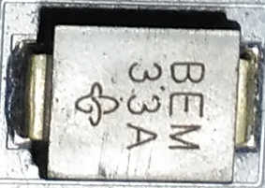
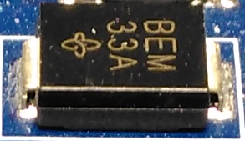
IC-BODY-EPOXY-02
AMBIENT | DIFFUSE | SPECULAR | SHININESS
14 14 14 | 33 33 33 | 185 186 181
0.050 0.050 0.050 | 0.129 0.129 0.129 | 0.723 0.727 0.707 | 0.65
material DEF IC-BODY-EPOXY-02 Material {
ambientIntensity 0.424
diffuseColor 0.129 0.129 0.129
specularColor 0.723 0.727 0.707
emissiveColor 0.0 0.0 0.0
shininess 0.65
transparency 0.0
}
Dark epoxy, shine

Slide 6
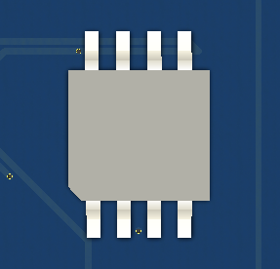
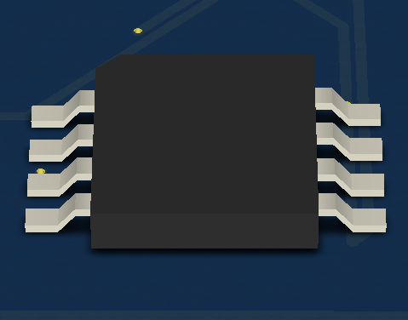
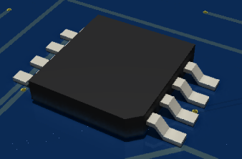
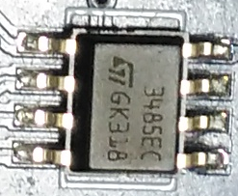
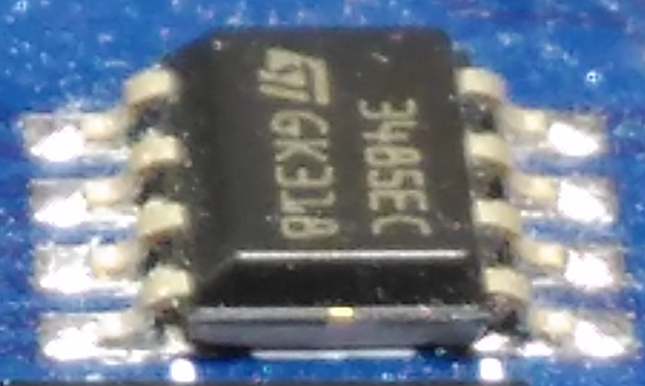
IC-BODY-EPOXY-03
AMBIENT | DIFFUSE | SPECULAR | SHININESS
17 17 13 | 48 48 49 | 120 119 109
0.066 0.066 0.050 | 0.188 0.188 0.191 | 0.469 0.465 0.426 | 0.30
material DEF IC-BODY-EPOXY-03 Material {
ambientIntensity 0.347
diffuseColor 0.188 0.188 0.191
SpecularColor 0.469 0.465 0.426
emissiveColor 0.0 0.0 0.0
shininess 0.30
transparency 0.0
}
Regular epoxy, smooth

Slide 7

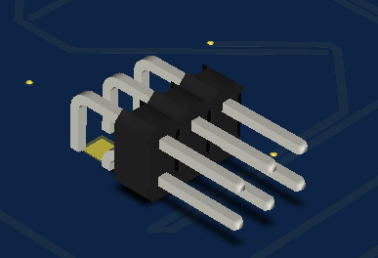
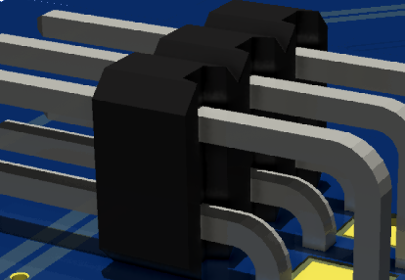
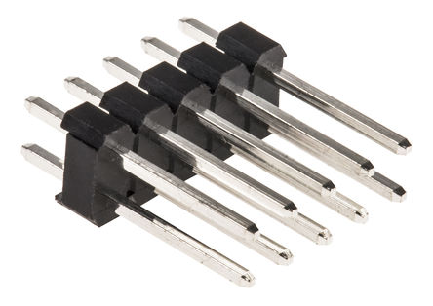

IC-BODY-EPOXY-04
AMBIENT | DIFFUSE | SPECULAR | SHININESS
14 10 11 | 38 37 37 | 84 80 78
0.055 0.039 0.043 | 0.148 0.145 0.145 | 0.180 0.168 0.160 | 0.35
material DEF IC-BODY-EPOXY-04 Material {
ambientIntensity 0.293
diffuseColor 0.148 0.145 0.145
SpecularColor 0.180 0.168 0.160
emissiveColor 0.0 0.0 0.0
shininess 0.35
transparency 0.0
}
Dark epoxy, rough surface

Slide 8
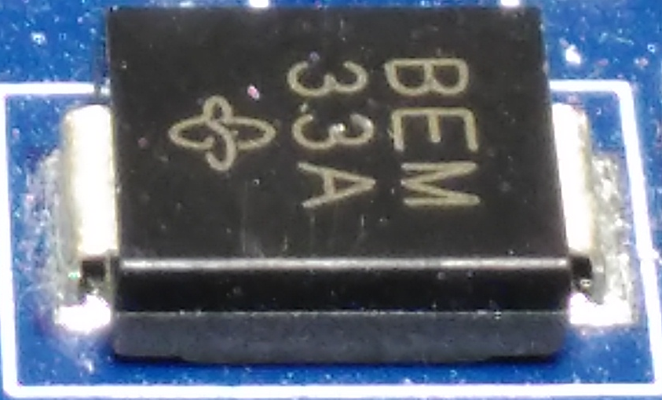
IC-LABEL-01
AMBIENT | DIFFUSE | SPECULAR | SHININESS
14 14 14 | 177 170 153 | 0 0 0
0.050 0.050 0.050 | 0.691 0.664 0.598 | 0.000 0.000 0.000 | 0.01
material DEF IC-LABEL-01 Material {
ambientIntensity 0.082
diffuseColor 0.691 0.664 0.598
specularColor 0.000 0.000 0.000
emissiveColor 0.0 0.0 0.0
shininess 0.01
transparency 0.0
}
Text mark, yellowish

Slide 9
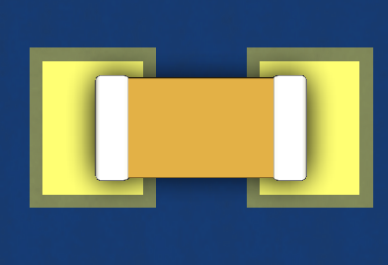
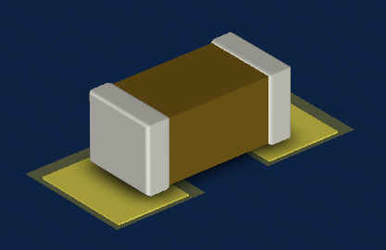
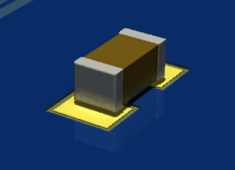
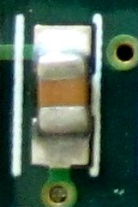
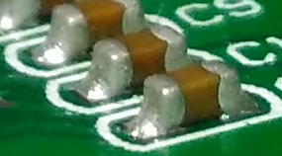

CAP-CERAMIC-01
AMBIENT | DIFFUSE | SPECULAR | SHININESS
84 49 19 | 120 93 22 | 84 66 44
0.328 0.191 0.074 | 0.469 0.363 0.083 | 0.328 0.258 0.172 | 0.30
material DEF CAP-CERAMIC-01 Material {
ambientIntensity 0.579
diffuseColor 0.469 0.363 0.086
specularColor 0.328 0.258 0.172
emissiveColor 0.0 0.0 0.0
shininess 0.3
transparency 0.0
}
ceramic, light brown, yellowish

Slide 10
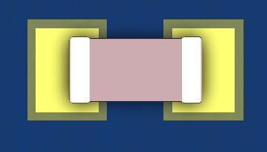
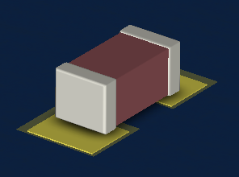
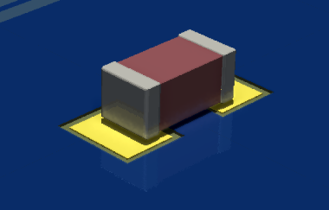
CAP-CERAMIC-02
AMBIENT | DIFFUSE | SPECULAR | SHININESS
83 65 53 | 148 86 90 | 27 70 69
0.324 0.254 0.207 | 0.578 0.336 0.352 | 0.105 0.273 0.270 | 0.25
material DEF CAP-CERAMIC-02 Material {
ambientIntensity 0.683
diffuseColor 0.578 0.336 0.352
specularColor 0.105 0.273 0.270
emissiveColor 0.0 0.0 0.0
shininess 0.25
transparency 0.0
}
ceramic, pink

Slide 11
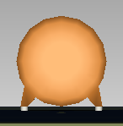
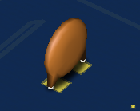
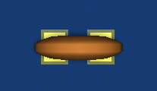
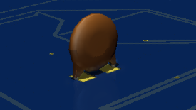
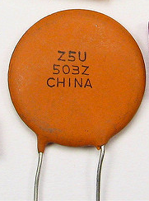
CAP-CERAMIC-03
AMBIENT | DIFFUSE | SPECULAR | SHININESS
92 22 12 | 193 116 44 | 32 52 71
0.359 0.086 0.047 | 0.754 0.453 0.172 | 0.125 0.203 0.277 | 0.10
material DEF CAP-CERAMIC-03 Material {
ambientIntensity 0.284
diffuseColor 0.754 0.453 0.172
specularColor 0.125 0.203 0.227
emissiveColor 0.0 0.0 0.0
shininess 0.10
transparency 0.0
}
ceramic, disk, orange
Windell Oskay

Slide 12

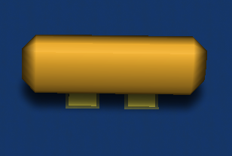
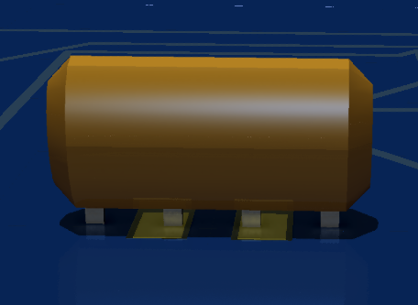
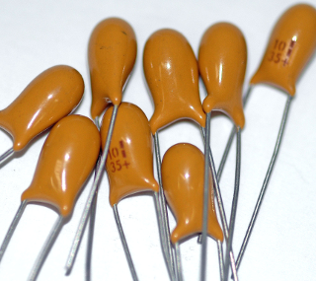
CAP-CERAMIC-04
AMBIENT | DIFFUSE | SPECULAR | SHININESS
91 42 9 | 208 152 40 | 45 93 189
0.355 0.164 0.035 | 0.813 0.594 0.156 | 0.176 0.363 0.738 | 0.55
material DEF CAP-CERAMIC-04 Material {
ambientIntensity 0.321
diffuseColor 0.813 0.594 0.156
specularColor 0.176 0.363 0.738
emissiveColor 0.0 0.0 0.0
shininess 0.55
transparency 0.0
}
Mataresephotos
Ceramic, light orange

Slide 13
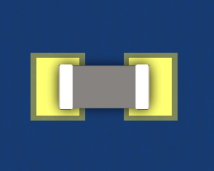
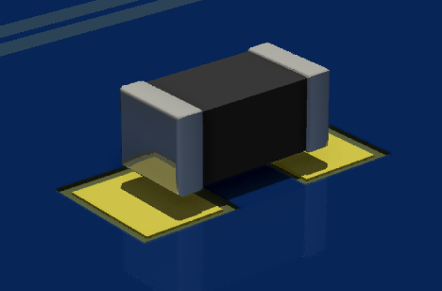
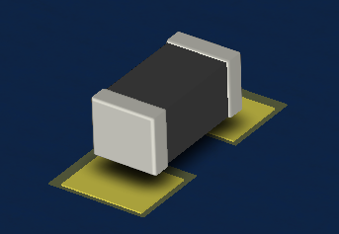
CAP-CERAMIC-05
AMBIENT | DIFFUSE | SPECULAR | SHININESS
13 12 17 | 70 70 70 | 52 48 45
0.051 0.047 0.066 | 0.273 0.273 0.273 | 0.203 0.188 0.176 | 0.15
material DEF CAP-CERAMIC-05 Material {
ambientIntensity 0.179
diffuseColor 0.273 0.273 0.273
specularColor 0.203 0.188 0.176
emissiveColor 0.0 0.0 0.0
shininess 0.15
transparency 0.0
}
ceramic, ferrite bead

Slide 14
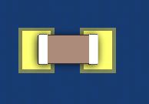
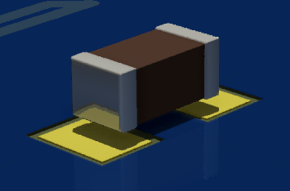
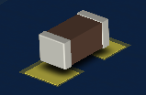
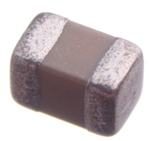
CAP-CERAMIC-06
AMBIENT | DIFFUSE | SPECULAR | SHININESS
44 32 18 | 97 69 55 | 57 57 57
0.172 0.125 0.072 | 0.379 0.270 0.215 | 0.223 0.223 0.223 | 0.15
material DEF CAP-CERAMIC-06 Material {
ambientIntensity 0.453
diffuseColor 0.379 0.270 0.215
specularColor 0.223 0.223 0.223
emissiveColor 0.0 0.0 0.0
shininess 0.15
transparency 0.0
}
oomlout
Ceramic, light brown

Slide 15
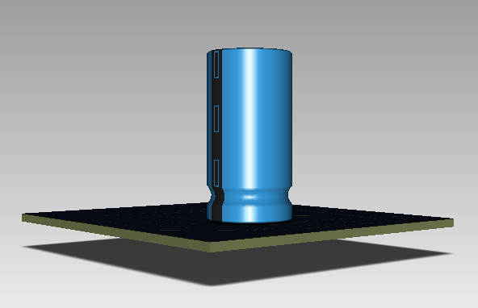
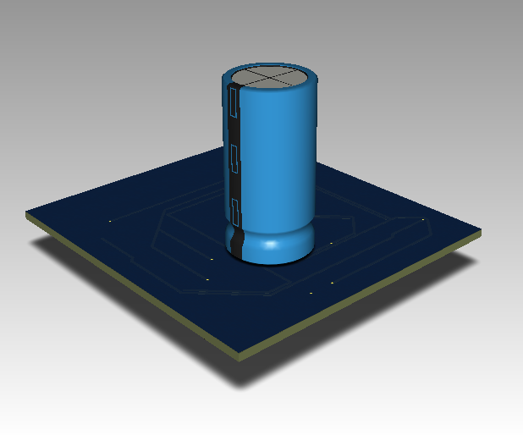
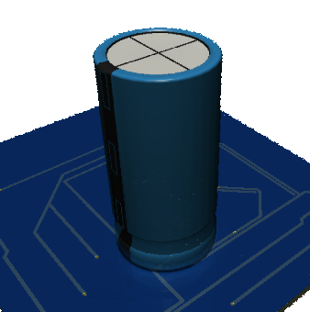
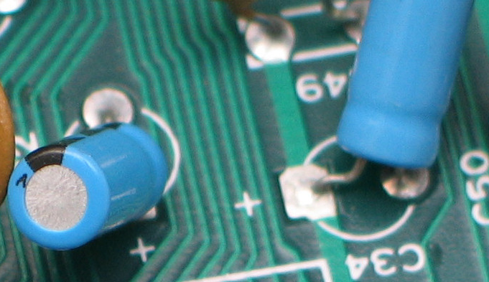
CAP-RADIAL-BLUE-01
AMBIENT | DIFFUSE | SPECULAR | SHININESS
9 35 60 | 45 131 187 | 195 118 63
0.035 0.137 0.234 | 0.173 0.512 0.730 | 0.762 0.461 0.246 | 0.80
material DEF CAP-RADIAL-BLUE-01 Material {
ambientIntensity 0.268
diffuseColor 0.173 0.512 0.730
specularColor 0.762 0.461 0.246
emissiveColor 0.0 0.0 0.0
shininess 0.80
transparency 0.0
}
Electrolytic, radial, blue, shiny
(Christian Taube)

Slide 16
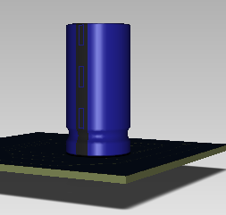
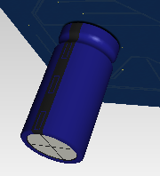
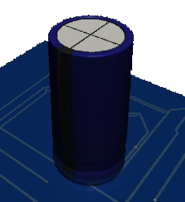
CAP-RADIAL-BLUE-02
AMBIENT | DIFFUSE | SPECULAR | SHININESS
12 08 23 | 29 28 121 | 95 100 81
0.047 0.031 0.09 | 0.113 0.109 0.473 | 0.371 0.391 0.316 | 0.80
material DEF CAP-RADIAL-BLUE-01 Material {
ambientIntensity 0.284
diffuseColor 0.113 0.109 0.473 specularColor 0.371 0.391 0.316
emissiveColor 0.0 0.0 0.0
shininess 0.80
transparency 0.0
}
Electrolytic, radial, blue, shiny

Slide 17




RES-THT-01
AMBIENT | DIFFUSE | SPECULAR | SHININESS
48 22 28 | 226 182 126 | 11 31 72
0.188 0.086 0.109 | 0.883 0.711 0.492 | 0.043 0.121 0.281 | 0.40
material DEF RES-THT-01 Material {
ambientIntensity 0.149
diffuseColor 0.883 0.711 0.492
specularColor 0.043 0.121 0.281
emissiveColor 0.0 0.0 0.0
shininess 0.40
transparency 0.0
}
Resistor, cylinder, beige
oomlout

Slide 18





RES-SMD
material DEF RES-SMD-01 Material {
diffuseColor 0.082 0.086 0.094
emissiveColor 0.000 0.000 0.000
specularColor 0.066 0.063 0.063
ambientIntensity 0.638
transparency 0.0
shininess 0.3
}
material DEF RES-SMD-02 Material {
diffuseColor 0.234 0.332 0.180
emissiveColor 0.000 0.000 0.000
specularColor 0.105 0.074 0.102
ambientIntensity 0.512
transparency 0.0
shininess 0.3
}
oomlout
material DEF RES-SMD-03 Material {
DiffuseColor 0.192 0.352 0.492
emissiveColor 0.000 0.000 0.000
specularColor 0.289 0.250 0.203
ambientIntensity 0.351
transparency 0.0
shininess 0.3
}
Resistor, SMD, Black, Fuse

Slide 19



PIN-01
AMBIENT | DIFFUSE | SPECULAR | SHININESS
68 53 62 | 211 210 200 | 36 40 55
0.266 0.207 0.242 | 0.824 0.820 0.781 | 0.141 0.156 0.215 | 0.70
material DEF PIN-01 Material {
ambientIntensity 0.271
diffuseColor 0.824 0.820 0.781
specularColor 0.328 0.258 0.172
emissiveColor 0.0 0.0 0.0
shininess 0.70
transparency 0.0
}
Grey pin, metal, aluminium, shiny

Slide 20





PIN-02
AMBIENT | DIFFUSE | SPECULAR | SHININESS
101 68 33 | 220 189 127 | 35 37 47
0.395 0.266 0.129 | 0.859 0.738 0.496 | 0.137 0.145 0.184 | 0.40
material DEF PIN-01 Material {
ambientIntensity 0.379
diffuseColor 0.859 0.738 0.496
specularColor 0.137 0.145 0.184
emissiveColor 0.0 0.0 0.0
shininess 0.40
transparency 0.0
}
oomlout
gold, shiny
oomlout

Slide 21





PLASTIC-WHITE-01
AMBIENT | DIFFUSE | SPECULAR | SHININESS
119 112 93 | 229 228 208 | 12 14 28
0.465 0.438 0.363 | 0.895 0.891 0.813 | 0.047 0.055 0.109 | 0.25
material DEF PLASTIC-WHITE-01 Material {
ambientIntensity 0.494
diffuseColor 0.895 0.891 0.813
specularColor 0.047 0.055 0.109
emissiveColor 0.0 0.0 0.0
shininess 0.25
transparency 0.0
}
oomlout
Plastic, white
oomlout

Slide 22





PLASTIC-BLUE-01
AMBIENT | DIFFUSE | SPECULAR | SHININESS
35 56 82 | 35 103 186 | 92 97 6
0.137 0.219 0.320 | 0.137 0.402 0.727 | 0.359 0.379 0.270 | 0.25
material DEF PLASTIC-WHITE-01 Material {
ambientIntensity 0.565
diffuseColor 0.137 0.402 0.727
specularColor 0.359 0.379 0.270
emissiveColor 0.0 0.0 0.0
shininess 0.25
transparency 0.0
}
teardowncentral
Blue, plastic
oomlout

Slide 23




PLASTIC-GREEN-01
AMBIENT | DIFFUSE | SPECULAR | SHININESS
0 64 27 | 87 174 114 | 45 27 50
0.000 0.250 0.105 | 0.340 0.680 0.445 | 0.176 0.105 0.195 | 0.25
material DEF PLASTIC-GREEN-01 Material {
ambientIntensity 0.315
diffuseColor 0.340 0.680 0.445
specularColor 0.176 0.105 0.195
emissiveColor 0.0 0.0 0.0
shininess 0.25
transparency 0.0
}
oomlout
Green, plastic, connector

Slide 24





PLASTIC-YELLOW-01
AMBIENT | DIFFUSE | SPECULAR | SHININESS
134 85 0 | 213 174 17 | 41 52 82
0.523 0.332 0.000 | 0.832 0.680 0.066 | 0.160 0.203 0.320 | 0.25
material DEF PLASTIC-YELLOW-01 Material {
ambientIntensity 0.522
diffuseColor 0.832 0.680 0.066
specularColor 0.160 0.203 0.320
emissiveColor 0.0 0.0 0.0
shininess 0.25
transparency 0.0
}
Yellow, plastic, connector
SparkFun
oomlout

Slide 25



PLASTIC-ORANGE-01
AMBIENT | DIFFUSE | SPECULAR | SHININESS
102 19 3 | 207 109 38 | 10 26 37
0.388 0.074 0.012 | 0.809 0.426 0.148 | 0.039 0.102 0.145 | 0.25
material DEF PLASTIC-ORANGE-01 Material {
ambientIntensity 0.284
diffuseColor 0.809 0.426 0.148
specularColor 0.039 0.102 0.145
emissiveColor 0.0 0.0 0.0
shininess 0.25
transparency 0.0
}
Orange, plastic, connector

Slide 26


LED
material DEF LED-RED Material {
diffuseColor 0.700 0.100 0.050
emissiveColor 0.000 0.000 0.000
specularColor 0.300 0.400 0.150
ambientIntensity 0.789
transparency 0.15
shininess 0.125
}
material DEF LED-GREEN Material {
diffuseColor 0.400 0.700 0.150
emissiveColor 0.000 0.000 0.000
specularColor 0.600 0.300 0.100
ambientIntensity 0.789
transparency 0.15
shininess 0.05
}
material DEF LED-BLUE Material {
DiffuseColor 0.100 0.250 0.700
emissiveColor 0.000 0.000 0.000
specularColor 0.500 0.600 0.300
ambientIntensity 0.789
transparency 0.15
shininess 0.125
}
RGB, Red, Green, Blue, LED,

