Slide 1
PassItOn
Make the most out of your ticket

Slide 2
The Team
Marios Vodas
Apostolos Glenis
Eugenia Stoufi
Elias Regopoulos
Panagiota Thomopoulou
We are all students (PhD and Bsc) at the University of Piraeus doing all sorts of awesome things mostly centered around Geographical Information Systems and UNIX technologies

Slide 3
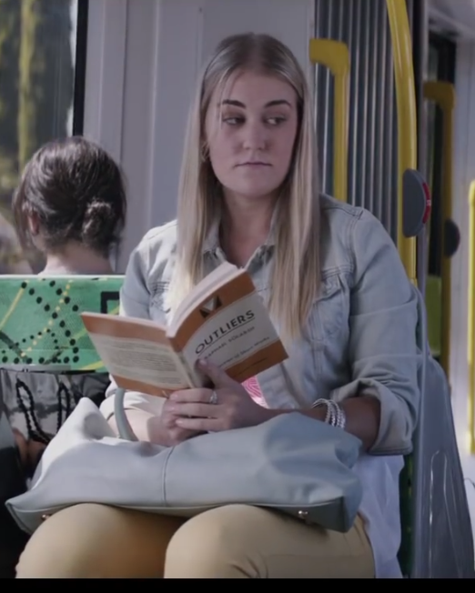
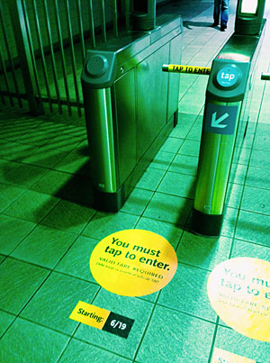
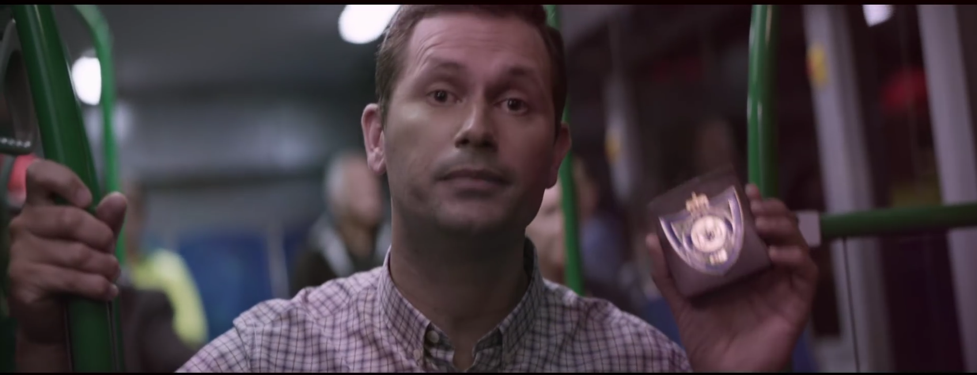
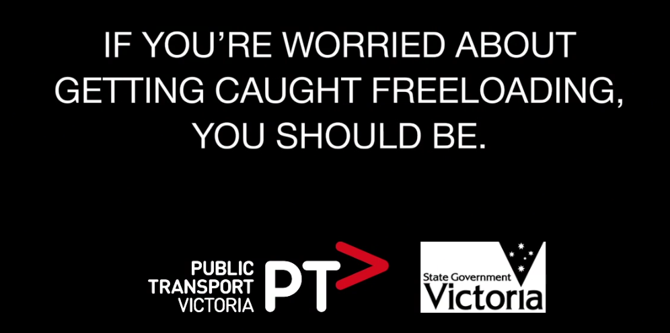
Problem statement

Slide 4
Enter PassItOn
Have users buy their ticket using their credit card:
There is no need to wait in line anymore
We created a centralized marketplace for tickets:
We can provide them the ability to use only a part of their ticket
Sometimes people end up bending the rules because it is more convenient

Slide 5
Flowchart
Start
Is there an appropriate ticket in the secondary market?
YES
NO
Buy the ticket and redeem the seller with the appropriate amount
Buy a full ticket
Market
Once the ride is over the user can make the ticket available in secondary market or donate the ticket directly
End

Slide 6
How did we do it
Google Directions API for route recommendation
NBG API for payments
Javascript with Cordova to tie it all together
A lean stack for prototyping

Slide 7
Revenue Model
We create a strategic partnership with the public transportation network.
We get added value for each ticket we sell
We also have a strategic partnership with the Bank.
We get a commission every time the user buys a full ticket
And possibly every time the value of a ticket gets reimbursed, the money was considered lost anyways

Slide 8
Not limited to tickets
The users can now share any type of product or service that expires in the near future.
The original idea was about a marketplace but sharing goods does not always have a fixed equilibrium
There is a niche market here for goods that are not available to other marketplaces
Also there is a chance to enhance social welfare through direct transfer of resources, ie the users might choose to use the system as a donation platform

Slide 9
The end

Slide 10
Problem Statement
In the Greek public transportation network, freeloaders are very common for a variety of reasons:
Security measures are lacking
A lot of the commute routes are small enough so they have a small chance of getting caught even with adequate security.
There is a large waiting time in queues in order to buy a ticket
The good Samaritan problem:
A lot of people leave their half used ticket in the station for other people to use before it expires.

Slide 11
Making things even easier
We track the user’s current location and show a Map
The user then points to the starting and ending location on the Map
We compute all the compatible routes and then present them to the user
We currently support three heuristics:
Minimum time spent in commute (leading also to lower cost)
Least possible change in mode of transportation (so you can read a book, or listen to your favorite music)
Least amount of walking (It is raining or freezing outside, or you are plain lazy)
The user then pays for the ticket using his credit card and its done
Once the remaining of the ticket gets bought from another user, he gets reimbursed with the current value of the ticket

Slide 12
Goods that our application could target
Concert tickets and Coupons
Concert Tickets get more expensive until the day of the event so they can be viewed as a short term investment.
Delivery services
Delivery services have very low utilization rate, because a lot of time is spent placing orders and managing routes. In an increasingly connected world of IoT devices, delivery services amongst diverse vendors could be fused to increase utilization
API Keys
API keys are useful for developers, but provide limited calls per hour. Sharing API calls while the key’s owner isn’t using them would increase their utilization

Slide 13
DEMO TIME

