Slide 1

the opinion you value

Slide 2

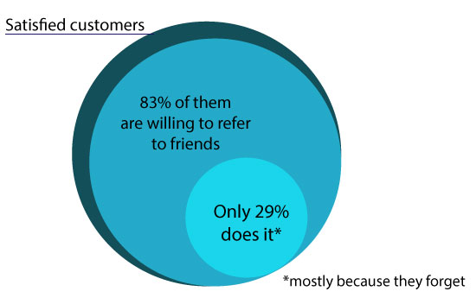
problem
When you need advice
but the ones you trust are not there…
When you see something your friend
needs and forget to tell him…

Slide 3
The idea
Easily give and receive advice from people you trust
Different expertise…Value of opinion…
New marketing channel
win-win situation

Slide 4
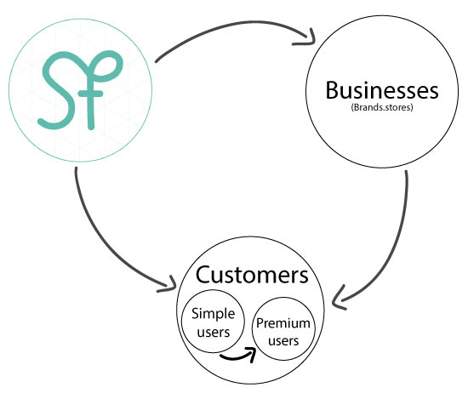

Competitive advantages
Polls for user traffic
Interactive shopping experience in physical stores
Instant mobile experience
Geolocation through beacons
Engagement through Gamification
Trusted network of users
Boost brand loyalty
Personalization
Boost sales on small and big companies
Combined network of all referral programs

Slide 5












competition
Mobile channel
Affiliate networks
White label sites
Review sites
Sole brand network
Shared network
Companies with their own referral programs
Web channel

Slide 6
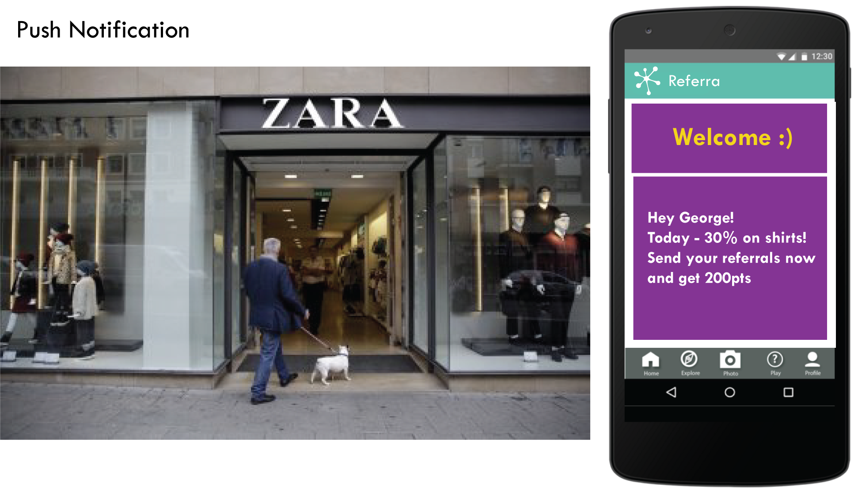

Slide 7
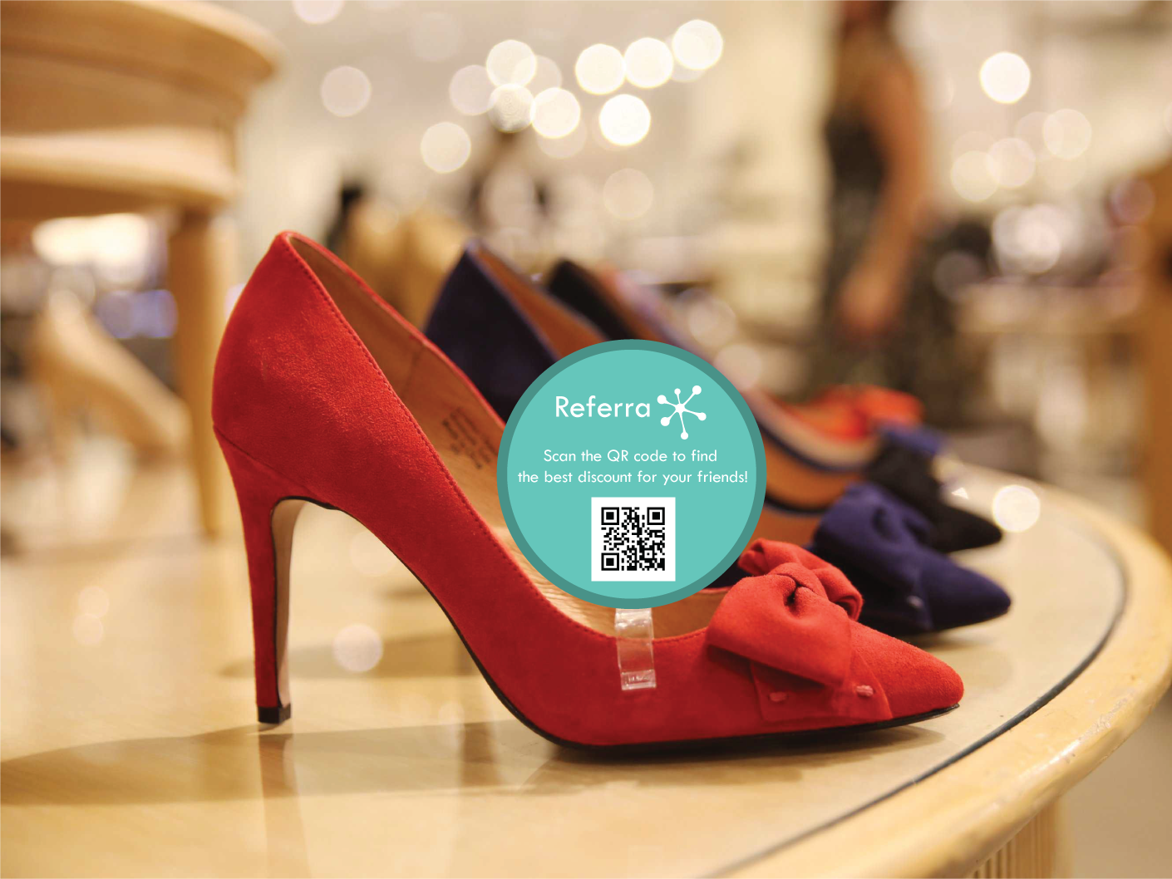
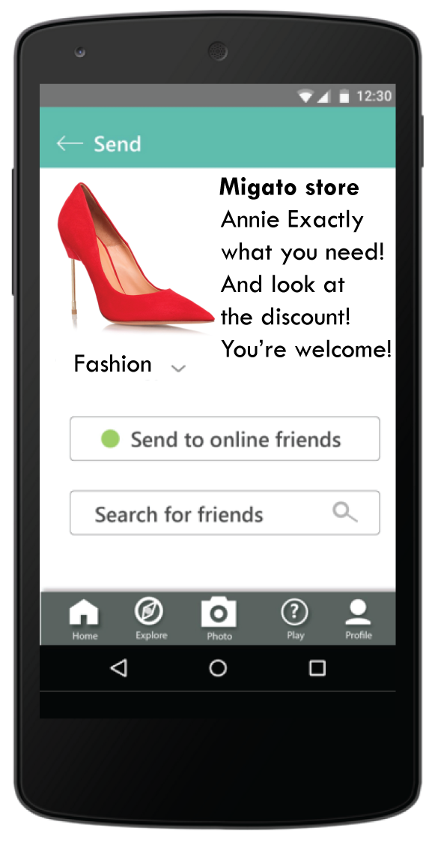
In Store Experience
2 Send
1 Scan

Slide 8
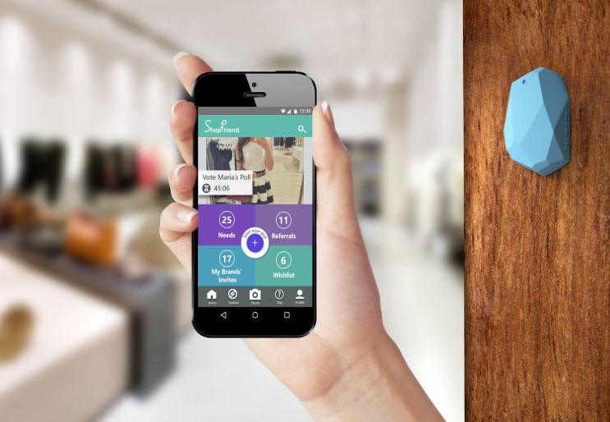
THANK YOU
Nothing influences people more than a recommendation from a trusted friend.
A trusted referral is the holy grail of advertising.
Mark Zuckerberg, Facebook.

