Slide 1

Another GFF/GTF Analysis Toolkit (AGAT):
Resolve Interoperability Issues and Accomplish More with your Annotations.
Jacques Dainat Ph.D.
Current Affiliation: ALCEDIAG
PAG - San Diego - January 2022
Notes:
It helps to resolve ... and can help you to accomplish...
I developed AGAT when I was working at NBIS, where I was expert in genome annotation and had to deal with these formats almost every day, and I was meeting recurrent problem...

Slide 2
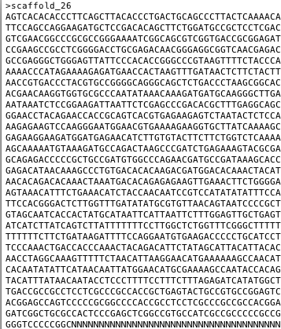
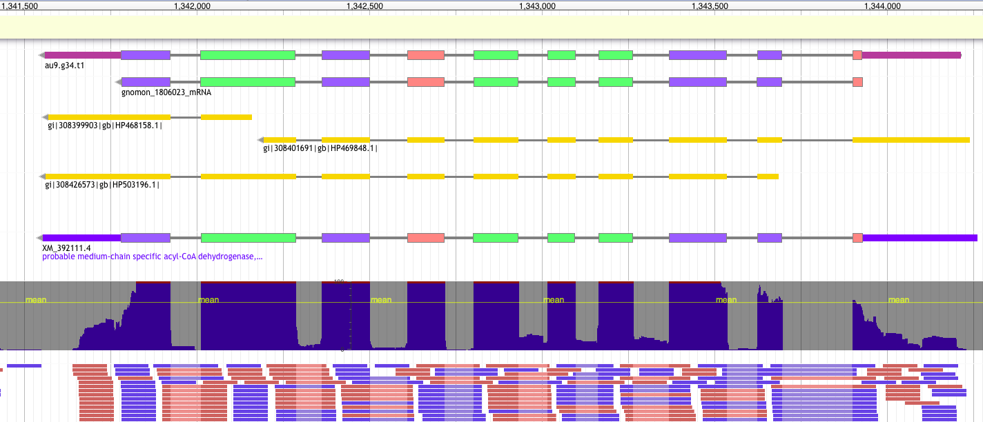
Introduction
GFF/GTF
FASTA
From sequence…
…to the description of the locations and the attributes of features
Notes:
GFF/Format is used to describe features like gene and transcripts in sequences.

Slide 3
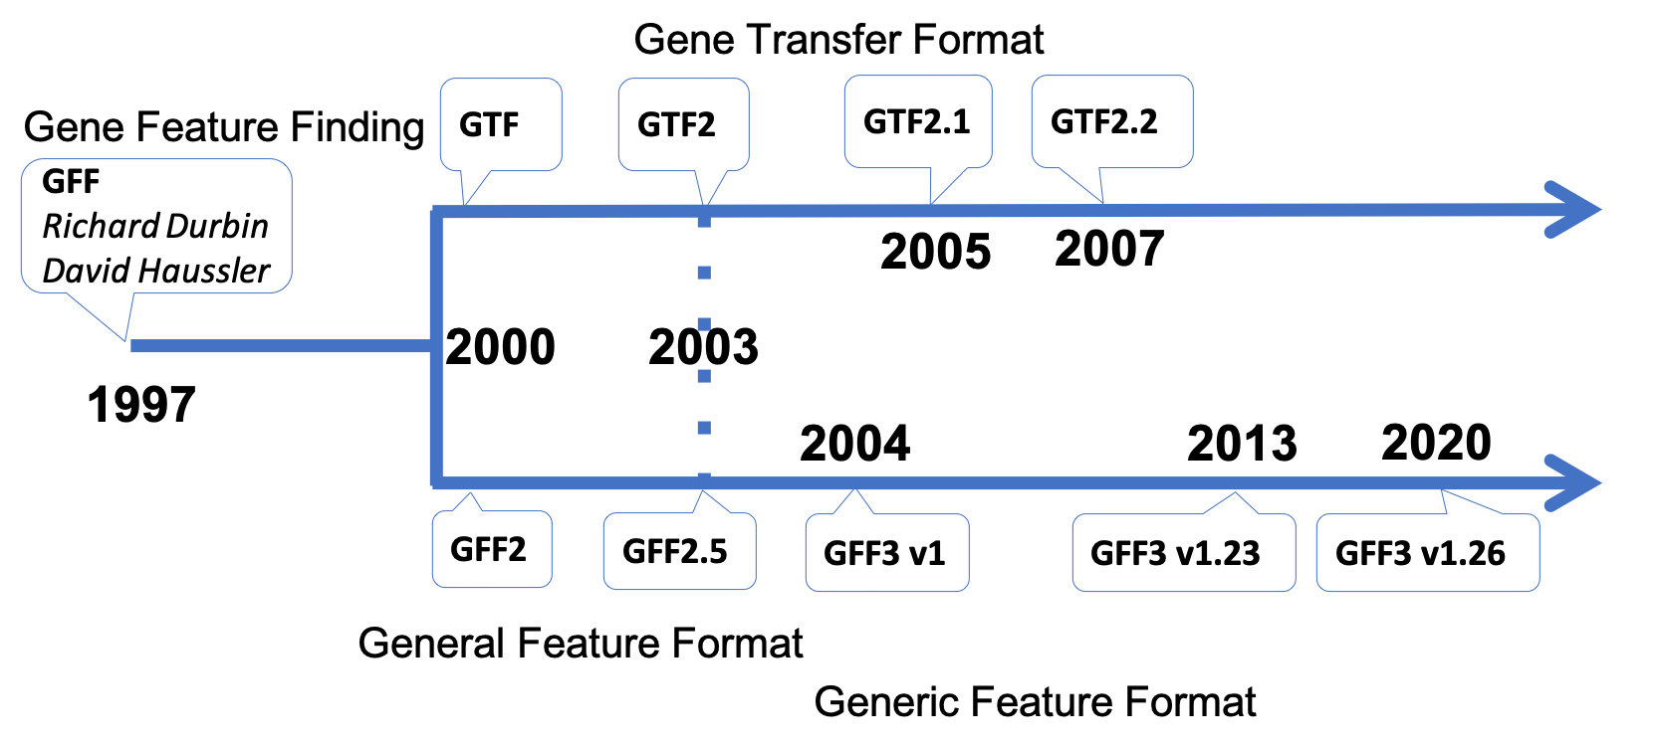
Introduction
GFF/GTF formats
https://agat.readthedocs.io/en/latest/gxf.html
Notes:
Conceived in 1997 the GFF format specifications have evolved many times to face up new needs and improve interoperability. Early in the evolution of the format, in 2000 a "speciation" occurred that gave birth to the General Transfer Format, while the GFF acronym changed to become the General Feature Format

Slide 4
Introduction
What software handles GFF/GTF formats?
Any tool that creates/stores/requires information about gene position
GFF/GTF
Structural information
Functional information
Custom information
Genome Annotation
>130 annotation tools*
https://github.com/NBISweden/GAAS/blob/master/annotation/knowledge/annotation_tools_genome.md
*
Notes:
These formats were originally designed for annotation tools. The vast majority of annotation tools that have been developed over the years converged to the use of one of this 2 convenient formats.
The GFF/GTF format has been widely accepted because it allows some freedom/flexibility and can hold a wide variety of information.

Slide 5
Introduction
What software handles GFF/GTF formats?
Any tool that creates/stores/requires information about gene position
JBrowse
WebApollo
GFF/GTF
Structural information
Functional information
Custom information
Genome viewer
Tablet
IGV
Submission to public archive
Genome Annotation
EMBLmyGFF3
Comparative genomics
snpEff
gffcompare
Variant Annotation
VEP
Stringtie
AnnoVar
Mapping
Hisat2
STAR
featureCounts
Etc.
SeqEditor
Notes:
These formats are democratized and widely used now. They are actually used by tools that require information about feature position for analysis.

Slide 6
Introduction
9 columns
1 feature = 1 line
Header
##gff-version 3.2.1
##sequence-region ctg123 1 1497228
ctg123 . Gene 1000 9000 . + . ID=gene1;Name=EDEN
ctg123 . mRNA 1050 9000 . + . ID=mRNA1;Parent=gene1;Name=EDEN.1
ctg123 . mRNA 1050 9000 . + . ID=mRNA2;Parent=gene1;Name=EDEN.2
ctg123 . exon 1300 1500 . + . ID=exon1;Parent=mRNA2
ctg123 . exon 1050 1500 . + . ID=exon2;Parent=mRNA1,mRNA2
ctg123 . exon 3000 3902 . + . ID=exon3;Parent=mRNA1
ctg123 . exon 5000 5500 . + . ID=exon4;Parent=mRNA1,mRNA2
ctg123 . exon 7000 9000 . + . ID=exon5;Parent=mRNA1,mRNA2
ctg123 . CDS 1201 1500 . + 0 ID=cds1;Parent=mRNA1;Name=edenprotein.1
ctg123 . CDS 3000 3902 . + 0 ID=cds1;Parent=mRNA1;Name=edenprotein.1
ctg123 . CDS 5000 5500 . + 0 ID=cds1;Parent=mRNA1;Name=edenprotein.1
ctg123 . CDS 7000 7600 . + 0 ID=cds1;Parent=mRNA1;Name=edenprotein.1
ctg123 . CDS 1201 1500 . + 0 ID=cds2;Parent=mRNA2;Name=edenprotein.2
ctg123 . CDS 5000 5500 . + 0 ID=cds2;Parent=mRNA2;Name=edenprotein.2
ctg123 . CDS 7000 7600 . + 0 ID=cds2;Parent=mRNA2;Name=edenprotein.2
1 record = features with relationship
2 - source
4 - start
6 - score
8 - phase
9 - attributes
tag = value
1 - sequence id
5 - end
3 - feature type
7 - strand
Notes:
GFF and GTF format are very similar. Let's have have look at a GFF file first
1) Header - contains metadata
2) one feature
3) 9 columns tab delimited
The 9th column is a list of attributes in tag-value type structure. Attributes can store a wide variety of information. Some attributes are used to set relationship between features.
4) features linked to each other can be called a record
Let's have a closer look at attributes providing a mechanism to group features.

Slide 7
GFF/GTF interoperability issues
GFF
ctg123 . gene 1000 9000 . + . ID=gene1
Level1
ctg123 . mRNA 1000 9000 . + . ID=mRNA1;Parent=gene1
Level2
ctg123 . exon 1000 2000 . + . ID=exon1;Parent=mRNA1
ctg123 . exon 8000 9000 . + . ID=exon2;Parent=mRNA1
ctg123 . CDS 1700 2000 . + 0 ID=cds01;Parent=mRNA1
ctg123 . CDS 8000 8300 . + 0 ID=cds01;Parent=mRNA1
Level3
GTF
Level1
ctg123 . gene 1000 9000 . + . gene_id g1;
ctg123 . mRNA 1000 9000 . + . gene_id g1; transcript_id t1;
Level2
ctg123 . exon 1000 2000 . + . gene_id g1; transcript_id t1;
ctg123 . exon 8000 9000 . + . gene_id g1; transcript_id t1;
ctg123 . CDS 1700 2000 . + 0 gene_id g1; transcript_id t1;
ctg123 . CDS 8000 8300 . + 0 gene_id g1; transcript_id t1;
Level3
GTF and GFF formats are very similar!!
But also very different….
Notes:
The formats can be seen as a 3 hierarchical levels structure.
GFF
deepest ... highest
GTF
deepest ... highest
GFF and GTF format are very similar overall

Slide 8
GFF/GTF interoperability issues
Over the years rules, terms, syntax, have evolved.
Difficulties come often from the 3rd column and 9th column
3rd column: GFF
3rd column: GTF
GFF version | Number of feature type accepted
GFF1 | infinite
GFF2 | infinite
GFF3 | Constrained to be either a term from the Sequence Ontology or an SO accession number (2278 terms).
GTF version | Number of feature type accepted | Feature type accepted
GTF1 | 5 | CDS, start_codon, stop_codon, exon, intron
GTF2 | 4 | CDS, start_codon, stop_codon, exon
GTF2.1 | 6 | CDS, start_codon, stop_codon, exon, 5UTR, 3UTR
GTF2.2 | 9 | CDS, start_codon, stop_codon, 5UTR, 3UTR, inter, inter_CNS, intron_CNS and exon
GTF2.5 | 8 | gene, transcript, exon, CDS, UTR, start_codon, stop_codon, Selenocysteine
GTF3 | 9 | gene, transcript, exon, CDS, Selenocysteine, start_codon, stop_codon, three_prime_utr and five_prime_utr
Notes:
feature types (3rd column) in GFF3 has been constraint to be part of the SO.

Slide 9
GFF/GTF interoperability issues
Over the years rules, terms, syntax, have evolved.
Difficulties come often from the 3rd column and 9th column
9th column GFF/GTF
Format | Description 9th column | Example
GFF1 | An optional string-valued field that can be used as a name to group together a set of records. | locus1
GFF2 | An optional list of feature attributes in the format tag value following the syntax used within objects in a .ace file, flattened onto one line by semicolon separators. | Target "HBA_HUMAN" ; E_value 0.0003
GFF3 | A list of feature attributes in the format tag=value separated by semicolons. Attribute values do not need to be and should not be quoted. | ID=exon1;Parent=mRNA1,mRNA2;Name=edenprotein.4
All GTF | Attributes must end in a semicolon which must then be separated from the start of any subsequent attribute by exactly one space character (NOT a tab character). Attributes’ values should be surrounded by double quotes. | gene_id "1"; transcript_id "1.a";
Notes:
Another difference between the two formats lie in the structure of the attribute column (the 9th column ).
Except for GFF1, the attributes are tag-value type structured and the syntax can differ depending the version.
Moreover, some tags have predefined meanings and some tags are mandatory. The mandatory tags differ between GTF and GFF formats.

Slide 10
GFF/GTF interoperability issues
GFF
GTF
Stop codon is included in CDS
Stop codon is not included in CDS
⬄
Notes:
One last difference that worth it to mention:

Slide 11
GFF/GTF interoperability issues
So many flavours and differences
But that is not all!!
Notes:
The differences existing between the GFF and the GTF format and between each of their corresponding versions make it quiet complicated to deal with them in a standardised way.

Slide 12

GFF/GTF interoperability issues
Synonym Term (e.g. UTR vs five_prime_UTR vs 5’UTR
Use of term not allowed in 3rd column
Feature type present or not
Unlimited attribute used in 9th column
etc
As many flavors of GFF/GTF formats as tools producing them!
=> ﻿recurrent problem of interoperability
Notes:
To cite only few of common other difficulties...
About the feature: One can write transcript instead of mRNA, or say UTR instead of 3’UTR and 5’UTR or the 3/5 number could also be written with letter or with number and so one.
About the attributes: There is actually no limit for naming the tag. You can use what ever you want.
People using regularly this format from different sources knows how crazy it can be.

Slide 13
GFF/GTF tools and libraries
Tools:
AEGeAn
gffread
GenomeTools
GFF3toolkit
Limits:
Often handle one type of format
Does not necessarily fix errors
Handle some specific features (can remove features)
Cannot be tuned
Libraries:
…
Limits:
Need of substantial bioinformatic skills to be able to write your own tools/scripts
Format is very flexible, it is difficult to handle all edge cases
Notes:
Many tools have been developed
Libraries exist in almost all programming language to play with GFF GTF format
In the goal of handling all cases with an univeral tool easy to use, I developed AGAT.

Slide 14
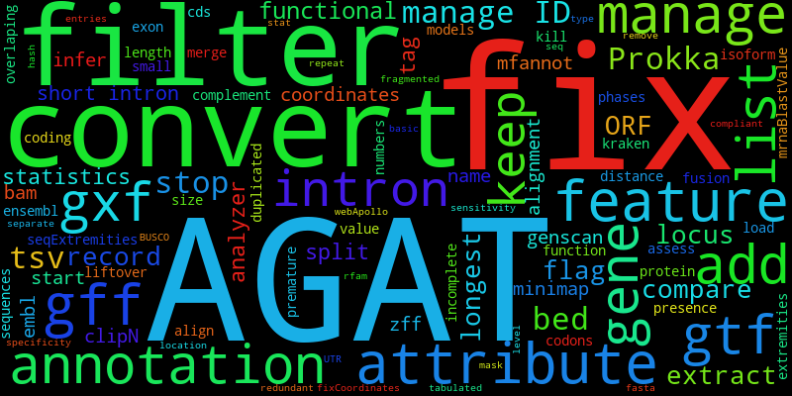
AGAT: Another Gff/Gtf Analysis Toolkit
70 scripts
sanitize
convert
merge
modify
statistics
fasta sequence extraction
add information
…
Notes:
AGAT has the power to check, fix, add missing information (features/attributes) of any kind of GTF and GFF to create complete, sorted and standardised gff3 format. Over the years it has been enriched by many many tools to perform just about any tasks that is possible related to GTF/GFF format files (sanitizing, conversions, merging, modifying, filtering, FASTA sequence extraction, adding information, and so one). Comparing to other methods AGAT is robust to even the most despicable GTF/GFF files.

Slide 15
AGAT: Another Gff/Gtf Analysis Toolkit
Robust and universal
Can read all version (GFF1, GFF2, GFF2.5, GFF3, GTF, GTF2, GTF2.1,
GTF2.2, GTF2.5 / GTF3)
Can deal will all feature type (3rd column)
Can interpret relationship between features in all possible ways
Create a fixed and sorted standardized GFF3 output
Notes:
Robust and universal thanks to 4 key points.

Slide 16

AGAT: Another Gff/Gtf Analysis Toolkit
Can deal will all feature type (3rd column)
ctg123 . fun_transcript 1000 9000 . + . ID=t1;Parent=g1
Level 1 (might have children) | Level 2 (has parent and might have children) | Level 3 (has parent and no children)
gene pseudogene … | mRNA tRNA … | exon stop_codon …
Features must be part of the AGAT’s json files
=> Can be tuned by the user
Notes:
Fun transcript not known by AGAT, it will inform the user and throw away the feature. If unknown by AGAT you can add it to the corresponding AGAT json file

Slide 17

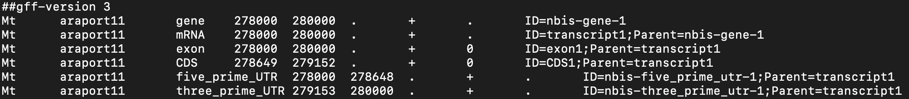
AGAT: Another Gff/Gtf Analysis Toolkit
Can interpret relationship between features in all possible ways
Parent/ID or gene_id/transcript_id
Common tag (e.g. locus_tag)
Sequential
Result :
=> AGAT can even mix the 3 approaches
Notes:
Part or not to the sequence onotlogy it does not make any difference to AGAT, but it will inform the user

Slide 18
AGAT: Another Gff/Gtf Analysis Toolkit
AGAT creates a standardized GFF3 like
Why GFF3?
﻿“addresses the most common extensions to GFF, while preserving backward compatibility with previous formats”
﻿great flexibility allowing holding wide variety of information
﻿well-defined specifications (SO)
Less constraint than GTF in 3rd column
Why GFF3 like?
AGAT does not care about the feature type term used in 3rd column. Just inform the user if not GFF3 compliant.

Slide 19
AGAT: Another Gff/Gtf Analysis Toolkit
GFF to GTF conversion
Tool | respect GTF format | UTR conserved | attribute conserved | Stop codon removed from CDS | Comment
AGAT | Yes - All (default GTF3) | Yes | Yes - All | Yes | Can take any GTF GFF as input. The only one keeping comments at the beginning of the file.
gffread | No - They say GTF2.2 but it is not: transcript should be removed; start_codon and stop_codon should stay. | No | No | No
GenomeTools | No - only CDS and exon kept | No | No | No | gene_id and transcript_id get new identifiers.
ea-utils | No - only CDS and exon kept | No | No | No
TransDecoder | No - start and stop codon removed | No | Name only | No | Needs the fasta file for the conversion. Location of the last CDS modified and incorrect
Kent utils | No - gene is missing or transcript is superfluous to be compliant to one of the GTF format | No | No | Yes | Create a new attribute 'gene_name'.

Slide 20
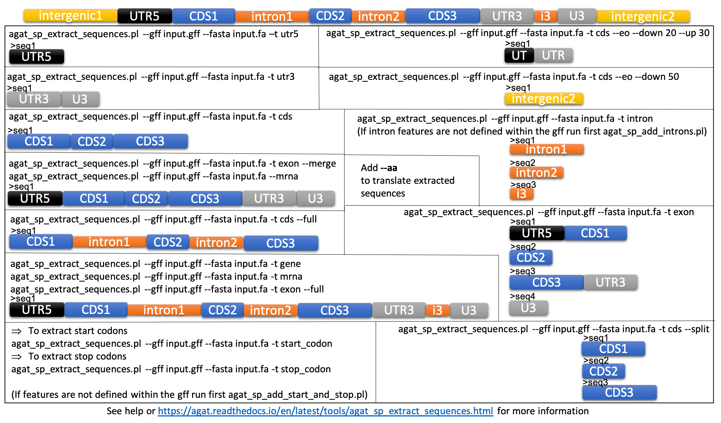
AGAT: Another Gff/Gtf Analysis Toolkit
Extract sequences (gxf + fasta)

Slide 21
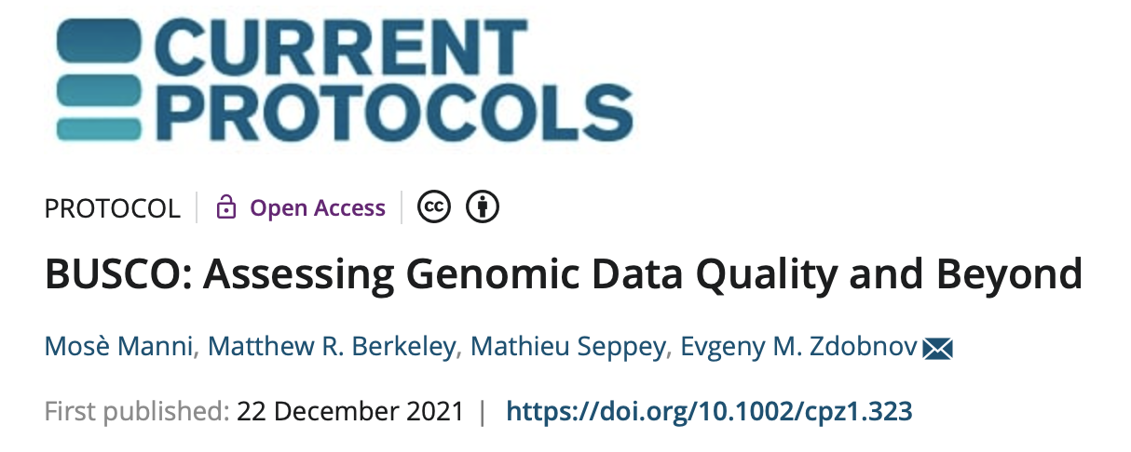
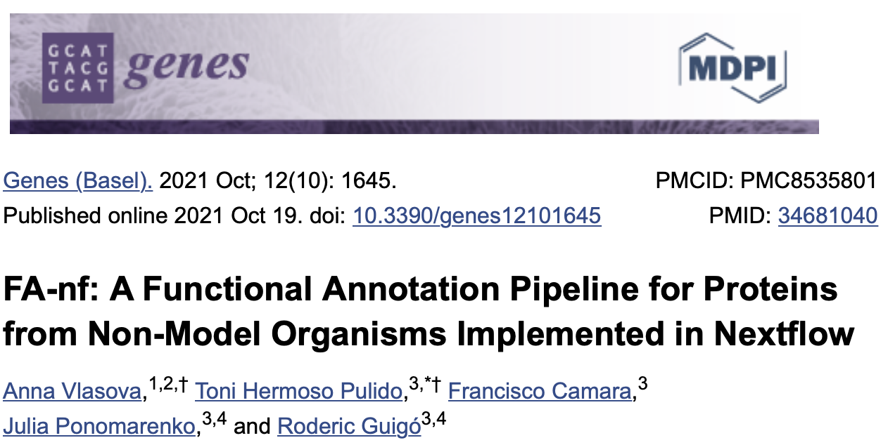
AGAT: Another Gff/Gtf Analysis Toolkit
AGAT can be useful in initial steps of pipelines to ensure that input GFF files can go through downstream processes smoothly.

Slide 22
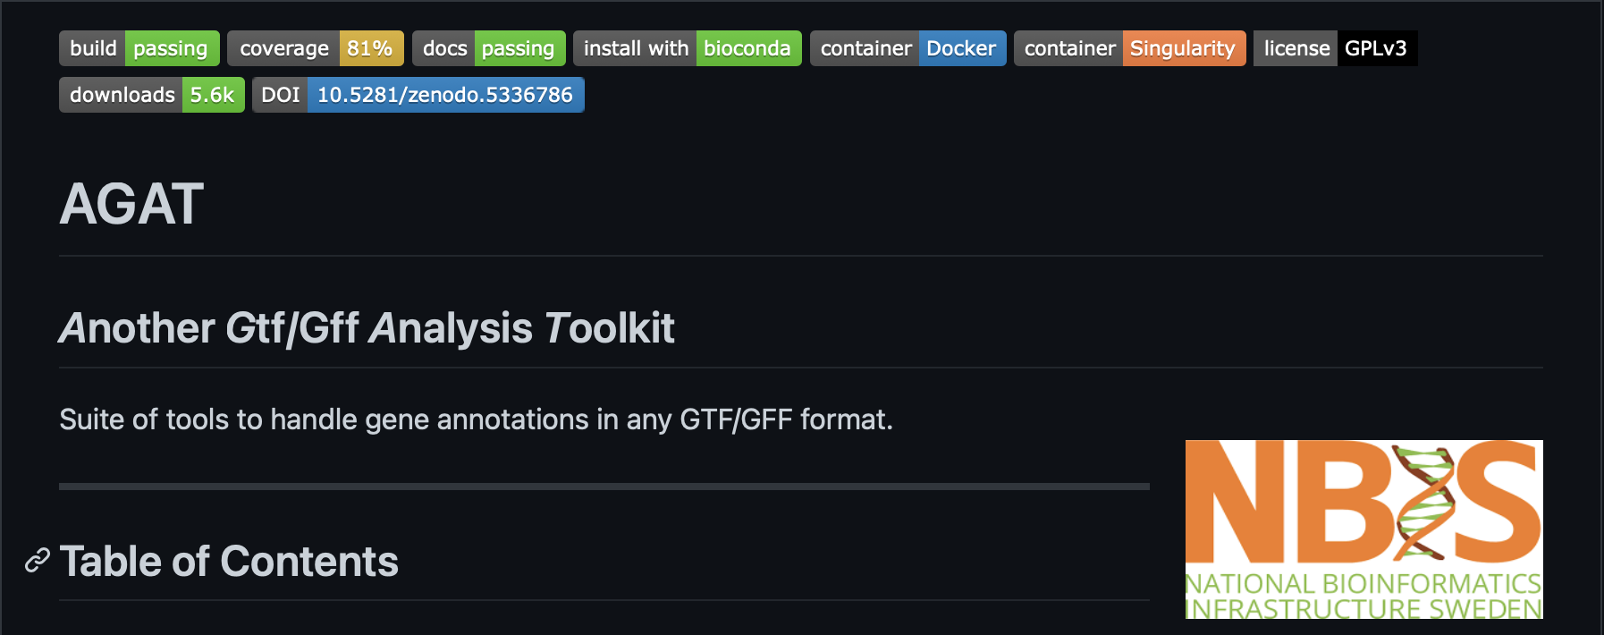
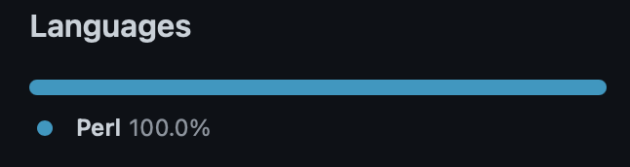



AGAT: Another Gff/Gtf Analysis Toolkit
Open source
Available on github
Easy use/install

Slide 23
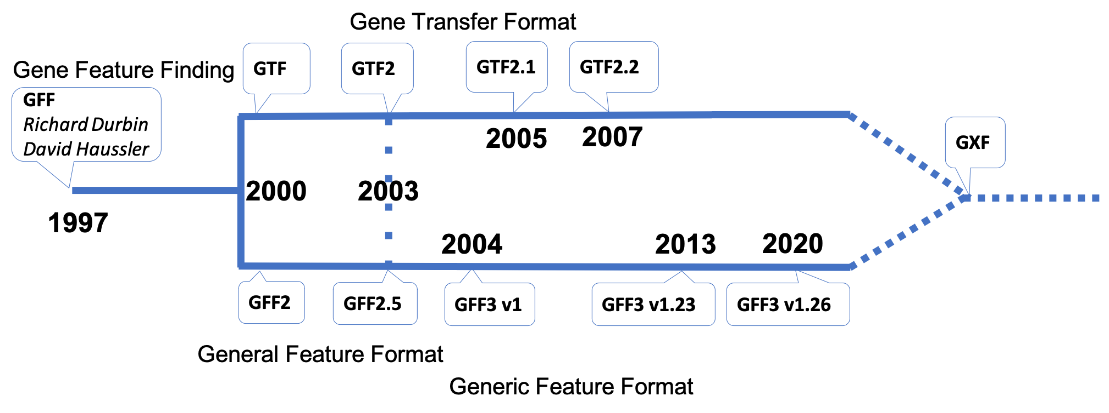
GFF/GTF interoperability issues, a last word
AGAT shows that GFF and GTF formats can be parsed indifferently
AGAT shows that GFF and GTF systems to link features to each other can cohabit
Why not just merge both formats? Everything will just be matter about feature content…
G F F
G T F
G X F
Generic eXchange Format
Notes:
The GFF format specifications has evolved many times to face up new needs and improve interoperability. Early in the evolution of the format, in 2000 a "speciation" occurred that gave birth to the General Transfer Format, while the GFF acronym changed to become the General Feature Format

Slide 24

Thank you for your attention
https://github.com/NBISweden/AGAT

