Slide 1
ELIXIR evaluation evaluation
Step 1
Richèl Bilderbeek

Slide 2
Goal
To conclude evaluation questions that we think are useful for assessing course quality

Slide 3
Why?
How are the evaluations evaluated?
The NBIS/ELIXIR STF, ‘Quality metrics’ (mandatory)

Slide 4
Why?
To find out if we can do better
16,000 learners have filled in this survey [1]. Was it worth their/our time?
[1] https://training-metrics-dev.elixir-europe.org/feedback-report

Slide 5
Can we do better?
Yes, if we conclude our favorite survey questions transparently [1]
[1] https://nbisweden.github.io/elixir_evaluation_evaluation/ (open to more authors)

Slide 6
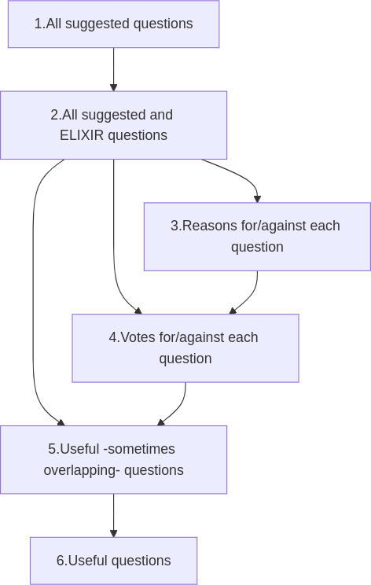
Procedure
Goal: conclude our favorite survey questions
  Transparently
  As a group
  Informed

Slide 7
Phase 1
Goal: Collect all questions that are considered 'good' by at least 1 NBIS trainer
Steps:
  1.1 Repeat ELIXIR goals
  1.2 Fill in anonymous survey within a month

Slide 8
1.1 ELIXIR goals
‘The [goal is to] assess the quality of ELIXIR training events [...]’ [1]
‘It is really important to us in order to continually improve the course and the materials we deliver’ [2]
[1] [Gurwitz et al., 2020] Gurwitz, Kim T., et al. "A framework to assess the quality and impact of bioinformatics training across ELIXIR." PLoS computational biology 16.7 (2020): e1007976.
[2] STF form

Slide 9
1.2 Your favorite questions
Which question(s) do you think (1) would achieve this goal, (2) is worth to ask all ELIXIR course participants?
Anonymous
Submit as many as you need, at
  https://forms.gle/5A5JUssebL6NUZTw7
Deadline before one week before next TrSG meeting

Slide 10
1.2 Some example questions
Did the teacher behave professionally? Yes, no, neutral
How enthusiastic was the teacher? Scale from 1 (not) to 10 (very much)
What was the hair color of the teacher? Free text
Did the course have these: (1) clear instructions, (2) videos of instructions, (3) answers to exercises (can select multiple)

Slide 11
Invitations
Consider to submit your favorite question(s) at
https://forms.gle/5A5JUssebL6NUZTw7
Consider authorship of (draft paper at)
  https://nbisweden.github.io/elixir_evaluation_evaluation/

Slide 12
Questions?

