Slide 1

(Meta)data
Introduction to Data Management Practices course
NBIS DM Team
data-management@scilifelab.se
https://nbisweden.github.io/module-metadata-dm-practices/index.html

Slide 2
What is the problem?
“Someone unfamiliar with your project should be able to look at your computer files and understand in detail what you did and why.”
“Your primary collaborator is yourself six months from now, and your past self don’t answer e-mails.”
Notes:
To understand how the data you produce has been generated, it is important to document descriptions of this, so that you, your collaborators, and someone else can understand it later on.
Actually, you yourself is the most likely recipient of this information, because “it is the doom of men that they forget”, as someone said.

Slide 3
Metadata
The data about the data (or anything really)
“One person’s metadata, is another person’s data”
Notes:
This - “the data about the data (or anything really)” - is what we call metadata.
However, it might not always be straightforward to draw a line between data and metadata. It depends on the particular research interest and focus of the person looking at the data and metadata.
“One person's metadata, is another person's data”

Slide 4
Metadata
Describe data at different levels
e.g. a whole study vs the samples
Examples
Creators
File types and formats of the data
Licence for re-use of the data
Methodology for data collection
Analytical and procedural information
Sources of samples
Sample treatment
Geolocation(s) of samples
Notes:
Some of this information might describe the particulars of a whole study. Some of it will describe detailed particulars of the different components of a study or experiment. Such as, for example:
See slide

Slide 5
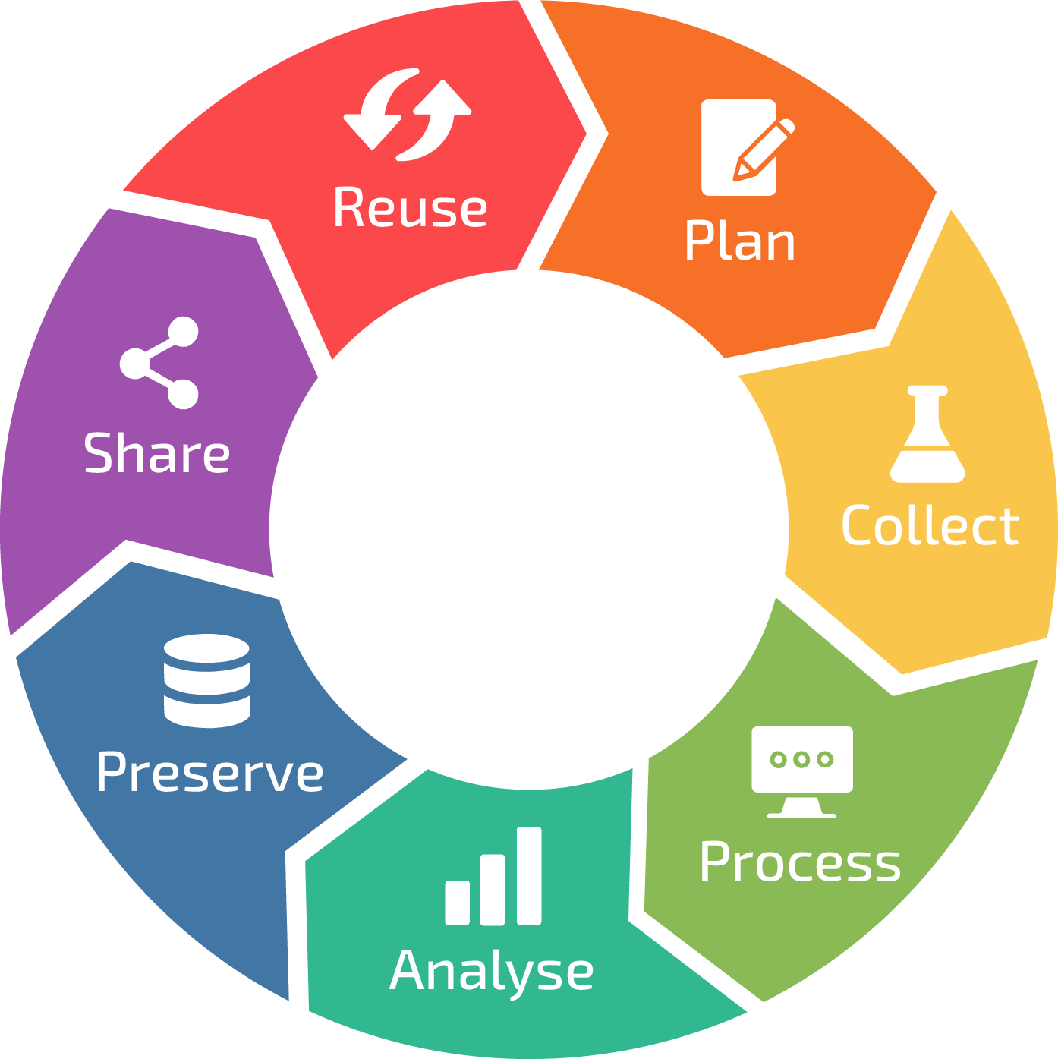
Metadata in the Data Life Cycle
Understanding datasets
Determine what metadata is needed for doing the project and sharing data
Describing datasets
Collecting metadata
Organising metadata in appropriate format(s)
Describing
datasets
Using metadata to perform analysis
RDM life cycle, by ELIXIR RDMkit
Notes:
Metadata touches all of the stages of the data lifecycle

Slide 6
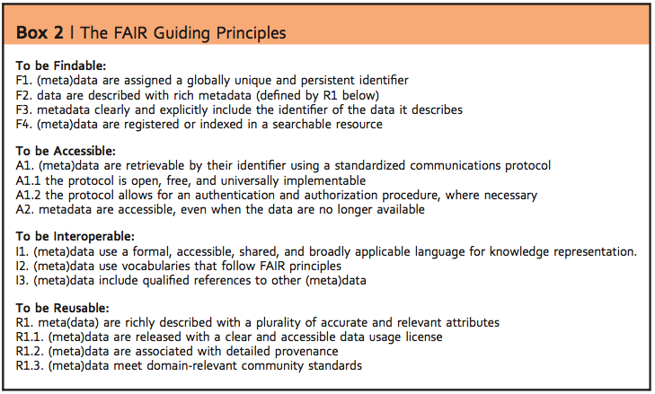
FAIR principles
from Wilkinson, Mark et al. “The FAIR Guiding Principles for scientific data management and stewardship”. Scientific Data 3, Article number: 160018 (2016) http://dx.doi.org/10.1038/sdata.2016.18
Notes:
Metadata is central to the FAIR principles. Your data can not be FAIR without good metadata

Slide 7
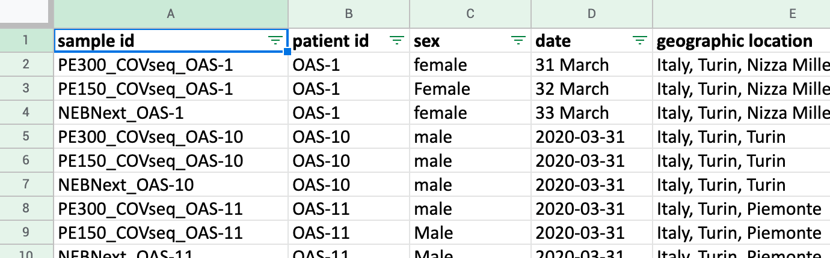
What problems do you see with the descriptions of these samples?
samples_metadata_lesson.csv
Notes:
If you have not done so already, create a folder on your computer for the course
Download the example datafile samples_metadata_lesson.csv, and save it the folder for the course on your computer.
This is a so called CSV (Comma Separated Values) file. A CSV file is a text file that contains tabular data, where the content for different columns is separated by commas (,) and often enclosed by quotes (‘ or “).
CSV files can be opened by text editor programs, as well as by spreadsheet programs such as e.g. Microsoft Excel, LibreOffice Calc, or Google Spreadsheet. Viewing the content of a CSV file will in many cases be easier in a spreadsheet program than in a text editor.
Open the samples_metadata_lesson.csv file in a program of choice.
The first line of the file contains the headers for the different columns. The rest of the lines contain information about a number of samples from a study.
Look at the content of the file and discuss with your neighbour
What are some of the problems you see with the descriptions of the samples?

Slide 8
Problems
Date formats
Different terms for the same information
Misspelled terms
Not clear what a data point means
Not clear what unit

Slide 9
Stringency
Descriptions must be understandable over time - not only for you
FAIR principles → also for computers
Consistency
Date formats
Units
Terms
Notes:
To be properly useful, the metadata should be understandable over time - for you and others.
And to follow the FAIR principles, others means computer programs as well as humans.
You also need to be consistent when describing metadata, e.g. do not mix different date formats, or use synonyms for the same phenomena.

Slide 10
How much metadata?
What is necessary for you to do your particular analysis
What is necessary for someone to understand the data
All the metadata you have
“How can I make this dataset as useful as possible for others?”
Notes:
How much metadata should you document? You can look at this at different levels.
The minimal level is the metadata necessary for you to do your particular analysis.
A further level is the metadata necessary for someone to understand the data.
Going further, documenting all the metadata you have might allow future analysis (by you or others) outside of the scope of your original study.
A good principle can be “how can I make this dataset as useful as possible for others?”.
We will discuss this more in the Metadata standards part of this lesson.

Slide 11
Terms
“A biologist would rather share a toothbrush with
another biologist than share a gene name”
Consistency and stringency
Controlled vocabularies
Ontologies
Thesauruses (Thesauri)
Taxonomies
Notes:
02. Controlled vocabularies & ontologies
Someone once said “A biologist would rather share a toothbrush with another biologist than share a gene name”. This is probably true for other domains of research too.
If we all stick to our own devices and name things as we see fit without regarding our fellow researchers we run the risk of being inconsistent and unclear.
To help with consistency when describing our data, we can use standardized term collections -
Controlled vocabularies,
Ontologies,
Thesauruses, and
Taxonomies.
The names for these different types of collections are often used interchangeably.

Slide 12
How many different medical conditions do you think this list of terms describes?
Bloodstream Infection, Circulatory Failure, Toxic Shock Syndrome, Pyemia, Circulatory Collapse, Blood Poisoning, Endotoxin Shock, Pyohemia, Hypovolemic Shock, Septicemia, Sepsis-associated hypotension, Pyaemia
Notes:
Discuss with your neighbour about how many different medical conditions you think this list of terms describes

Slide 13
Solution
Sepsis | Shock | Septic shock
Blood Poisoning | Circulatory Collapse | Endotoxin Shock
Bloodstream Infection | Circulatory Failure | Sepsis-associated hypotension
Pyaemia | Hypovolemic Shock | Toxic Shock Syndrome
Pyemia
Pyohemia
Septicemia
Notes:
MeSH (Medical Subject Headings) lists the following synonyms

Slide 14
Controlled vocabulary
List of terms to describe some domain of knowledge
Only one term per phenomenon
Term definition
List synonyms
Each term has a unique identifier
Medical Subject Headings - MeSH
Sepsis
Definition: Systemic inflammatory response syndrome with a proven or suspected infectious etiology.
Synonyms: Blood Poisoning, Bloodstream Infection, Pyaemia, Pyemia, …
MeSH Unique ID: D018805
Notes:
A Controlled vocabulary is a list of terms that describes a certain domain of knowledge.
In the controlled vocabulary you only use one term to describe one particular phenomenon, excluding all other synonyms.
The vocabulary should provide a definition for the term, and any synonyms.
In a publicly managed controlled vocabulary, the terms should also have unique identifiers, so that they can be referenced.
Go through the example of the MeSH entry for Sepsis

Slide 15
Ontology
A controlled vocabulary
Captures term relationships, e.g.
is a
part of
contained in
produced by
Hierarchy / Tree
A term can be present at several places in the hierarchy
Notes:
An ontology (in this context) is a controlled vocabulary, that apart from being a list of agreed terms, also captures relationships between these terms.
Some common examples of relationships are: is a, part of, contained in, produced by.
Terms are organised in hierarchies / trees.
Note that a term can be in several places in the hierarchy.
A couple of examples: next slide

Slide 16
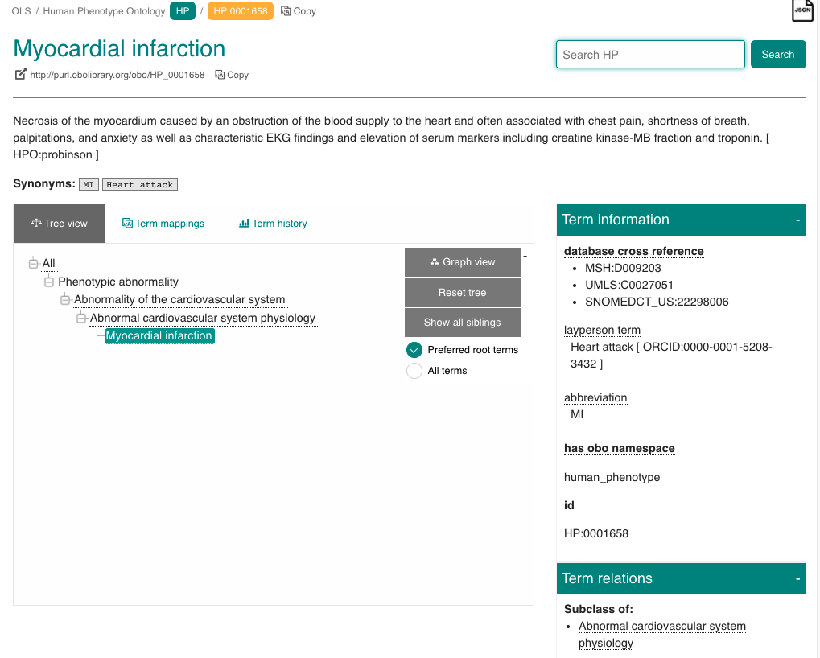
Human Phenotype Ontology
https://www.ebi.ac.uk/ols/ontologies/hp/terms?iri=http%3A%2F%2Fpurl.obolibrary.org%2Fobo%2FHP_0001658
Notes:
In the Human Phenotype Ontology,
Looking at the term Myocardial infarction, we can see that it is a type of Abnormal cardiovascular system physiology is a type of Abnormality of the cardiovascular system is a type of Phenotypic abnormality.
We can also see the definition, synonyms, id. It also has cross references to corresponding terms in other ontologies

Slide 17
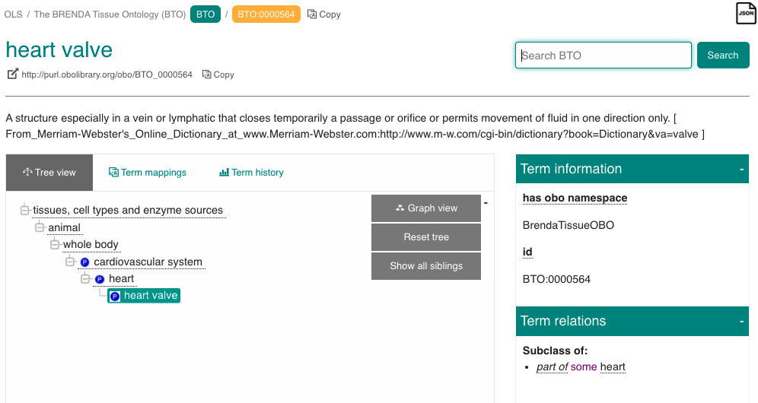
Brenda Tissue Ontology
https://www.ebi.ac.uk/ols/ontologies/bto/terms?iri=http%3A%2F%2Fpurl.obolibrary.org%2Fobo%2FBTO_0000564
Notes:
in the BRENDA Tissue Ontology, the heart valve is a part of the heart is a part of the cardiovascular system is a part of the whole body

Slide 18
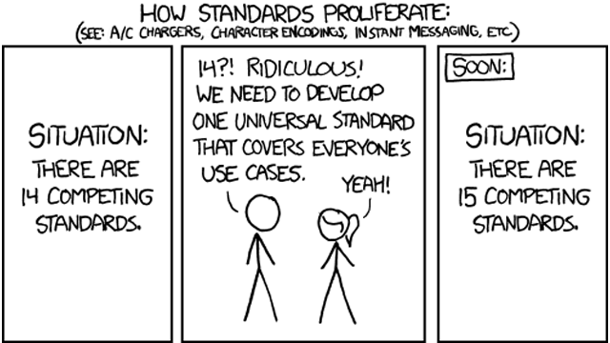
A universal standard?
https://xkcd.com/927/
CC BY-NC 2.5
Notes:
As you see, depending on the way you look at reality, the domains of knowledge have to be structured in several different ways.
There is no all-encompassing ontology that captures everything.
You will have to rely on several different ontologies to describe your research. The question is which ontologies to choose.

Slide 19
Making your own?
At what point does it make sense to use something that exists?
Number of terms
Nature of terms
Relationships of terms
Terms management
Definitions
FAIRness
Unique identifiers
Home brew vocabularies makes it harder to achieve machine readability
Notes:
You can decide to make your own controlled vocabularies.
It might seem like less work than finding good ones that already exist.
In the long run, you are better off using publicly managed vocabularies and lists, as much of the thinking about describing different domains has already been done.
Another important aspects is that it will support the machine-readability aspect of FAIR. With unique identifiers for terms that describes your data (and their relationships), it can be possible for computer code to generate knowledge descriptions from data.

Slide 20
Metadata standards
Collections of metadata elements of relevance for a particular purpose
Elements
Mandatory, Recommended, or Optional
Defined input value type
Free text, data, geographical position, numerical values, ontology terms
Can itself be an ontology term
Stricter → potentially increased FAIRness
Generic to Specific
Notes:
03. Metadata standards
A metadata standard could be described as a collection of metadata fields or elements that are of relevance for the particular type of scientific study data that is to be documented.
Such standards will often consist of some elements that are mandatory, some recommended, and some that are optional.
They will (at least should) define what type of input values are expected for each element, e.g.
free text,
date in a specific format,
geographical positions,
numerical values, and
controlled vocabularies or ontologies.
Sometimes the element name itself is a specified ontology term. The further we go on being strict about defining the elements and values the more we open up for increasing the FAIRness aspects of the data from a computational point of view.
Standards range from the very generic to the very specific. Let’s have a look at a couple of examples: Next slide

Slide 21
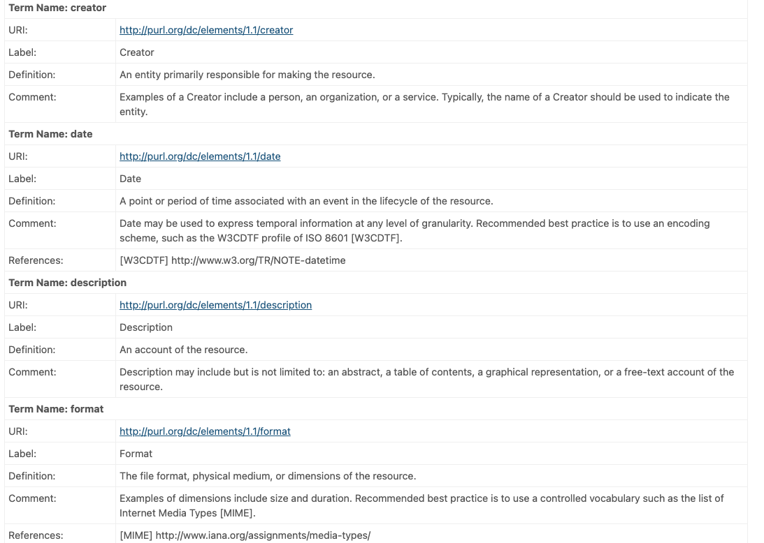
Generic - Dublin Core
Describing digital and physical resources
15 elements
https://www.dublincore.org/specifications/dublin-core/dces/
CC BY 3.0
Notes:
[Option to go to the page on the web]
The Dublin Core is a generic standard for describing digital and physical resources. In its basic form it specifies 15 elements, such as Creator, Title, Description, Date, etc.
[Show the different elements and value types]

Slide 22
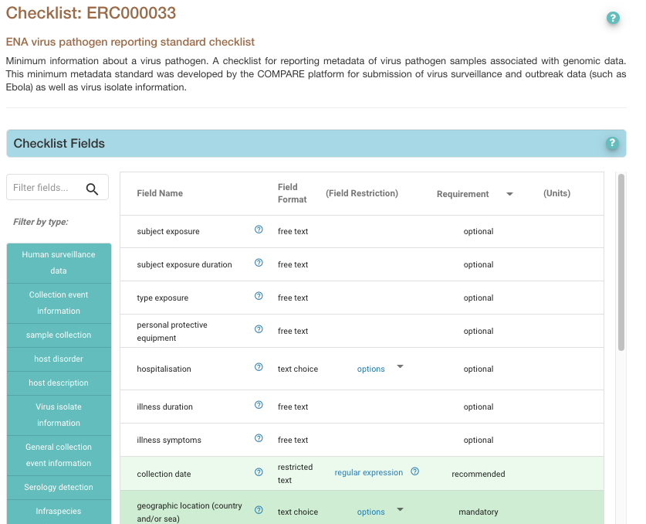
Specific - an ENA checklist
ENA virus pathogen reporting standard checklist
Reporting metadata of virus pathogen samples associated with genomic data
35 elements - 9 mandatory and 15 recommended
https://www.ebi.ac.uk/ena/browser/view/ERC000033
Notes:
[Option to go to the page on the web]
An example of a more specific standard is the ENA virus pathogen reporting standard checklist, for reporting metadata of virus pathogen samples associated with genomic data to the European Nucleotide Archive.
It has 35 elements, of which 9 are mandatory and 15 recommended.
Example of elements are geographic location, host scientific name, host health state, collection date, etc.
[Show the different elements and value types. Point out that value types are often very free]

Slide 23
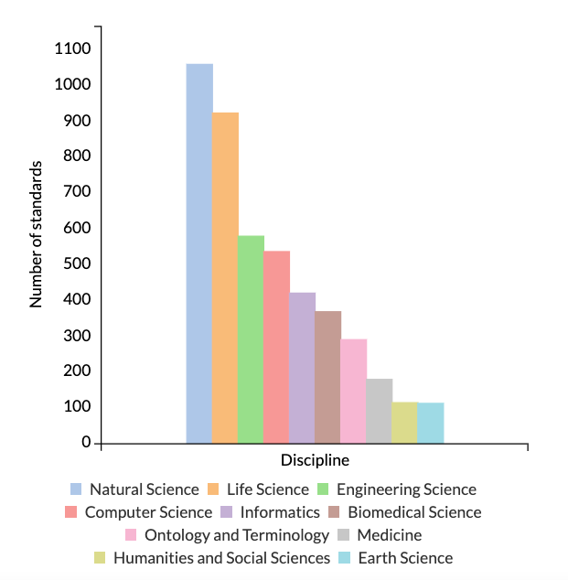
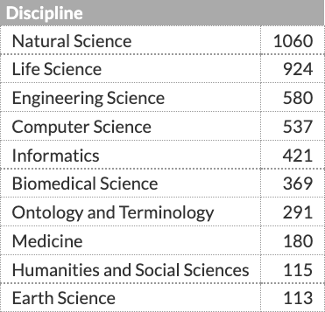
How do I know what to use?
https://fairsharing.org/summary-statistics/
CC BY-SA 4.0
Notes:
Given that reality is hard to categorise, and that different types of research investigate their subject matter from various different angles, there has emerged numerous different ontologies and metadata standards.
In Life Science alone there are currently more than hundreds of standards. So how do I know what to use? -> Next slide (episode)

Slide 24
Data dictionary
Your own metadata standard
Document what type of information is supposed to be entered for the metadata fields
Name, units, allowed values, definitions, ...
Notes:
04. Data dictionary
It is good practice to make a data dictionary for your metadata. “Your own metadata standard”
This is a file that explains what type of information is supposed to be entered for at particular (meta)data field.
This is where you document names of (meta)data fields, expected measurement units, allowed values, and definitions for what the field is about.

Slide 25
Exercise:
Start a data dictionary
Notes:
The file samples_metadata_lesson.csv contains information about a set of samples for a research project. In this exercise you will start writing a data dictionary for this file.

Slide 26
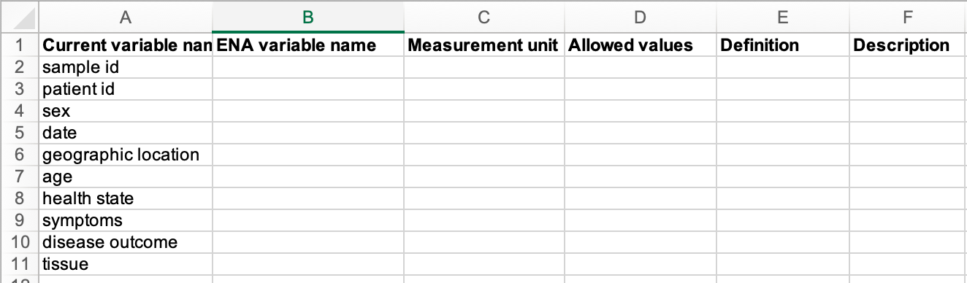
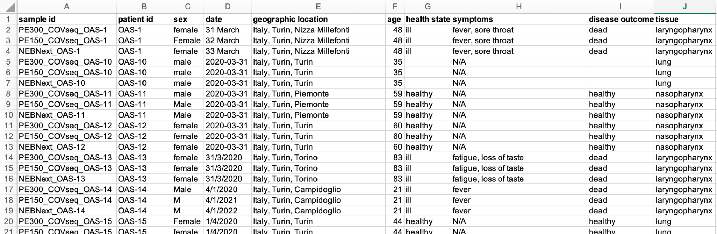
Start a Data dictionary
Open samples_metadata_lesson.csv
Create a new data_dictionary file
Add headings to data_dictionary
Current variable name
ENA variable name
Measurement unit
Allowed values
Definition
3.
data_dictionary
4.
Copy headings from samples_metadata_lesson.csv to rows in data_dictionary
Add some definitions
Add some units
Add some allowed value definitions
samples_metadata_lesson.csv
Notes:
Open the FILE that you downloaded in the beginning of the lesson, in a spreadsheet program of you choice
Open another empty spreadsheet file, name it data_dictionary.
Add the following headings to the data_dictionary file: Current variable name, ENA Variable name, Measurement unit, Allowed values, Definition, Description
If you wonder about the ENA Variable name column, it will be used in the next excersise
Copy the headings of the FILE file to the first column (Current variable name) of the data_dictionary file, one heading term per row.
Now you should have a first row with the headings under step 3, and then one term (from the FILE file headings) per row in the first column.
Try adding definitions (to the Definition column) for some of the terms.
Are there any terms where you can specify information in the Measurement unit?

Slide 27
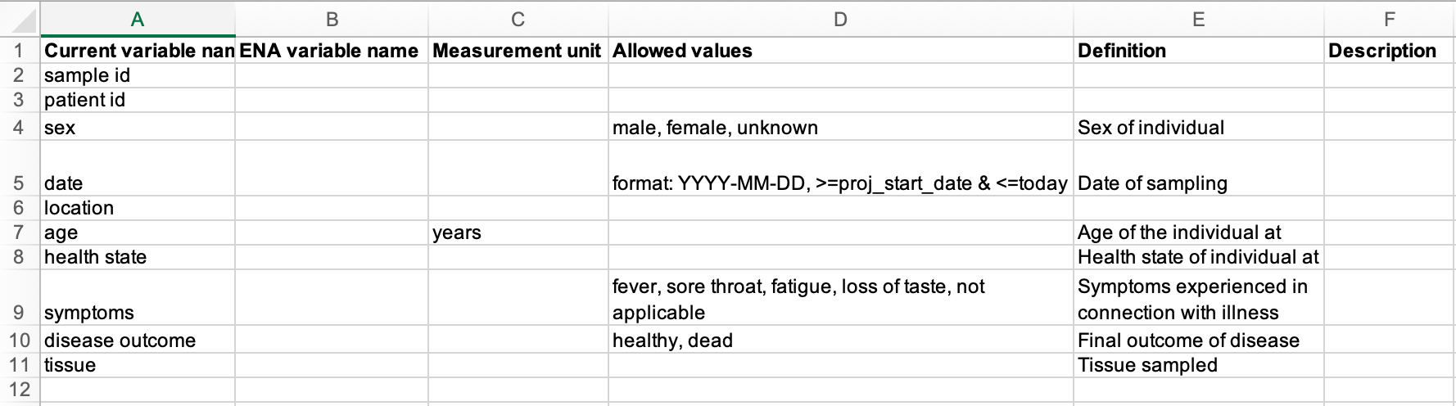
Data dictionary - start
Notes:
The beginning of the data dictionary could now look something like this

Slide 28
Plan ahead
Use standards of deposition databases were you plan to publish your data
Helps with selecting elements
Makes data submission much easier
Notes:
If you plan to deposit your data in a public repository (and you should) this is the first place to look for standards.
They will have instructions for what metadata information they request for the data that they harbour.
If you try to structure your own metadata according to these from the start, submitting your data will be a lot more straightforward.

Slide 29
Exercise:
Look up an ENA checklist to improve the data dictionary
Notes:
In this exercise we are assuming that you are planning to submit data about your samples to the European Nucleotide Archive - ENA.
The ENA has set of suggested metadata standards for different types of samples that they call checklists.

Slide 30
Improve the data dictionary
Go to https://www.ebi.ac.uk/ena/browser/checklists to see the available checklists
Scroll down the listing until you find the ERC000033 ENA virus pathogen reporting standard checklist
Go through the data dictionary and find suitable field names in the ENA default sample checklist for those fields. Add them to the ENA Variable name column of your data dictionary file.
Are all mandatory fields present, or will you need to add fields?
Are there fields that need to be split into more fields?
Are there controlled vocabularies you should adhere to?
Notes:
Go to https://www.ebi.ac.uk/ena/browser/checklists to see the available checklists
Scroll down the listing until you find the ERC000011 ENA default sample checklist
The ENA default sample checklist lists the expected name and content for a number of metadata fields that can be submitted for samples. If you put your mouse pointer over the ? icon, you will get a description about of what type of information the different fields are supposed to contain.
Open the data dictionary file that you started in the previous exercise.
Go through the data dictionary and find suitable field names in the ENA default sample checklist for those fields. Add them to the ENA Variable name column of your data dictionary file.

Slide 31
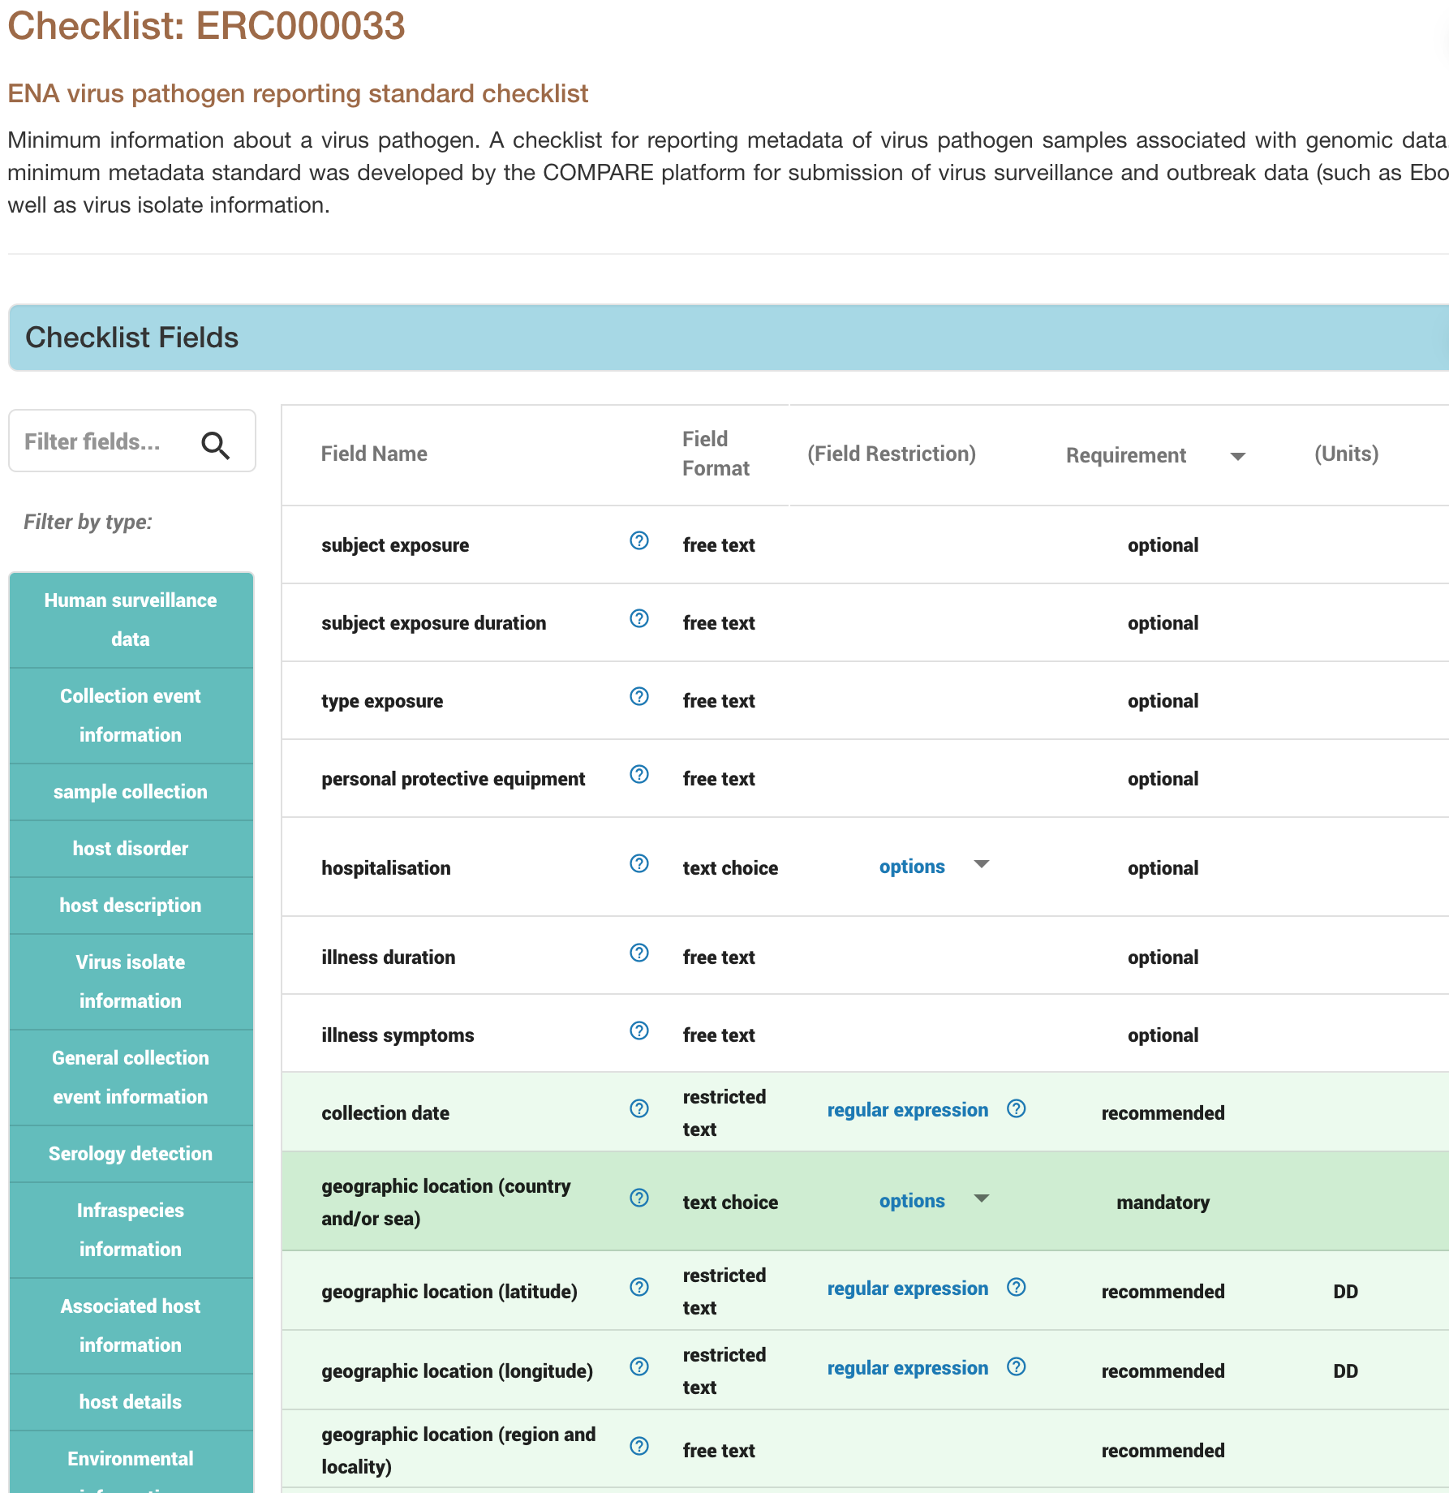
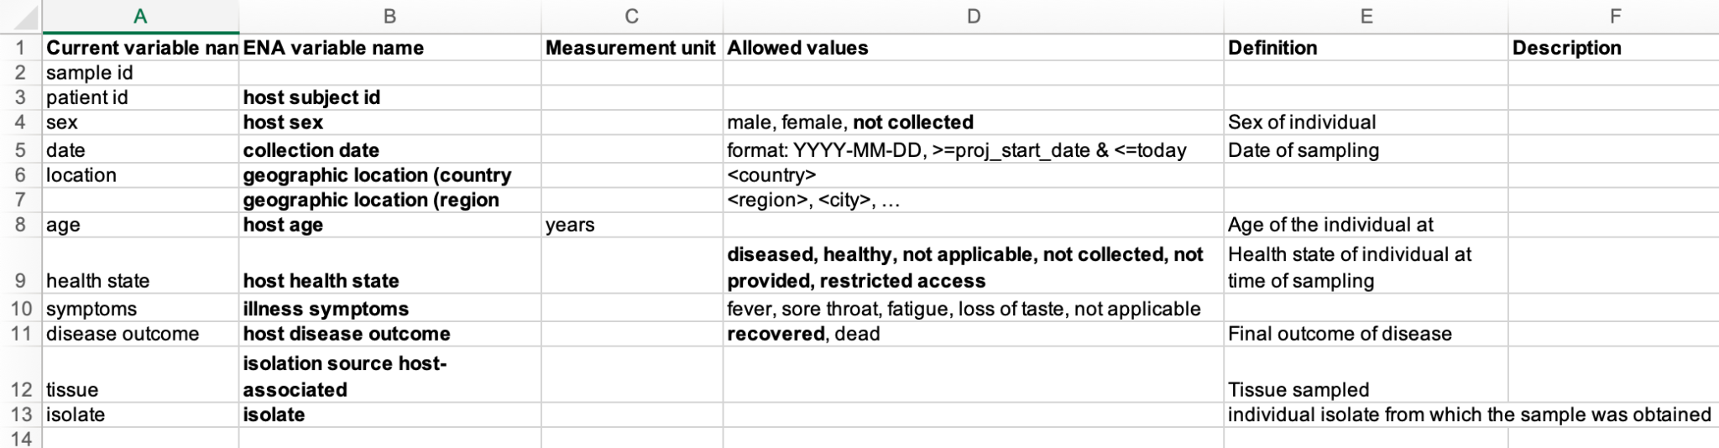
Improve the data dictionary
https://www.ebi.ac.uk/ena/browser/view/ERC000033
Notes:
The data dictionary could now look something like this

Slide 32
Finding ontologies
This standard is liberal when it comes the allowed values for the different fields
We can do better!
Use ontology terms
Improves FAIRness
But which ontologies…?
https://www.ebi.ac.uk/ena/browser/view/ERC000033
Notes:
05. Finding ontologies
As you noticed in the previous excercise, the ENA checklist in most cases did not specify any particular standard to use when assigning values to the different fields.
However, if you can be more specific regarding how you describe the different metadata aspects for your data it will increase the FAIRness of your data.
For this you should use controlled vocabularies or ontologies.
As we have said earlier, there are hundreds of metadata standards, controlled vocabularies and ontologies in the Life Sciences alone. So how do you find the ones that are appropriate for your data? Fortunately, there are tools and resources to help you with this.
→ Next slide

Slide 33



Finding ontologies
Tools
FAIRsharing.org
EBI Ontology Tooling page
Ontology Lookup Service - OLS
Zooma - map free text to ontology terms
Not an exact science… There is no perfect way...
Sometimes hard
Trial and error
https://fairsharing.org/
https://www.ebi.ac.uk/spot/ontology/
CC BY-SA 4.0
Notes:
A few useful examples:
FAIRsharing.org is a resource that aims at collecting and connecting existing standards, databases. Use it to find recommended standards for different research domains and databases.
The European Bioinformatics Institute (EMBL-EBI) makes availble a set of resources for ontologies, e.g.:
Zooma
OLS
Let’s have a look at these
→ Next slide

Slide 34
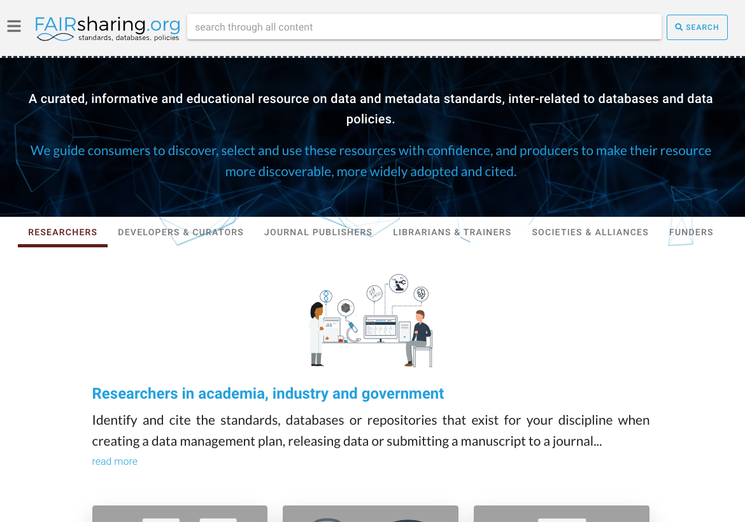
FAIRsharing.org
https://fairsharing.org/
CC BY-SA 4.0
Notes:
NB! Practice the demo
FAIRsharing.org is a resource to find standards, databases and data policies
Click the search field
Type human and hit return
Show list of results
Type, subject, domain, …
Point out that it’s not only ontologies, but e.g. databases as well
Click on Human Phenotype Ontology as an example.
Show that there is a lot of info for this standard
Scroll down to the Additional information section at the bottom of the page
Click View in OBO Foundry
Point out different ways of viewing - select OLS

Slide 35
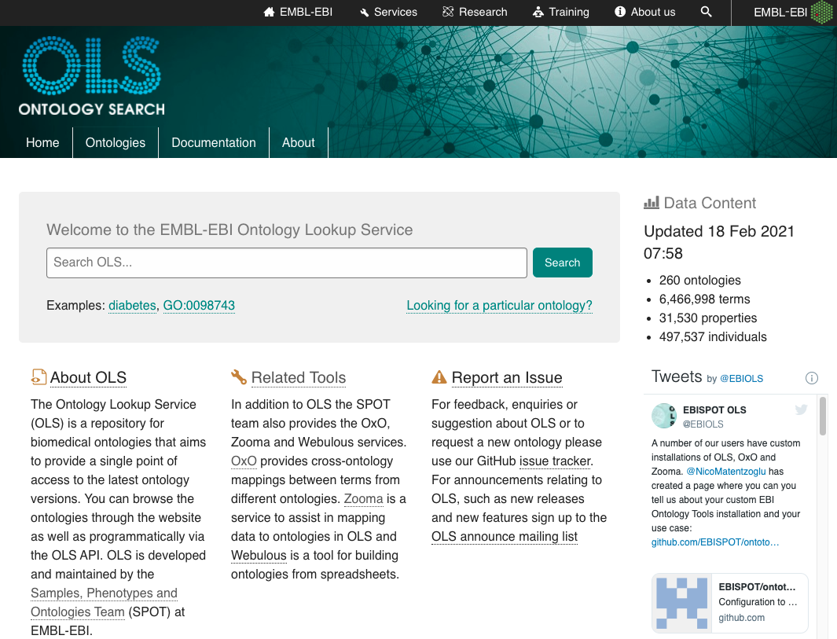
OLS
https://www.ebi.ac.uk/ols/
Notes:
OLS is a resource for browsing and searching ontologies
Demo:
Go to OLS
Enter diabetes in search field
Note that suggestions pop up
Hit return
Show result list
Filtering option
Different results

Slide 36
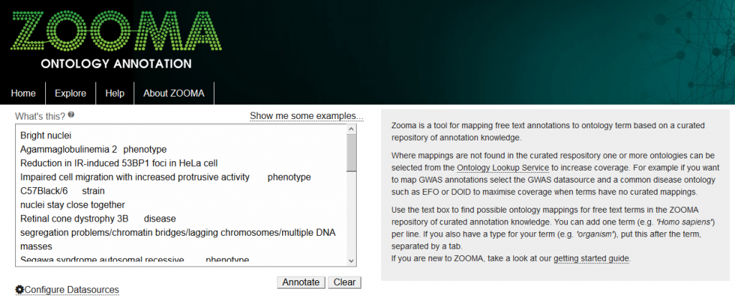
Zooma
https://www.ebi.ac.uk/training/online/courses/cellular-microscopy-phenotype-ontology-quick-tour/annotating-data-with-cmpo/
CC BY 4.0
https://www.ebi.ac.uk/spot/zooma/
Notes:
Zooma is a tool that maps free text to ontology terms
Demo:
Go to Zooma
Click show me some examples
Point out that you can add a term and a type
Separated by tab - note that you cannot type a tab in the browser window. Text has to be written elsewhere and copy-pasted for this to work…
Show that you can limit sources to look in
Click annotate
Show the result
Term, Confidence, source, and ontology ID (but there is no link…)

Slide 37
Exercise:
Find suitable ontologies for your data
Notes:
→ Next slide

Slide 38
Finding ontologies and terms
Try finding and deciding on suitable ontologies and terms to use for the data file
illness symptoms, using OLS
isolation source host-associated (tissue), using FAIRsharing.org
Notes:
NB! Practice the repeat run-through of the exercise
To be more specific about the terms used for some of the fields, try to find a suitable ontology and the terms to use for the values that will be in your data file (samples_metadata_lesson.csv), for these fields:
illness symptoms, using OLS
isolation source host-associated, using FAIRsharing.org
Add the name of the ontology and the terms you have selected to the data dictionary.
You don’t have to stick to the tools specified. Try the different ones if you want to. As you will probably notice, there is no perfect way that always finds what you want. It will almost always involve a fair bit of trial and error.
Afterwards go through the different lookups
For each field you will have to look into the data file to see what values are there now
Then try to find an ontology and the appropriate terms in that ontology
Add the name of the ontology and the terms you have choosen to the allowed values columns
illness symptoms
Go to OLS, search for one of the symptoms in the samples_metadata_lesson.csv file, e.g. fever
Choose one of the search results that seems appropriate, e.g. from the NCI Thesaurus OBO Edition - NCIT
The term for fever in NCIT is Fever. Also note that it has an identifier NCIT:C3038
Find terms for the other symptoms in NCIT, by either browsing the tree (click on the Show siblings button in the ontology tree to expand the contents of the tree), or by searching
See below for the NCIT terms for the symptoms
isolation source host-associated
Go to FAIRsharing.org
Go to “Standards”
Search for “anatomy”
Find a suitable ontology, e.g. Foundational Model of Anatomy - FMA, and go to the information page
Look at the “FMA Ontology Display”. Click View in BioPortal
Select the classes tab. Look through the tree of terms, or search for a term in the “Jump to” field
So FMA would be a suitable ontology. See below for the FMA terms for the tissues

Slide 39
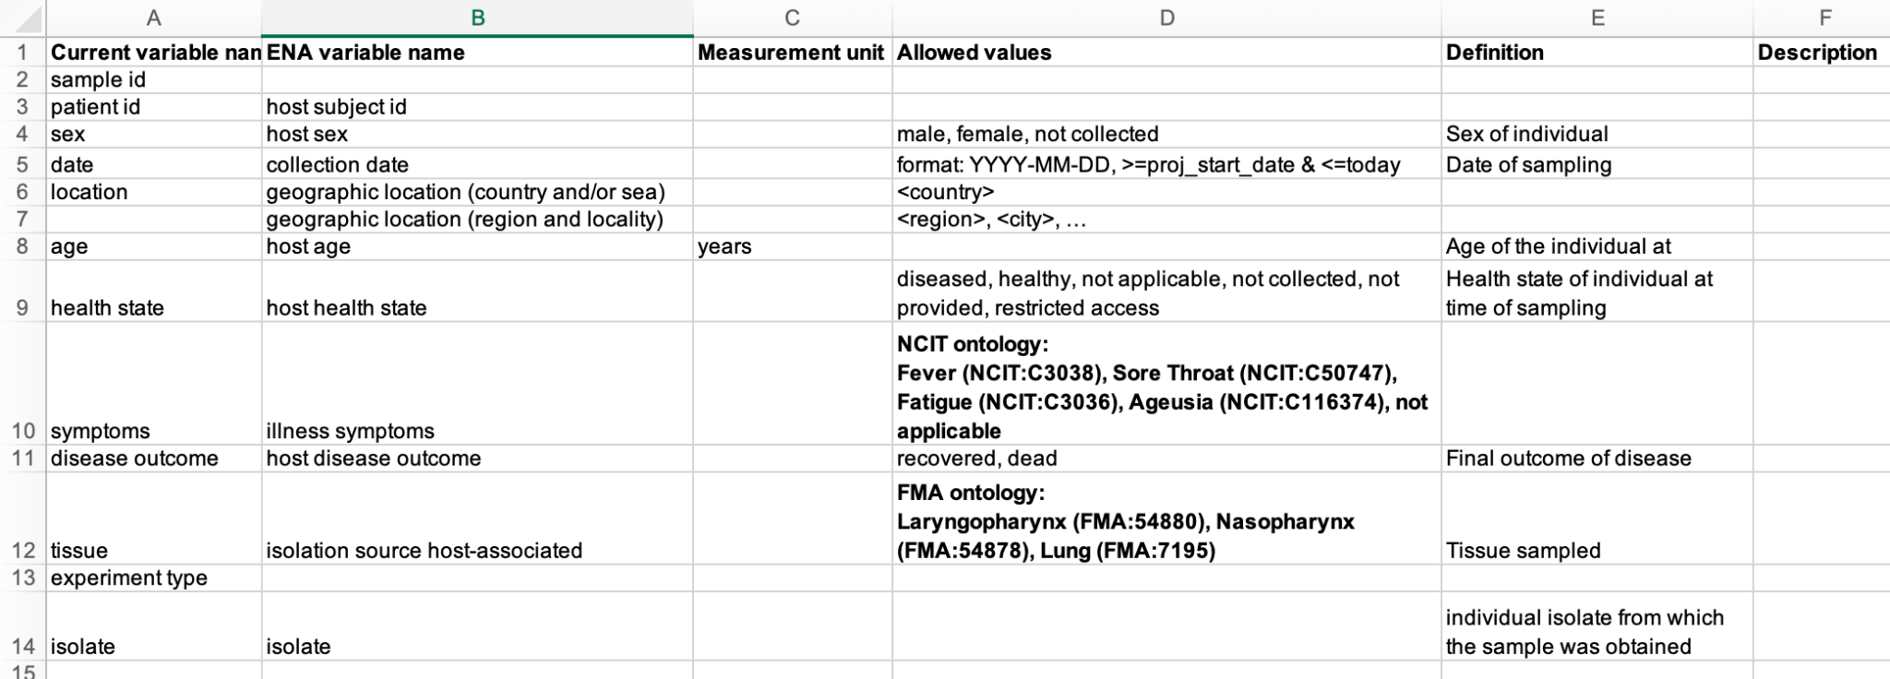
Update the data dictionary
Notes:
The data dictionary could now look something like this:

Slide 40
Summary
Information about data is called metadata
Good metadata is a necessity for understanding the data - FAIRness
Try to be consistent when describing data
Use controlled vocabularies and ontologies when specifying metadata
Metadata standards - generic and domain specific
Use data dictionaries to document standards for your data
There are tools to help you decide on ontologies and terms to use
Notes:
See slide

Slide 41
Metadata in context (bonus)
Introduction to Data Management Practices course
NBIS DM Team
data-management@scilifelab.se
https://nbisweden.github.io/module-metadata-dm-practices/index.html

Slide 42
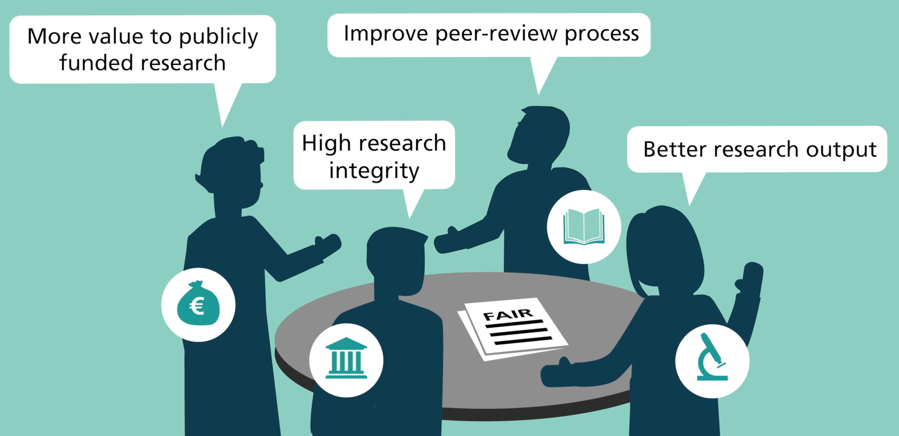

OpenScience and FAIR
Works with my software
Robot: MetaManMachine by Nikola Vasiljevic (2021), CC BY-SA 4.0, doi:10.5281/zenodo.4471098
Background from ‘FAIR Principles’ by Martínez-Lavanchy, et al (2019), CC-BY 4.0. doi:10.11581/dtu:00000049

Slide 43
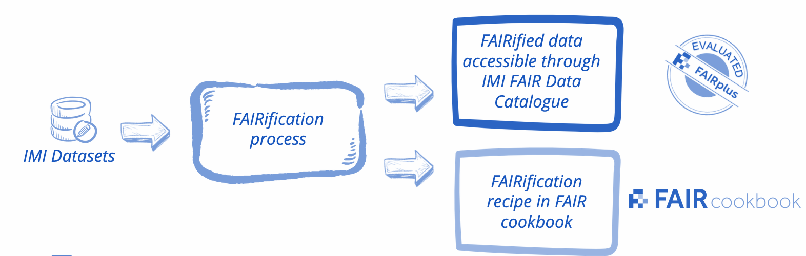
Making sense of your group’s data
“ data should be readable for machines without the need for specialised or ad hoc algorithms, translators, or mappings”
How about another group’s data?

Slide 44
Making sense of other group’s data
“ data should be readable for machines without the need for specialised or ad hoc algorithms, translators, or mappings”
“ data should be assessable so that judgments can be made about their reliability and the competence of those who created them”.
How about FAIR research data?

Slide 45
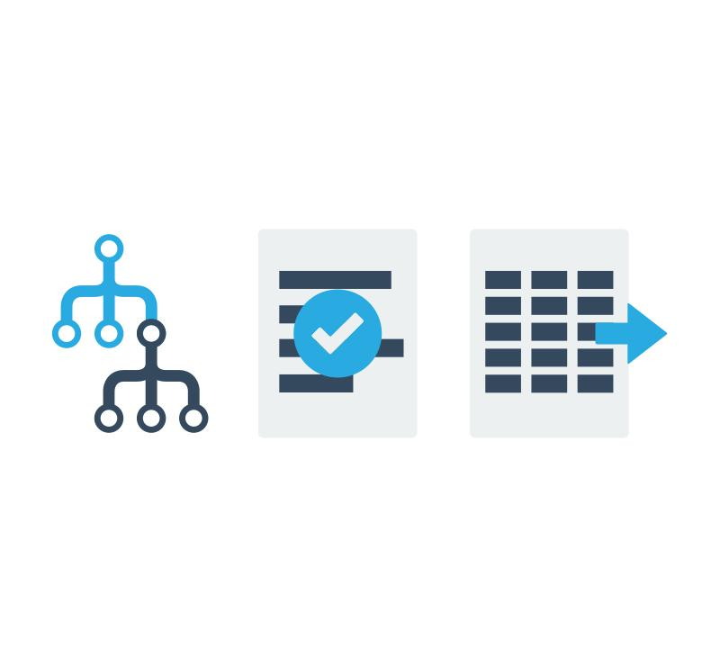

Making sense of FAIR research data
“ data should be readable for machines without the need for specialised or ad hoc algorithms, translators, or mappings”
“ data should be assessable so that judgments can be made about their reliability and the competence of those who created them”.
576+
788+
245+
*
Formats
Terminologies
Guidelines
Data storage & exchange
Requirements & checklists
Conceptual models & controlled vocabularies
* Numbers from the FAIRsharing Registry

Slide 46
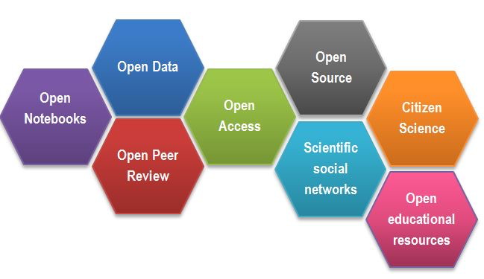
A web of FAIR data and services
Open Science facets as a beehive by Gema Bueno, CC-BY 4.0, https://www.fosteropenscience.eu/content/what-open-science-introduction
“From Gutenberg to Berners–Lee”
What types of research assets?
Where will people be looking?
Who should have access?
Which standards/specifications?
What cross-references and what documentation can you provide? (Rich metadata!)

Slide 47
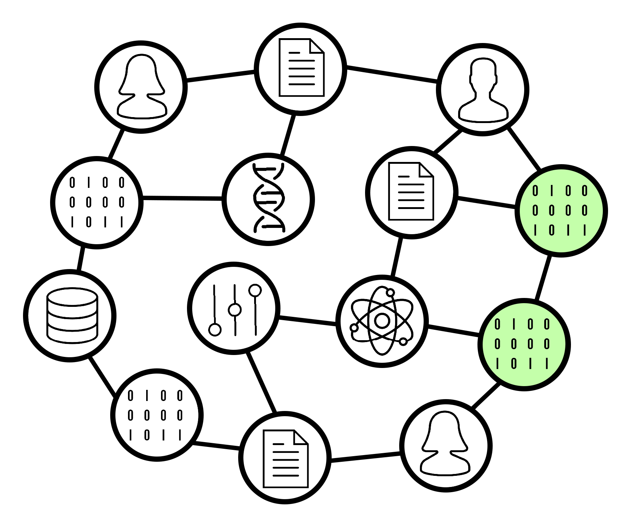
A web of FAIR data and services
Graph: “PID Graph” from the FREYA project
“From Gutenberg to Berners–Lee”
F - What types of research assets?
F - Where will people be looking?
Who should have access?
Which standards/specifications?
What cross-references and what documentation can you provide? (Rich metadata!)

Slide 48
A web of FAIR data and services
Graph: “PID Graph” from the FREYA project
“From Gutenberg to Berners–Lee”
What types of research assets?
Where will people be looking?
Who should have access?
Which standards/specifications?
What cross-references and what documentation can you provide? (Rich metadata!)
Works with my software
Robot: MetaManMachine by Nikola Vasiljevic (2021), CC BY-SA 4.0, doi:10.5281/zenodo.4471098

Slide 49
Metadata in the Data Life Cycle
Understanding datasets
Determine what metadata is needed for doing the project and sharing data
Describing datasets
Collecting metadata
Organising metadata in appropriate format(s)
Describing
datasets
Using metadata to perform analysis
RDM life cycle, by ELIXIR RDMkit
Notes:
Metadata touches all of the stages of the data lifecycle

Slide 50


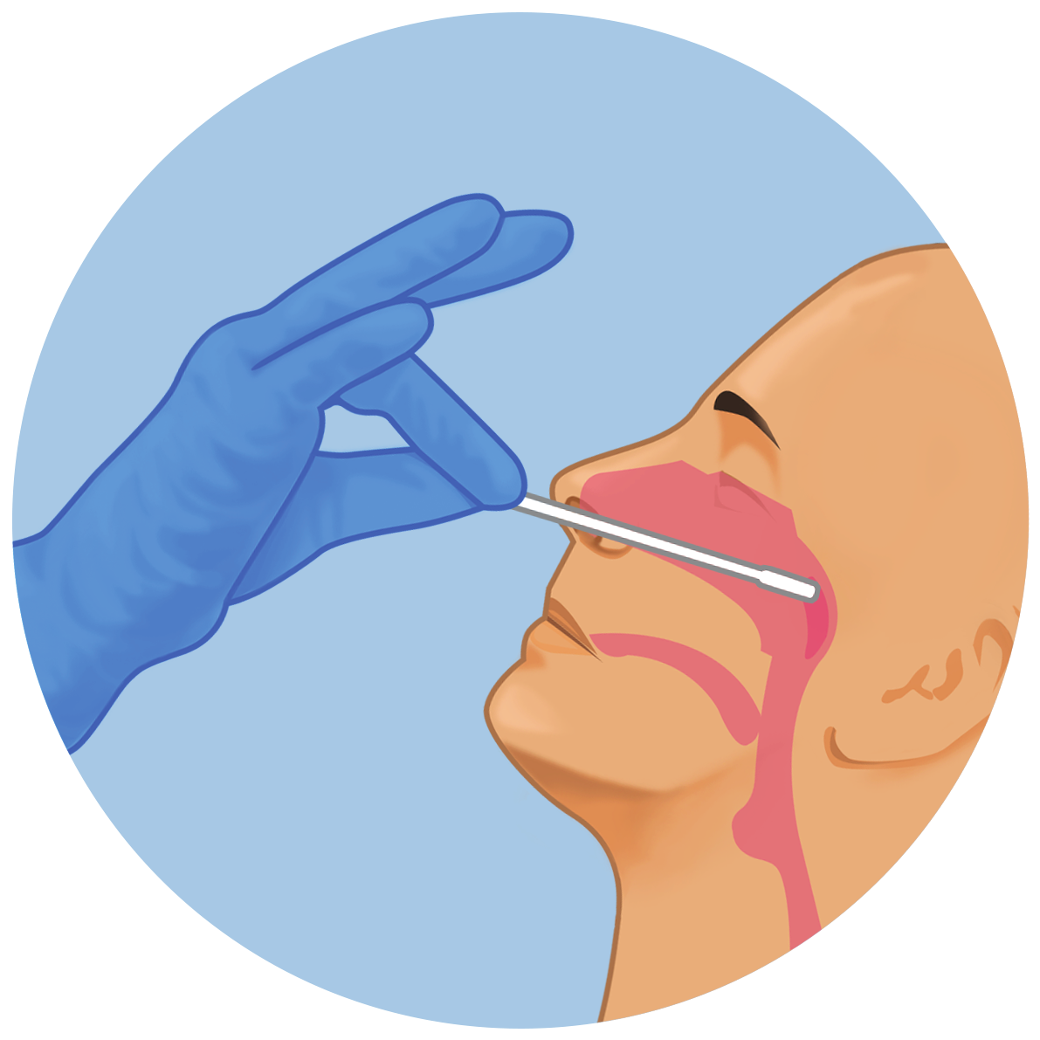
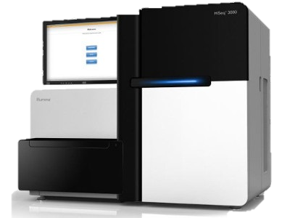


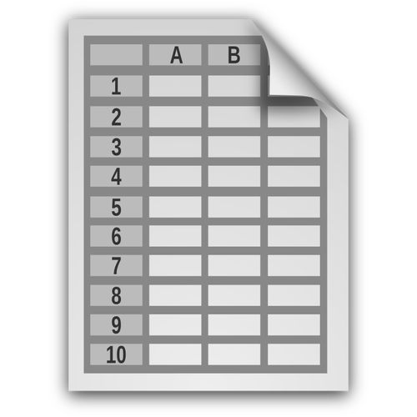
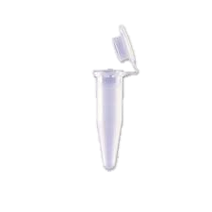



(Meta)data in context
Study & data design
Sampling & specimen collection
Sample preparation
Sample analysis & data generation
Data processing to prepare inputs for analysis
Data analysis
Communicating results
Procedures
Biosamples and instruments
Data and computational workflows
Outputs
Information systems
Laboratory workspaces
Biobank or Collection
Data delivery
Digital workspaces
Local data archive etc
Research databases
“Protocol” & “project plan” icons by Justin Blake, and “infrastructure” icon by Eko Purnomo, from thenounproject.com
Notes:
Other icons are public domain from US CDC and OpenClipart
https://openclipart.org/detail/216996/computer
https://openclipart.org/detail/300668/spreadsheet-document-icon-with-no-text
https://www.cdc.gov/other/agencymaterials.html
https://www.cdc.gov/coronavirus/2019-ncov/lab/guidelines-clinical-specimens.html
www.cdc.gov/coronavirus/2019-ncov/downloads/lab/NP-Specimen-Collection-Infographic.pdf

Slide 51
(Meta)data in context
Study & data design
Sampling & specimen collection
Sample preparation
Sample analysis & data generation
Data processing to prepare inputs for analysis
Data analysis
Communicating results
Procedures
Biosamples and instruments
Data and computational workflows
Outputs
Information systems
Laboratory workspaces
Biobank or Collection
Data delivery
Digital workspaces
Local data archive etc
Research databases
“Protocol” & “project plan” icons by Justin Blake, and “infrastructure” icon by Eko Purnomo, from thenounproject.com
Notes:
Other icons are public domain from US CDC and OpenClipart
https://openclipart.org/detail/216996/computer
https://openclipart.org/detail/300668/spreadsheet-document-icon-with-no-text
https://www.cdc.gov/other/agencymaterials.html
https://www.cdc.gov/coronavirus/2019-ncov/lab/guidelines-clinical-specimens.html
www.cdc.gov/coronavirus/2019-ncov/downloads/lab/NP-Specimen-Collection-Infographic.pdf

Slide 52
(Meta)data in context
Study & data design
Sampling & specimen collection
Sample preparation
Sample analysis & data generation
Data processing to prepare inputs for analysis
Data analysis
Communicating results
Procedures
Biosamples and instruments
Data and computational workflows
Outputs
Information systems
Laboratory workspaces
Biobank or Collection
Data delivery
Digital workspaces
Local data archive etc
Research databases
“Protocol” & “project plan” icons by Justin Blake, and “infrastructure” icon by Eko Purnomo, from thenounproject.com
Notes:
Other icons are public domain from US CDC and OpenClipart
https://openclipart.org/detail/216996/computer
https://openclipart.org/detail/300668/spreadsheet-document-icon-with-no-text
https://www.cdc.gov/other/agencymaterials.html
https://www.cdc.gov/coronavirus/2019-ncov/lab/guidelines-clinical-specimens.html
www.cdc.gov/coronavirus/2019-ncov/downloads/lab/NP-Specimen-Collection-Infographic.pdf

Slide 53
(Meta)data in context
Study & data design
Sampling & specimen collection
Sample preparation
Sample analysis & data generation
Data processing to prepare inputs for analysis
Data analysis
Communicating results
Procedures
Biosamples and instruments
Data and computational workflows
Outputs
Information systems
Laboratory workspaces
Biobank or Collection
Data delivery
Digital workspaces
Local data archive etc
Research databases
“Protocol” & “project plan” icons by Justin Blake, and “infrastructure” icon by Eko Purnomo, from thenounproject.com
Notes:
Other icons are public domain from US CDC and OpenClipart
https://openclipart.org/detail/216996/computer
https://openclipart.org/detail/300668/spreadsheet-document-icon-with-no-text
https://www.cdc.gov/other/agencymaterials.html
https://www.cdc.gov/coronavirus/2019-ncov/lab/guidelines-clinical-specimens.html
www.cdc.gov/coronavirus/2019-ncov/downloads/lab/NP-Specimen-Collection-Infographic.pdf

Slide 54
(Meta)data in context
Study & data design
Sampling & specimen collection
Sample preparation
Sample analysis & data generation
Data processing to prepare inputs for analysis
Data analysis
Communicating results
Procedures
data protection,
ethics permit,
infrastructure,
standards,
protocols, data dictionaries,
data access, …
Biosamples and instruments
Data and computational workflows
Outputs
Laboratory workspaces
Biobank or Collection
Data delivery
Digital workspaces
Local data archive etc
Research databases
“Protocol” & “project plan” icons by Justin Blake, and “infrastructure” icon by Eko Purnomo, from thenounproject.com
Notes:
Other icons are public domain from US CDC and OpenClipart
https://openclipart.org/detail/216996/computer
https://openclipart.org/detail/300668/spreadsheet-document-icon-with-no-text
https://www.cdc.gov/other/agencymaterials.html
https://www.cdc.gov/coronavirus/2019-ncov/lab/guidelines-clinical-specimens.html
www.cdc.gov/coronavirus/2019-ncov/downloads/lab/NP-Specimen-Collection-Infographic.pdf

Slide 55
(Meta)data in context
Study & data design
Sampling & specimen collection
Sample preparation
Sample analysis & data generation
Data processing to prepare inputs for analysis
Data analysis
Communicating results
Procedures
data protection,
ethics permit,
infrastructure,
standards,
protocols, data dictionaries,
data access, …
Biosamples and instruments populations (statistical) and inclusion criteria,
physical processing steps,
working storage conditions,
long-term storage location,
sample quality assessment, sample annotations,
reagents, instruments, kits, …
Data and computational workflows
Outputs
Data delivery
Digital workspaces
Local data archive etc
Research databases
“Protocol” & “project plan” icons by Justin Blake, and “infrastructure” icon by Eko Purnomo, from thenounproject.com
Notes:
Other icons are public domain from US CDC and OpenClipart
https://openclipart.org/detail/216996/computer
https://openclipart.org/detail/300668/spreadsheet-document-icon-with-no-text
https://www.cdc.gov/other/agencymaterials.html
https://www.cdc.gov/coronavirus/2019-ncov/lab/guidelines-clinical-specimens.html
www.cdc.gov/coronavirus/2019-ncov/downloads/lab/NP-Specimen-Collection-Infographic.pdf

Slide 56
(Meta)data in context
Study & data design
Sampling & specimen collection
Sample preparation
Sample analysis & data generation
Data processing to prepare inputs for analysis
Data analysis
Communicating results
Procedures
data protection,
ethics permit,
infrastructure,
standards,
protocols, data dictionaries,
data access, …
Biosamples and instruments populations (statistical) and inclusion criteria,
physical processing steps,
working storage conditions,
long-term storage location,
sample quality assessment, sample annotations,
reagents, instruments, kits, …
Data and computational workflows
digital processing steps,
working storage conditions,
long-term storage location,
data quality assessment,
sample/data annotations,
reference data, analysis method…
Outputs
Research databases
“Protocol” & “project plan” icons by Justin Blake, and “infrastructure” icon by Eko Purnomo, from thenounproject.com
Notes:
Other icons are public domain from US CDC and OpenClipart
https://openclipart.org/detail/216996/computer
https://openclipart.org/detail/300668/spreadsheet-document-icon-with-no-text
https://www.cdc.gov/other/agencymaterials.html
https://www.cdc.gov/coronavirus/2019-ncov/lab/guidelines-clinical-specimens.html
www.cdc.gov/coronavirus/2019-ncov/downloads/lab/NP-Specimen-Collection-Infographic.pdf

Slide 57
(Meta)data in context
Study & data design
Sampling & specimen collection
Sample preparation
Sample analysis & data generation
Data processing to prepare inputs for analysis
Data analysis
Communicating results
Procedures
data protection,
ethics permit,
infrastructure,
standards,
protocols, data dictionaries,
data access, …
Biosamples and instruments populations (statistical) and inclusion criteria,
physical processing steps,
working storage conditions,
long-term storage location,
sample quality assessment, sample annotations,
reagents, instruments, kits, …
Data and computational workflows
digital processing steps,
working storage conditions,
long-term storage location,
data quality assessment,
sample/data annotations,
reference data, analysis method…
Outputs
publications, data,
tools,
workflows,
reports,
dashboards, …
“Protocol” & “project plan” icons by Justin Blake, and “infrastructure” icon by Eko Purnomo, from thenounproject.com
Notes:
Other icons are public domain from US CDC and OpenClipart
https://openclipart.org/detail/216996/computer
https://openclipart.org/detail/300668/spreadsheet-document-icon-with-no-text
https://www.cdc.gov/other/agencymaterials.html
https://www.cdc.gov/coronavirus/2019-ncov/lab/guidelines-clinical-specimens.html
www.cdc.gov/coronavirus/2019-ncov/downloads/lab/NP-Specimen-Collection-Infographic.pdf

Slide 58
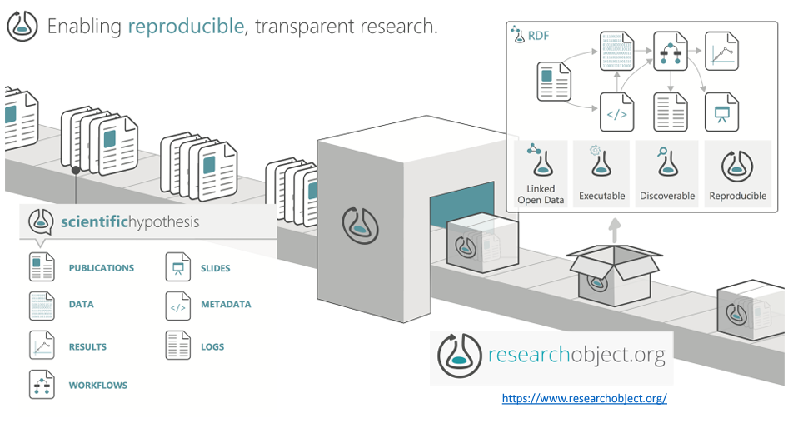
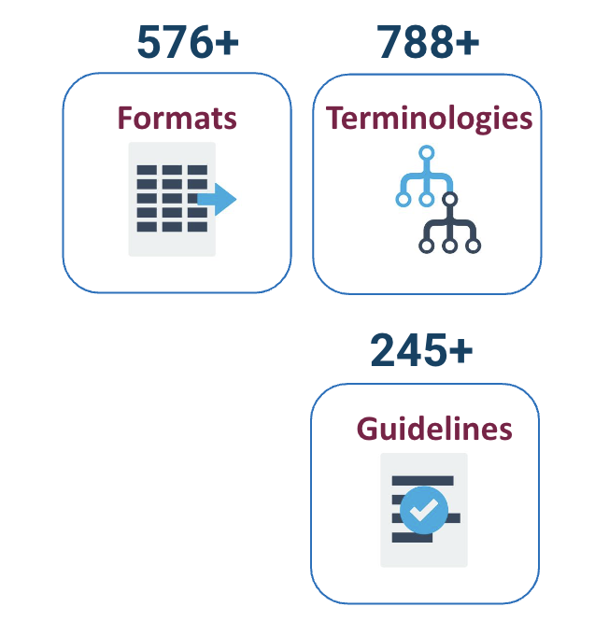
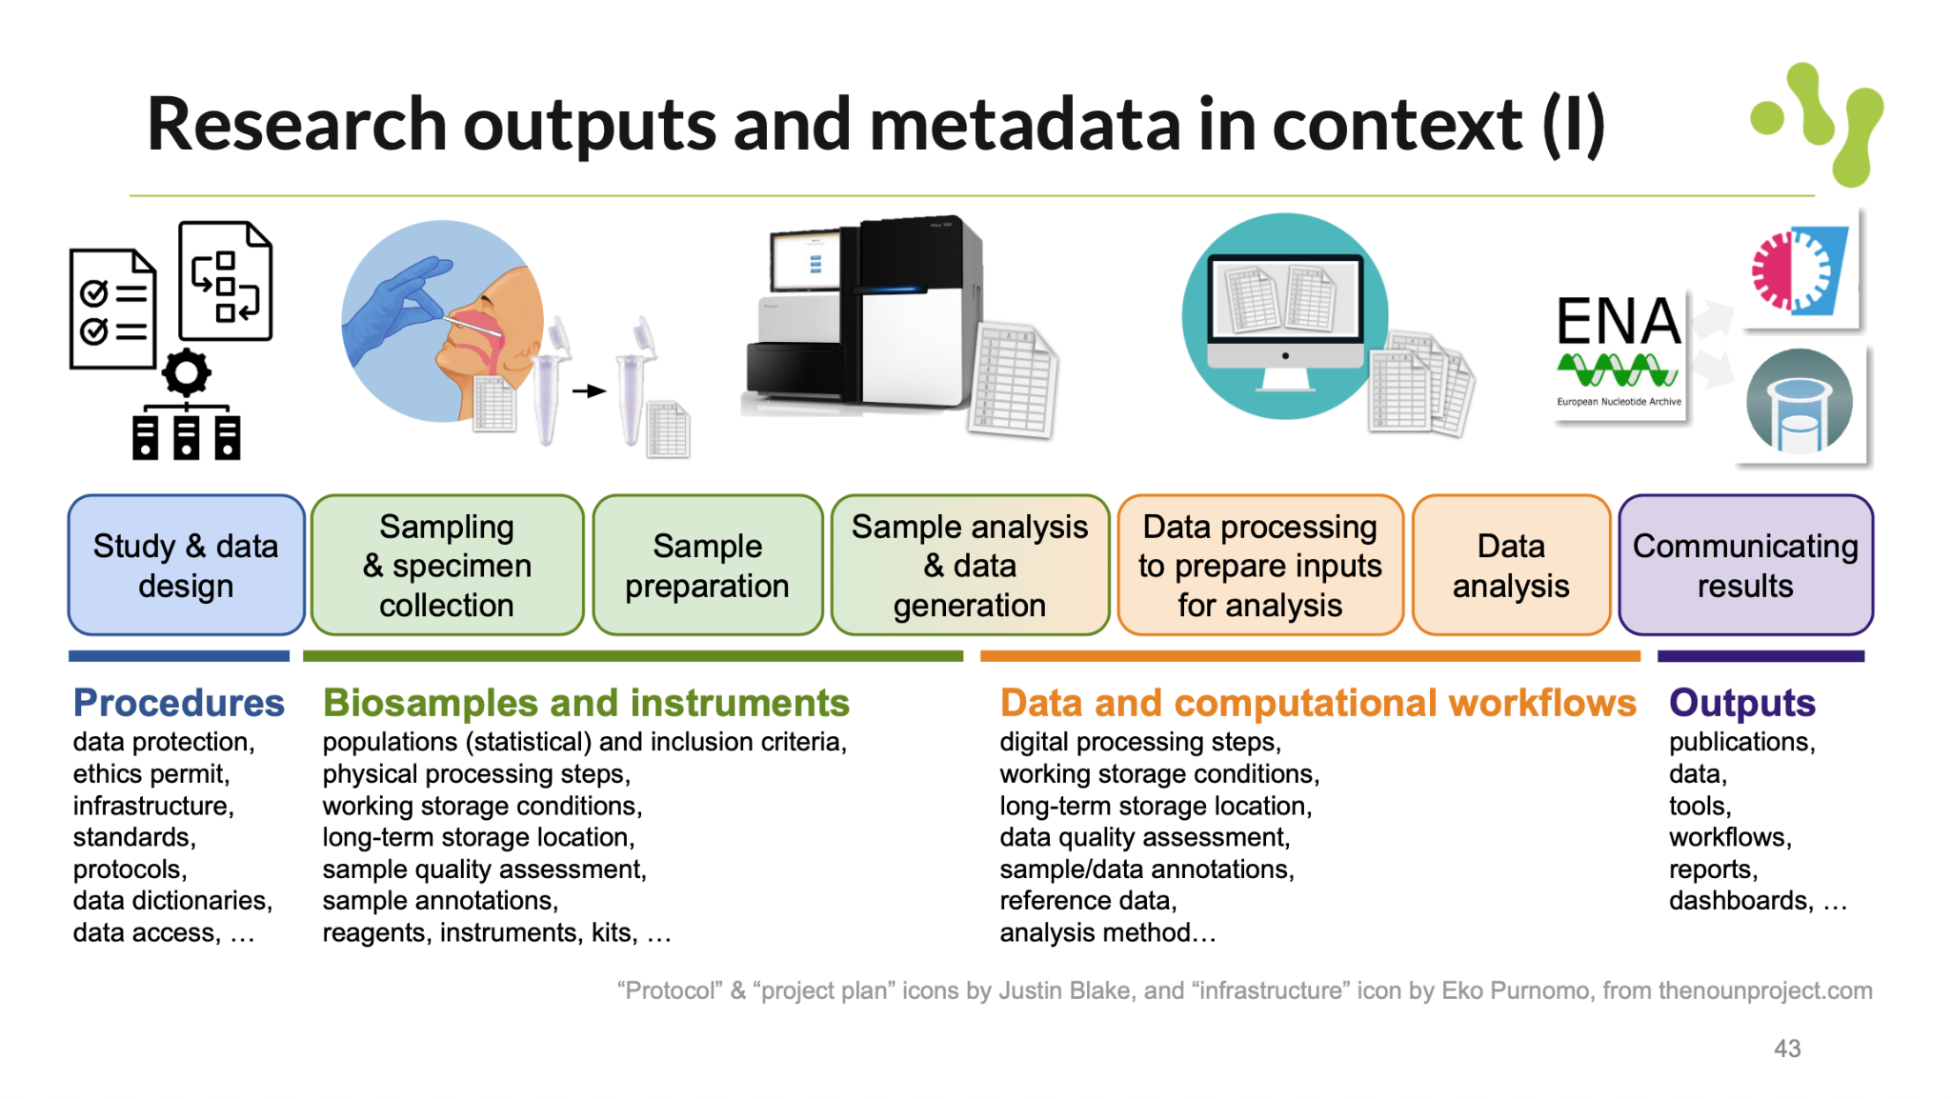
(Meta)data organisation

Slide 59
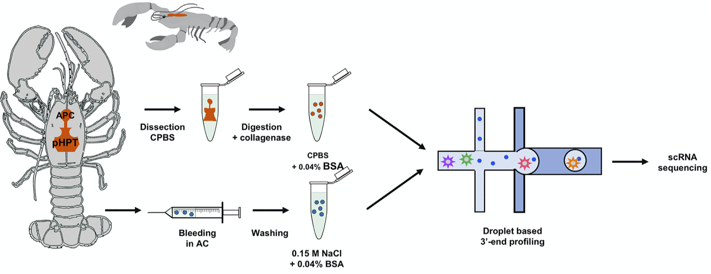
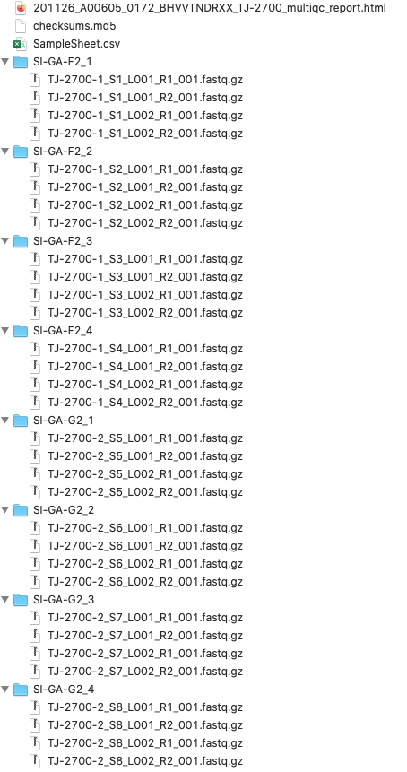
Sequencing example
“Protocol” icon by Justin Blake from thenounproject.com
Söderhäll, I., Fasterius, E., Ekblom, C., & Söderhäll, K. (2022). Characterization of hemocytes and hematopoietic cells of a freshwater crayfish based on single-cell transcriptome analysis. In iScience Vol. 25, Issue 8, p. 104850. Elsevier. https://doi.org/10.1016/j.isci.2022.104850
Sample information
Experiment information
File information
Sample collection protocol
Nucleic acid extraction protocol
Library construction protocol
Sequencing protocol

Slide 60
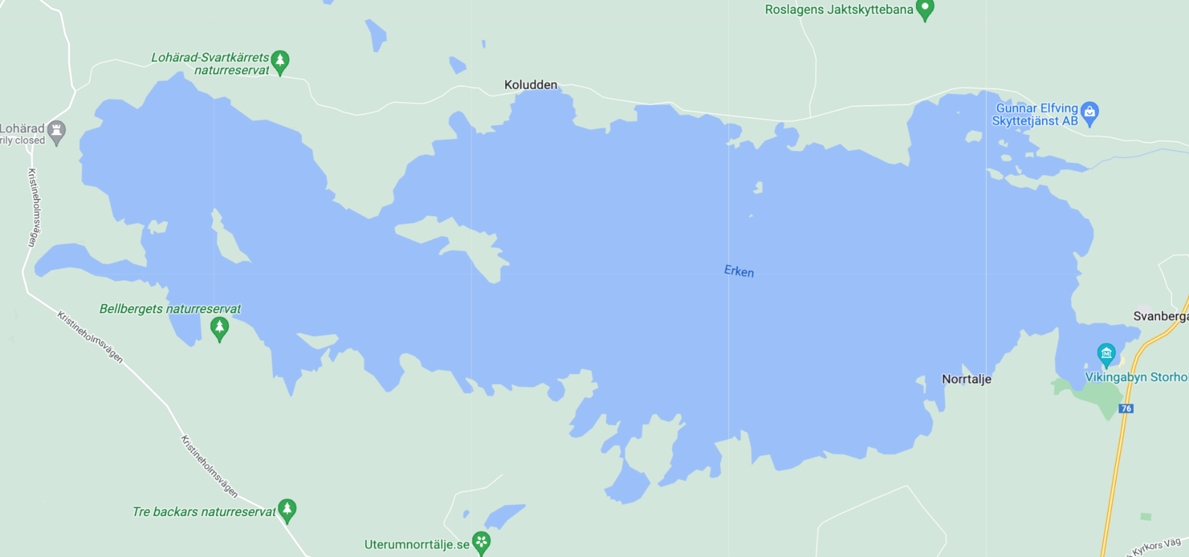
Sample collection protocols
Map data © Google. Crayfish derived from Illustration in Söderhäll et al. (2022).
Obtain freshwater crayfish (adult males) from lake Erken, Sweden (59.8 N 18.6 E)
Maintain in the crayfish facility in running tap water,10-12°C, 12:12 light:dark cycle…
Feed once a week
Map data © Google

Slide 61
Extraction protocol
Protocol illustration derived from Illustration in Söderhäll et al. (2022).
Dissect and digest into single cells by incubation in 300 μl of 0.1% collagenase … at room temperature for 20 min on a rotating plate … then filtered through a 40 mm cell strainer
Pool isolated cells from four animals for scRNA-seq

Slide 62

Sample information
ENA Checklist: ERC00001 – ENA default sample checklist
Population
Organism Pacifastacus leniusculus
Genotype wild type genotype
Geographical location Sweden, Lake Erken
Growth condition laboratory aquarium since Sep 2020
Sampling date 2020-11-06
Developmental stage adult
Body weight 35
Sex male
Organism part hematopoietic system
Cell type hemocyte
Individual
Specimen
Sample

Slide 63
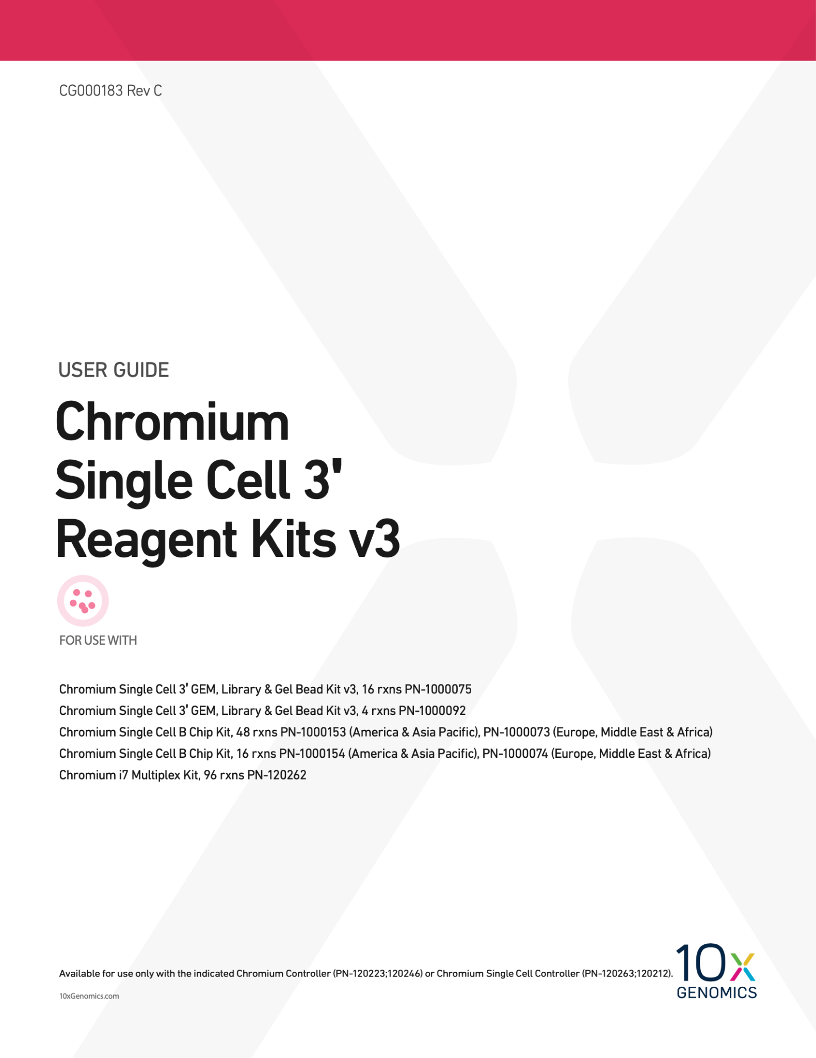
Library construction protocol
Protocol illustration derived from Illustration in Söderhäll et al. (2022).
Prepare sequencing libraries using Chromium Single Cell 3’ reagent kit v3 (cat# 1000075/1000073/120262, 10xGenomics)
According to the manufacturer’s protocol CG000183 Single Cell 3’ Reagent Kit User Guide, v3 chemistry, 10xGenomics

Slide 64
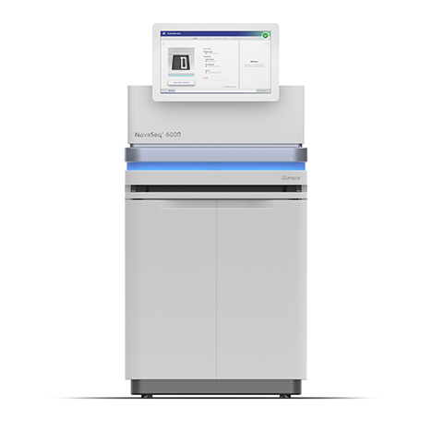

Sequencing protocol
28+8+0+91 bp read length
NovaSeq 6000 system
SP flowcell
v1 sequencing chemistry
Include a sequencing library for the phage PhiX as 1% spike-in in the sequencing run

Slide 65
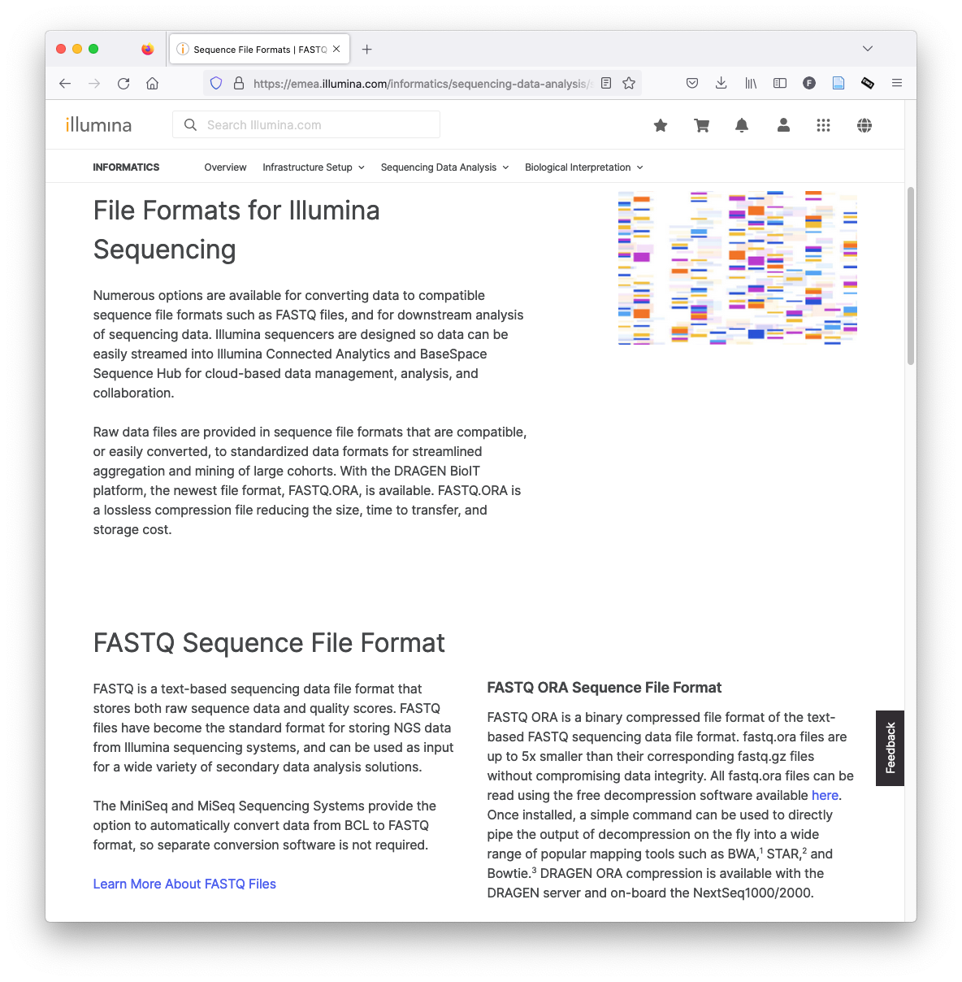
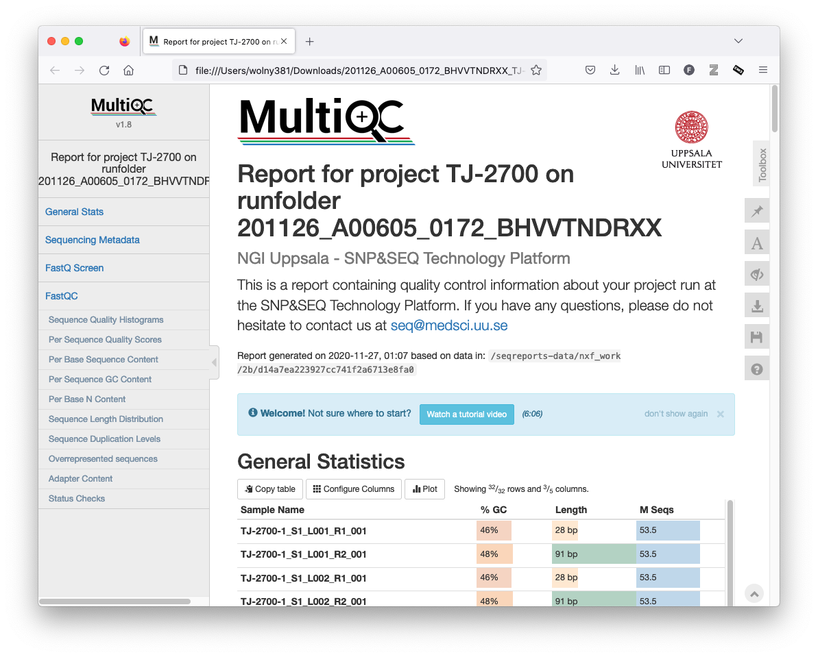
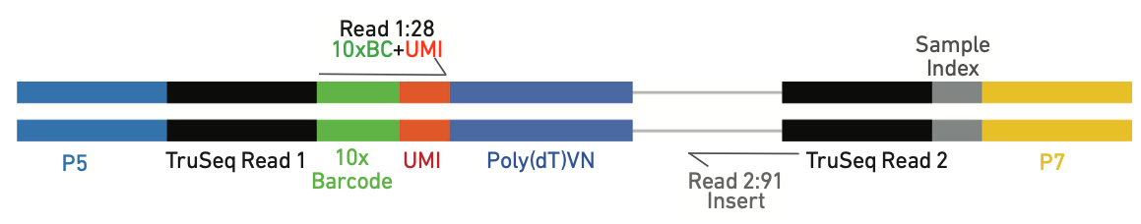
Files delivered by NGI

