Slide 1

Metadata
Introduction to Data Management Practices course
NBIS DM Team
data@nbis.se
https://nbisweden.github.io/module-metadata-dm-practices/index.html

Slide 2
What is the problem?
“Someone unfamiliar with your project should be able to look at your computer files and understand in detail what you did and why.”
“Your primary collaborator is yourself six months from now, and your past self don’t answer e-mails.”
Notes:
To understand how the data you produce has been generated, it is important to document descriptions of this, so that you, your collaborators, and someone else can understand it later on.
Actually, you yourself is the most likely recipient of this information, because “it is the doom of men that they forget”, as someone said.

Slide 3
Metadata
The data about the data (or anything really)
“One person’s metadata, is another person’s data”
Notes:
This - “the data about the data (or anything really)” - is what we call metadata.
However, it might not always be straightforward to draw a line between data and metadata. It depends on the particular research interest and focus of the person looking at the data and metadata.
“One person's metadata, is another person's data”

Slide 4
Metadata
Describe data at different levels
e.g. a whole study vs the samples
Examples
Creators
File types and formats of the data
Licence for re-use of the data
Methodology for data collection
Analytical and procedural information
Sources of samples
Sample treatment
Geolocation(s) of samples
Notes:
Some of this information might describe the particulars of a whole study. Some of it will describe detailed particulars of the different components of a study or experiment. Such as, for example:
See slide

Slide 5
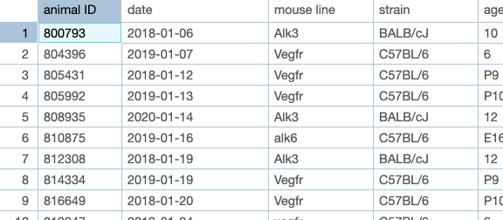
What problems do you see with the descriptions of these samples?
samples_metadata_lesson.csv
Notes:
If you have not done so already, create a folder on your computer for the course
Download the example datafile samples_metadata_lesson.csv, and save it the folder for the course on your computer.
This is a so called CSV (Comma Separated Values) file. A CSV file is a text file that contains tabular data, where the content for different columns is separated by commas (,) and often enclosed by quotes (‘ or “).
CSV files can be opened by text editor programs, as well as by spreadsheet programs such as e.g. Microsoft Excel, LibreOffice Calc, or Google Spreadsheet. Viewing the content of a CSV file will in many cases be easier in a spreadsheet program than in a text editor.
Open the samples_metadata_lesson.csv file in a program of choice.
The first line of the file contains the headers for the different columns. The rest of the lines contain information about a number of samples from a study.
Look at the content of the file and discuss with your neighbour
What are some of the problems you see with the descriptions of the samples?

Slide 6
Problems
Date formats
Different terms for the same information
Misspelled terms
Not clear what a data point means
Not clear what unit

Slide 7
Stringency
Descriptions must be understandable over time - not only for you
FAIR principles → also for computers
Consistency
Date formats
Units
Terms
Notes:
To be properly useful, the metadata should be understandable over time - for you and others.
And to follow the FAIR principles, others means computer programs as well as humans.
You also need to be consistent when describing metadata, e.g. do not mix different date formats, or use synonyms for the same phenomena.

Slide 8
How much metadata?
What is necessary for you to do your particular analysis
What is necessary for someone to understand the data
All the metadata you have
“How can I make this dataset as useful as possible for others?”
Notes:
How much metadata should you document? You can look at this at different levels.
The minimal level is the metadata necessary for you to do your particular analysis.
A further level is the metadata necessary for someone to understand the data.
Going further, documenting all the metadata you have might allow future analysis (by you or others) outside of the scope of your original study.
A good principle can be “how can I make this dataset as useful as possible for others?”.
We will discuss this more in the Metadata standards part of this lesson.

Slide 9
Terms
“A biologist would rather share a toothbrush with
another biologist than share a gene name”
Consistency and stringency
Controlled vocabularies
Ontologies
Thesauruses (Thesauri)
Taxonomies
Notes:
Someone once said “A biologist would rather share a toothbrush with another biologist than share a gene name”. This is probably true for other domains of research too.
If we all stick to our own devices and name things as we see fit without regarding our fellow researchers we run the risk of being inconsistent and unclear.
To help with consistency when describing our data, we can use standardized term collections -
Controlled vocabularies,
Ontologies,
Thesauruses, and
Taxonomies.
The names for these different types of collections are often used interchangeably.

Slide 10
How many terms for Breast Cancer can you think of?
Notes:
Discuss with your neighbour about what other terms you could use for “Breast Cancer”.

Slide 11
MeSH synonyms
Breast Neoplasm
Neoplasm, Breast
Breast Tumors
Breast Tumor
Tumor, Breast
Tumors, Breast
Neoplasms, Breast
Breast Cancer
Cancer, Breast
Mammary Cancer
Cancer, Mammary
Cancers, Mammary
Mammary Cancers
Malignant Neoplasm of Breast
Breast Malignant Neoplasm
Breast Malignant Neoplasms
Malignant Tumor of Breast
Breast Malignant Tumor
Breast Malignant Tumors
Cancer of Breast
Cancer of the Breast
Mammary Carcinoma, Human
Carcinoma, Human Mammary
Carcinomas, Human Mammary
Human Mammary Carcinomas
Mammary Carcinomas, Human
Human Mammary Carcinoma
Mammary Neoplasms, Human
Human Mammary Neoplasm
Human Mammary Neoplasms
Neoplasm, Human Mammary
Neoplasms, Human Mammary
Mammary Neoplasm, Human
Breast Carcinoma
Breast Carcinomas
Carcinoma, Breast
Carcinomas, Breast
Notes:
MeSH (Medical Subject Headings) lists the following synonyms for “Breast Neoplasm”

Slide 12
Controlled vocabulary
List of terms to describe some domain of knowledge
Only one term per phenomenon
Term definition
List synonyms
Each term has a unique identifier
Medical Subject Headings - MeSH
Breast Neoplasms
Definition: Tumors or cancer of the human BREAST
Synonyms: Breast Tumors, Breast Tumor, Breast Cancer, …
MeSH Unique ID: D001943
Notes:
A Controlled vocabulary is a list of terms that describes a certain domain of knowledge.
In the controlled vocabulary you only use one term to describe one particular phenomenon, excluding all other synonyms.
The vocabulary should provide a definition for the term, and any synonyms.
In a publicly managed controlled vocabulary, the terms should also have unique identifiers, so that they can be referenced.
Go through the example of the MeSH entry for Breast Neoplasms

Slide 13
Ontology
A controlled vocabulary
Captures term relationships, e.g.
is a
part of
contained in
produced by
Hierarchy / Tree
A term can be present at several places in the hierarchy
Notes:
An ontology (in this context) is a controlled vocabulary, that apart from being a list of agreed terms, also captures relationships between these terms.
Some common examples of relationships are: is a, part of, contained in, produced by.
Terms are organised in hierarchies / trees.
Note that a term can be in several places in the hierarchy.
A couple of examples: next slide

Slide 14
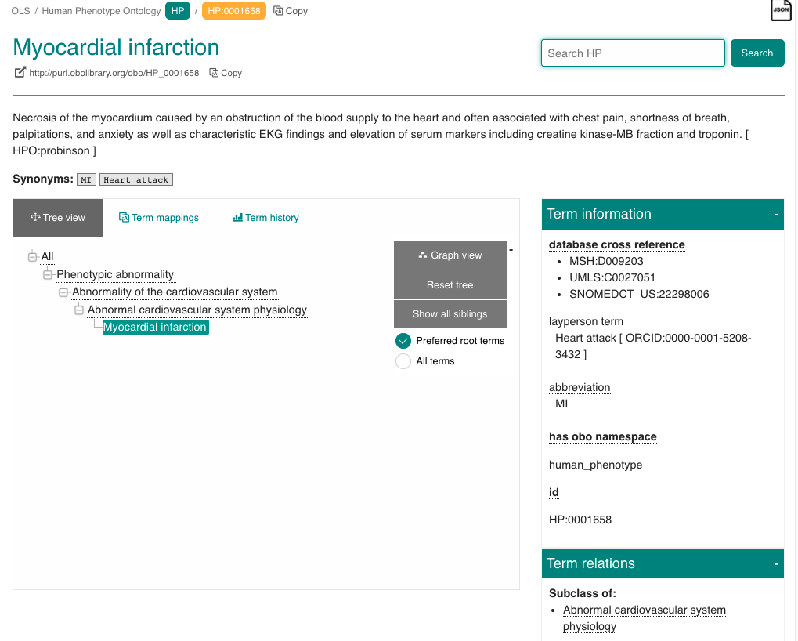
Human Phenotype Ontology
Notes:
In the Human Phenotype Ontology,
Looking at the term Myocardial infarction, we can see that it is a type of Abnormal cardiovascular system physiology is a type of Abnormality of the cardiovascular system is a type of Phenotypic abnormality.
We can also see the definition, synonyms, id. It also has cross references to corresponding terms in other ontologies

Slide 15
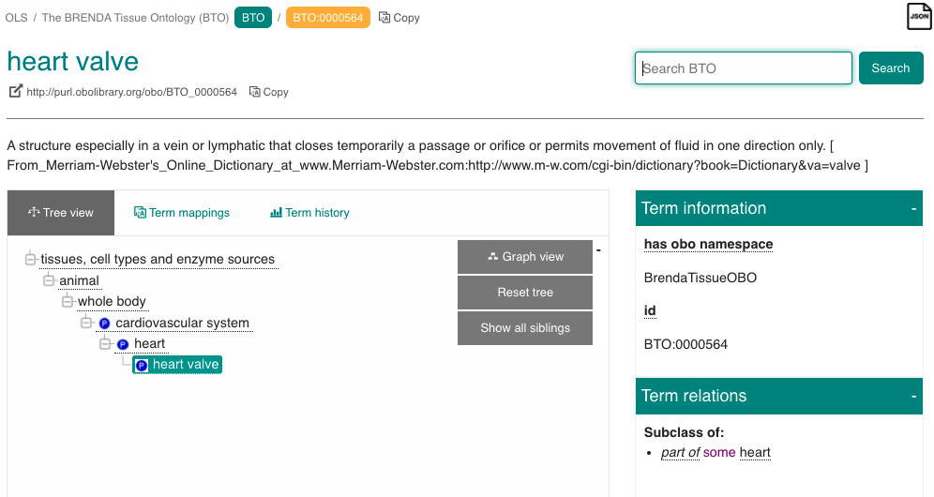
Brenda Tissue Ontology
Notes:
in the BRENDA Tissue Ontology, the heart valve is a part of the heart is a part of the cardiovascular system is a part of the whole body

Slide 16
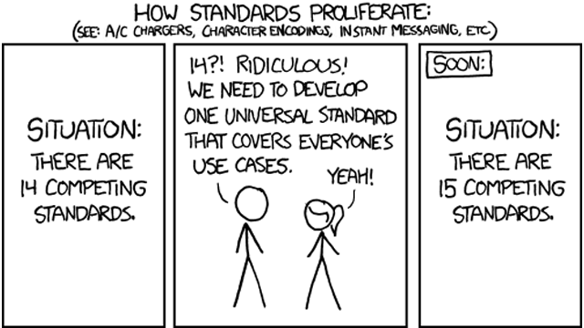
A universal standard
Notes:
As you see, depending on the way you look at reality, the domains of knowledge have to be structured in several different ways.
There is no all-encompassing ontology that captures everything.
You will have to rely on several different ontologies to describe your research. The question is which ontologies to choose.

Slide 17
Making your own?
At what point does it make sense to use something that exists?
Number of terms
Nature of terms
Relationships of terms
Terms management
Definitions
FAIRness
Unique identifiers
Home brew vocabularies makes it harder to achieve machine readability
Notes:
You can decide to make your own controlled vocabularies.
It might seem like less work than finding good ones that already exist.
In the long run, you are better off using publicly managed vocabularies and lists, as much of the thinking about describing different domains has already been done.
Another important aspects is that it will support the machine-readability aspect of FAIR. With unique identifiers for terms that describes your data (and their relationships), it can be possible for computer code to generate knowledge descriptions from data.

Slide 18
Metadata standards
Collections of metadata elements of relevance for a particular purpose
Elements
Mandatory, Recommended, or Optional
Defined input value type
Free text, data, geographical position, numerical values, ontology terms
Can itself be an ontology term
Stricter → potentially increased FAIRness
Generic to Specific
Notes:
A metadata standard could be described as a collection of metadata fields or elements that are of relevance for the particular type of scientific study data that is to be documented.
Such standards will often consist of some elements that are mandatory, some recommended, and some that are optional.
They will (at least should) define what type of input values are expected for each element, e.g.
free text,
date in a specific format,
geographical positions,
numerical values, and
controlled vocabularies or ontologies.
Sometimes the element name itself is a specified ontology term. The further we go on being strict about defining the elements and values the more we open up for increasing the FAIRness aspects of the data from a computational point of view.
Standards range from the very generic to the very specific. Let’s have a look at a couple of examples: Next slide

Slide 19
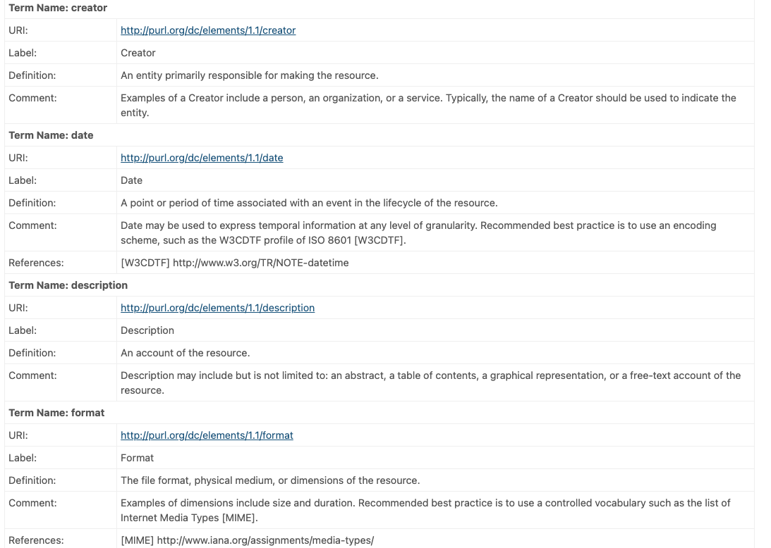
Generic - Dublin Core
Describing digital and physical resources
15 elements
https://www.dublincore.org/specifications/dublin-core/dces/
Notes:
[Option to go to the page on the web]
The Dublin Core is a generic standard for describing digital and physical resources. In its basic form it specifies 15 elements, such as Creator, Title, Description, Date, etc.
[Show the different elements and value types]

Slide 20
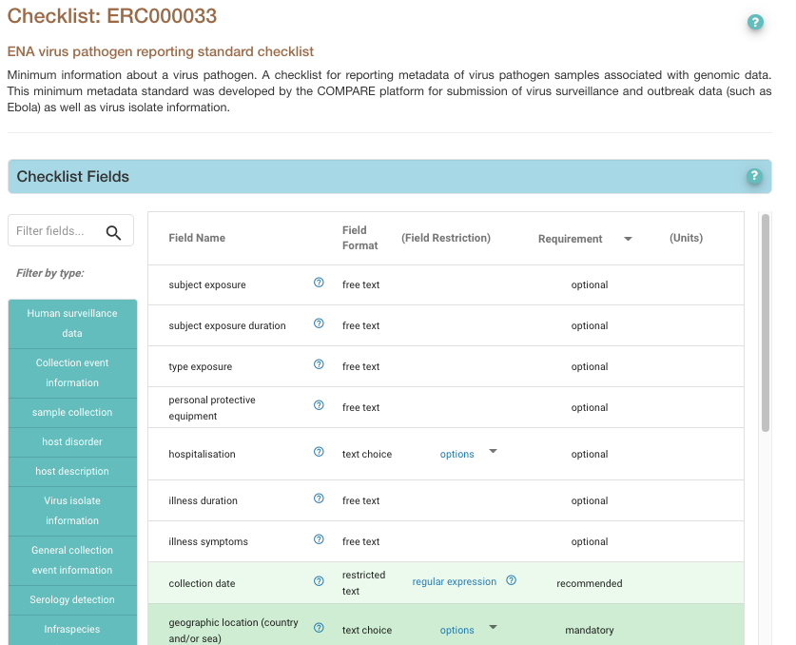
Specific - an ENA checklist
ENA virus pathogen reporting standard checklist
Reporting metadata of virus pathogen samples associated with genomic data
35 elements - 9 mandatory and 15 recommended
https://www.ebi.ac.uk/ena/browser/view/ERC000033
Notes:
[Option to go to the page on the web]
An example of a more specific standard is the ENA virus pathogen reporting standard checklist, for reporting metadata of virus pathogen samples associated with genomic data to the European Nucleotide Archive.
It has 35 elements, of which 9 are mandatory and 15 recommended.
Example of elements are geographic location, host scientific name, host health state, collection date, etc.
[Show the different elements and value types. Point out that value types are often very free]

Slide 21
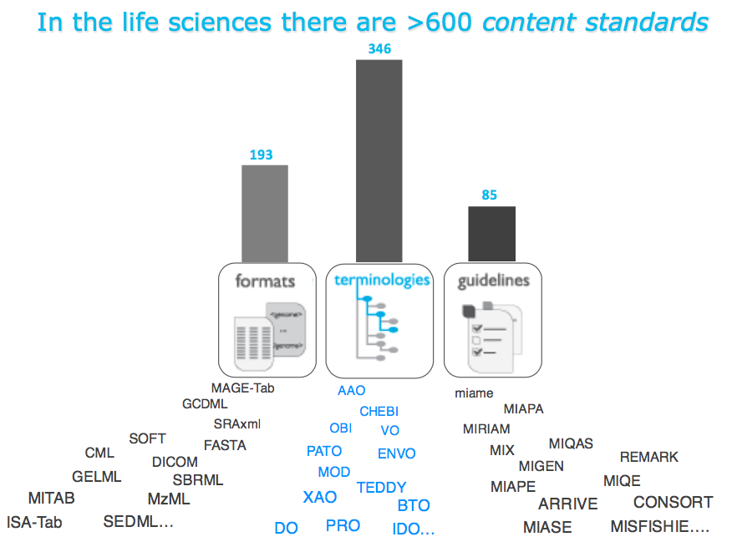
How do I know what to use?
Notes:
Given that reality is hard to categorise, and that different types of research investigate their subject matter from various different angles, there has emerged numerous different ontologies and metadata standards.
In Life Science alone there are currently more than hundreds of standards. So how do I know what to use? -> Next slide (episode)

Slide 22
Data dictionary
Your own metadata standard
Document what type of information is supposed to be entered for the metadata fields
Name, units, allowed values, definitions, ...
Notes:
It is good practice to make a data dictionary for your metadata.
This is a file that explains what type of information is supposed to be entered for at particular (meta)data field.
This is where you document names of (meta)data fields, expected measurement units, allowed values, and definitions for what the field is about.

Slide 23
Exercise:
Start a data dictionary
Notes:
The file samples_metadata_lesson.csv contains information about a set of samples for a research project. In this exercise you will start writing a data dictionary for this file.

Slide 24
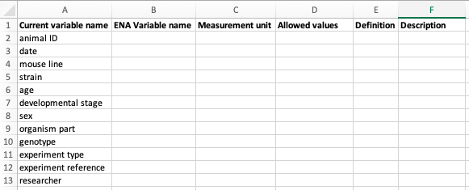
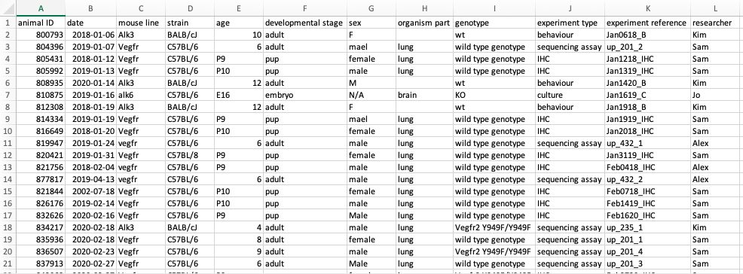
Start a Data dictionary
Open samples_metadata_lesson.csv
Create a new data_dictionary file
Add headings to data_dictionary
Current variable name
ENA variable name
Measurement unit
Allowed values
Definition
Description
3.
data_dictionary
4.
Copy headings from samples_metadata_lesson.csv to rows in data_dictionary
Add some definitions
Add some units
samples_metadata_lesson.csv
Notes:
Open the FILE that you downloaded in the beginning of the lesson, in a spreadsheet program of you choice
Open another empty spreadsheet file, name it data_dictionary.
Add the following headings to the data_dictionary file: Current variable name, ENA Variable name, Measurement unit, Allowed values, Definition, Description
If you wonder about the ENA Variable name column, it will be used in the next excersise
Copy the headings of the FILE file to the first column (Current variable name) of the data_dictionary file, one heading term per row.
Now you should have a first row with the headings under step 3, and then one term (from the FILE file headings) per row in the first column.
Try adding definitions (to the Definition column) for some of the terms.
Are there any terms where you can specify information in the Measurement unit?

Slide 25
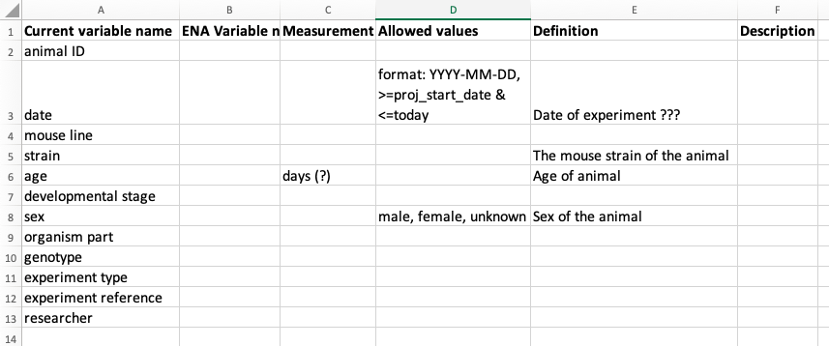
Data dictionary - start
Notes:
The beginning of the data dictionary could now look something like this

Slide 26
Plan ahead
Use standards of deposition databases were you plan to publish your data
Helps with selecting elements
Makes data submission much easier
Notes:
If you plan to deposit your data in a public repository (and you should) this is the first place to look for standards.
They will have instructions for what metadata information they request for the data that they harbour.
If you try to structure your own metadata according to these from the start, submitting your data will be a lot more straightforward.

Slide 27
Exercise:
Look up an ENA checklist to improve the data dictionary
Notes:
In this exercise we are assuming that you are planning to submit data about your samples to the European Nucleotide Archive - ENA.
The ENA has set of suggested metadata standards for different types of samples that they call checklists.

Slide 28
Improve data dictionary
Go to https://www.ebi.ac.uk/ena/browser/checklists to see the available checklists
Scroll down the listing until you find the ERC000011 ENA default sample checklist
Go through the data dictionary and find suitable field names in the ENA default sample checklist for those fields. Add them to the ENA Variable name column of your data dictionary file.
Notes:
Go to https://www.ebi.ac.uk/ena/browser/checklists to see the available checklists
Scroll down the listing until you find the ERC000011 ENA default sample checklist
The ENA default sample checklist lists the expected name and content for a number of metadata fields that can be submitted for samples. If you put your mouse pointer over the ? icon, you will get a description about of what type of information the different fields are supposed to contain.
Open the data dictionary file that you started in the previous exercise.
Go through the data dictionary and find suitable field names in the ENA default sample checklist for those fields. Add them to the ENA Variable name column of your data dictionary file.

Slide 29
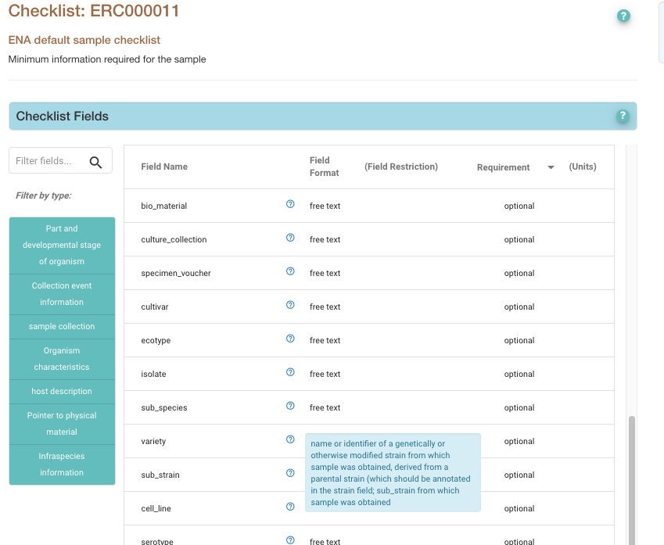
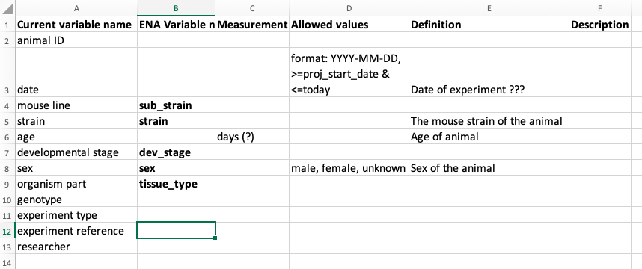
Improve data dictionary
Notes:
The data dictionary could now look something like this

Slide 30
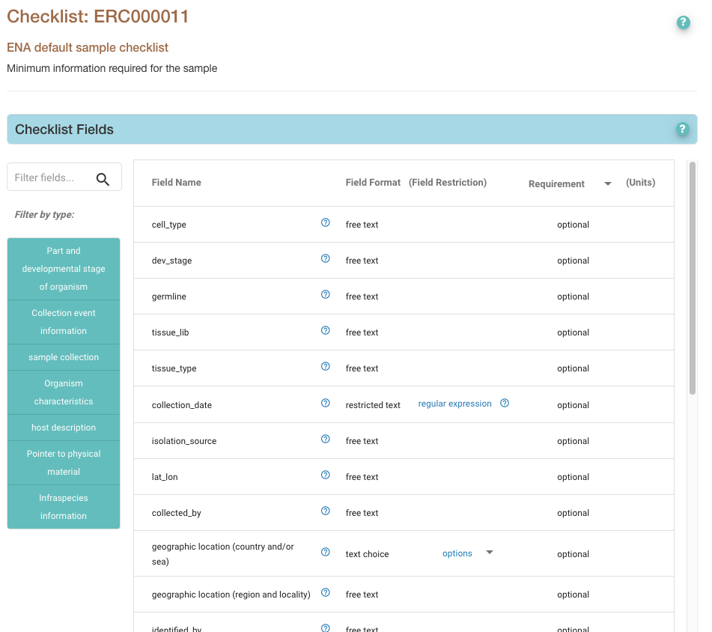
Finding ontologies
This standard is very liberal when it comes the allowed values for the different fields
We can do better!
Use ontology terms
Improves FAIRness
But which ontologies…?
Notes:
As you noticed in the previous excercise, the ENA checklist did not specify any particular standard to use when assigning values to the different fields.
However, if you can be more specific regarding how you describe the different metadata aspects for your data it will increase the FAIRness of your data.
For this you should use controlled vocabularies or ontologies.
As we have said earlier, there are hundreds of metadata standards, controlled vocabularies and ontologies in the Life Sciences alone. So how do you find the ones that are appropriate for your data? Fortunately, there are tools and resources to help you with this.
→ Next slide

Slide 31



Finding ontologies
Tools
FAIRsharing.org
EBI Ontology Tooling page
Zooma - map free text to ontology terms
Ontology Lookup Service - OLS
Not an exact science… There is no perfect way...
Sometimes hard
Trial and error
Notes:
A few useful examples:
FAIRsharing.org is a resource that aims at collecting and connecting existing standards, databases. Use it to find recommended standards for different research domains and databases.
The European Bioinformatics Institute (EMBL-EBI) makes availble a set of resources for ontologies, e.g.:
Zooma
OLS
Let’s have a look at these
→ Next slide

Slide 32
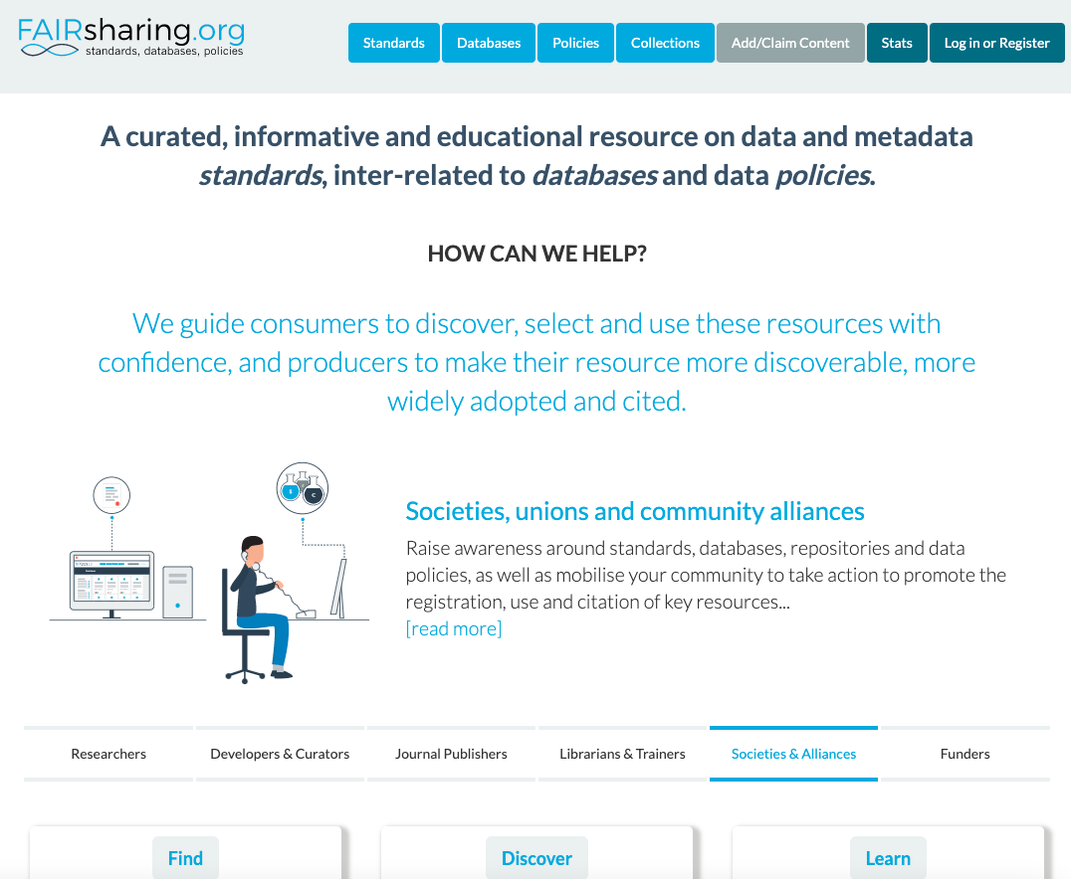
FAIRsharing.org
Notes:
NB! Practice the demo
FAIRsharing.org is a resource to find standards, databases and data policies
Click the search field
Type mouse and hit return
Show list of results
Type, subject, domain, …
Point out that it’s not only ontologies, but e.g. databases as well
Click on MousePATHology as an example.
Show that there is a lot of info for this standard
Point out the Ontology display (on the right)
Click View in OBO Foundry
Point out different ways of viewing - select OLS

Slide 33
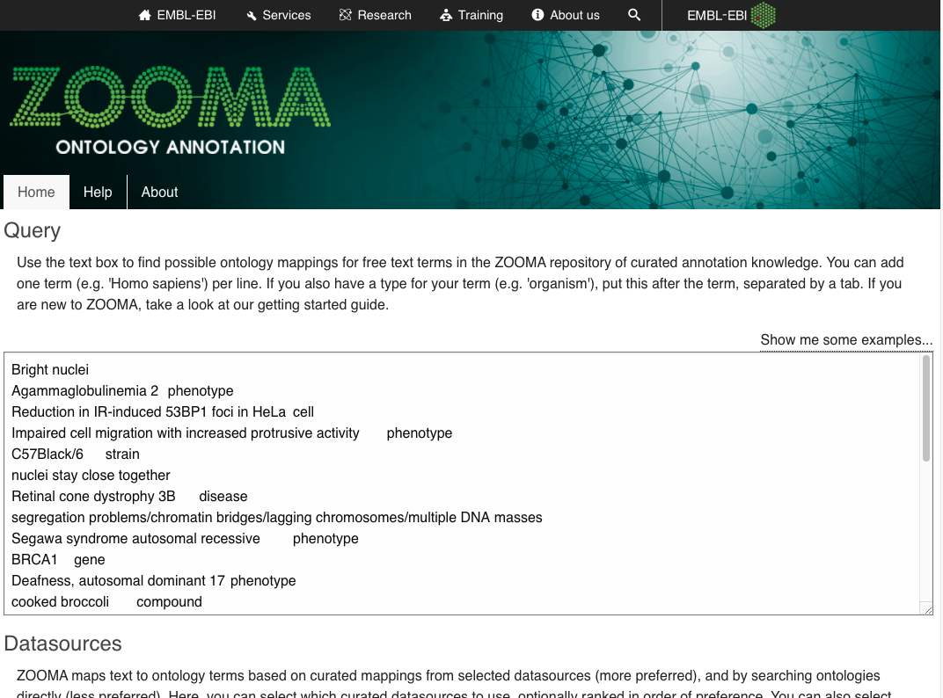
Zooma
Notes:
Zooma is a tool that maps free text to ontology terms
Demo:
Go to Zooma
Click show me some examples
Point out that you can add a term and a type
Separated by tab - note that you cannot type a tab in the browser window. Text has to be written elsewhere and copy-pasted for this to work…
Show that you can limit sources to look in
Click annotate
Show the result
Term, Confidence, source, and ontology ID (but there is no link…)

Slide 34
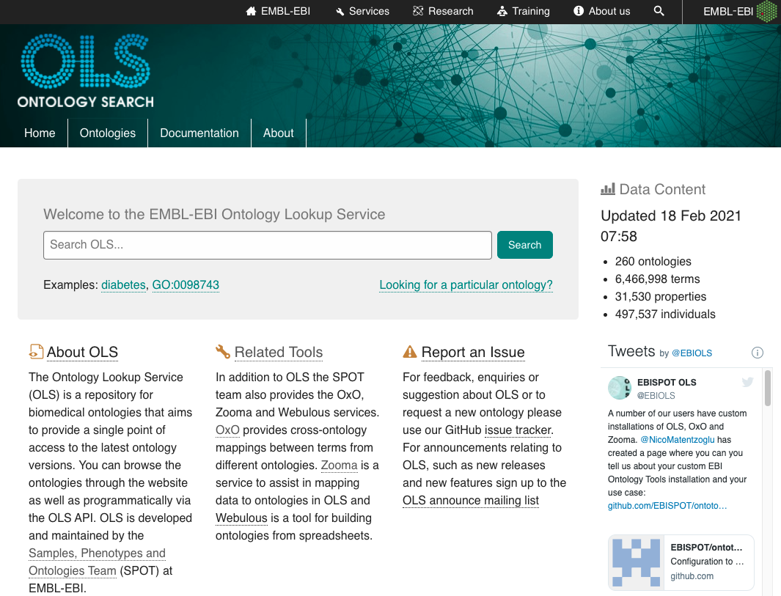
OLS
Notes:
OLS is a resource for browsing and searching ontologies
Demo:
Go to OLS
Enter diabetes in search field
Note that suggestions pop up
Hit return
Show result list
Filtering option
Different results

Slide 35
Exercise:
Find suitable ontologies for your data
Notes:
→ Next slide

Slide 36
Finding ontologies and terms
Try finding and deciding on suitable ontologies and terms to use for the data file
strain, using OLS
dev_stage, using Zooma
tissue_type, using FAIRsharing.org
Notes:
NB! Practice the repeat run-through of the exercise
To be more specific about the terms used for some of the fields, try to find a suitable ontology and the terms to use for the values that will be in your data file (samples_metadata_lesson.csv), for these fields:
strain, using OLS
dev_stage, using Zooma
tissue_type, using FAIRsharing.org
Add the name of the ontology and the terms you have selected to the data dictionary.
You don’t have to stick to the tools specified. Try the different ones if you want to. As you will probably notice, there is no perfect way that always finds what you want. It will almost always involve a fair bit of trial and error.
Afterwards go through the different lookups
For each field you will have to look into the data file to see what values are there now.
Then try to find an ontology and the appropriate terms in that ontology
Add the name of the ontology and the terms you have choosen to the allowed values columns
strain
Go to OLS, search for one of the strain names in the FILE, e.g. BALB/cJ
Choose one of the search results that seems appropriate, e.g. from the NCI Thesaurus OBO Edition - NCIT
The term for this mouse strain in NCIT is BALB/cJ Mouse
Click on the Show siblings button in the ontology tree, on the left
This will show all other mouse strains defined in this ontology.
Look for C56BL/6. The term for this mouse strain in NCIT is C56BL/6 Mouse
So NCIT would be a suitable ontology, and C56BL/6 Mouse (NCIT:C14424),BALB/cJ Mouse (NCIT:C14657) the terms to use for the strains used.
dev_stage
Go to Zooma, and search for pup
In the result listing look at the ontologies that it suggests. The one going to the BRENDA Tissue Ontology - BTO, seems relevant. Click on to the page for the term.
Look at the siblings to the term pup in the tree view.
There are also terms for adult and embryo (where is it?).
So BTO would be a suitable ontology, and pup (BTO:0004377), adult (BTO:0001043), and embryo (BTO:0000379) the terms to use for the developmental stages.
tissue_type
Go to FAIRsharing.org
Go to “Standards”
Search for “tissue”
Find a suitable ontology, e.g. Mouse Adult Gross Anatomy Ontology - MA, and go to the information page
Look at the “MA Ontology Display”. Click View in BioPortal.
Select the classes tab. Look through the tree of terms, or search for a term in the “Jump to” field.
So MA would be a suitable ontology, and lung (MA:0000415) and brain (MA:0000168) terms that can be used for the tissue_type.

Slide 37
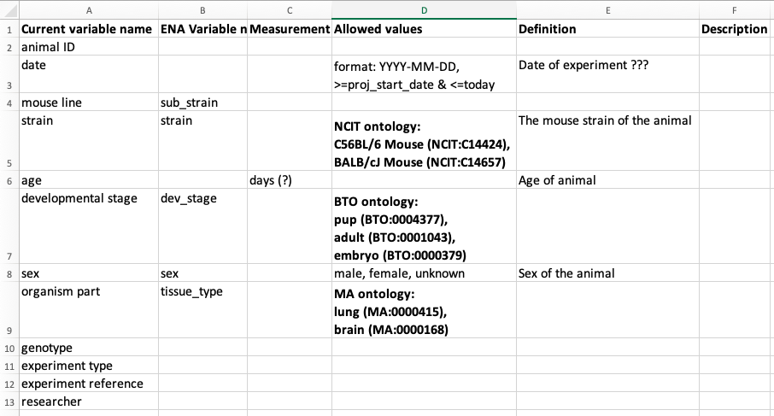
Update data dictionary
Notes:
The data dictionary could now look something like this:

Slide 38
Summary
Information about data is called metadata
Good metadata is a necessity for understanding the data - FAIRness
Try to be consistent when describing data
Use controlled vocabularies and ontologies when specifying metadata
Metadata standards - generic and domain specific
Use data dictionaries to document standards for your data
There are tools to help you decide on ontologies and terms to use
Notes:
See slide

