Slide 1

Open Science & FAIR
Introduction to Data Management Practices course
NBIS DM Team
data-management@scilifelab.se
https://nbisweden.github.io/module-open-science-dm-practices/index.html
Notes:
Start with an icebreaker to reflect on the principles of Open Science
Continue with reflections on the FAIR data principles
And conclude with a picture of the carrot and stick for implementing this

Slide 2
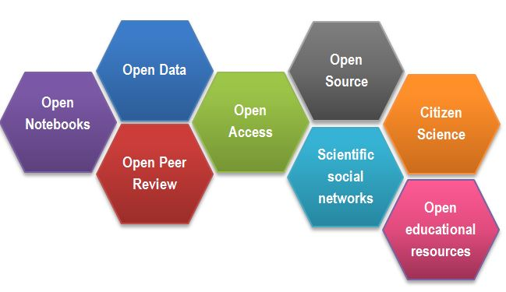
Open Science
Make scientific research and its dissemination accessible to all levels of society.
Open methodology
Open source
Open data
Open access
Open peer review
Open educational resources
“Open Science facets as a beehive” by Gema Bueno de la Fuente licenced under CC-BY
Notes:
By Open Science we mean the movement to make scientific research and its dissemination accessible to all levels of society. Principles of open science are:
Open methodology
Open source
Open data
Open access
Open peer review
Open educational resources
Of these, Open data and Open source are some of the main drivers for good Data Management practices.

Slide 3
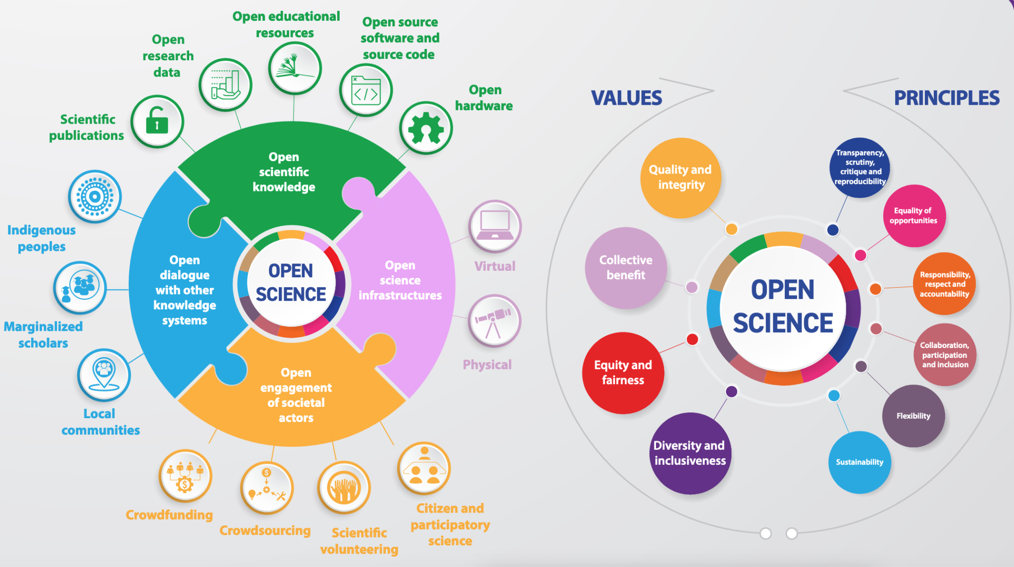
UNESCO Open Science Recommendation & Toolkit
Illustration from UNESCO open science toolkit: contents under a Creative Commons Attribution Share-Alike 3.0 License
Notes:
From https://unesdoc.unesco.org/ark:/48223/pf0000387983

Slide 4
What do you think are reasons for Open Data?
Notes:
What do you think are reasons for Open Data? Discuss with your neighbours.

Slide 5
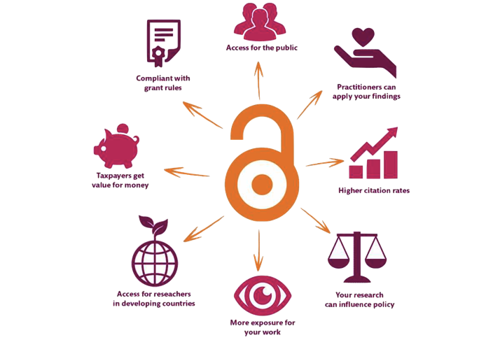
Open Data
Democracy and transparency
Publicly funded research data should be accessible to all
Published results and conclusions should be possible to check by others
Research
Enables others to combine data, address new questions, and develop new analytical methods
Reduce duplication and waste
Innovation and utilization outside research
Public authorities, companies, and private persons outside research can make use of the data
Citation
Citation of data will be a merit for the researcher that produced it
Picture source: Karolinska institute library
Notes:
See slide

Slide 6
Ethical?
Doing “sloppy” science & not being open and transparent
Waste of resources
Contributing to the current research credibility crisis
Contributing to the current reproducibility crisis
Harming the profession
Harming public trust in research
My take of material by Rochelle Tractenberg “Unexpected Ethical Challenges in Bioinformatics and Genomics.”
Notes:
It can be argued that not being transparent about the data and methods that are used to reach the scientific conclusions that you publish, is not ethical.
It can be considered to be a waste of resources, potentially harming the profession, public trust in research, and contributing to the current research credibility/reproducibility crisis.

Slide 7
Crisis?
Do you think we have a credibility and/or reproducibility crisis?
If so, what are some of its causes?
Notes:
Let learners discuss for 5 minutes
Some causes:
Credibility
Research fraud has been exposed
The scientific process is not understood
…
Reproducibility
Methods unclear
Software not available
Data not available
Researchers don’t get academic credit for being transparent
You can build a CV faster when being sloppy(?)
…

Slide 8
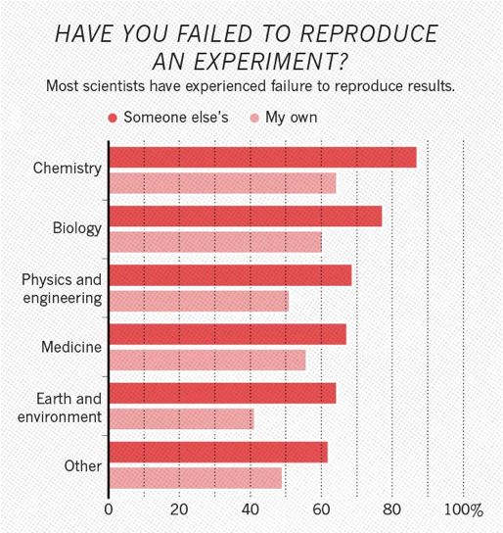
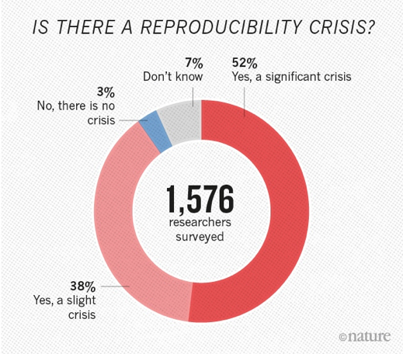
A reproducibility crisis
[1] "1,500 scientists lift the lid on reproducibility". Nature. 533: 452–454
[2] Begley, C. G.; Ellis, L. M. (2012). "Drug development: Raise standards for preclinical cancer research". Nature. 483 (7391): 531–533.
Notes:
When surveyed, the research community to a large extent seem to agree to that there is a reproducibility crisis.

Slide 9
A reproducibility crisis
Reproduction of data analyses in 18 articles on microarray-based gene expression profiling published in Nature Genetics in 2005–2006:
Can reproduce…
…in principle
Software not available
…with some discrepancies
Cannot reproduce
Data not available
…from processed data with some discrepancies
Methods unclear
Different results
…partially with some discrepencies
Summary of the efforts to replicate the published analyses.
Adopted from: Ioannidis et al. Repeatability of published microarray gene expression analyses.
Nature Genetics 41 (2009) doi:10.1038/ng.295
Notes:
Many studies have been done on Reproducibility of published research, and regardless of scientific domain, it seems that more or less half of the publications looked at are not possible to reproduce.
A large part of those are because the underlying data is not available or not understandable. Often it is also not possible to understand how the analyses were done.

Slide 10
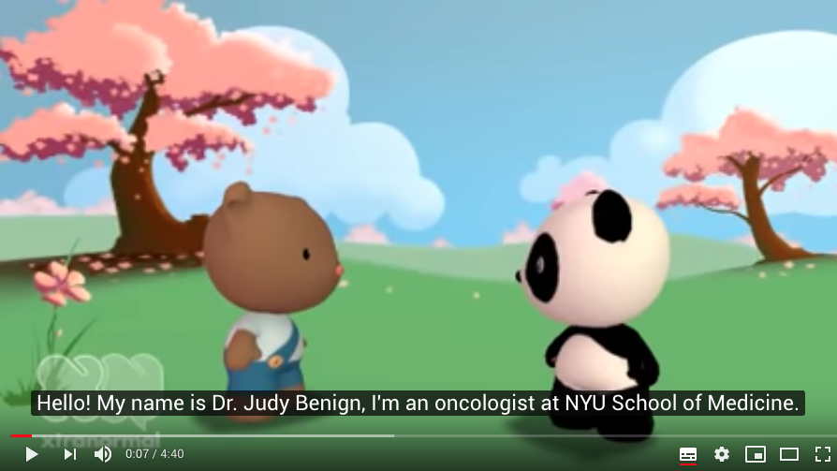
Data Management Snafu
https://www.youtube.com/watch?v=N2zK3sAtr-4

Slide 11
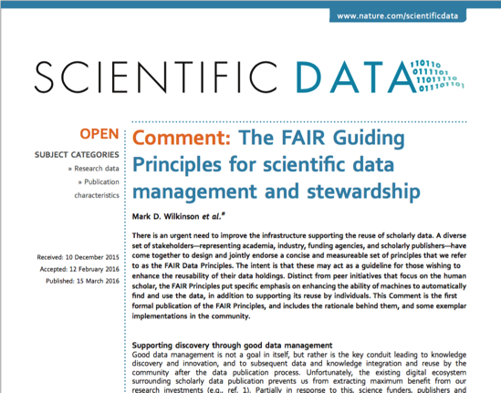
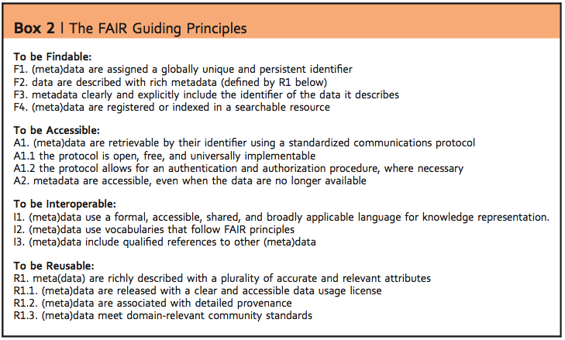
FAIR
To be useful for others data should be:
FAIR - Findable, Accessible, Interoperable, and Reusable … for both Machines and Humans
Wilkinson, Mark et al. “The FAIR Guiding Principles for scientific data management and stewardship”. Scientific Data 3, Article number: 160018 (2016) http://dx.doi.org/10.1038/sdata.2016.18
^{DOI: 10.1038/sdata.2016.18}
Notes:
To try to guide the scientific community on how to ensure that the research data is useful for others in the digital age, the FAIR principles were published in 2016.
“To be useful for others data should be FAIR - Findable, Accessible, Interoperable, and Reusable … for both Machines and Humans”
So what this mean?

Slide 12
Findable
Data have a globally unique persistent identifier
e.g. a DOI, database accession number, etc
Data are described by metadata
Information that explains the data
Data and metadata are findable in a search resource
There must be ways of searching for the data
Data publication
Metadata
Data organisation
READMEs
Cleaning metadata
Version control
DMPs
Notes:
See slide

Slide 13
Accessible
Data is retrievable through a standardised communication protocol (open, free, allowing authentication & authorisation where necessary)
e.g. http, sftp, etc
Metadata are accessible, even if data is no longer available
Information about the data can be found even if data is no longer available
Data publication
Metadata
Notes:
See slide

Slide 14
Interoperable
Metadata use a formal, accessible, shared language for knowledge representation
Metadata is available in a form that even a computer can make use of
Metadata use vocabularies that follow the FAIR principles
Standardised ways of capturing information about the data (that are in themselves FAIR)
Metadata include qualified references to other metadata
If the data relies on other data, there must be links to those
Metadata
DMPs
Notes:
See slide

Slide 15
Reusable
Data have a clear data usage license
It is obvious under what conditions the data can be reused
Metadata are associated with detailed provenance
The metadata is detailed enough to understand for what research questions it is relevant to reuse
Metadata meet domain-relevant community standards
Metadata is described according to existing standards in the research field
Data publication
Metadata
Data organisation
READMEs
Cleaning metadata
Version control
DMPs
Notes:
See slide

Slide 16
FAIR
Both humans and machines are intended users of data
The principles are not necessarily about open data
“As open as possible, as closed as necessary”
FAIRness is not something absolute
Different levels of FAIR maturity
FAIR does not enforce any particular technical standards
Notes:
A couple of things to note about FAIR: See slide

Slide 17
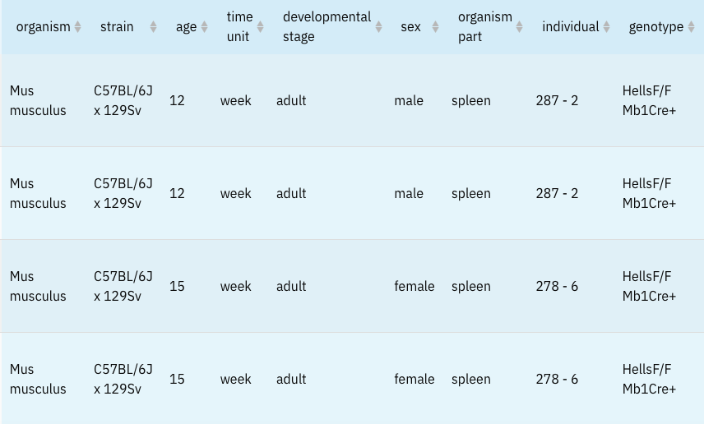
Metadata?
The data about the data (or anything really)
Example: Spleen samples from mice

Slide 18
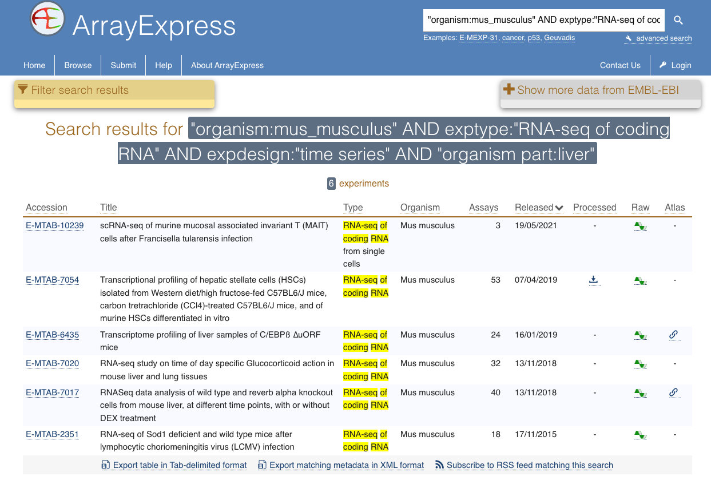
Simple FAIR data example
Picture source: ArrayExpress @ EMBL-EBI
Notes:
FAIRified data allows searching for very explicit datasets. This example search will only retrieve RNA-sequencing experiments from liver tissue from the common house mouse with a time series design. Using the specific and controlled fields and terms used to describe the data makes it possible to be this specific. To find such data without these precise descriptions would make it very difficult to find. You would have to guess what terms the dataset creators might have used, and will probably have to go through a lot of irrelevant datasets.

Slide 19

When to be FAIR?
FAIR at source?
Research happens...
Retroactively?
© rassco
Notes:
This is all quite a mouthful, and a different angle on what is considered to be part of the scientific process for most researchers.
So what is a poor researcher to do?
If I as a researcher am to do this - Which is easier,
to use practices that supports the FAIR principles from the start of a project (“FAIR at source“),
or after it is done, when someone asks for it, retroactively?

Slide 20
Good Data Management Practices
Data Management Plans, to do your thinking ahead of time
Using standard metadata descriptions, to clearly define your data
Organising your outputs, so you and others can understand what you have done
Use versioning control to keep track of changes you do
Clean up metadata and data to be consistent with the standards you have chosen
Submit your data to international public repositories, so others can find and reuse your data
Notes:
The first thing is to start thinking about, and planning for, what practices I can apply in my research to make this easier. And that is what the rest of this course is about.
Data Management Plans, to do your thinking ahead of time
Using standard metadata descriptions, to clearly define your data
Organising your outputs, so you and others can understand what you have done
Use versioning control to keep track of changes you do
Clean up metadata and data to be consistent with the standards you have chosen
Submit your data to international public repositories, so others can find and reuse your data

Slide 21
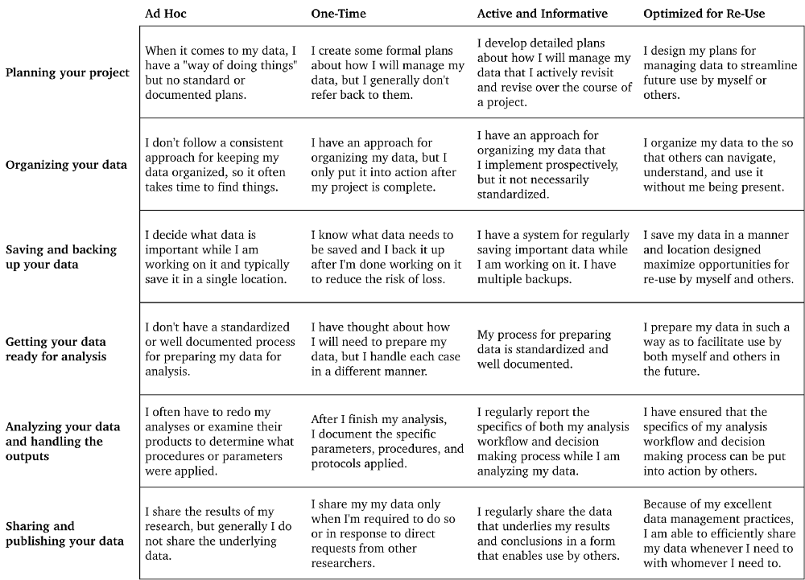
What data management practices do you apply in your research projects today?
Borghi, J. et al (2018). Support your Data. https://doi.org/10.3897/rio.4.e26439
Notes:
Let’s do a bit of self-evaluation about what your data management practices look like today. For this we’ll use this evaluation tool. We’ve set this up online - next slide.

Slide 22
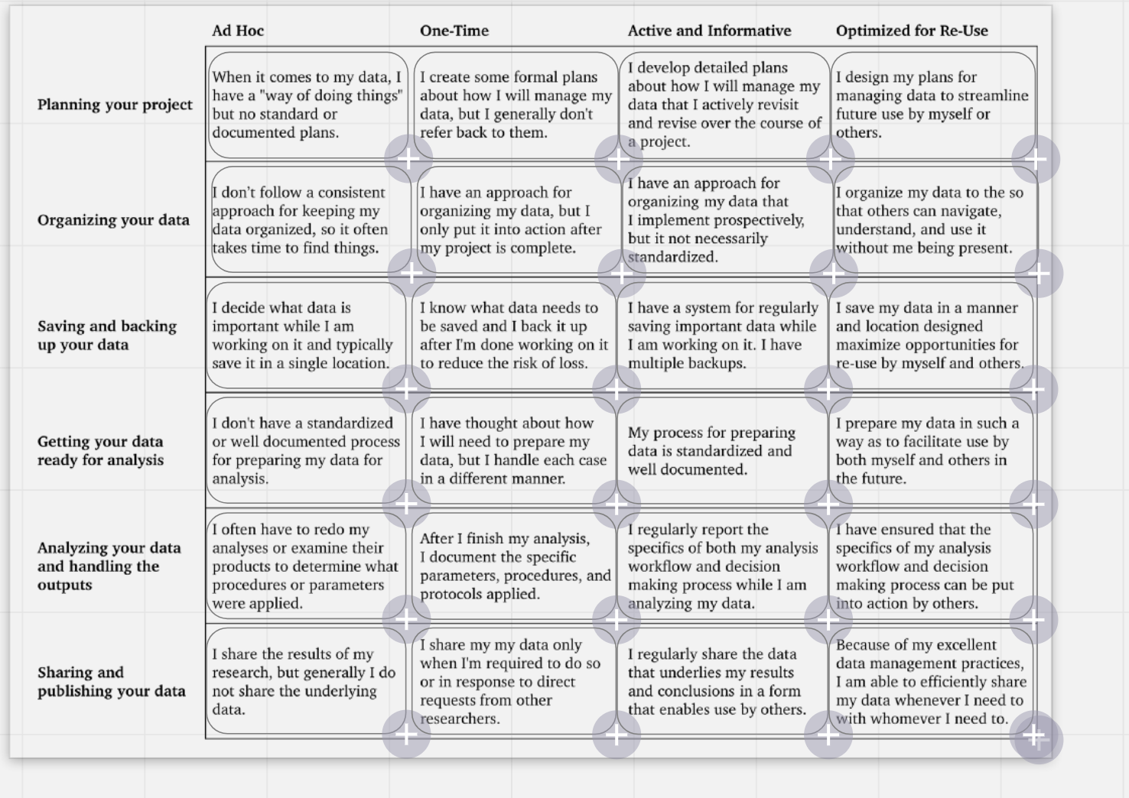
Voting
https://bit.ly/support_your_data_rubric
Notes:
Go to this url, which will take you to a page in a tool called Miro. When I start the “voting” functionality, you can click the boxes of your current level. Do not click a box more than once.

Slide 23
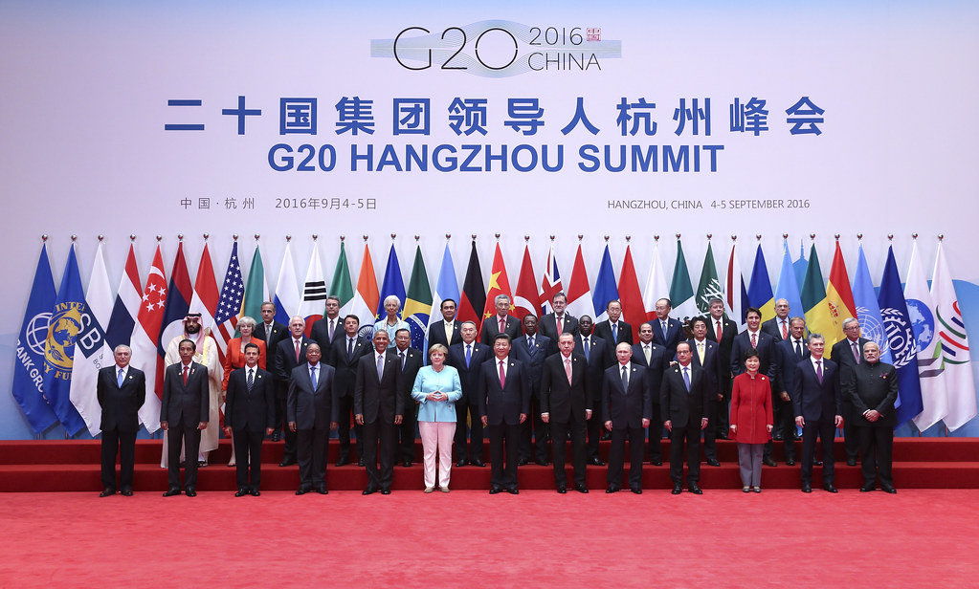
The Political landscape
"G20 Summit in Hangzhou" by Organisation for Economic Co-operation and Develop is licensed under CC BY-NC 2.0
‘We support appropriate efforts to promote open science and facilitate appropriate access to publicly funded research results on findable, accessible, interoperable and reusable (FAIR)’
Notes:
EU and the G20 have endorsed the FAIR principles.

Slide 24



The Political Landscape
Policymakers are pushing for research data to be made available as openly as possible
Big investments are being made in infrastructure and skills for data sharing and reuse
Notes:
See slide

Slide 25

Policy landscape
Open Science
UNESCO's Recommendation on Open Science
EU
Open Science Policy, Directives
European Research Council, Horizon Europe
EOSC
Swedish research policy bills 2016, 2020, 2024
Transition to open research data by 2026 & push for FAIR
Government assignments to KB & VR
SUHF national roadmap for open science
University policies
National guidelines for open science (KB)
FAIR
“As open as possible,
as closed as necessary”
“FAIR […] open data sharing should become the default [...]”
“[...] research results [...] meet the FAIR principles and can be reused by everyone”
Notes:
UNESCO published their recommendation on open science in 2021
Open Science and FAIR permeates a lot of policies and funding within the EU
The Swedish government has emphasised this in the two latest research bills, and tasked the Swedish Research Council (VR) and the National Library (KB) to lead the transition to an open science system by 2026 at the latest.
The Association of Higher Education Institutions (SUHF) has created a national roadmap for open science
Universities are establishing policies in this area
In 2024, the national library published the national guidelines for open science

Slide 26
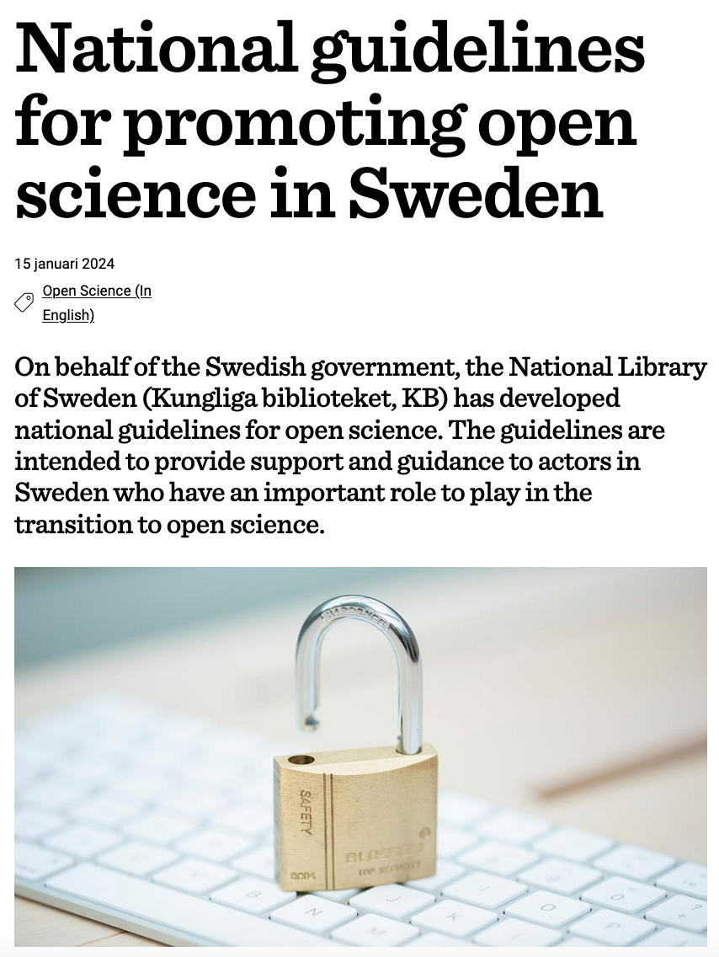
National Guidelines for Open Science
Open Access to Scholarly Publications: Research publications freely available without any subscription or payment barriers​
Open Access to Research Data: Availability/accessibility of research data for reproducibility, to further scientific inquiry​
Open Research Methods: Transparency of research methodologies to facilitate replication and validation of research findings​
Open Educational Resources: Freely accessible educational materials to enhance learning and teaching practices​
Public Engagement in Science: Public, community, citizen science to increase public understanding and trust in science
Infrastructures Supporting Open Science: Develop/support infrastructures for open science ecosystem, including repositories and data management systems​
https://www.kb.se/samverkan-och-utveckling/nytt-fran-kb/nyheter-samverkan-och-utveckling/2024-01-15-national-guidelines-for-promoting-open-science-in-sweden.html

Slide 27
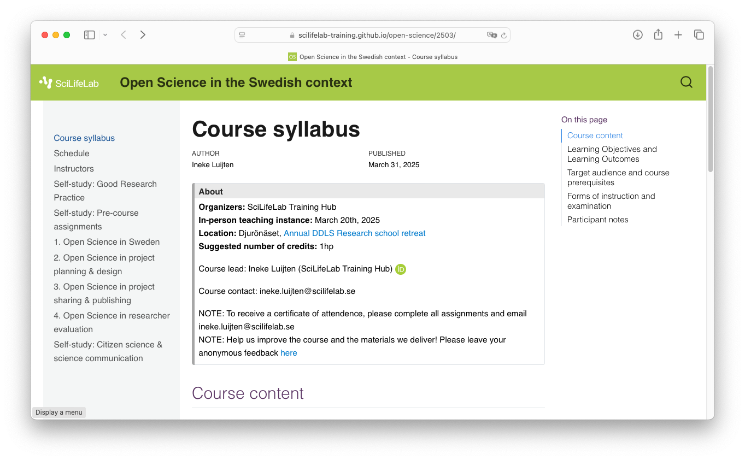
Open Science in the Swedish context
https://scilifelab-training.github.io/open-science/2503/

Slide 28

Motivators
https://www.pngwing.com/en/free-png-nlacv
Notes:
The political push for Open Science and FAIR can considered to be more of a stick than a carrot for researchers, but it will not become a reality if researchers don’t see the carrot.

Slide 29
Open Science: from policy to practice
Policy
Make it required
Incentive
Make it rewarding
Community
Make it normative
User Interface/Experience
Make it easy
Infrastructure
Make it possible
From: Luijten, Ineke; Anderberg, Sabina (2025). Open Science in Sweden (Module 1 of OSitSC). SciLifeLab Training Hub. Educational resource. https://doi.org/10.17044/scilifelab.29337071.v2
Adjusted from: Brian Nosek - The Center for Open Science (2019) Strategy for culture change.
Notes:
So the political push for open science and FAIR is very strong and we're doing our best to provide the infrastructure and training to make it possible and easy.
What is still lagging behind is, partly the culture change needed, but most importantly the incentives to make it rewarding for researchers to be Open and FAIR. There are global initiatives that are working towards improving this.
The aim of this course is to encourage you to use good Data Management practices to make your research easier in the long run, so that you can meet the emerging demands in this area from the society.

Slide 30
Good Data Management Practices
Data Management Plans, to do your thinking ahead of time
Using standard metadata descriptions, to clearly define your data
Organising your outputs, so you and others can understand what you have done
Use versioning control to keep track of changes you do
Clean up metadata and data to be consistent with the standards you have chosen
Submit your data to international public repositories, so others can find and reuse your data
Notes:
The first thing is to start thinking about, and planning for, what practices I can apply in my research to make this easier. And that is what the rest of this course is about.
Data Management Plans, to do your thinking ahead of time
Using standard metadata descriptions, to clearly define your data
Organising your outputs, so you and others can understand what you have done
Use versioning control to keep track of changes you do
Clean up metadata and data to be consistent with the standards you have chosen
Submit your data to international public repositories, so others can find and reuse your data

Slide 31
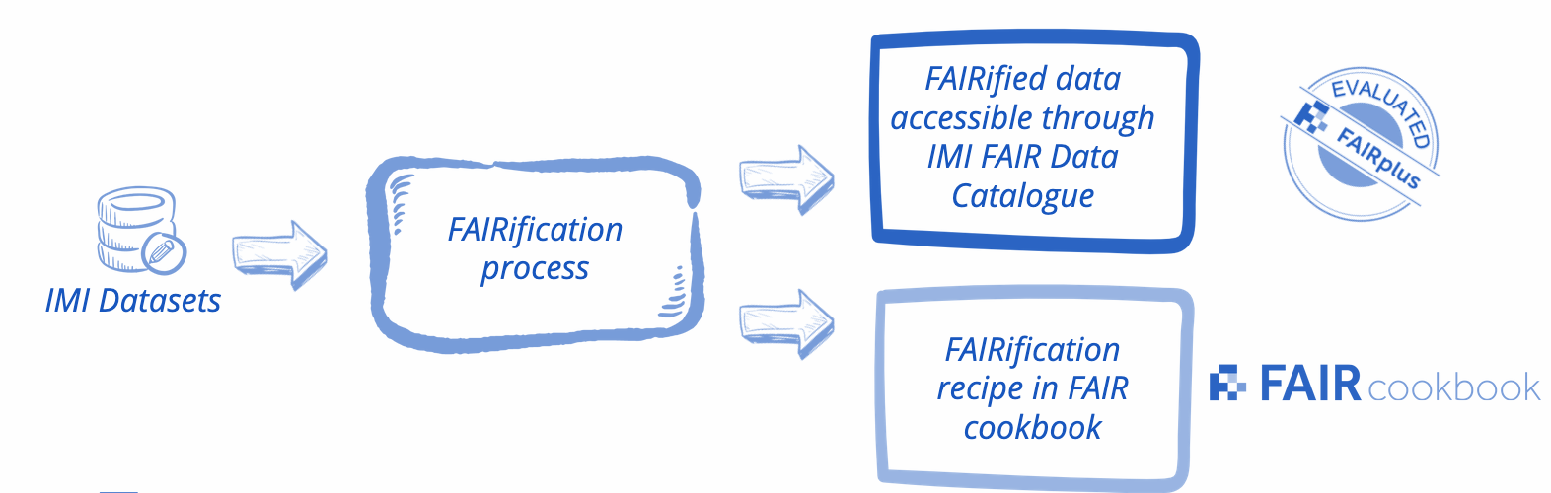
Making sense of your group’s data
“ data should be readable for machines without the need for specialised or ad hoc algorithms, translators, or mappings”
How about another group’s data?

Slide 32
Making sense of another group’s data
“ data should be readable for machines without the need for specialised or ad hoc algorithms, translators, or mappings”
“ data should be assessable so that judgments can be made about their reliability and the competence of those who created them”.
How about FAIR research data?

Slide 33
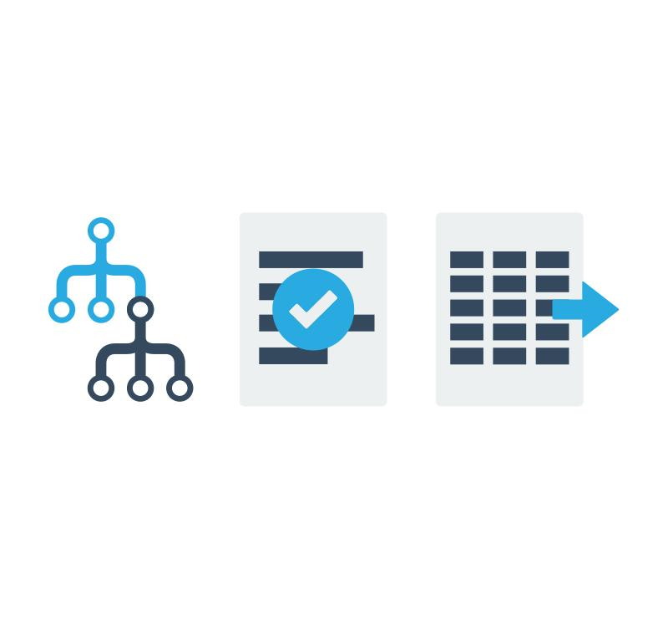

Making sense of FAIR research data
“ data should be readable for machines without the need for specialised or ad hoc algorithms, translators, or mappings”
“ data should be assessable so that judgments can be made about their reliability and the competence of those who created them”.
576+
788+
245+
*
Formats
Terminologies
Guidelines
Data storage & exchange
Requirements & checklists
Conceptual models & controlled vocabularies
* Numbers from the FAIRsharing Registry

Slide 34
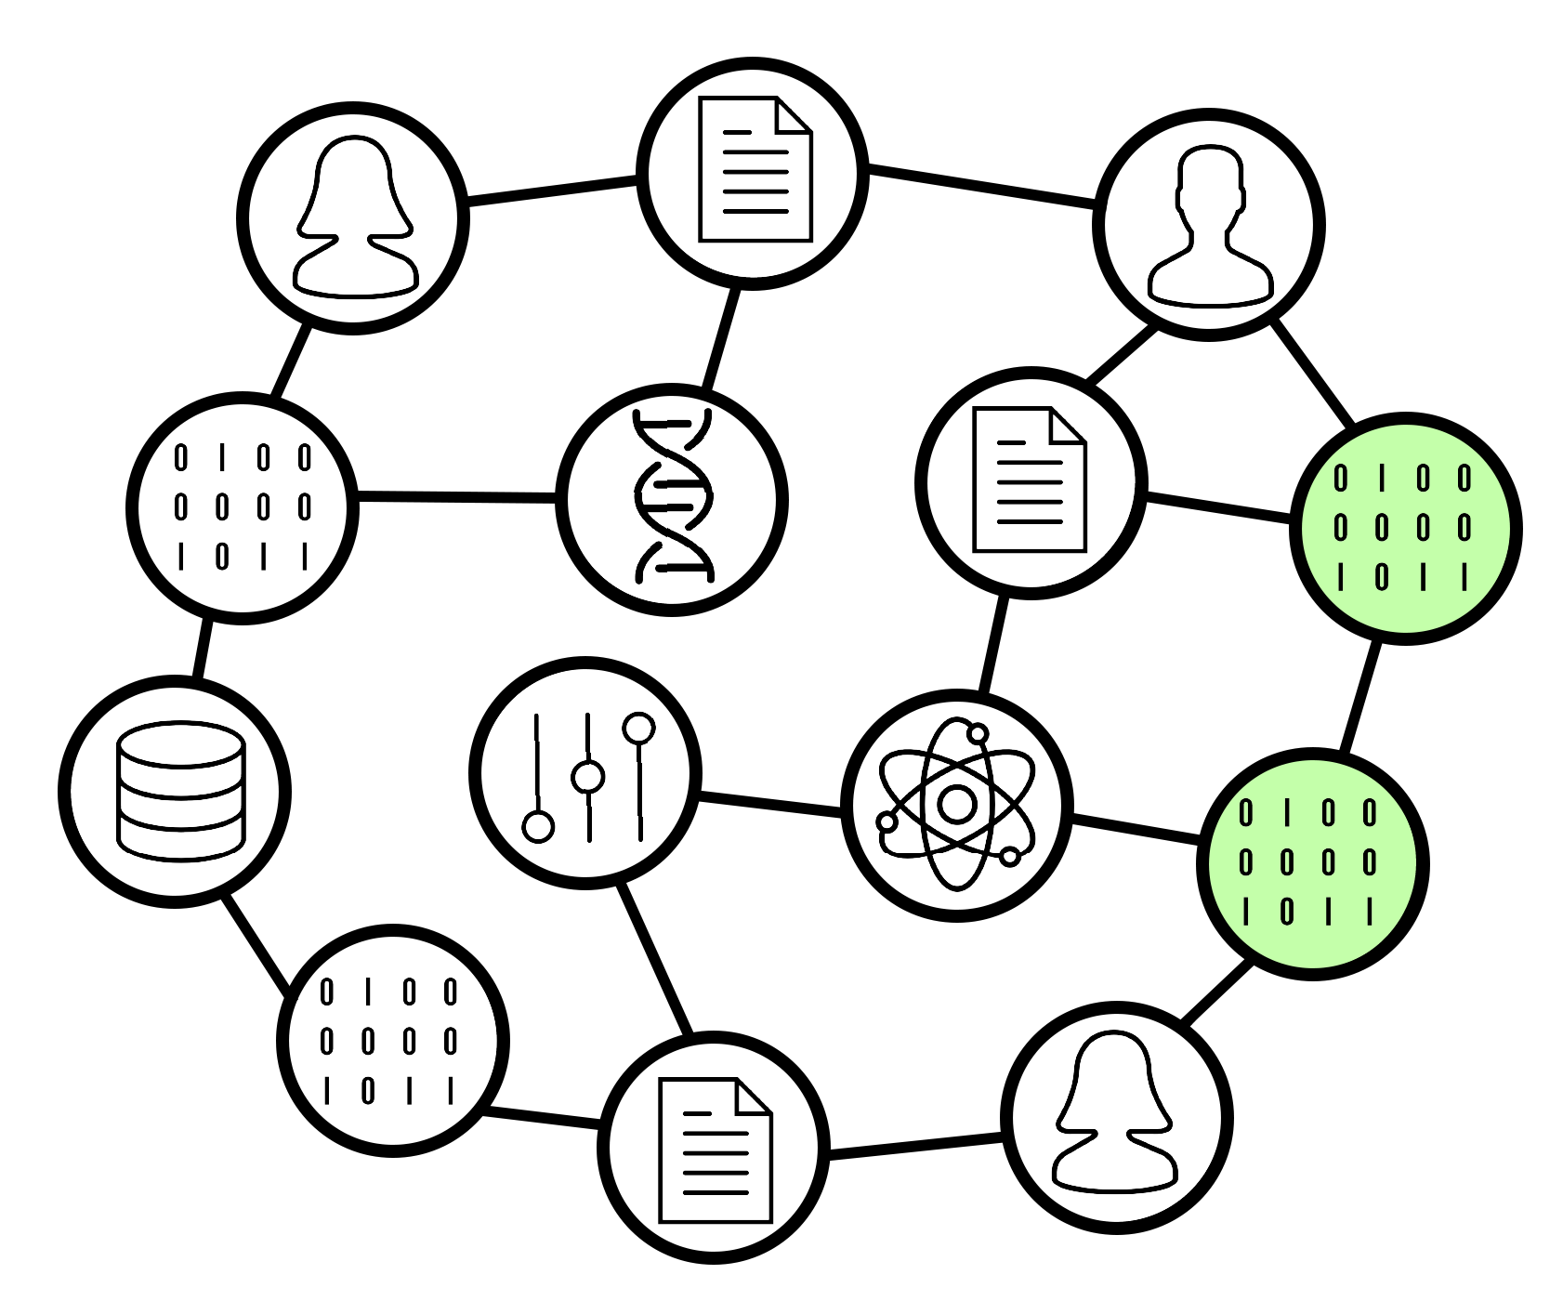

Towards a web of FAIR data and services
Graph: “PID Graph” from the FREYA project
“From Gutenberg to Berners–Lee”
What types of research assets?
Where will people be looking?
Who should have access?
Which standards/specifications?
What cross-references and what documentation can you provide? (Rich metadata!)
Works with my software
Robot: MetaManMachine by Nikola Vasiljevic (2021), CC BY-SA 4.0, doi:10.5281/zenodo.4471098

