Slide 1

Introduction to RStudio
Introduction to Data Management Practices course
NBIS DM Team
data-management@scilifelab.se
https://nbisweden.github.io/module-rstudio-intro-dm-practices

Slide 2
Learning objectives
Briefly explain what R is
Get familiarized with RStudio IDE
Recognize the benefits of R Projects
Know how to create an R Project and a README with Markdown

Slide 3
R in a nutshell
R
Powerful programming language
Open source
Rich ecosystem of packages
Large and active community
Notes:
Powerful programming language
R has advanced tools and functions, making complex data tasks more manageable.
Open Source
R is free to use, which makes it accessible to everyone, from students to large organizations.
Rich ecosystem of packages
Thousands of packages (add-on tools) are available for various analyses, visualizations, and more.
Large and active community
R has a supportive, global community sharing tips, tutorials, and resources.

Slide 4
What is RStudio IDE?
Integrated Development Environment, R and python
Includes code editor and a console
Provides project and file management
Features interactive data visualization tools
Integrates with R packages seamlessly
Cheat sheets and Keyboard shortcuts → HELP within RStudio
Let us take a look on the 4 panes!

Slide 5
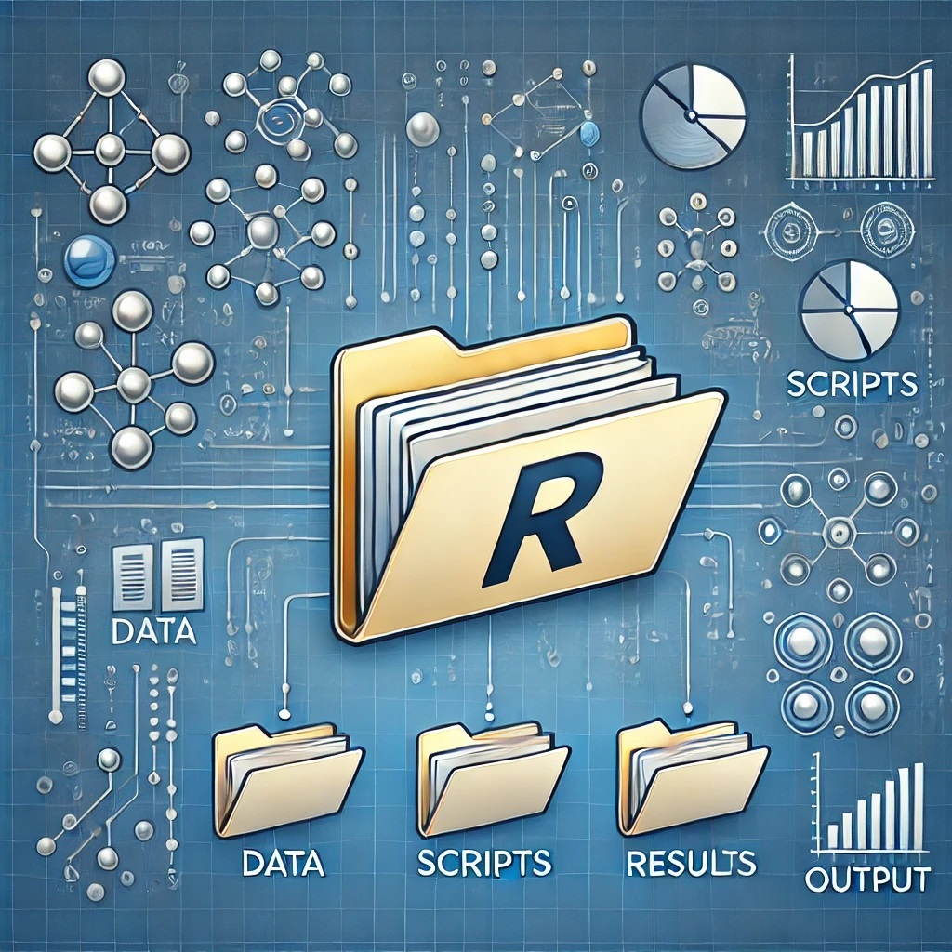
The benefits of R Projects
Working directory - where the science happens
Relative pathways
Consistency, automatic directory setup
Reproducibility, easier for others to review
Let us create an R Project with a few folders!
Image generated by ChatGPT

Slide 6
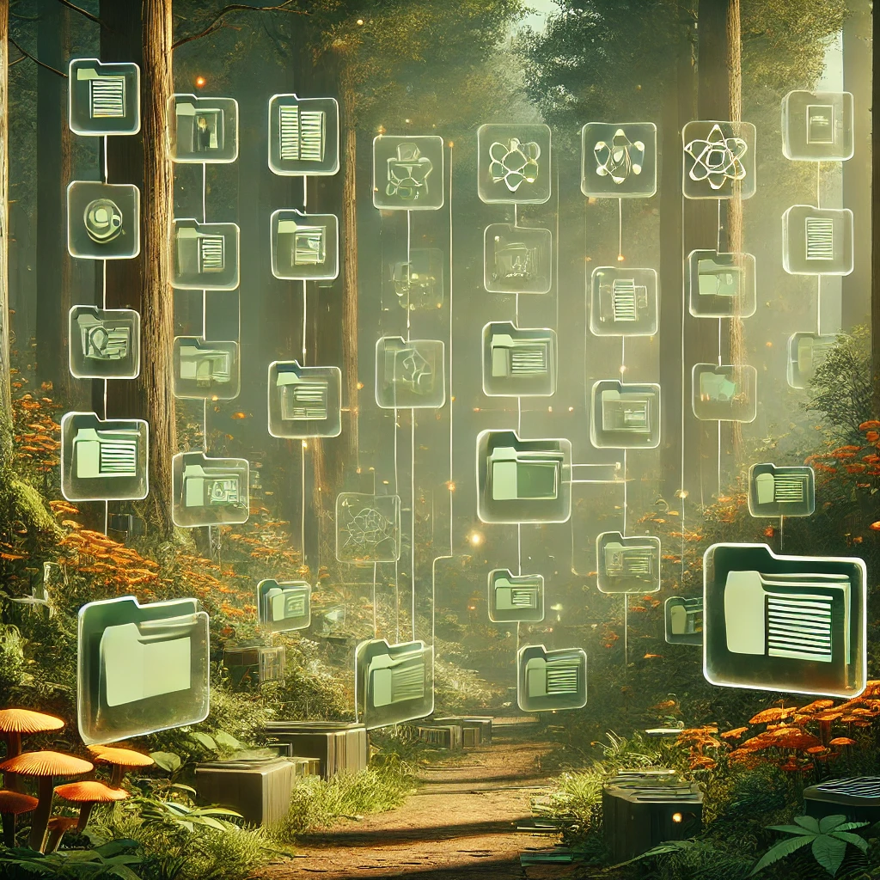
README README README
The first thing we look for!
Helps you and others to understand the project
Markdown can be used to write your README
Sounds good, but what should be included?
Image generated by ChatGPT

Slide 7
Write a README with Markdown
# Project overview
---
## **Data description**
---
### *File organization*
---
#### ***Data processing***
---
##### `Usage instructions`
---
## ~~Contact information~~
Project overview ———————————— Data description ———————————— File organization ————————————
Data processing ————————————
Usage instructions ———————————— Contact information
Notes:
Project overview in large font (header 1).
A horizontal line (---).
Data description in bold (header 2).
Another horizontal line (---).
File organization in italic (header 3).
Another horizontal line (---).
Data processing in bold and italic (header 4).
Another horizontal line (---).
A line of code (Usage instructions) in a monospaced font (header 5).
Another horizontal line (---).
Contact information with a strikethrough (header 2).

Slide 8
Question?
Next up is Introduction to scripted analysis with R

