Slide 1

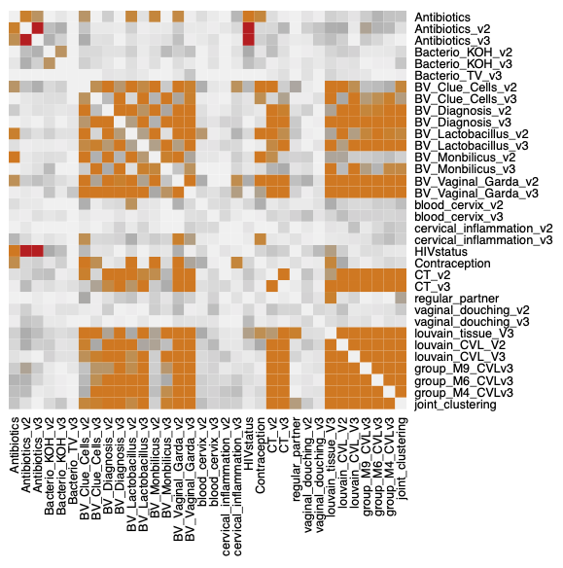
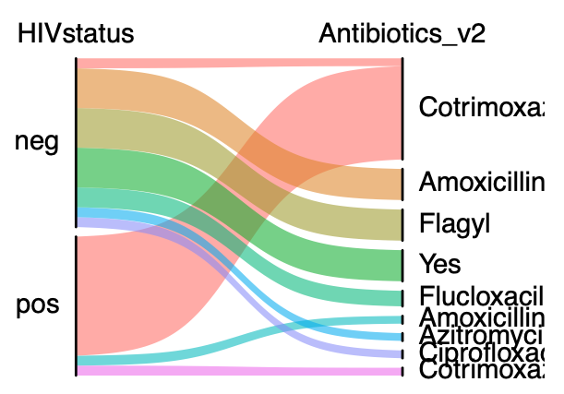
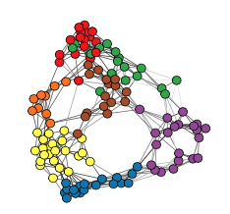
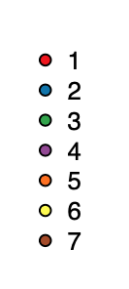
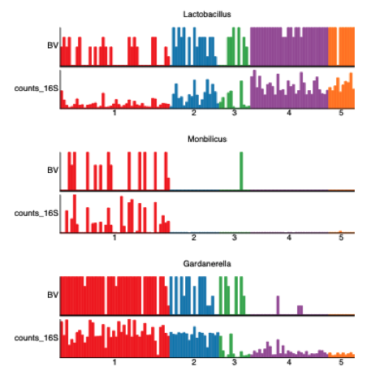
Fig. 1
a
v1
v2
v3
c
d
CVL 16S
CVL 16S
Joint
clustering
Tissue 16S
110 women
RNAseq
proteome
b
IHC
Patient groups
Metadata: Inflammation vs
Blood vs
CT
BV
e
f
Baterial diversity
maybe?
Classica microbiota plot
Metadata: bacterial vaginosis versus 16S bacterial counts per group
Cohort description and patient clustering, metadata and other factors

Slide 2

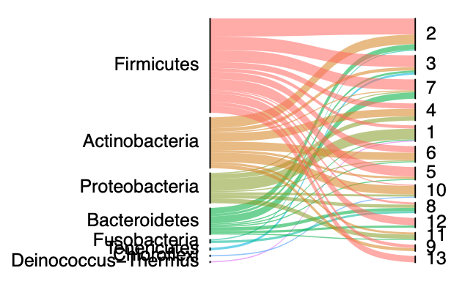
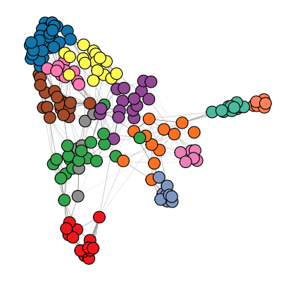
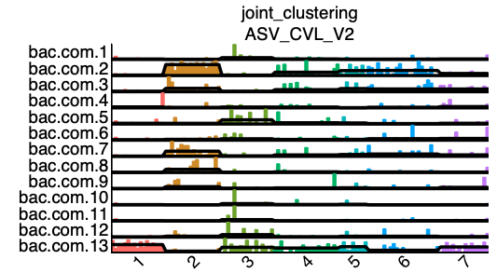
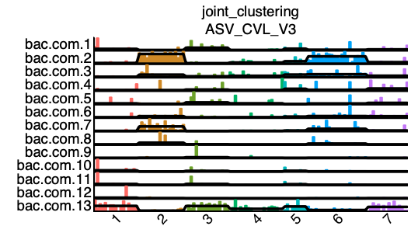
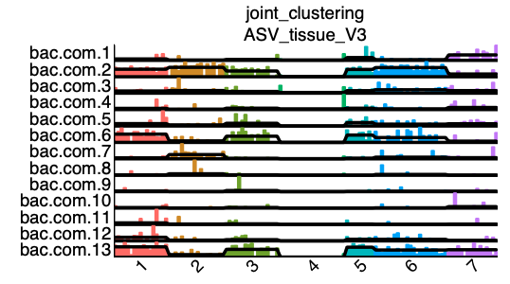
Fig. 2
Description of bacterial communities, functional annotation and comparison between patient groups
a
Bacterial communities
b
2 BVAB1,2,3
G. vaginalis
4 Corynebacterium sp Enhydrobacter aerosaccus
Gemela sp
10 C. metallidurans
Sphingomonas
Actinomyces Intrasporangiaceae
8 A. lactolyticus
A. obesiensis C. ureolyticus F. nucleatum
11 Phyllobacteriaceae
Neorhizobium
Rhodococcus
5 L. reuteri
c
7
Prevotella sp
P. bergensis P. buccalis P. corporis P. disiens
13 L. coleohominis
L. crispatus/acidophilus
L. iners L. Jensenii
other Lactobacillales
3 Mycoplasma hominis
Prevotella bivia Prevotella melaninogenica Ureaplasma parvum
Veillonella montpellierensis
12 Faecalibacterium prausnitzii other Faecalibacterium
other Ruminococcaceae other Ruminococcus2 Prevotella copri Streptococcus intermedius/constellat
Functional
Enrichment withPiCrust2
https://www.nature.com/articles/s41587-020-0548-6
https://github.com/picrust/picrust2/wiki/PICRUSt2-Tutorial-(v2.3.0-beta)
d
v2 vs v3
e
CVL vs tissue
Description of the microbiome profiles, taxonomic classes, and how their function changes over time and tissue assayed

Slide 3
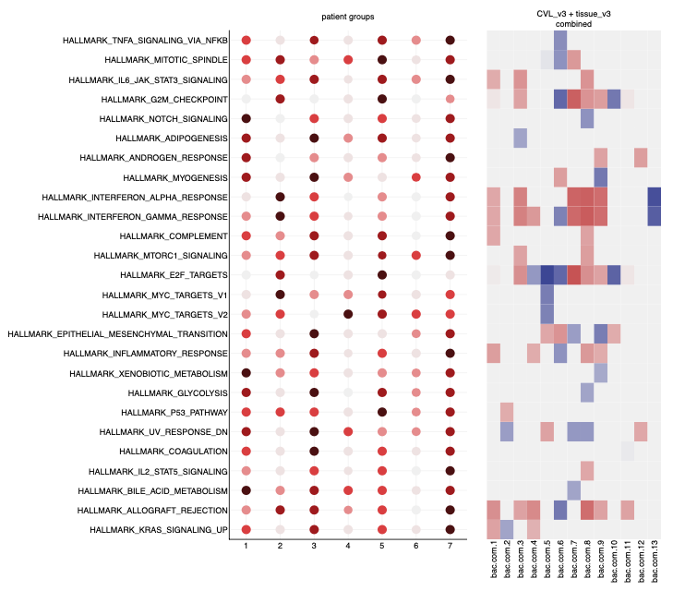
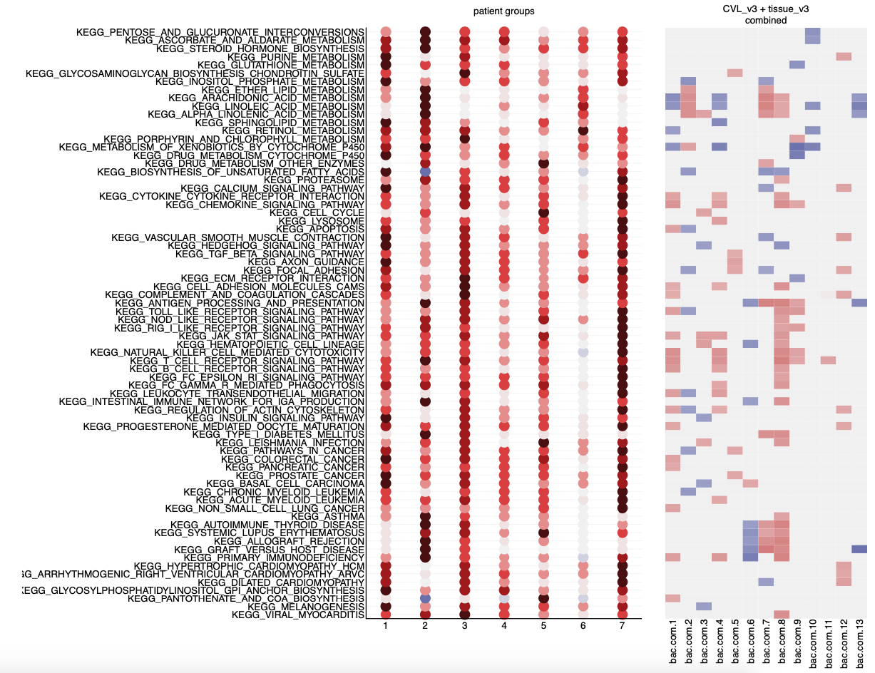
Fig. 3
a
Hallmark
b
Kegg pathways
Transcriptome here maybe ?
Using joint patient groups
c
d
Proteome validation (some)
+
IHC (some)
Proteome – microbiome correlation?
Description of how the microbiome is associated with tissue expression, and validate with protein and immunofluorescence data.

Slide 4
Fig. S1

Slide 5
Fig. S2

Slide 6
Fig. S3

Slide 7
Fig. S4

