Slide 2
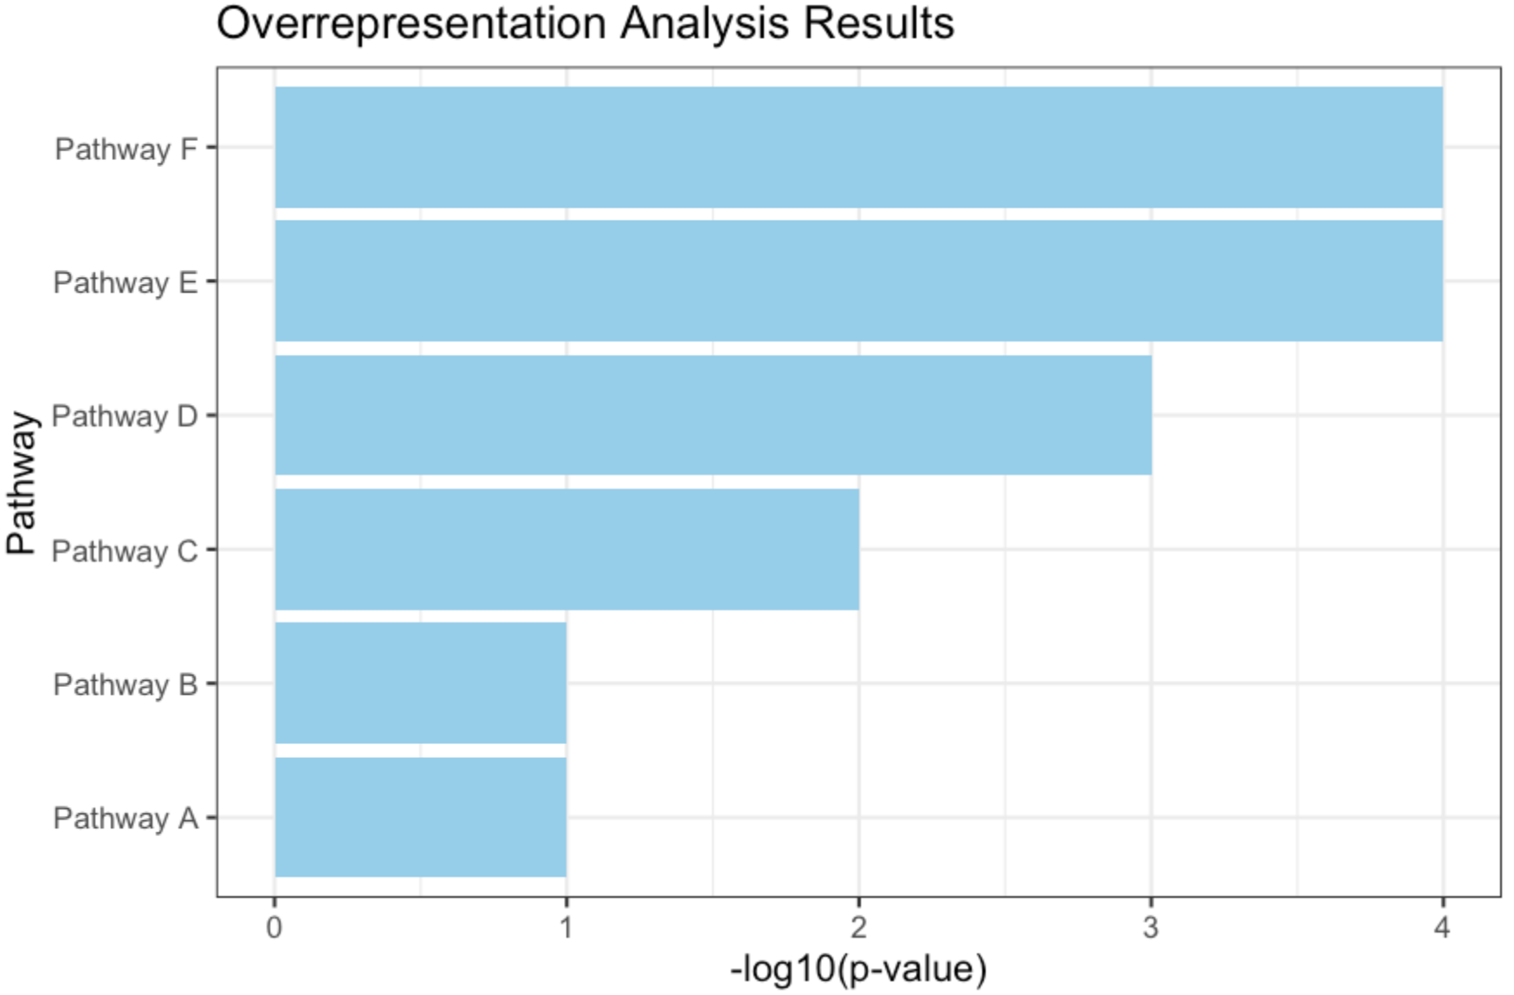
Selected
Not selected
In a category
10 | 2
90 | 14000
Not In a category
All genes
in given pathways
DEG

Slide 3
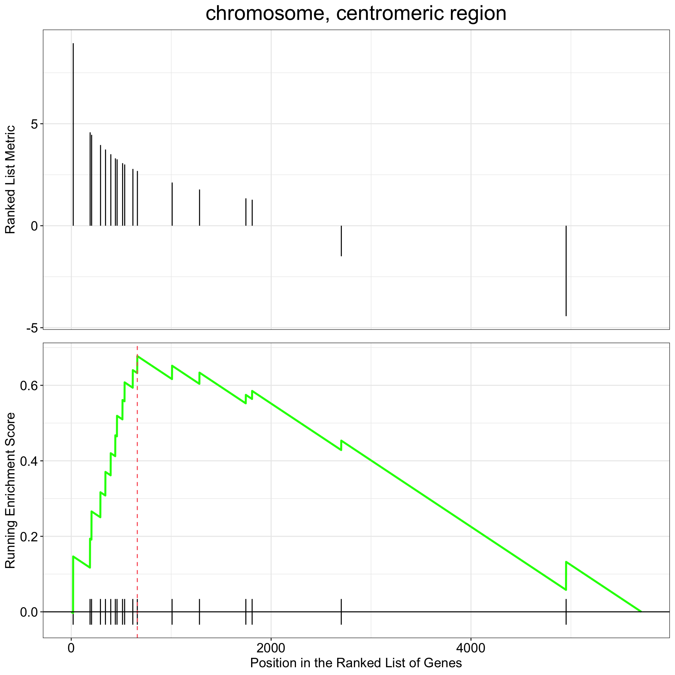
Magnitude of
change
Enrichment score
Magnitude of
change
Upregulated
Downregulated
Significance
P-Value

Slide 4
Complete Linkage
Maximum distance
Single Linkage
Minimum distance
Average Linkage
Average of all points
Ward’s Linkage
Minimize within cluster variance

