Slide 1
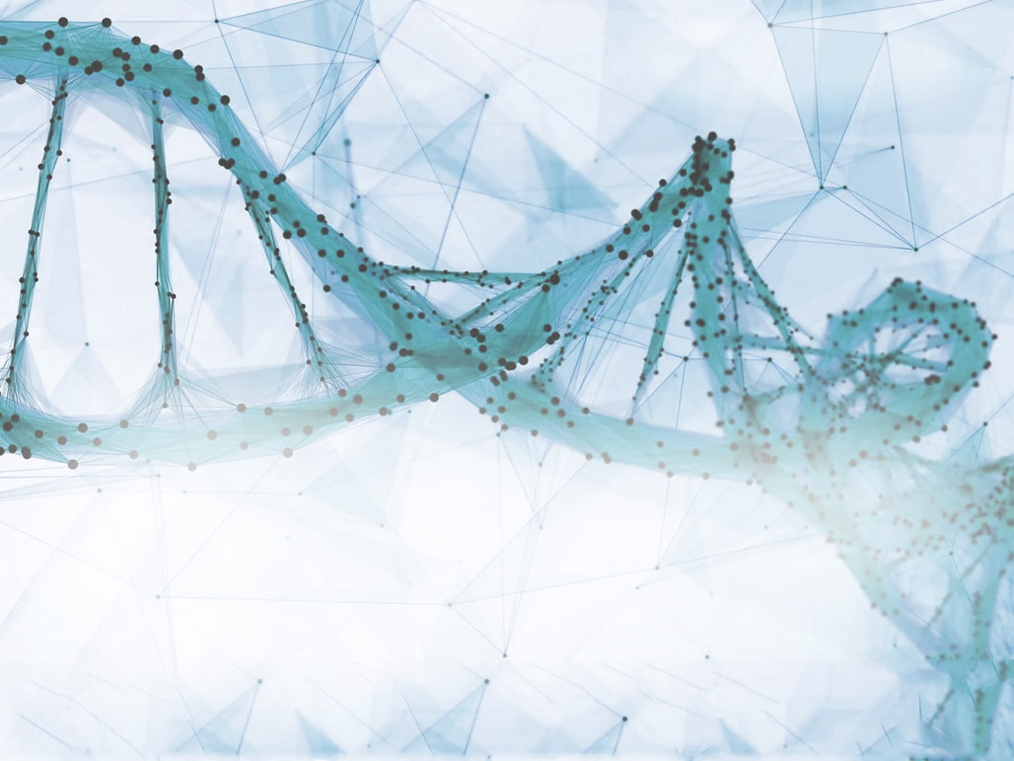
Vector and bitmap images
Workshop on Advanced Data Visualization
Markus Ringnér

Slide 2
Outline
Once you have designed and produced your plot, how do you make sure it can be used in publication quality figures?
There will be some R and ggplot at the end.

Slide 3
What is an image?
How are images stored on computers?

Slide 4
This is an image!
Now it is art!

Slide 5
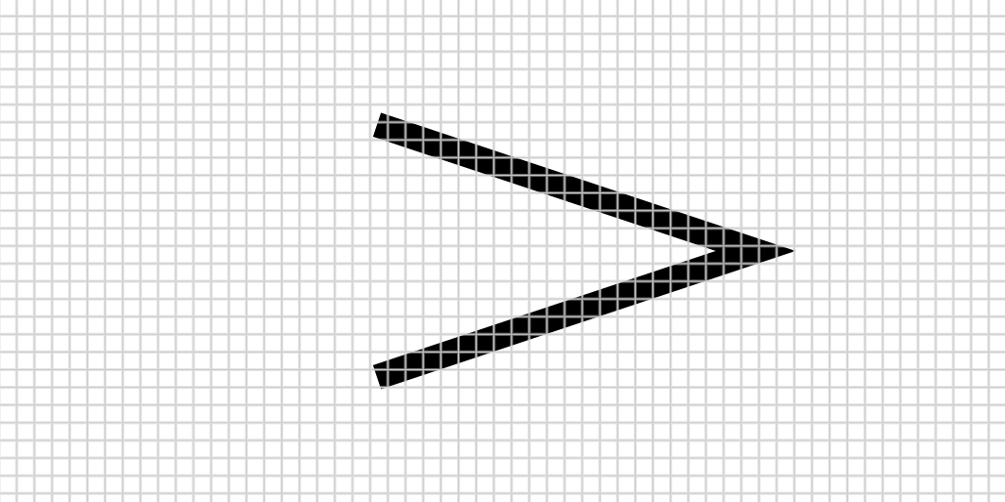
Bitmap (or raster) image
File size depends on resolution
Number of pixels * 1 bit (black/white).

Slide 6
Vector image in (encapsulated) postscript
ps_example1.eps
%!PS
%%Creator: Markus Ringnér
%%BoundingBox: 0 0 400 200
%%End Comments
newpath
150 50 moveto
300 100 lineto
150 150 lineto
10 setlinewidth
stroke

Slide 7
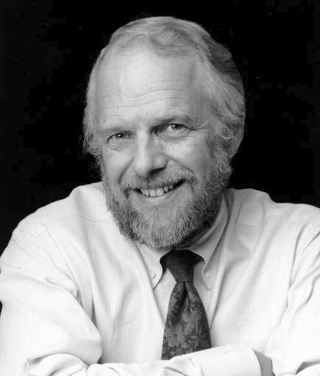
John Warnock
A Hidden Surface Algorithm for Computer Generated Half-Tone Pictures (1969).
Inventor of postscript, pdf, …
Key idea was to describe all of the content of pages for printing not as collections of spots, but at a much more abstract level – as geometry.

Slide 8
File sizes of images
$ wc ps_example1.eps 10 24 149 ps_example1.eps
Vector image file size: 149 characters.
Image size (bounding box): 400 * 200 points. 1 pt = 1/72 inches.
Bitmap image at 300 dpi gives:
(300*400/72)*(300*200/72) = 1,388,889 pixels
32-bit tiff with no compression: 1388889*32/(8*1024*1024) = 5.3 Megabyte
$ ls -lh ps_example1.* -rw-r--r-- 1 markus staff 149B Nov 2 16:41 ps_example1.eps -rw-r--r--@ 1 markus staff 5.3M Nov 2 17:20 ps_example1.tiff

Slide 9
Lossless compression of bitmap image
$ ls -lh ps_example1.* -rw-r--r-- 1 markus staff 149B Nov 2 16:41 ps_example1.eps -rw-r--r--@ 1 markus staff 5.3M Nov 2 17:20 ps_example1.tiff -rw-r--r--@ 1 markus staff 33K Nov 2 17:21 ps_example1.png
5.3M / 149B = 5.3*1024*1024/149 ≈ 37000
33K / 149B = 33*1024/149 ≈ 200
$ du -h ps_example1.*
4.0K ps_example1.eps
5.3M ps_example1.tiff
36K ps_example1.png

Slide 10
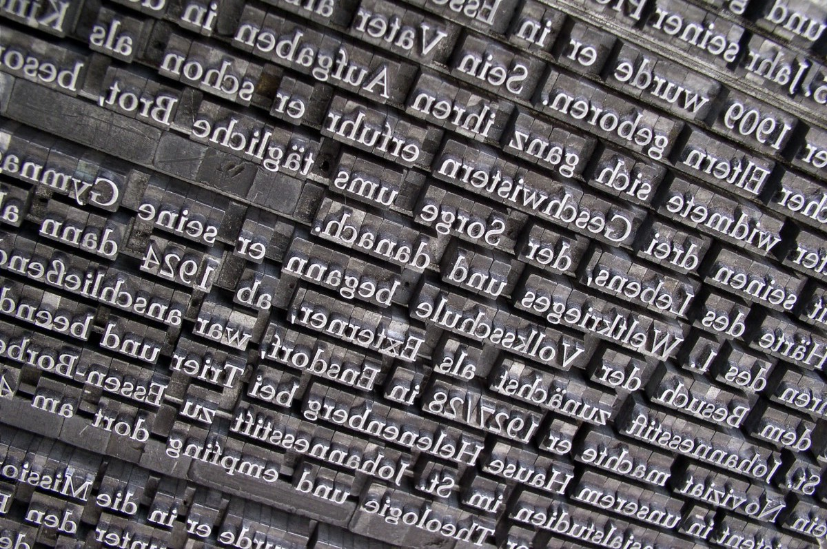
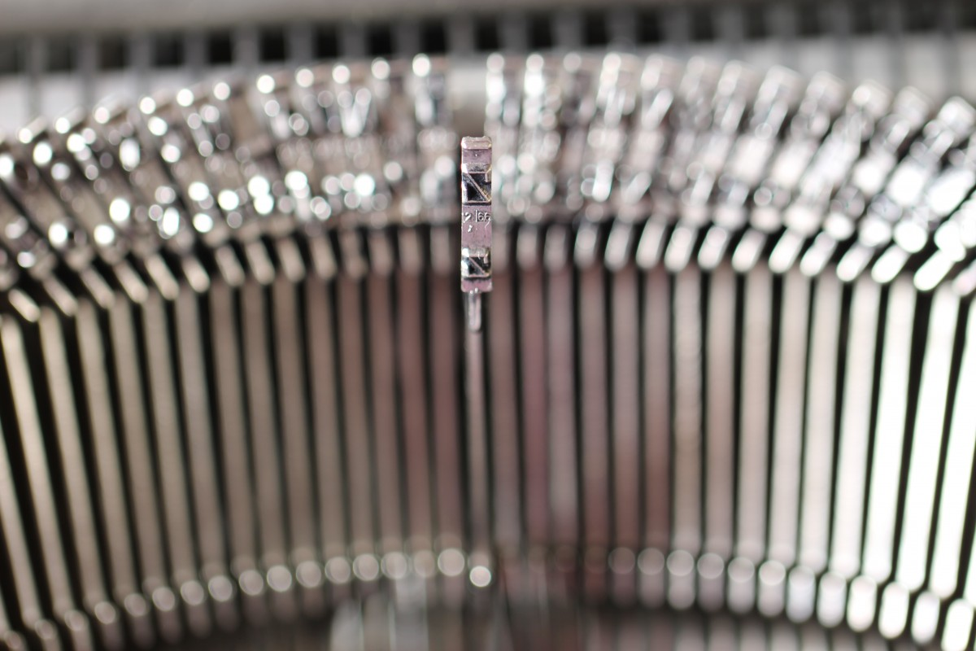
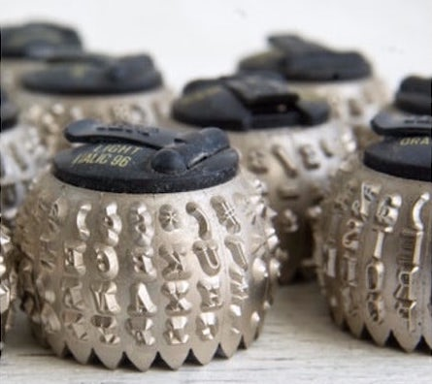
Fonts (bitmap)
Before the 1990s there were typicallt only bitmap fonts on computers and printers; raster images of glyphs only available in certain optimized sizes (Axis).

Slide 11
Fonts (scalable)
%!PS
%%Creator: Markus Ringnér
%%BoundingBox: 0 0 400 200
%%End Comments
newpath
150 50 moveto
300 100 lineto
150 150 lineto
10 setlinewidth
stroke
/Times-Roman findfont
24 scalefont
setfont
newpath
50 100 moveto
(Example) show
Special facilities in the PostScript language:
Characters from fonts
Apple LaserWriter (1985 with postscript)
Can make your own fonts.
Programming language, even recursive functions.
Hinting and anti-aliasing

Slide 12

Scaling images (bitmap)

Slide 13

Scaling images (vector)
Also scaling to small sizes. For example gene names in dense plots.

Slide 14
Vector images vs bitmap images
In terms of file size, vector images are typically much smaller than the corresponding bitmap.
Vector images are scalable (redrawn to compensate for scale changes). Bitmap graphics are affected by resolution.
Vector images are simple to edit (Adobe Illustrator, Affinity Designer, …)
Bitmap fonts can be faster to draw/print (not requiring computer processing).
Vector graphics are not suited for photographs.
Drawing vs Painting.

Slide 15
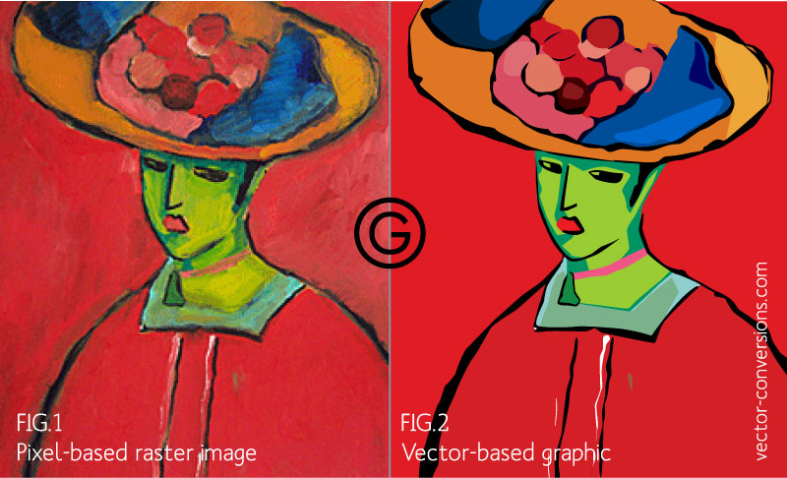
Painting vs Drawing

Slide 16
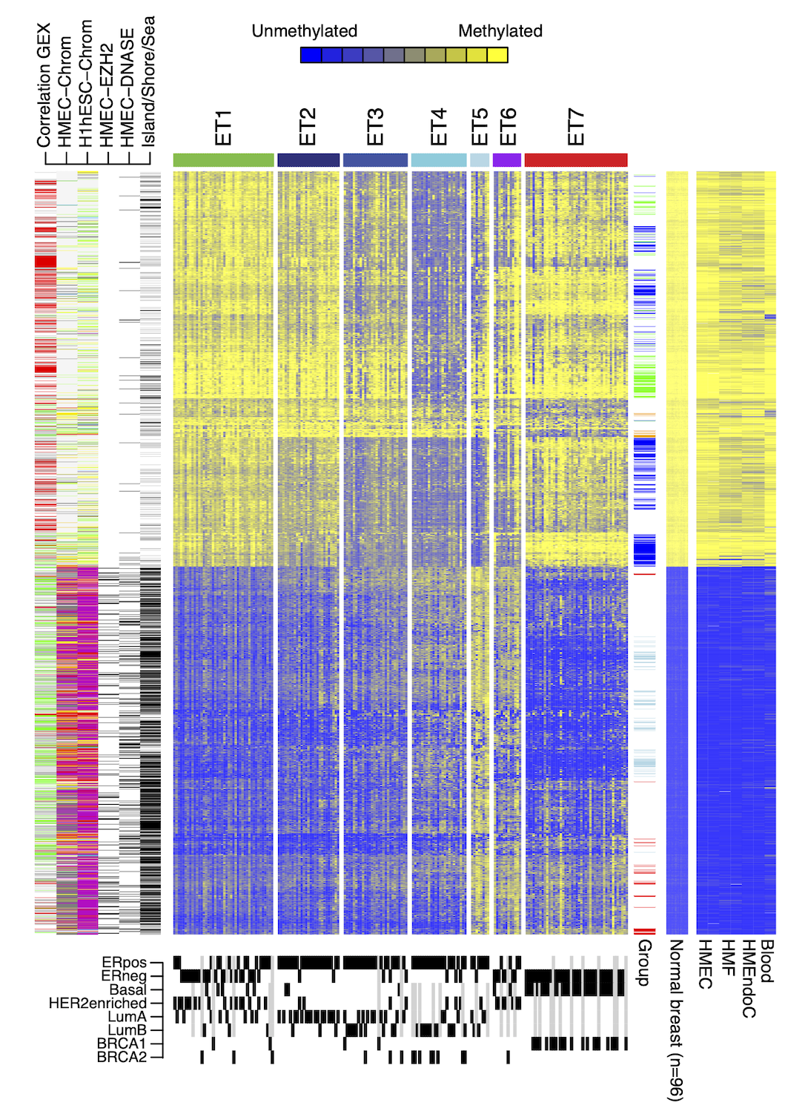
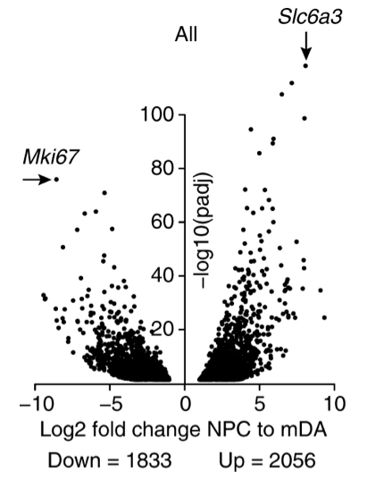
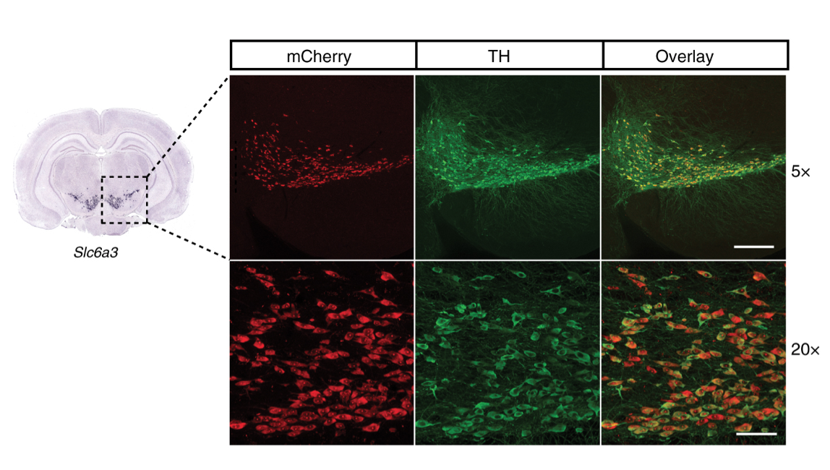
Mixing bitmap and vector graphics
File size of vector image larger than of corresponding bitmap? “Photograph”?
Convert to bitmap as late as possible and to the requested size and resolution.
Have “code” to regenerate your plots for new sizes and resolutions.

Slide 17
File formats
Vector graphics: pdf, eps, svg, …
(compound formats)
Bitmap file formats: jpg, png, tiff, …
(lossy or lossless data compression)

Slide 18


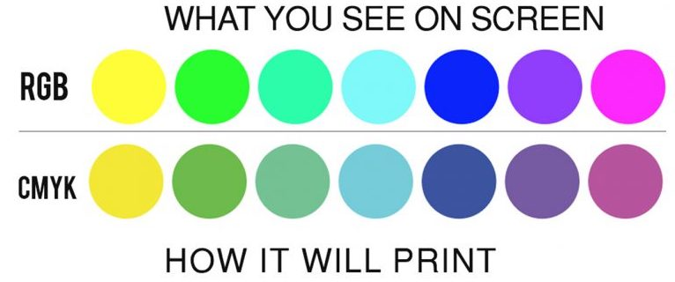
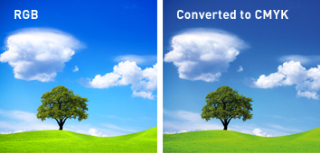
RGB and CMYK
Primary colors are arbitrary, but …
RGB: Red-Green-Blue – additive type of color mode
CMYK: Cyan-Magenta-Yellow-Black – subtractive type of color mode
Cyan, magenta, and yellow are lighter than red, green, and blue.
If you are going to print: CMYK
If only to be seen digitally: RGB
Most modern printers will convert automatically, but …

Slide 19
Generate figures with consistent sizes and font sizes
Explicitly specify font sizes.
Explicitly specify the width and height of the plot. Easier in inches/millimeters than pixels + dpi.
Export the plot with ggsave, and not by copying or exporting from R/Rstudio window (that can be resized arbitrarily), to ensure a controlled and reproducible process.
If you print on paper to test, remember to set scale to 100% or similar (not fit to page …).

Slide 20
Example plot – 90 mm wide, min font size 6
library(ggplot2)
x <- 1:10 y <- x*abs(rnorm(10))
p1 <- ggplot(data.frame(x,y), mapping=aes(x=x,y=y)) + geom_point() + geom_smooth() + ggtitle("The Title") + theme(title=element_text(size=14, hjust=0.5), axis.title=element_text(size=10), axis.text = element_text(size=6))

Slide 21
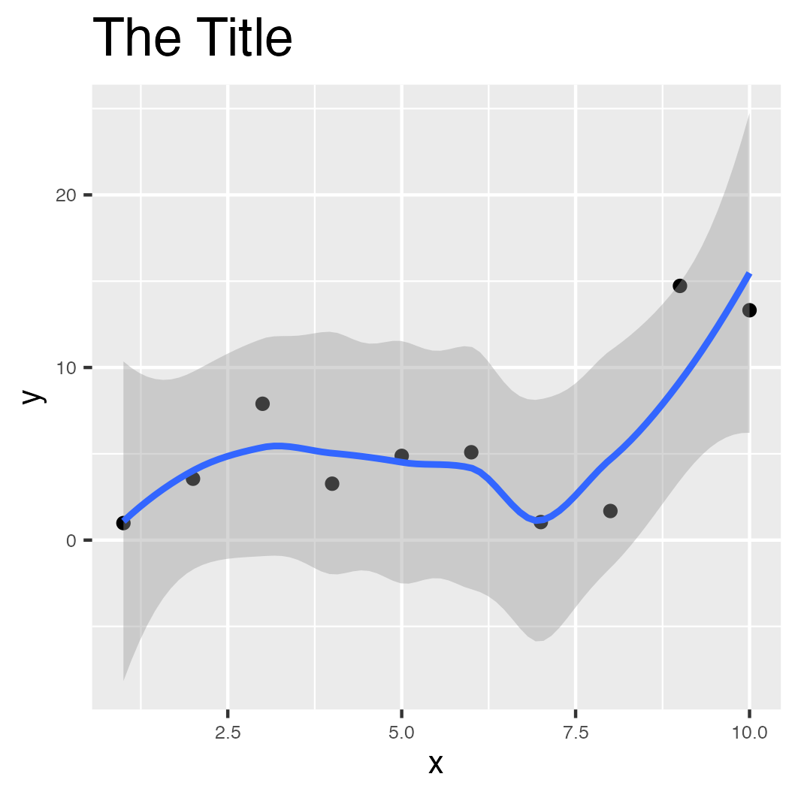
ggsave(filename="gg_example.png",plot=p1, device="png", height=90, width=90, units="mm", dpi=300)
ggsave(filename="gg_example.pdf",plot=p1, device="pdf", height=90, width=90, units="mm", dpi=300)

Slide 22
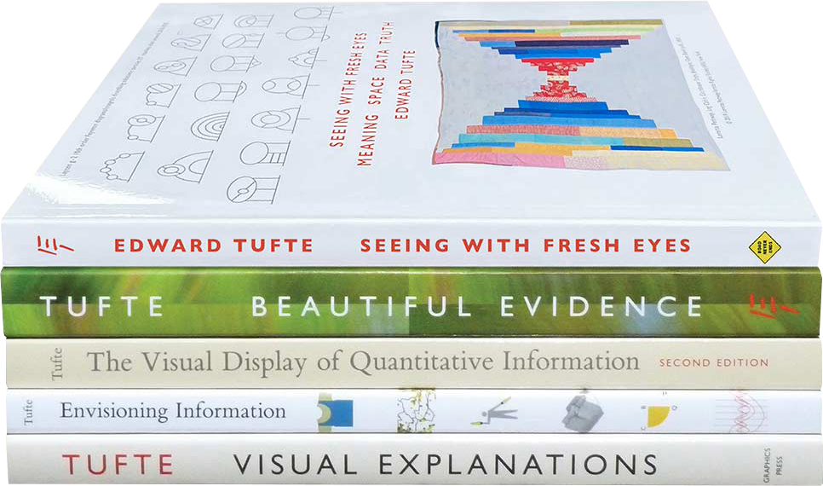
Conclusions
Hopefully this has provided some helpful initial thoughts on how to produce publication quality figures.
Inspiration
www.edwardtufte.com

Slide 23
Thank you. Questions?

