Slide 1
Jacques Dainat PhD
Methods in genome annotation
SLU Uppsala – Februari 2019

Slide 2
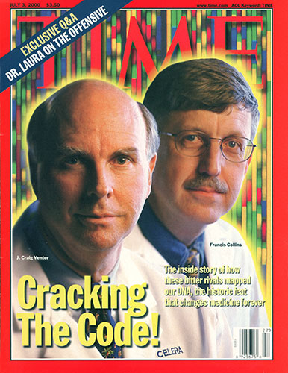
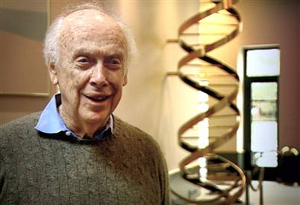
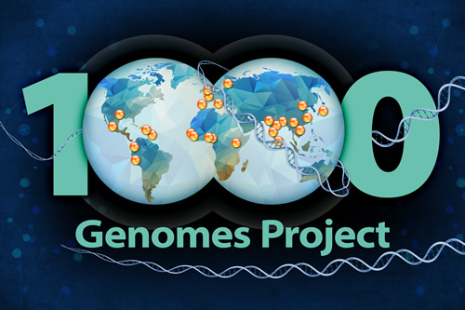
Let’s get philosophical
… prices go down
Human genome sequencing:
2004: Genome of Craig Wenter costs 70 mln $
Sanger’s sequencing
2007: Genome of James Watson costs 2 mln $
454 pyrosequencing
2014: Ultimate goal: 1000 $ / individual
2016: Illumina Xten: Almost there! (1200 $)
2017: NovaSeq: ”Hold my beer…” (100 $)

Slide 3

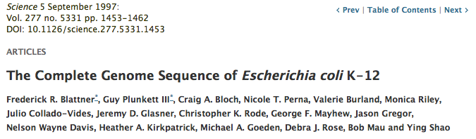
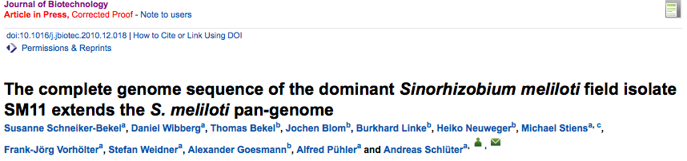
Let’s get philosophical
… scientific value diminishes
IF 31.6
IF 2.9

Slide 4
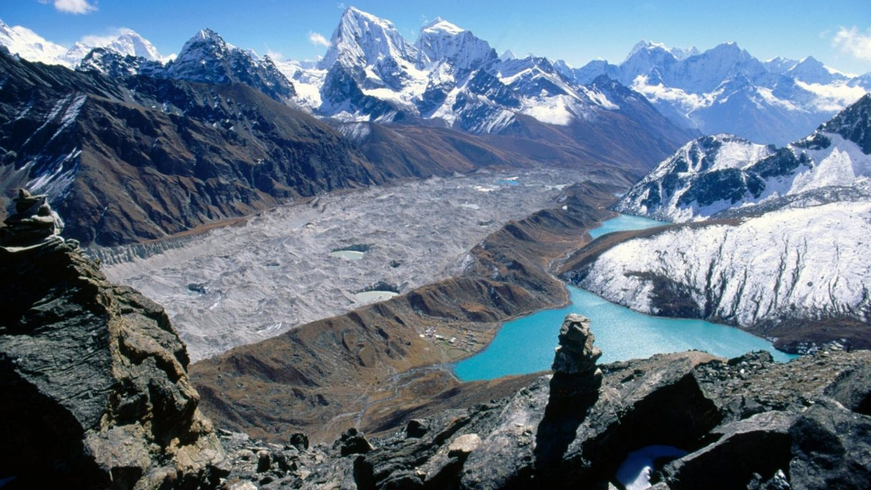
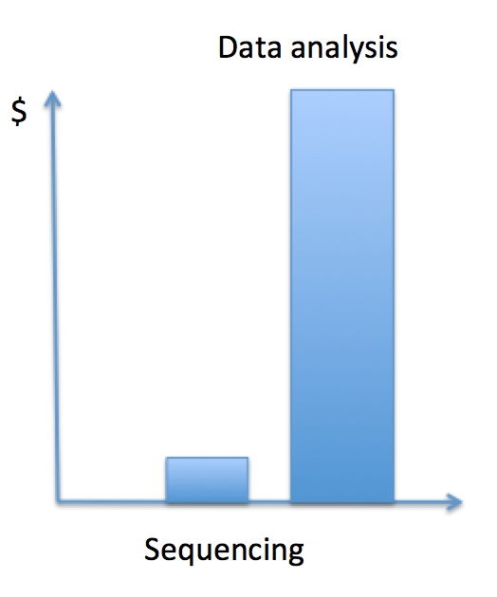

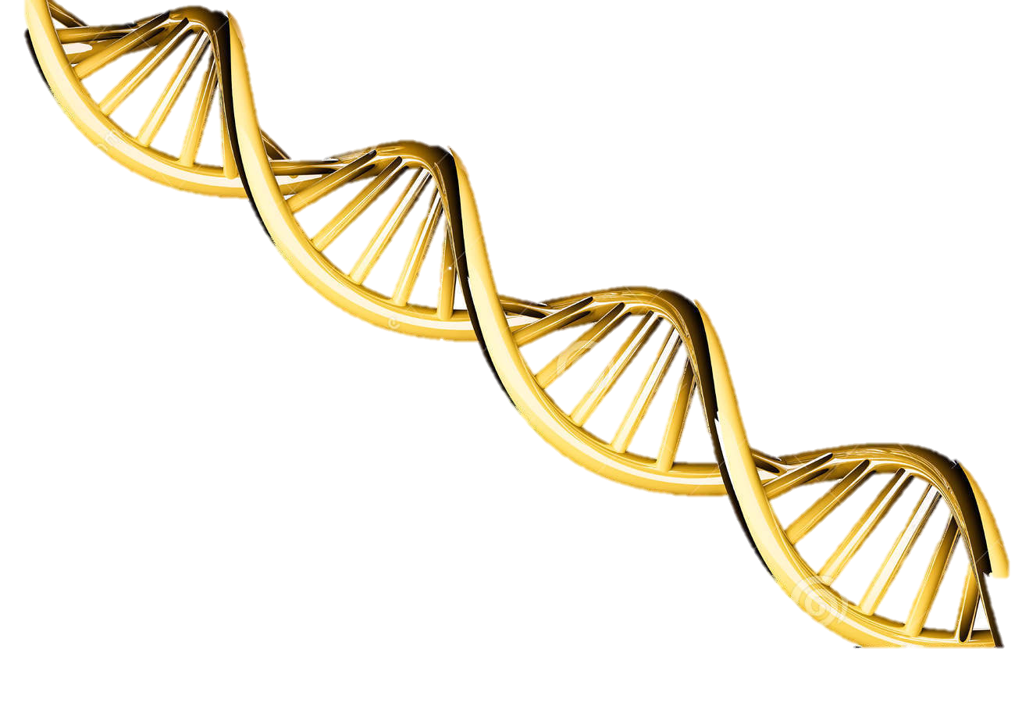
Let’s get philosophical
Notes:
Raw sequence data is not useful for most biologist, to be meaningful to them it has to be converted into biological significant knowledge => Gene, mRNAs etc… which are the GOLDEN NUGGETS in the middle of this hugue montain of data !!
So annotation is the first step toward the knowledge acquisition (i.e. Leuven)

Slide 5
Introduction to annotation
What is annotation ?
Structural annotation:
Find out where the regions of interest (usually genes) are in the sequence data and what they look like.
functional annotation:
Find out what the regions do. What do they code for?
VS
It is the annotation that bridges the gap from the sequence to the biology of the organism

Slide 6
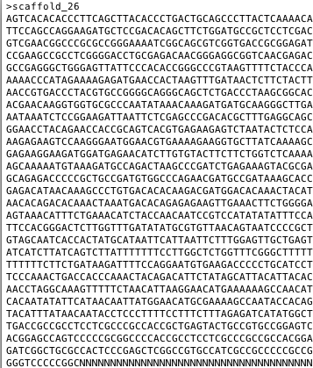
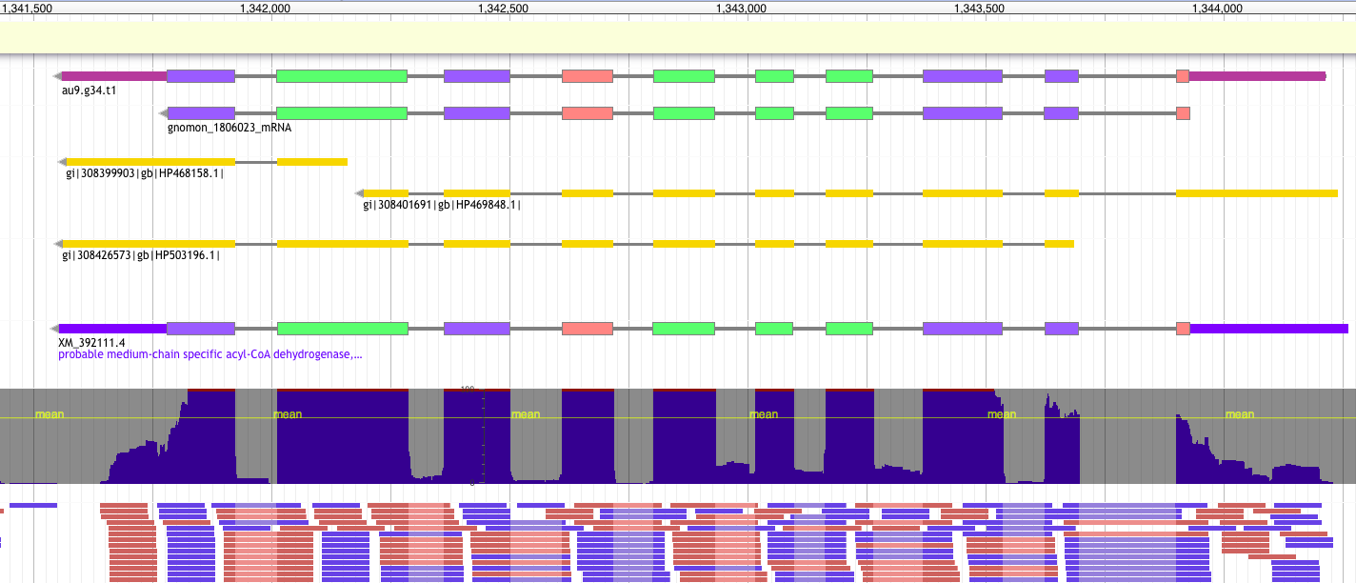
Introduction to annotation
From a genome…
FASTA
…to an annotated gene
GTF/GFF
9 columns
1 feature = 1 line
2. source
4. start
6. score
8. phase
Ctg123 maker Gene 1000 9000 . + . ID=gene1; Name=EDEN
1. sequence id
3. feature type
5. end
7. strand
9. attribute(s)
tag=value

Slide 7
Introduction to annotation
GFF / GTF formats
https://github.com/NBISweden/GAAS/blob/master/annotation/CheatSheet/gxf.md
Gene Transfer Format
General Feature Finding
GTF
GTF2
GTF2.1
GTF2.2
GTF2.X
GFF
Richard Durbin and David Haussler
2005
2007
2000
2003
Nowadays
1997
2004
2013
GFF2
GFF2.5
GFF3 v1
GFF3 v1.23
General Feature Format
Notes:
﻿In top of that the format has changed a lot through time.
Indeed, the development of this format has not been an easy task.
Facing some limitation using the original specification, GFF has evolved into different flavors depending on the different needs of different laboratories.
In 10 years (97-2007) the format has evolved a lot. The GFF3 is stable stable since many years (2004).

Slide 8
Introduction to annotation: GFF3
9 columns
1 feature = 1 line
##gff-version 3.2.1
##sequence-region ctg123 1 1497228
Ctg123 . Gene 1000 9000 . + . ID=gene1;Name=EDEN
ctg123 . mRNA 1050 9000 . + . ID=mRNA1;Parent=gene1;Name=EDEN.1
ctg123 . mRNA 1050 9000 . + . ID=mRNA2;Parent=gene1;Name=EDEN.2
ctg123 . exon 1300 1500 . + . ID=exon1;Parent=mRNA3
ctg123 . exon 1050 1500 . + . ID=exon2;Parent=mRNA1,mRNA2
ctg123 . exon 3000 3902 . + . ID=exon3;Parent=mRNA1
ctg123 . exon 5000 5500 . + . ID=exon4;Parent=mRNA1,mRNA2
ctg123 . exon 7000 9000 . + . ID=exon5;Parent=mRNA1,mRNA2
ctg123 . CDS 1201 1500 . + 0 ID=cds1;Parent=mRNA1;Name=eden1
ctg123 . CDS 3000 3902 . + 0 ID=cds1;Parent=mRNA1;Name=eden1
ctg123 . CDS 5000 5500 . + 0 ID=cds1;Parent=mRNA1;Name=eden1
ctg123 . CDS 7000 7600 . + 0 ID=cds1;Parent=mRNA1;Name=eden1
Ctg123 . CDS 1201 1500 . + 0 ID=cds2;Parent=mRNA2;Name=eden2
ctg123 . CDS 5000 5500 . + 0 ID=cds2;Parent=mRNA2;Name=eden2
Ctg123 . CDS 7000 7600 . + 0 ID=cds2;Parent=mRNA2;Name=eden2
Header
2) source
4) start
6) score
8) phase
9) attributes
tag=value
1) sequence id
5) end
3) feature type
(SO term = 2278 possibilities)
7) strand
! Features are grouped by parent relationship
Notes:
How look a GFF3 file ?
Here One gene
parent / children relationship provides a mechanism allowing to group features at several hierarchical level allowing representing complex entities like here.
The content can differ a lot according to the tool/group producing the file.
About the feature: One can write transcript instead of mRNA, or say UTR instead of 3’UTR and 5’UTR or the 3/5 number could also be written with letter and so one.
About the attributes: There is actually no limit for naming the tag. You can use what ever you want.

Slide 9
Introduction to annotation: GTF2.X
9 columns
1 feature = 1 line
#!genome-build GRCz11
#!genome-date 2017-05
Ctg123 . Gene 1000 9000 . + . gene_id gene1; name EDEN;
ctg123 . Transcript 1050 9000 . + . gene_id gene1; transcript_id=t1; name EDEN;
ctg123 . Transcript 1050 9000 . + . gene_id gene1; transcript_id=t2; name EDEN;
ctg123 . exon 1300 1500 . + . gene_id gene1; transcript_id=t1; name EDEN;
ctg123 . exon 1050 1500 . + . gene_id gene1; transcript_id=t1; name EDEN;
tg123 . exon 1050 1500 . + . gene_id gene1; transcript_id=t2; name EDEN;
ctg123 . exon 3000 3902 . + . gene_id gene1; transcript_id=t1; name EDEN;
ctg123 . exon 5000 5500 . + . gene_id gene1; transcript_id=t1; name EDEN;
ctg123 . exon 5000 5500 . + . gene_id gene1; transcript_id=t2; name EDEN;
ctg123 . exon 7000 9000 . + . gene_id gene1; transcript_id=t1; name EDEN;
ctg123 . exon 7000 9000 . + . gene_id gene1; transcript_id=t2; name EDEN;
ctg123 . CDS 1201 1500 . + 0 gene_id gene1; transcript_id=t1; name EDEN;
ctg123 . CDS 3000 3902 . + 0 gene_id gene1; transcript_id=t1; name EDEN;
ctg123 . CDS 5000 5500 . + 0 gene_id gene1; transcript_id=t1; name EDEN;
ctg123 . CDS 7000 7600 . + 0 gene_id gene1; transcript_id=t1; name EDEN;
Ctg123 . CDS 1201 1500 . + 0 gene_id gene1; transcript_id=t2; name EDEN;
ctg123 . CDS 5000 5500 . + 0 gene_id gene1; transcript_id=t2; name EDEN;
Ctg123 . CDS 7000 7600 . + 0 gene_id gene1; transcript_id=t2; name EDEN;
Header
2) source
4) start
6) score
8) phase
9) attributes
tag value;
1) sequence id
5) end
7) strand
3) feature type
(9 possibilities)
! Features grouped by a common attribute (gene_id / transcript_id)
Notes:
How look a GFF3 file ?
Here One gene
parent / children relationship provides a mechanism allowing to group features at several hierarchical level allowing representing complex entities like here.
The content can differ a lot according to the tool/group producing the file.
About the feature: One can write transcript instead of mRNA, or say UTR instead of 3’UTR and 5’UTR or the 3/5 number could also be written with letter and so one.
About the attributes: There is actually no limit for naming the tag. You can use what ever you want.

Slide 10
Introduction to annotation
/!\ different type of gff: annotation / alignment / other
Match_part
Alignment
Match
(protein1)
Match
(protein2)
DNA
Annotation
gene
Intron, exon, CDS,splice site, UTR, mRNA, isoforms

Slide 11



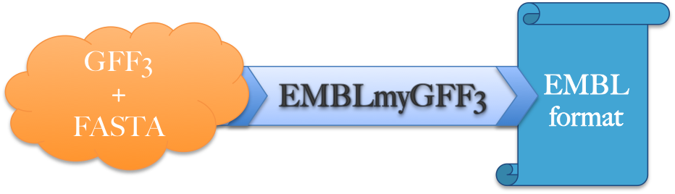

Introduction to annotation
The main steps in genome annotation
1
2
3
4
5
Downstream analysis
Structural annotation
Manual curation
Functional annotation
QC assembly
Submission
EuGene-EP

Slide 12
Introduction to annotation
Before annotation – check assembly quality
The quality of the assembly will heavily influence the quality of the annotation
SNP-errors can change start/stop-codons
Indels can cause frame-shifts
High fragmentation could break loci
missing loci cannot be annotated
=> Annotation tools have difficulties to deal with those problems
Notes:
if a locus is completely missing from the assembly, it cannot be annotated

Slide 13
Introduction to annotation
Assembly check and preparation
Fragmentation (N50, number of sequences, how many small contigs)
Sanity of the fasta file (Ns, IUPAC, lowercase nucleotides)
Completeness / duplication / fragmentation
Presence of Organelles
Other (GC content, how distant from other species)

Slide 14
Introduction to annotation
BUSCO output
# BUSCO version is: 3.0.2
# The lineage dataset is: fungi_odb9 (Creation date: 2016-02-13, number of species: 85, number of BUSCOs: 290)
#
# Summarized benchmarking in BUSCO notation for file genome.fa
# BUSCO was run in mode: genome
C:98.6%[S:97.9%,D:0.7%],F:0.0%,M:1.4%,n:290
286 Complete BUSCOs (C)
284 Complete and single-copy BUSCOs (S)
2 Complete and duplicated BUSCOs (D)
0 Fragmented BUSCOs (F)
4 Missing BUSCOs (M)
290 Total BUSCO groups searched

Slide 15
Introduction to annotation
Repeat Masking
Repeatmodeler to find new repeats
http://www.repeatmasker.org/RepeatModeler/
Repeatmasker to mask known repeats
http://www.repeatmasker.org
+ Save time
+ Increase quality of the annotation

Slide 16
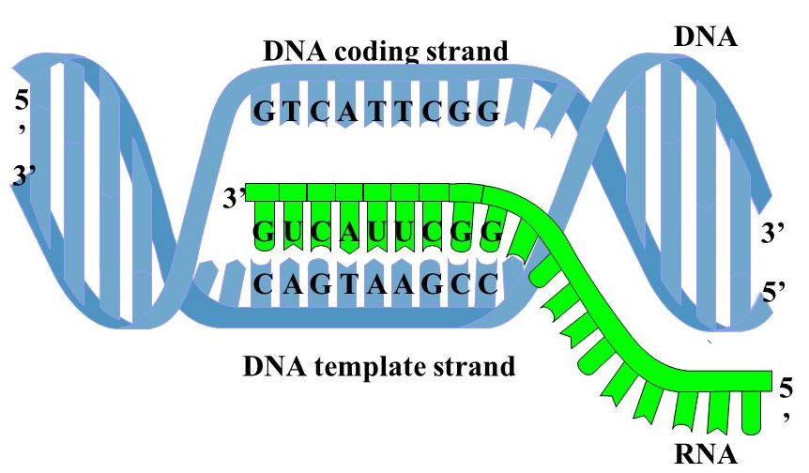
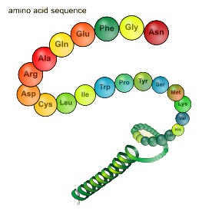
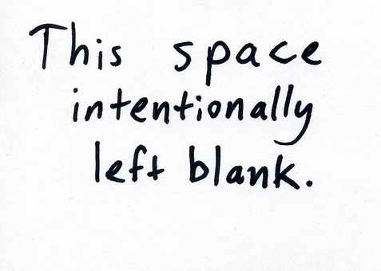
Introduction to annotation
Types of external data used
Ø
Proteins
Transcripts
Known amino acid sequences from other organisms
Assembled from RNA-seq or downloaded ESTs

Slide 17
Introduction to annotation
Types of data used: Proteins
Conserved in sequence => conserved annotation with little noise
Proteins from model organisms often used => bias?
Proteins can be incomplete => problems as many annotation procedures are heavily dependent on protein alignments
>ENSTGUP00000017616 pep:novel chromosome:taeGut3.2.4:8_random:2849599:2959678:-1 gene:ENSTGUG00000017338 transcript:ENSTGUT00000018018 gene_biotype:protein_coding transcript_biotype:protein_coding
RSPNATEYNWHHLRYPKIPERLNPPAAAGPALSTAEGWMLPWGNGQHPLLARAPGKGRER
DGKELIKKPKTFKFTFLKKKKKKKKKTFK
>ENSTGUP00000017615 pep:novel chromosome:taeGut3.2.4:23_random:205321:209117:1 gene:ENSTGUG00000017337 transcript:ENSTGUT00000018017 gene_biotype:protein_coding transcript_biotype:protein_coding
PDLRELVLMFEHLHRVRNGGFRNSEVKKWPDRSPPPYHSFTPAQKSFSLAGCSGESTKMG
IKERMRLSSSQRQGSRGRQQHLGPPLHRSPSPEDVAEATSPTKVQKSWSFNDRTRFRASL
RLKPRIPAEGDCPPEDSGEERSSPCDLTFEDIMPAVKTLIRAVRILKFLVAKRKFKETLR
PYDVKDVIEQYSAGHLDMLGRIKSLQTRVEQIVGRDRALPADKKVREKGEKPALEAELVD
ELSMMGRVVKVERQVQSIEHKLDLLLGLYSRCLRKGSANSLVLAAVRVPPGEPDVTSDYQ
SPVEHEDISTSAQSLSISRLASTNMD
Notes:
BIAS? Wrong annotation are easily propagated
Do not allow defining UTRs

Slide 18
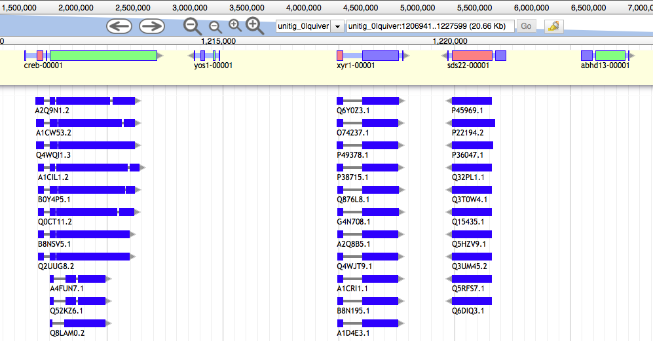
Introduction to annotation
Protein sequences are aligned to the genome

Slide 19
Introduction to annotation
Types of data used: RNA-seq
DNA
Exon
Intron
Exon
Intron
Exon
Intron
Exon
UTR
UTR
ATG
Start codon
GT
AG
GT
AG
GT
AG
TAG, TAA, TGA
Stop codon
Transcription
Pre-mRNA
UTR
UTR
AA
ATG
Start codon
TAG, TAA, TGA
Stop codon
AAAAA
Splicing
mRNA
UTR
UTR
AAAAAAAAA
ATG
Start codon
TAG, TAA, TGA
Stop codon
Translation
Notes:
To define transcribed portion ! Conpare to Protein it contains UTR !!

Slide 20
Introduction to annotation
Types of data used: RNA-seq
Should always be included in an annotation project
From the same organism as the genomic data => unbiased
/!\ Can be very noisy (tissue/species dependent), can include pre-mRNA
Sample different tissues or life stages if possible
Avoid gonads; muscle or liver is good

Slide 21
Introduction to annotation
RNA-seq - Spliced reads
DNA
Exon
Intron
Exon
Intron
Exon
Intron
Exon
UTR
UTR
ATG
Start codon
GT
AG
GT
AG
GT
AG
TAG, TAA, TGA
Stop codon
Transcription
Pre-mRNA
UTR
UTR
AA
ATG
Start codon
TAG, TAA, TGA
Stop codon
AAAAA
Splicing
mRNA
UTR
UTR
AAAAAAAAA
ATG
Start codon
TAG, TAA, TGA
Stop codon
Translation

Slide 22
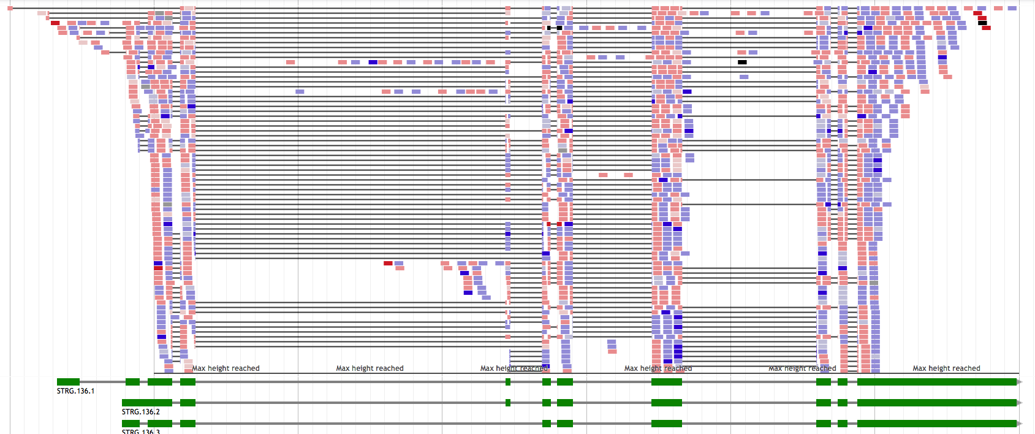
Introduction to annotation
RNA-seq - Spliced reads

Slide 23
Introduction to annotation
Pre-mRNA
DNA
Exon
Intron
Exon
Intron
Exon
Intron
Exon
UTR
UTR
ATG
Start codon
GT
GT
GT
TAG, TAA, TGA
Stop codon
Transcription
Pre-mRNA
UTR
UTR
AA
ATG
Start codon
TAG, TAA, TGA
Stop codon
AAAAA
Splicing
mRNA
UTR
UTR
ATG
Start codon
TAG, TAA, TGA
Stop codon
Translation
Notes:
If you have sequenced preMRNA some reads will span into the intronic regions and provide wrong information about what is CDS or not

Slide 24
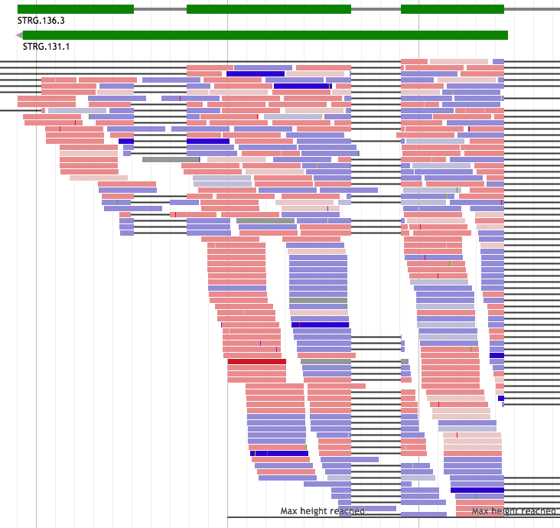
Introduction to annotation
RNA-seq – pre-mRNA noise

Slide 25

Introduction to annotation
Types of data used: RNA-seq
RNA-seq (short-reads) need to be assembled first
Genome guided assembly
=> Cufflinks/Stringtie/…: mapped reads -> transcripts
De novo
=> Trinity: assembles transcripts without a genome

