Slide 1
Jacques Dainat PhD
Methods in genome annotation
Uppsala – May 2019

Slide 2
This lecture will focus on eukaryotes
The different annotation approaches (coding genes)
1.1 Introduction
1.2 Ab initio
1.3. Hybrid
1.4 Chooser, combiner
1.5 Pipeline
2. Annotation of other genome features
Assessing an annotation
Closing remarks
Notes:
I will not talk about prokaryote annotation that are easy to resolve.

Slide 3
1. The different annotation approaches
1.1 Introduction

Slide 4
The different approaches
Annotation tools
First annotation tools
90’s
>100 annotation tools*
Nowadays
GFFs
Structural annotation + functional annotation + …
*estimation
https://github.com/NBISweden/GAAS/blob/master/annotation/CheatSheet/annotation_tools.md
Notes:
There is a plethoric choice of annotation tools.
Vast majority of annotation tools (at least modern one – let say since the the early 2000s) produce GFF outputs.
The GFF format allows some freedom/flexibility and can hold wide variety of information.
The GFF format became a reference format for annotations and the vast majority of annotation tools produce GFF.
And each tool can produce the GFF in its own way.

Slide 5
The different approaches
Similarity-based methods :
These use similarity to annotated sequences like proteins, cDNAs, or ESTs
Ab initio prediction :
Likelihood based methods
Hybrid approaches :
Ab initio tools with the ability to integrate external evidence/hints
Comparative (homology) based gene finders :
These align genomic sequences from different species and use the alignments to guide the gene predictions
Chooser, combiner approaches :
These combine gene predictions of other gene finders
Pipelines :
These combine multiple approaches

Slide 6
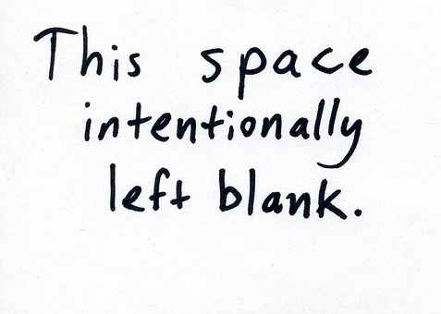
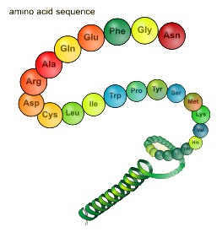
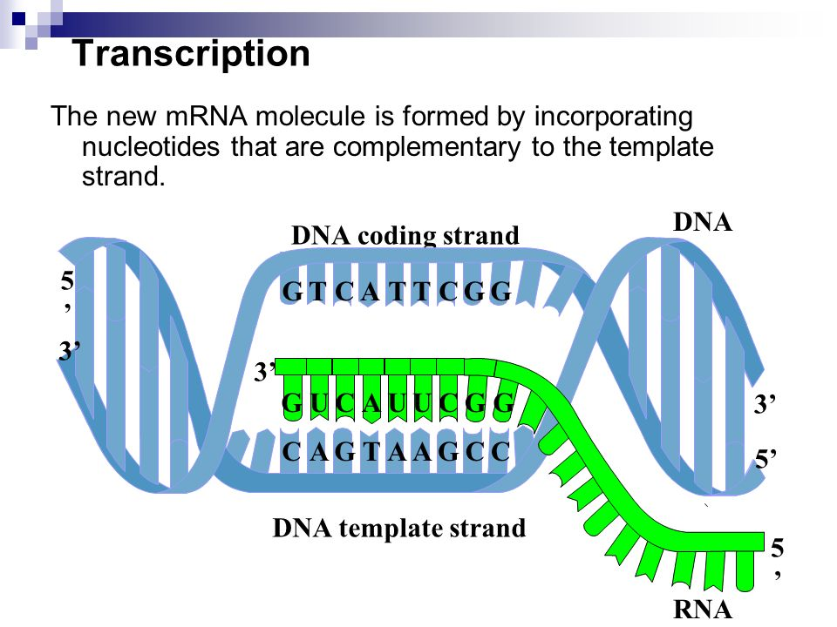
The different approaches
Types data used vs methods
Ø
Proteins
Transcripts
Known amino acid sequences from other organisms
Assembled from RNA-seq or downloaded ESTs
Annotation approach
Similarity |  | X | X
Pure ab initio | X
Hybrid |  | X | X
Comparative | X | X | X
Chooser/combiner | X | X | X
Pipeline | X | X | X

Slide 7
The different approaches
Similarity-based methods :
These use similarity to annotated sequences like proteins, cDNAs, or ESTs
Ab initio prediction :
Likelihood based methods
Hybrid approaches :
Ab initio tools with the ability to integrate external evidence/hints
Comparative (homology) based gene finders :
These align genomic sequences from different species and use the alignments to guide the gene predictions
Chooser, combiner approaches :
These combine gene predictions of other gene finders
Pipelines :
These combine multiple approaches

Slide 8
1. The different annotation approaches
1.2 Ab-initio annotation tools
“intrinsic approach”

Slide 9
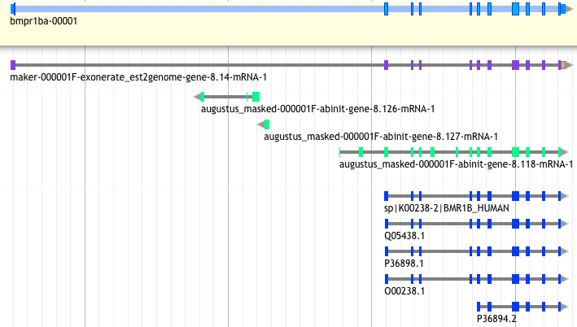
Ab initio method
Uses likelihoods to find the most likely gene models
Easy to use!
augustus --species=chicken contig.fa > augustus_chicken.gff

Slide 10
Ab initio method
method based on gene content :
(statistical properties of protein-coding sequence )
codon usage
hexamer usage
GC content
compositional bias between codon positions
nucleotide periodicity
exon/intron size
…
and on signal detection:
Promoter
ORF
Start codon
Splice site (Donor and acceptor)
Stop codon
Poly(A) tail
CpG islands
…
=> Ab initio tools will combine this information through different Probabilistic models: HMM, GHMM, WAM, etc.
These models need to be created if not already existing for your organism => training!
Notes:
HMM = hidden Markov models
GHMM = General Hidden Markov Mode
(GHMM may be a DNA sequence of any length, whereas in ordinary HMMs, the observation is always a single nucleotide.)
WAM = Weight array model
WMM = Weight matrix model

Slide 11
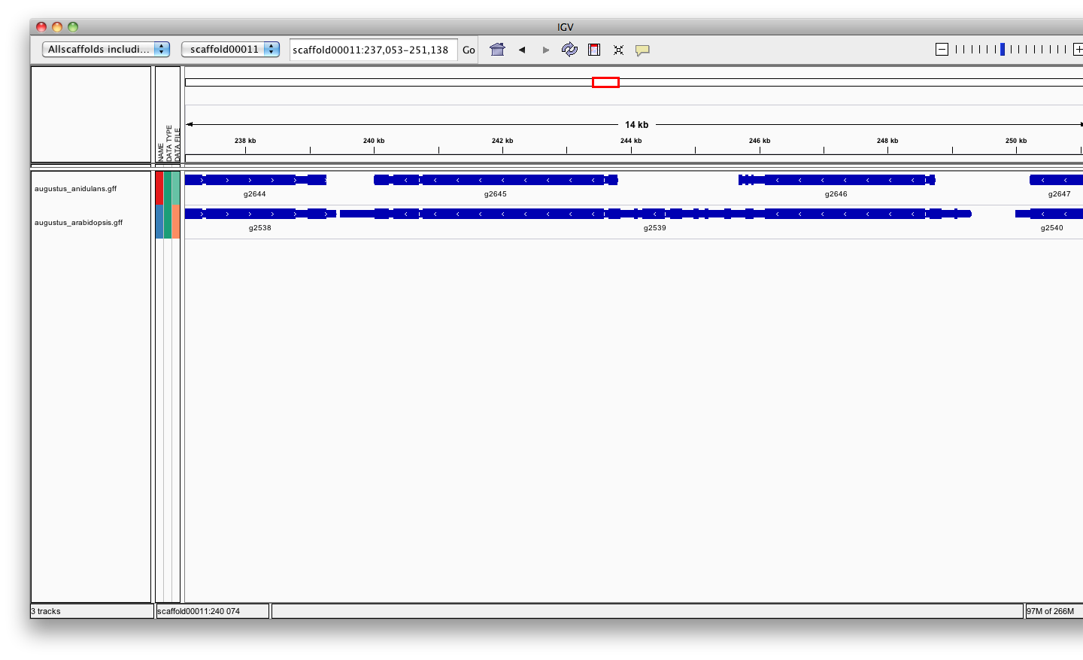
Ab initio method
Training ab-initio gene-finders
Some gene-finders train themselves, others need a separate training procedure
Around 500 already known genes are usually needed to train the gene-finder
=> These ”known” genes can be inferred from aligned transcripts or proteins
The quality of the gene-finder results hugely relies on the quality of the training!
A fungal genome
Fungi
Plants

Slide 12
Ab initio method
Assess the quality of the ab-initio model/training:
TN
FN
TP
FP
TN
FN
TP
FN
TN
~
REALITY
PREDICTION
Sensitivity is the proportion of true predictions compared to the total number of correct genes (including missed predictions)
Specificity is the proportion of true predictions among all predicted genes (including incorrectly predicted ones)
Ab Initio methods can approach 100% sensitivity, however as the sensitivity increases, accuracy suffers as a result of increased false positives.
Notes:
The goal for a good annotation is to get keep these two values as high as possible

Slide 13
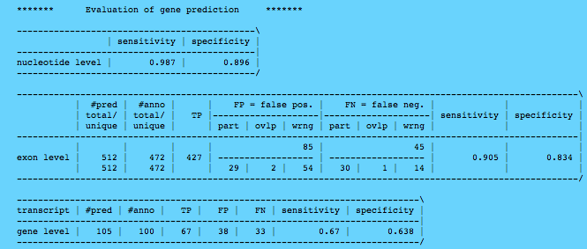
Ab initio method

Slide 14
Ab initio method
Popular tools:
SNAP Works ok, easy to train, not as good as others especially on longer intron genomes.
Augustus Works great, hard to train (but getting better).
GeneMark-ES Self training, no hints, buggy, not good for fragmented genomes or long introns (Best suited for Fungi).
FGENESH Works great, costs money even for training.
GlimmerHMM (Eukaryote)
GenScan
Gnomon (NCBI)
Supported by MAKER
http://weatherby.genetics.utah.edu/MAKER/wiki/index.php/MAKER_Tutorial
Notes:
Glimmer: apparently easy to train but manually tuning needed.

Slide 15
Ab initio method
Strengths :
Fast and easy means to identify genes
Annotate unknown genes
“Exhaustive” annotation
Need no external evidence
Limits :
No UTR*
No alternatively spliced transcripts*
Over prediction (exons or genes)
Training needed to perform well in terra incognita’
Split single gene into multiple predictions
Fused with neighboring genes
Less accurate than homology based method:
Exon boundaries
Splicing sites
Hybrid method
Notes:
Gene finders generally do a poor job (~50%) predicting genes in eukaryotes

Slide 16
1. The different annotation approaches
1.3 Hybrid approaches

Slide 17
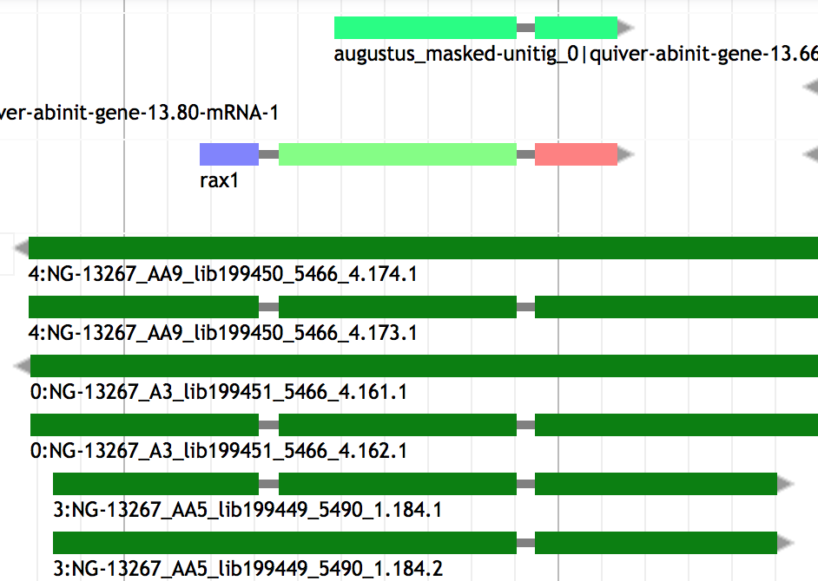
Hybrid method
Hybrid (evidence-drivable gene predictors) approaches incorporate hints in the form of EST or protein alignments to increase the accuracy of the gene prediction.
Notes:
GenomeScan : The blast hits have to be converted into a probability, but this is made relatively easily, as the E-values give guidance… ( Understanding Bioinformatics, Par Marketa J. Zvelebil,Jeremy O. Baum). It’s a version based on genscan.
EuGene* can be seen as a combiner because collect information about splice sites and ATG has to be done outside the program.

Slide 18
Hybrid method
Hybrid (evidence-drivable gene predictors) approaches incorporate hints in the form of EST alignments or protein profiles to increase the accuracy of the gene prediction.
GenomeScan Blast hit used as extra guide
Augustus 16 types of hints accepted (gff): start, stop, tss, tts, ass, dss, exonpart, exon, intronpart, intron, CDSpart, CDS, UTRpart, UTR, irpart, nonexonpart.
GeneMark-ET EST-based evidence hints
GeneMark-EP Protein-based evidence hints
SNAP Accepts EST and protein-based evidence hints.
Gnomon Uses EST and protein alignments to guide gene prediction and add UTRs
FGENESH+ Best suited for plant
EuGene* Any kind of evidence hints. Hard to configure (best suited for plant)
Self training !
Notes:
GenomeScan : The blast hits have to be converted into a probability, but this is made relatively easily, as the E-values give guidance… ( Understanding Bioinformatics, Par Marketa J. Zvelebil,Jeremy O. Baum). It’s a version based on genscan.
EuGene* can be seen as a combiner because collect information about splice sites and ATG has to be done outside the program.

Slide 19
Hybrid method
Strength : High accuracy
Limits :
- Extra computation to generate alignments
- heterogeneous sequence quality :
Incomplete,
Error during transcriptome assembly
Contamination
Sequence missing
Orientation error

Slide 20
Hybrid method
The BRAKER1 gene finding pipeline:
BRAKER1: Unsupervised RNA-Seq-Based Genome Annotation with GeneMark-ET and AUGUSTUS
Katharina J. Hoff et al.
Bioinformatics (2016) 32 (5): 767-769. doi: 10.1093/bioinformatics/btv661
BRAKER1 was more accurate than MAKER2 when it is using RNA-Seq as sole source for training and prediction.
BRAKER1 does not require pre-trained parameters or a separate expert-prepared training step.
BRAKER2 since 2019 (Incorporate Protein Homology Information)

Slide 21
1. The different annotation approaches
1.4 Chooser / combiner

Slide 22
Chooser / combiner
Overview
combining different lines of evidence into gene models
Evidence:
ESTs / Transcripts
Proteins
Ab-initio prediction
Combining

Slide 23
Chooser / combiner
Use battery of gene finders and evidence (EST, RNAseq, protein) alignments and:
Tool | Consensus based chooser | Evidence based chooser | weight of different sources | Comment
A) Choose the prediction whose best matches the evidence
MAKER* |  | X
PASA* |  | X
B) Choose the prediction whose structure best represents the consensus
JIGSAW | X
C) Choose the best possible set of exons and combine them in a gene model
EVM Evidencemodeler | X | X | X | User can set the expected evidence error rate manually or/and learn from a training set
Evigan | X |  | X | Unsupervised learning method
Ipred |  | X |  | Does not require any a priori knowledge Can also combine only evidences to create a gene model
Strength => They improve on the underlying gene prediction models
Notes:
EVM choose the post-processed gene model that is most consistent with the evidences
~ GAZE : GAZE (Howe et al. 2002), pro- vides a general framework to assemble an optimal set of gene structures given a user-supplied feature set, scoring scheme,
Ipred: Franziska Zickmann and Bernhard Y Renard BMC Genomics. 2015; 16(1): 134.doi: 10.1186/s12864-015-1315-9
EVIGAN is the scuccessor of GLEAN
* Are pipelines that contain chooser

Slide 24
1. The different annotation approaches
1.5 Gene annotation pipelines
(The ultimate step)
Align evidence, add UTRs and more
Notes:
Much more complex, align themselves the evidences, annotate UTRs, repeat mask, annotate other kind of features within the genome…

Slide 25
Annotation pipeline
PASA Produces evidence-driven consensus gene models
- minimalist pipeline ()
+ good for detecting isoforms
+ biologically relevant predictions
=> using Ab initio tools and combined with EVM it does a pretty good job !
- PASA + Ab initio + EVM not automatized
NCBI pipeline Evidence + ab initio (Gnomon), repeat masking, gene naming, data formatting, miRNAs, tRNAs
Ensembl Evidence based only ( comparative + homology ) …
MAKER2 Evidence based and/or ab initio …
…
Notes:
PASA: Does not do anything else that align evidences and define gene models with UTRs
NCBI pipeline integrates gnomon ; data formatting = Save in correct format for dowmstream hanmdling/analysis

Slide 26
2. Annotation of other genome features

Slide 27
Other genome features
Feature type | DB associated | Tool example | approach
ncRNA | Rfam | infernal | HMM + CM
tRNA | Sprinzl database | tRNAscan-SE | CM + WMA
snoRNA |  | snoscan | HMM + SCFG
miRNA | miRBase | Splign miR-PREFeR (for plant) | sequence alignment Based on expression patterns
Repeats | Repbase, Dfam | repeatMasker | HMM, blast
Pseudogenes |  | pseudopipe | homology-based (blast)
…
Notes:
ncRNA annotation are less reliable but are of good interest to give clue about them. Should call them putative ncRNA
SCFG and HMM are al probabilistic models
CM is a type of stochastic context-free grammar (profile SCFG) that describes both sequence and secondary structure.
it is more capable of identifying RNA homologs that conserve their secondary structure more than their primary sequence.
Infernal uses CMs to search for new family members in sequence databases and to create potentially large multiple sequence alignments. Version 1.1 of Infernal introduces a new filter pipeline for RNA homology search based on accelerated profile hidden Markov model (HMM) methods and HMM-banded CM alignment methods.
WMA = weight matrix anaylsis
snoRNAs = Small nucleolar RNAs
snoGPS for the detection of pseudouridylation-guide snoRNAs
Pseudopipe : To be launched after gene annotation

Slide 28
3. Assessing an annotation

Slide 29
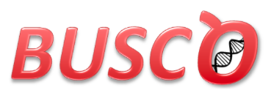
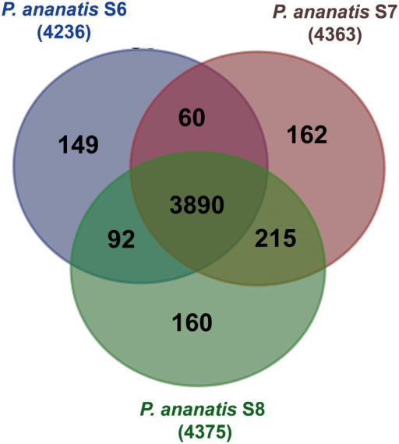
Assessing an annotation
Simple statistics (number genes / number exon per gene)
(and compare against assembly result )
Protein/transcript evidence (AED score in MAKER)
Comparative genomics (OrthoMCL)
Domain / Function attached
Visualization

Slide 30
Assessing an annotation
Selection of most common visualization or/and Manual curation tools
Name | Standalone | Web tool | Manual curation | year | comment
Artemis | X |  | X | 2000 | Can save annotation in EMBL format
IGV | X |  |  | 2011 | Popular
Savant | X |  |  | 2010 | Sequence Annotation, Visualization and ANalysis Tool. enable Plug-ins
Tablet | X |  | X | 2013
IGB | X |  |  | 2008 | enable Plug-ins. Can load local and remote data (dropbox, UCSC genome, etc)
Jbrowse |  | X |  | 2010 | GMOD (successor of Gbrowse)
Web Apollo |  | X | X | 2013 | Active community (gmod). Based on Jbrowse. Real-time collaboration
UCSC |  | X |  | 2000 | A large amount of locally stored data must be uploaded to servers across the internet
Ensembl genome browsers |  | X |  | 2002 | A large amount of locally stored data must be uploaded to servers across the internet
FOR AN EXHAUSTIVE LIST: https://en.wikipedia.org/wiki/Genome_browser

Slide 31
4. To resume / Closing remarks

Slide 32
Closing remarks
>100 annotation tools – as many methods
(https://github.com/NBISweden/GAAS/blob/master/annotation/CheatSheet/annotation_tools.md)
6 main class of approaches (Similarity-based, ab initio, hybrid, comparative, combiner, pipeline )
How to choose Method:
Scientific question behind ( need of a conservative annotation vs exhaustive)
Species dependent (plant / Fungi / eukaryotes)
phylogenetic relationship of the investigated genome to other annotated genomes (Terra incognita, close, already annotated).
Data available (hmm profile, RNAseq, etc…)
Depending on computing resources (ab initio ~ hours < vs > pipeline ~ weeks)
Notes:
There is a plethoric choice of methods
conservative will be more based on evidence without ab-initio (Ensembl). <= You want only real/existing gene
Exhaustive will be more ab initio <= you don’t care about over prediction (you will filter … by clusterisation ?)

Slide 33
Closing remarks
Effort versus accuracy
accuracy
Effort / time

Slide 34
Closing remarks
Several ab-initio tools together give better result that one alone
(they complement each other)
Pipelines give good results
MAKER2 the most flexible, adjustable
Most methods only build gene models, no functional inference
No annotation method is perfect, they do mistakes !!
Annotation requires manual curation
As for assembly, an annotation is never finished, it can always be improved
=> e.g. Human (to know how to stop)
Submit your annotation in public archive
Notes:
to know how to stop, otherwise you could spend your whole thesis on an annotation. So when is good enough for the scientific question you want to answer, don’t hesitate to stop.

Slide 35
THE END
https://github.com/NBISweden/GAAS
Notes:
Slide made based on 10.1371/journal.pone0050609.t001
Evaluating High-Throughput Ab Initio Gene Finders to Discover Proteins Encoded in Eukaryotic Pathogen Genomes Missed by Laboratory Techniques. Stephen J. Goodswen, Paul J. Kennedy, John T. Ellis )
CRAIG = abinitio the first CRF (conditional random fields ) (1 CRF). Use only targested genome
Conrad = 2em CRF (not adapted to big genome). Use multi genome, many of its parameters are trained in the same way as GHMM parameters
Contrast = 3em CRF , Use multi genome
FGENESH = widely used for plant
Salzberg says: Integrated approaches. These combine multiple forms of evidence, such as the predictions of other gene finders
Jigsaw, EuGène(graph-based ), Gaze.
Mark Yandell says: GAZE Highly configurable gene predictor (Ab initio tool)
Dans la publication EuGène they say : GAZE: is not a proper gene predictor, because it cannot produce a list of possible coding regions alone.
In another EuGene publication they say about Eugene : We first collect information about splice sites and ATG by submitting the sequence to NetGene2 [20], SplicePredictor [2] and NetStart [13] using a dedicated Perl script.

