Slide 1
Lucile Soler PhD
Nima Rafati PhD
Methods in genome annotation
Tromsø – May 2021

Slide 2
﻿Contents
1. Introduction
2. The different annotation methods (coding genes)
2.1 Intrinsic / ab initio
2.2 Extrinsic / similarity-based
2.3 Hybrid : Ab initio evidence-driven
2.4 comparative
2.4 combiner / chooser
2.5 pipeline
3. Annotation of other genome features
4. Annotation assessment
5. To resume / Closing remarks

Slide 3
1. Introduction

Slide 4
Introduction: What is annotation?
What is annotation?
Structural annotation:
Find out where the regions of interest (usually genes) are in the sequence data and what they look like.
=> Gene prediction / Gene Finding
functional annotation:
Find out what the regions do. What do they code for?
+
It is the annotation that bridges the gap from the sequence to the biology of the organism
Notes:
More and more genomes are sequenced and assembled and more and more need annotation
Find out where the regions of interest (usually genes) are in the sequence data and what they look like.
=> Gene prediction / Gene Finding

Slide 5
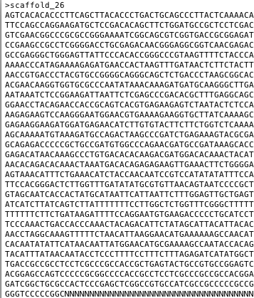
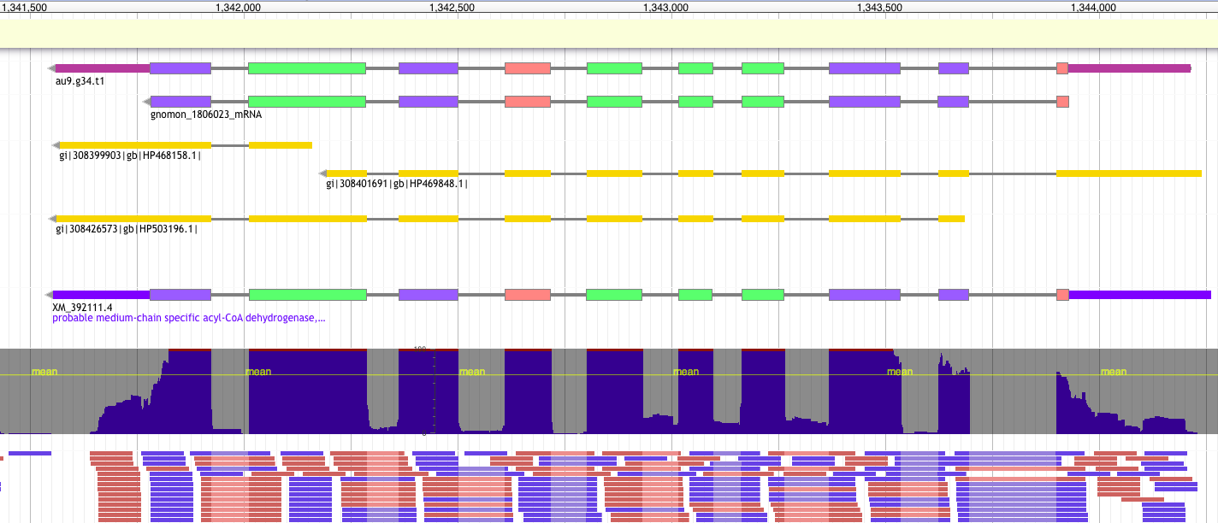
Introduction: Formats
From a genome…
FASTA
…to an annotated gene
GTF/GFF
9 columns
1 feature = 1 line
2. source
4. start
6. score
8. phase
Ctg123 maker Gene 1000 9000 . + . ID=gene1; Name=EDEN
1. sequence id
3. feature type
5. end
7. strand
9. attribute(s)
tag=value

Slide 6



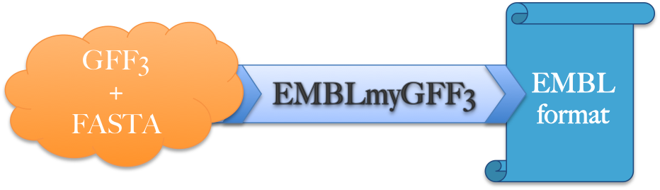

Introduction: Overview
The main steps in genome annotation
1
2
3
4
5
Downstream analysis
Structural annotation
Manual curation
Functional annotation
QC assembly
Submission
EuGene-EP

Slide 7
Introduction: Structural annotation
Experimental (ESTs, cDNAs, RNA-seq)
Predictive
Isolate and clone cognate transcripts (as cDNA) sequence them and compare cDNA with genomic DNA
=> It’s the ONLY secure method but:
Cloning is time consuming.
Lowly expressed genes are difficult to detect.
…
Intrinsic / ab initio
Extrinsic
Hybrid

Slide 8
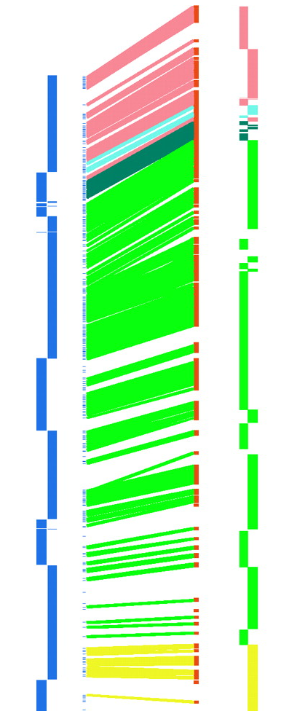
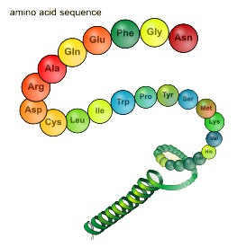
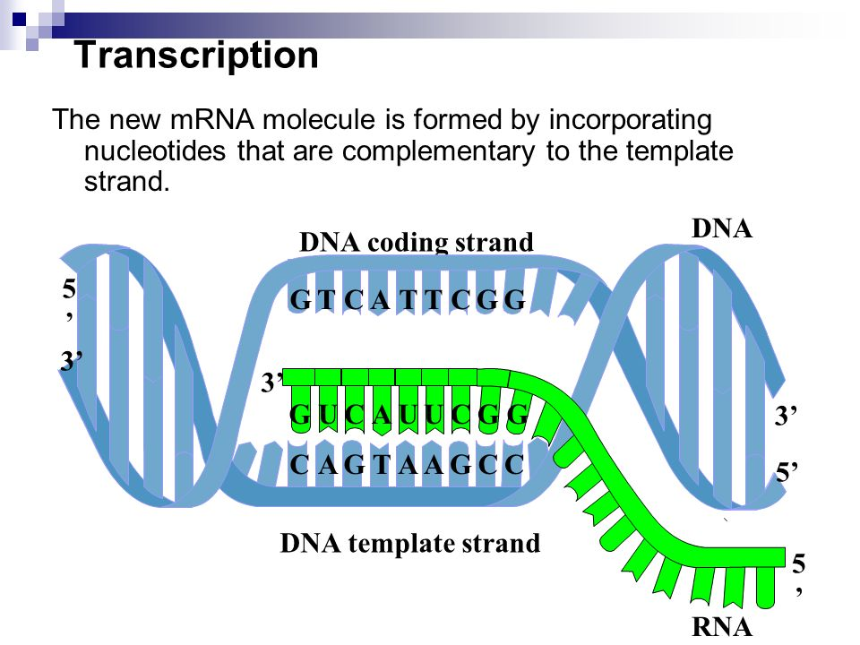
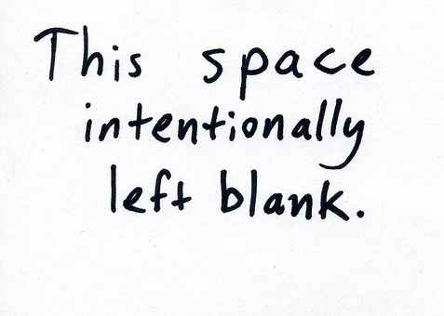
Introduction: Predictive methods
Intrinsic / Ab-initio
Extrinsic
Ø
Proteins
Transcripts
Genomes
Use of information/features from the sequence itself
Known amino acid sequences from other organisms
Assembled from RNA-seq or downloaded ESTs
Close relative genomes

Slide 9
2. The different methods/approaches

Slide 10
The different approaches
Similarity-based methods :
These use similarity to annotated sequences like proteins, cDNAs, or ESTs
Ab initio prediction :
Likelihood based methods
Hybrid (Ab initio evidence-driven) approaches :
Ab initio tools with the ability to integrate external evidence/hints
Comparative (homology) based gene finders :
These align genomic sequences from different species and use the alignments to guide the gene predictions
Chooser, combiner approaches :
These combine gene predictions of other gene finders
Pipelines :
These combine multiple approaches

Slide 11
Extrinsic approaches
2.1. Extrinsic approaches
Similarity-based methods
These use similarity to annotated sequences like
Proteins
Transcripts
ESTs

Slide 12
The different approaches
Types data used vs methods
Ø
Proteins
Transcripts
Known amino acid sequences from other organisms
Assembled from RNA-seq or downloaded ESTs
Annotation approach
Similarity |  | X | X
Pure ab initio | X
Hybrid | X | X | X
Comparative | X | X | X
Chooser/combiner | X | X | X
Pipeline | X | X | X

Slide 13
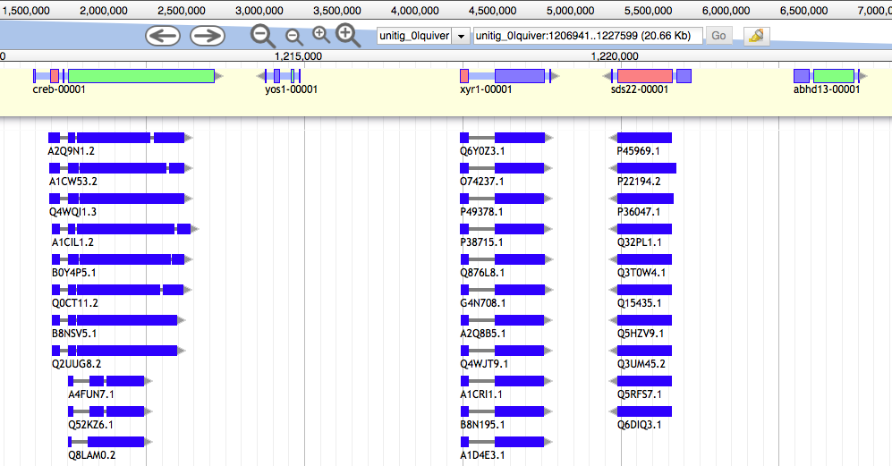
Similarity-based method: Protein data
Protein sequences are aligned to the genome
Conserved in sequence => conserved annotation with little noise
Notes:
BIAS? Wrong annotation are easily propagated
Do not allow defining UTRs

Slide 14
Similarity-based method: Protein data
Limits :
Related to pre-existing data
Proteins from model organisms often used => bias?
Proteins can be incomplete
Protein can be wrong (PE)
No UTR
>sp|Q9NSK7|CS012_HUMAN Protein C19orf12 OS=Homo sapiens OX=9606 GN=C19orf12 PE=1 SV=3
MERLKSHKPATMTIMVEDIMKLLCSLSGERKMKAAVKHSGKGALVTGAMAFVGGLVGGPP
GLAVGGAVGGLLGAWMTSGQFKPVPQILMELPPAEQQRLFNEAAAIIRHLEWTDAVQLTA
LVMGSEALQQQLLAMLVNYVTKELRAEIQYDD
>sp|Q2V2T9|SCL16_ARATH Putative scarecrow-like protein 16 OS=Arabidopsis thaliana OX=3702 GN=SCL16 PE=5 SV=1
MQIPTLIDSMANKLHKKPPPLLKLTVIASDAEFHPPPLLGISYEELGSKLVNFATTRNVA
MEFRIISSSYSDGLSSLIEQLRIDPFVFNEALVVNCHMMLHYIPDEILTSNLRSVFLKEL
RDLNPTIVTLIDEDSDFTSTNFISRLRSLYNYMWIPYDTAEMFLTRGSEQRQWYEADISW
KIDNVVAKEGAERVERLEPKSR

Slide 15
Similarity-based method: RNA-seq data
Types of data used: RNA-seq
DNA
Exon
Intron
Exon
Intron
Exon
Intron
Exon
UTR
UTR
ATG
Start codon
GT
AG
GT
AG
GT
AG
TAG, TAA, TGA
Stop codon
Transcription
Pre-mRNA
UTR
UTR
AA
ATG
Start codon
TAG, TAA, TGA
Stop codon
AAAAA
Splicing
mRNA
UTR
UTR
AAAAAAAAA
ATG
Start codon
TAG, TAA, TGA
Stop codon
Translation

Slide 16
Similarity-based method: RNA-seq data
From the same organism as the genomic data => unbiased
Sample different tissues or life stages if possible

Slide 17

Similarity-based method: RNA-seq data
Limits :
/!\ Can be very noisy (tissue/species dependent), can include pre-mRNA
=> Avoid gonads and liver ; muscle is good
Hard to catch low expressed / peculiar expressed (stage of life, condition, etc…) / isoforms
short-reads:
need to be assembled first
Genome guided assembly
Stringtie: mapped reads -> transcripts
De novo
=> Trinity: assembles transcripts without a genome
Transcriptome assembly errors
Long-reads:
error rate / frameshift / indels

Slide 18
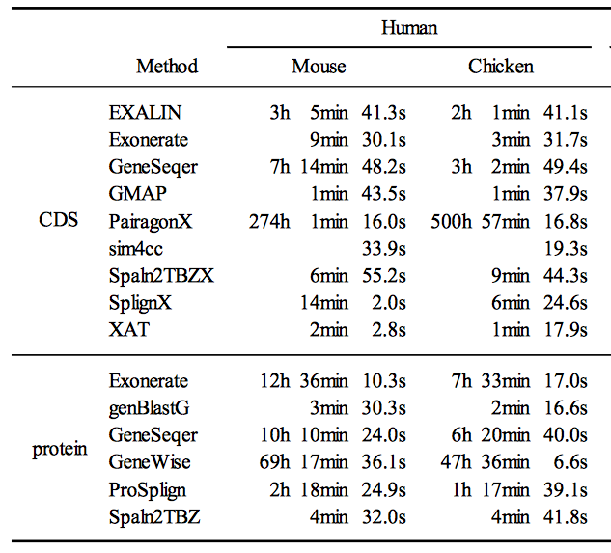
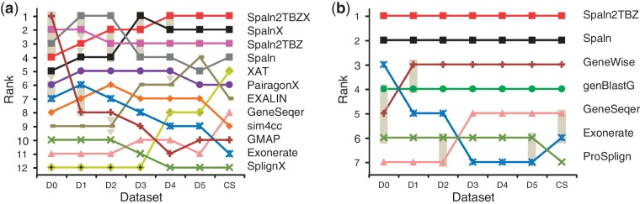
Similarity-based method: Protein / transcripts
DNA | AA
Blastn | Pmatch
Vsearch | tblastn
NSimScan | PSimScan
Rough approximation (fast)
Splice-site aware alignment (slow – moderately slow)
HUMAN??
DNA | AA
Exonerate | Exonerate
Gmap | Genewise
GenomeThreader | GenomeThreader
Notes:
2 steps approach

Slide 19
2.2 Intrinsic / ab initio
Using a probabilistic models to predict features

Slide 20
The different approaches
Types data used vs methods
Ø
Proteins
Transcripts
Known amino acid sequences from other organisms
Assembled from RNA-seq or downloaded ESTs
Annotation approach
Similarity |  | X | X
Pure ab initio | X
Hybrid | X | X | X
Comparative | X | X | X
Chooser/combiner | X | X | X
Pipeline | X | X | X

Slide 21
Intrinsic / ab initio
How it works?
method based on gene content :
(statistical properties of protein-coding sequence )
codon usage
hexamer usage
GC content
compositional bias between codon positions
nucleotide periodicity
exon/intron size
…
and on signal detection:
Promoter
ORF
Start codon
Splice site (Donor and acceptor)
Stop codon
Poly(A) tail
CpG islands
…
=> Ab initio tools will combine this information through different Probabilistic models: HMM, GHMM, WAM, etc.
These models need to be created if not already existing for your organism => training!
Notes:
HMM = hidden Markov models
GHMM = General Hidden Markov Mode
(GHMM may be a DNA sequence of any length, whereas in ordinary HMMs, the observation is always a single nucleotide.)
WAM = Weight array model
WMM = Weight matrix model

Slide 22
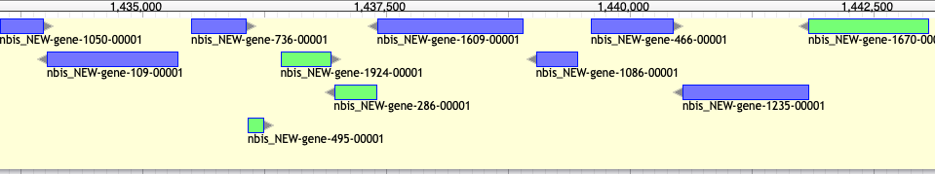
Intrinsic / ab initio
Bacterial gene prediction
- Short intergenic regions
- Uninterrupted ORFs (No intron)
- Very conserved signals
easy problem: Accuracy > 90%

Slide 23
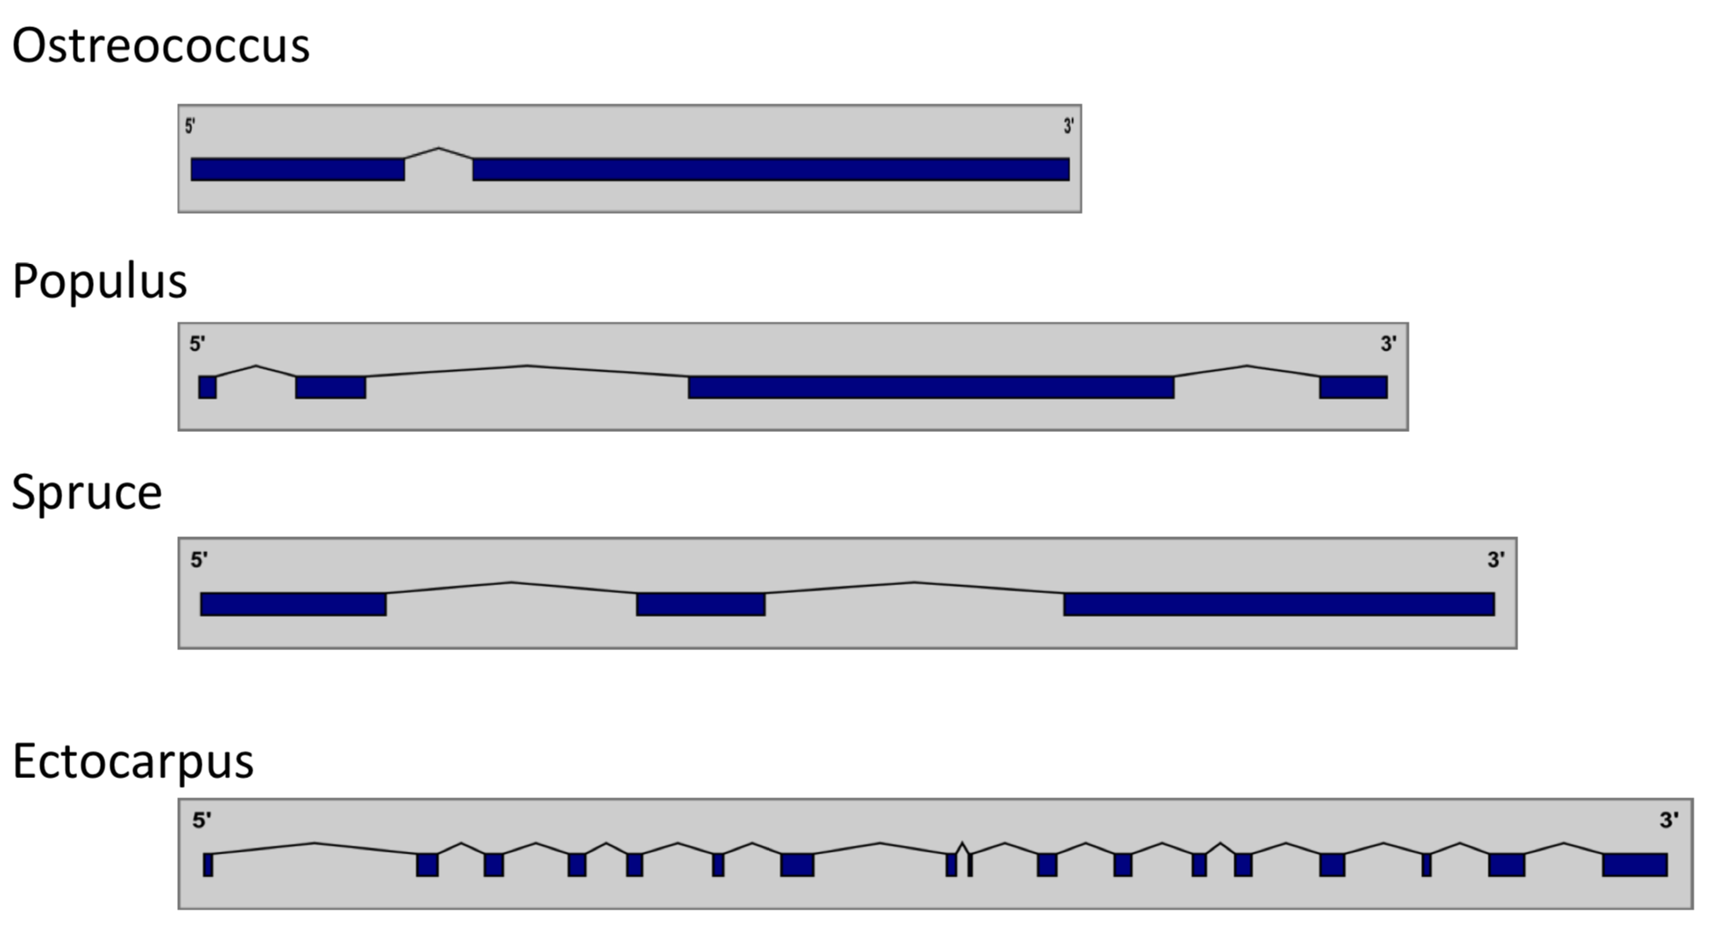
Intrinsic / ab initio
Eukaryotic gene prediction
- Presence of intron => structures Differ
- Isoforms
- New features (e.g. lncRNAs)
Hard problem: Accuracy < 70%
Requires training

Slide 24
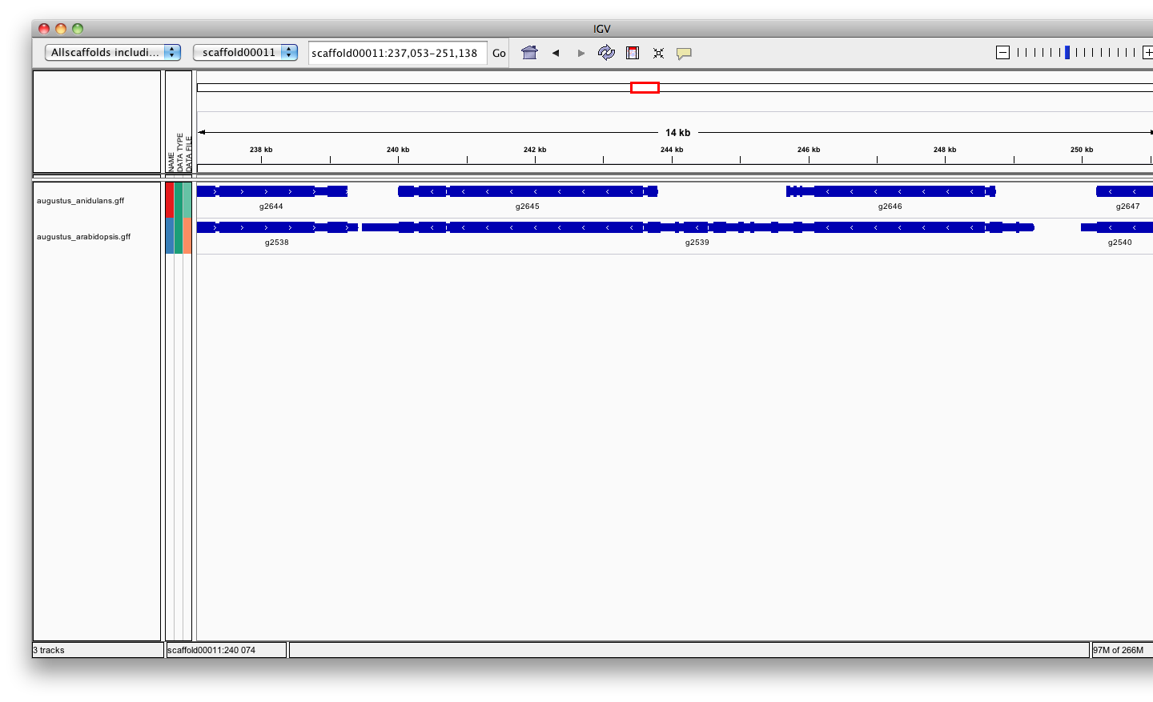
Intrinsic / ab initio
Training ab-initio gene-finders
Ab-initio tools need of a probabilistic model (also called profile) => Training
Few self-trained tools, most need a separate training procedure
The quality of the gene-finder results hugely relies on the quality of the training!
Needs training for every genome (= different training sets)
Training:
sets of high quality genes (>500)
=> These ”known” genes are usually inferred from aligned transcripts or proteins
Need of a
A fungal genome
Fungi
Plants
Notes:
The goal for a good annotation is to get keep these two values as high as possible

Slide 25
Intrinsic / ab initio
Assess the quality of the ab-initio model/training:
Can we check the formula
TN
FN
TP
FP
TN
FN
TP
FN
TN
~
REALITY
PREDICTION
Sensitivity is the proportion of true predictions compared to the total number of correct genes (including missed predictions)
Specificity is the proportion of true predictions among all predicted genes (including incorrectly predicted ones)
Ab Initio methods can approach 100% sensitivity, however as the sensitivity increases, accuracy suffers as a result of increased false positives.
Notes:
The goal for a good annotation is to get keep these two values as high as possible

Slide 26
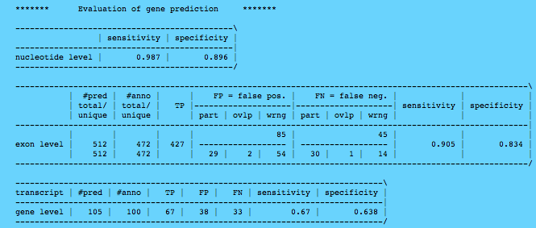
Intrinsic / ab initio
Notes:
of the 100 genes 67 were predicted exactly 90.5% of the exons were predicted exactly 83.4% of the predicted exons were exactly as in the test set.
Need to be as high as possible

Slide 27
Intrinsic / ab initio
Popular tools:
SNAP Works ok, easy to train, not as good as others especially on longer intron genomes.
Augustus Works great, hard to train (but getting better).
GeneMark-ES Self training, no hints, buggy, not good for fragmented genomes or long introns (Best suited for Fungi).
FGENESH Works great, costs money even for training.
GlimmerHMM (Eukaryote)
GenScan
Gnomon (NCBI)
Supported by MAKER
http://weatherby.genetics.utah.edu/MAKER/wiki/index.php/MAKER_Tutorial
Notes:
Glimmer: apparently easy to train but manually tuning needed.

Slide 28
Intrinsic / ab initio
Strengths :
Fast and easy
Annotate unknown genes
Sensitivity ok
Need no external evidence**
Limits :
No UTR*
No alternatively spliced transcripts*
Bad specificity (Over prediction of exons or/and genes)
Training needed (Need external evidence**)
Common errors in annotation:
Split single gene into multiple predictions
Fused with neighboring genes
Less accurate than homology based method:
Exon boundaries
Splicing sites
External evidence

Slide 29
2.3 Hybrid approaches
(Ab initio evidence-driven)
Ab initio tools with the ability to integrate external evidence/hints

Slide 30
The different approaches
Types data used vs methods
Ø
Proteins
Transcripts
Known amino acid sequences from other organisms
Assembled from RNA-seq or downloaded ESTs
Annotation approach
Similarity |  | X | X
Pure ab initio | X
Hybrid (Ab initio evidence-driven) | X | X | X
Comparative | X | X | X
Chooser/combiner | X | X | X
Pipeline | X | X | X
Adjust the box

Slide 31
Hybrid : Ab initio evidence-driven
Evidence-drivable gene predictors approaches incorporate hints/extrinsic information in the form of alignments (transcript, protein, whole genome) to increase the accuracy of the gene prediction.
Can predict locus without extrinsic information
Improve prediction when extrinsic information available

Slide 32
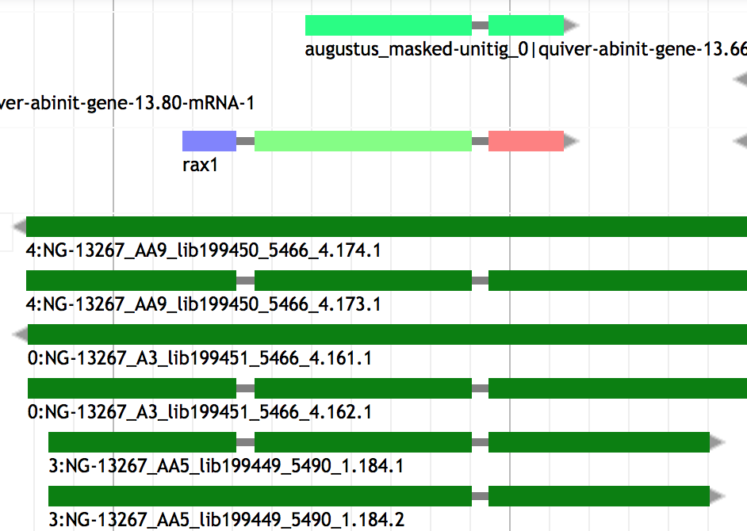
Hybrid : Ab initio evidence-driven
Strength :
Lots of data available
Protein well conserved
High accuracy
Limits :
Extra computation to generate alignments
heterogeneous sequence quality :
Incomplete
Error during transcriptome assembly
Contamination
Sequence missing
Orientation error

Slide 33
Hybrid : Ab initio evidence-driven
Tools
GenomeScan Blast hit used as extra guide
Augustus 16 types of hints accepted (gff): start, stop, tss, tts, ass, dss, exonpart, exon, intronpart, intron, CDSpart, CDS, UTRpart, UTR, irpart,
nonexonpart.
GeneMark-ET EST-based evidence hints
GeneMark-EP Protein-based evidence hints
SNAP Accepts EST and protein-based evidence hints.
Gnomon* Uses EST and protein alignments to guide gene prediction and add UTRs
FGENESH+ Best suited for plant
EuGene* Any kind of evidence hints. Hard to configure (best suited for plant)
Self training !
Notes:
GenomeScan : The blast hits have to be converted into a probability, but this is made relatively easily, as the E-values give guidance… ( Understanding Bioinformatics, Par Marketa J. Zvelebil,Jeremy O. Baum). It’s a version based on genscan.
EuGene collect information about splice sites and ATG but has to be done outside the program.
* Can be seen as combiner

Slide 34
Hybrid : Ab initio evidence-driven
The BRAKER1 gene finding pipeline:
BRAKER1: Unsupervised RNA-Seq-Based Genome Annotation with GeneMark-ET and AUGUSTUS
Katharina J. Hoff et al.
Bioinformatics (2016) 32 (5): 767-769. doi: 10.1093/bioinformatics/btv661
BRAKER1 was more accurate than MAKER2 when it is using RNA-Seq as sole source for training and prediction.
BRAKER1 does not require pre-trained parameters or a separate expert-prepared training step.
BRAKER2 since 2019 (Incorporate Protein Homology Information)

Slide 35
2.3 Comparative based method
These align genomic sequences from different species
and use the alignments to guide the gene predictions

Slide 36
The different approaches
Types data used vs methods
Ø
Proteins
Transcripts
Known amino acid sequences from other organisms
Assembled from RNA-seq or downloaded ESTs
Annotation approach
Similarity |  | X | X
Pure ab initio | X
Hybrid | X | X | X
Comparative | X | X | X
Chooser/combiner | X | X | X
Pipeline | X | X | X

Slide 37
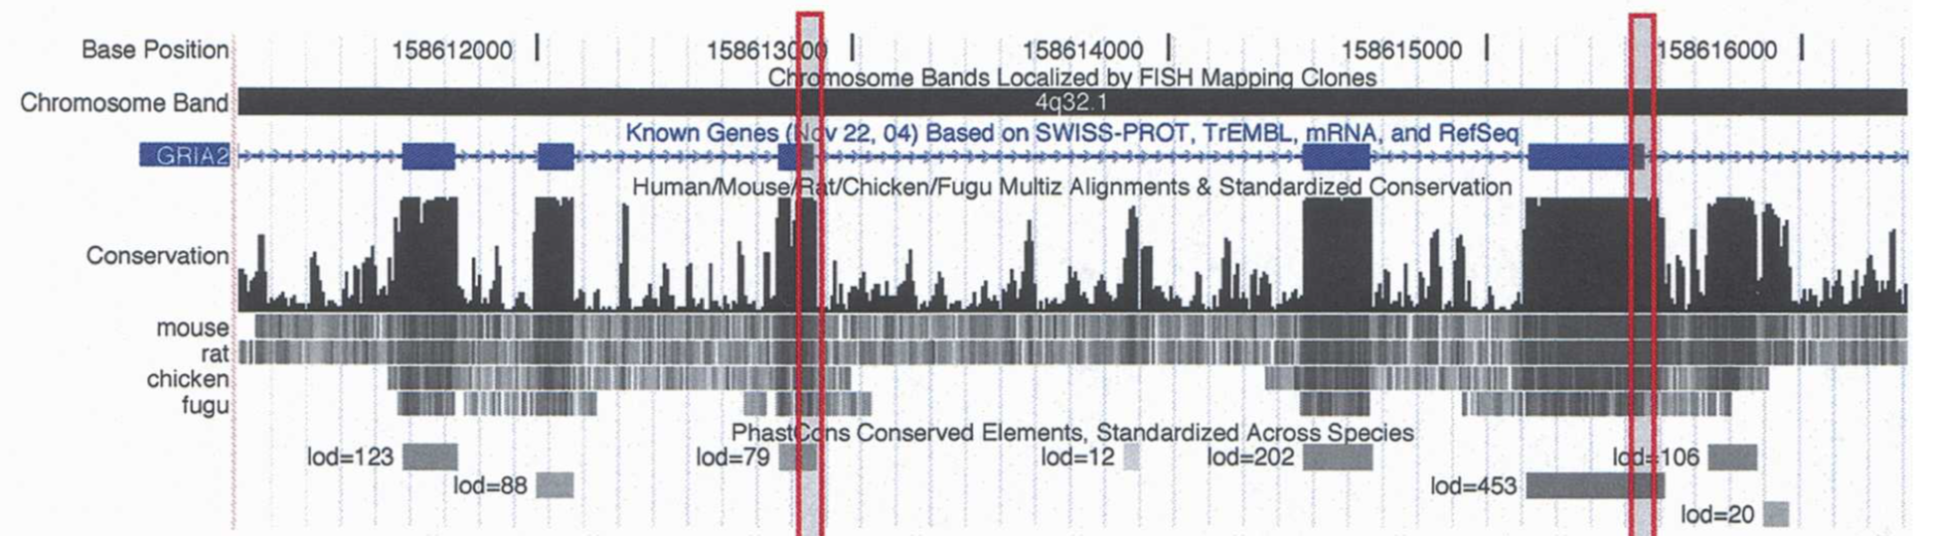
Comparative-based method
The main assumption of these methods is that the functional parts of an eukaryotic genomic sequence, the exons, tend to be more conserved than the non-functional ones, the introns.
These align genomic sequences from different species and use the alignments to guide the ab-initio gene predictions.
Limits : - Whole genome alignment is time/memory consuming
- Need relatively close related genome (<50 My)

Slide 38
Comparative-based method: Tools
Dual genome, de novo gene structure prediction:
Rosetta (Pioneer – 2000)
SGP-2 (2003) – considers only the conservation in protein-coding regions
TWINSCAN (2001) - included models of conservation in splice sites and start and stop codons
SLAM (2003)
TWAIN (2005)
More than 2 genomic sequences:
N-SCAN* (2006)
Conrad *(CRF, 2007)
CONTRAST* (CRF, 2008) -> 58% accuracy
Augustus-CPG*
*Can use similarity-based information
Notes:
CRF=Conditional random fields
Multiple informants (genomes) are generally better than one
SGP-2 and TWINSCAN was first program outperforming GENSCAN
SLAM : Generalized pair hidden Markov model, a hybrid of generalized hidden Markov models, which have been used previously for gene finding, and pair hidden Markov models, which have applications to sequence alignment.
Before and including TWAIN they were using ~GHMM (GPHMM) with P for pair
TWINSCAN: Korf, I., Flicek, P., Duan, D. & Brent, M. R. Integrating genomic homology into gene structure prediction. Bioinformatics 17, S140–S148 (2001).
N-SCAN: Gross, S. S. & Brent, M. R. Using multiple alignments to improve gene prediction. J. Comput. Biol. 13, 379–393 (2006). This paper presents N-SCAN, a multi-genome de novo gene predictor that was the most accurate program for animal genomes until CONTRAST was introduced.
SGP-2: https://www.ncbi.nlm.nih.gov/pmc/articles/PMC430976/
SLAM: https://genome.cshlp.org/content/13/3/496.full
TWAIN: http://www.cbcb.umd.edu/software/pirate/twain/twaindoc.html_original
CONTRAST: Gross, S. S., Do, C. B., Sirota, M. & Batzoglou, S. CONTRAST: a discriminative, phylogeny-free approach to multiple informant de novo gene prediction. Genome Biol. (in the press). This paper presents CONTRAST, a CRF-based, multi-genome de novo gene predictor that is currently the most accurate predictor, at least for mammals and flies. CONTRAST is also likely to work well on other complex eukaryotic genomes.
Conrad: DeCaprio D, Vinson JP, Pearson MD, Montgomery P, Doherty M, Galagan JE. Conrad: gene prediction using conditional random fields. Genome Res. 2007;17(9):1389-1398. doi:10.1101/gr.6558107
CAT: Fiddes IT, Armstrong J, Diekhans M, et al. Comparative Annotation Toolkit (CAT)-simultaneous clade and personal genome annotation. Genome Res. 2018;28(7):1029-1038. doi:10.1101/gr.233460.117

Slide 39
2.5. Combiner / Chooser
Combining heterogeneous data into gene models
Selection of gene models

Slide 40
The different approaches
Types data used vs methods
Ø
Proteins
Transcripts
Known amino acid sequences from other organisms
Assembled from RNA-seq or downloaded ESTs
Annotation approach
Similarity |  | X | X
Pure ab initio | X
Hybrid | X | X | X
Comparative | X | X | X
Chooser/combiner | X | X | X
Pipeline | X | X | X

Slide 41
Chooser / combiner
Combiner concept: combining different lines of evidence into gene models
Evidence:
ESTs / Transcripts
Proteins
Gene prediction (ab-initio or evidence-based)
Gene models
﻿=> add untranslated regions (UTR)

Slide 42
Chooser / combiner
Combiner concept: combining different lines of evidence into gene models
Evidence: ESTs / Transcripts / Proteins
Gene prediction (ab-initio or evidence-based)
=> Select the best possible set of exons and combine them in a consensus gene model
Notes:
Tools which find the most optimal exon-intron structure among the evidences and then create a new consensus gene: e.g: EVidenceModeler, JIGSAW and GLEAN

Slide 43
Chooser / combiner
Chooser concept: Select best gene models
Evidence: ESTs / Transcripts / Proteins
Gene models
=> Choose the prediction whose best matches the evidence

Slide 44
Chooser / combiner
Chooser concept: Select best gene models
Gene models
=> Choose the prediction whose structure best represents the consensus

Slide 45
Chooser / combiner
Use battery of gene finders and evidence (EST, RNAseq, protein) alignments and:
Tool | Consensus based chooser | Evidence based chooser | weight of different sources | Comment
A) Choose the prediction whose best matches the evidence
MAKER* |  | X
PASA* |  | X
B) Choose the prediction whose structure best represents the consensus
JIGSAW | X
C) Choose the best possible set of exons and combine them in a gene model
EVM Evidencemodeler | X | X | X | User can set the expected evidence error rate manually or/and learn from a training set
Evigan | X |  | X | Unsupervised learning method
Ipred |  | X |  | Does not require any a priori knowledge Can also combine only evidences to create a gene model
Strength => They improve on the underlying gene prediction models
Notes:
EVM choose the post-processed gene model that is most consistent with the evidences
~ GAZE : GAZE (Howe et al. 2002), pro- vides a general framework to assemble an optimal set of gene structures given a user-supplied feature set, scoring scheme,
Ipred: Franziska Zickmann and Bernhard Y Renard BMC Genomics. 2015; 16(1): 134.doi: 10.1186/s12864-015-1315-9
EVIGAN is the scuccessor of GLEAN
* Are pipelines that contain chooser

Slide 46
2.6 Pipelines
(The ultimate step)
Align evidence
add annotation (UTR, score, gene name)
Annotation of other features (Repeat, tRNA, etc)
And more…
Notes:
Much more complex, align themselves the evidences, annotate UTRs, repeat mask, annotate other kind of features within the genome…

Slide 47
The different approaches
Types data used vs methods
Ø
Proteins
Transcripts
Known amino acid sequences from other organisms
Assembled from RNA-seq or downloaded ESTs
Annotation approach
Similarity |  | X | X
Pure ab initio | X
Hybrid | X | X | X
Comparative | X | X | X
Chooser/combiner | X | X | X
Pipeline | X | X | X

Slide 48
Annotation pipeline
* Evidence-based only
** May use ab initio
PASA* Produces evidence-driven consensus gene models
- minimalist pipeline ()
+ good for detecting isoforms
+ biologically relevant predictions
=> using Ab initio tools and combined with EVM it does a pretty good job !
- PASA + Ab initio + EVM not automatized
NCBI pipeline Evidence + ab initio (Gnomon), repeat masking, gene naming, miRNAs, tRNAs, …
Ensembl** Evidence based only ( comparative + homology ) …
Comparative Annotation Toolkit (CAT) ab-initio (Augustus) evidence driven + comparative
MAKER2 Evidence based and/or ab initio …
…
Notes:
PASA: Does not do anything else that align evidences and define gene models with UTRs
NCBI pipeline integrates gnomon ; data formatting = Save in correct format for dowmstream hanmdling/analysis

Slide 49
3. Annotation of other genome features

Slide 50
Other genome features
Feature type | DB associated | Tool example | approach
ncRNA | Rfam | infernal | HMM + CM
tRNA | Sprinzl database | tRNAscan-SE | CM + WMA
snoRNA |  | snoscan | HMM + SCFG
miRNA | miRBase | Splign miR-PREFeR (for plant) | sequence alignment Based on expression patterns
Repeats | Repbase, Dfam | repeatMasker | HMM, blast
Pseudogenes |  | pseudopipe | homology-based (blast)
…
Notes:
ncRNA annotation are less reliable but are of good interest to give clue about them. Should call them putative ncRNA
SCFG and HMM are al probabilistic models
CM is a type of stochastic context-free grammar (profile SCFG) that describes both sequence and secondary structure.
it is more capable of identifying RNA homologs that conserve their secondary structure more than their primary sequence.
Infernal uses CMs to search for new family members in sequence databases and to create potentially large multiple sequence alignments. Version 1.1 of Infernal introduces a new filter pipeline for RNA homology search based on accelerated profile hidden Markov model (HMM) methods and HMM-banded CM alignment methods.
WMA = weight matrix anaylsis
snoRNAs = Small nucleolar RNAs
snoGPS for the detection of pseudouridylation-guide snoRNAs
Pseudopipe : To be launched after gene annotation

Slide 51
4. Assessing an annotation

Slide 52
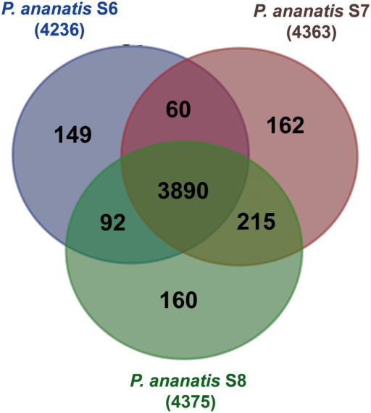
Assessing an annotation
Simple statistics (number genes / number exon per gene)
(and compare against assembly result )
Protein/transcript evidence (AED score in MAKER)
Comparative genomics (OrthoMCL)
Domain / Function attached
Visualization

Slide 53
Assessing an annotation
Selection of most common visualization or/and Manual curation tools
Name | Standalone | Web tool | Manual curation | year | comment
Artemis | X |  | X | 2000 | Can save annotation in EMBL format
IGV | X |  |  | 2011 | Popular
Savant | X |  |  | 2010 | Sequence Annotation, Visualization and ANalysis Tool. enable Plug-ins
Tablet | X |  | X | 2013
IGB | X |  |  | 2008 | enable Plug-ins. Can load local and remote data (dropbox, UCSC genome, etc)
Jbrowse |  | X |  | 2010 | GMOD (successor of Gbrowse)
Web Apollo |  | X | X | 2013 | Active community (gmod). Based on Jbrowse. Real-time collaboration
UCSC |  | X |  | 2000 | A large amount of locally stored data must be uploaded to servers across the internet
Ensembl genome browsers |  | X |  | 2002 | A large amount of locally stored data must be uploaded to servers across the internet
FOR AN EXHAUSTIVE LIST: https://en.wikipedia.org/wiki/Genome_browser

Slide 54
5. To resume / Closing remarks

Slide 55
Closing remarks
>100 annotation tools – as many methods
(https://github.com/NBISweden/GAAS/blob/master/annotation/CheatSheet/annotation_tools.md)
GTF/GFF format
6 main class of approaches (Similarity-based, ab initio, hybrid, comparative, combiner, pipeline )
How to choose Method:
Scientific question behind ( need of a conservative annotation vs exhaustive)
Species dependent (plant / Fungi / eukaryotes)
phylogenetic relationship of the investigated genome to other annotated genomes (Terra incognita, close, already annotated).
Data available (hmm profile, RNAseq, etc…)
Depending on computing resources (ab initio ~ hours < vs > pipeline ~ weeks)
Notes:
There is a plethoric choice of methods
conservative will be more based on evidence without ab-initio (Ensembl). <= You want only real/existing gene
Exhaustive will be more ab initio <= you don’t care about over prediction (you will filter … by clusterisation ?)

Slide 56
Closing remarks
Effort versus accuracy
accuracy
Effort / time

Slide 57
Closing remarks
Several ab-initio tools together give better result that one alone
(they complement each other)
Pipelines give good results
MAKER2 the most flexible, adjustable
Most methods only build gene models, no functional inference
No annotation method is perfect, they do mistakes !!
Annotation requires manual curation
As for assembly, an annotation is never finished, it can always be improved
=> e.g. Human (to know how to stop)
Submit your annotation in public archive
Notes:
to know how to stop, otherwise you could spend your whole thesis on an annotation. So when is good enough for the scientific question you want to answer, don’t hesitate to stop.

Slide 58
THE END
https://github.com/NBISweden/GAAS
Notes:
Slide made based on 10.1371/journal.pone0050609.t001
Evaluating High-Throughput Ab Initio Gene Finders to Discover Proteins Encoded in Eukaryotic Pathogen Genomes Missed by Laboratory Techniques. Stephen J. Goodswen, Paul J. Kennedy, John T. Ellis )
CRAIG = abinitio the first CRF (conditional random fields ) (1 CRF). Use only targested genome
Conrad = 2em CRF (not adapted to big genome). Use multi genome, many of its parameters are trained in the same way as GHMM parameters
Contrast = 3em CRF , Use multi genome
FGENESH = widely used for plant
Salzberg says: Integrated approaches. These combine multiple forms of evidence, such as the predictions of other gene finders
Jigsaw, EuGène(graph-based ), Gaze.
Mark Yandell says: GAZE Highly configurable gene predictor (Ab initio tool)
Dans la publication EuGène they say : GAZE: is not a proper gene predictor, because it cannot produce a list of possible coding regions alone.
In another EuGene publication they say about Eugene : We first collect information about splice sites and ATG by submitting the sequence to NetGene2 [20], SplicePredictor [2] and NetStart [13] using a dedicated Perl script.

