Slide 1
Lucile Soler, PhD
Jacques Dainat, PhD
How to do a genome annotation?
Tromsø – May 2021
Notes:
This lecture will focus on what we need to do an annotation

Slide 2
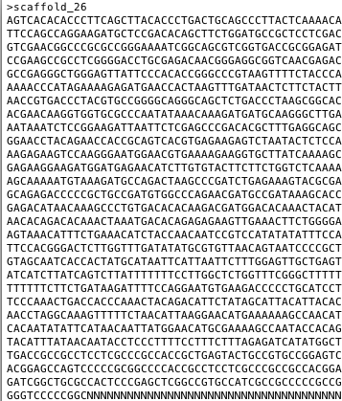
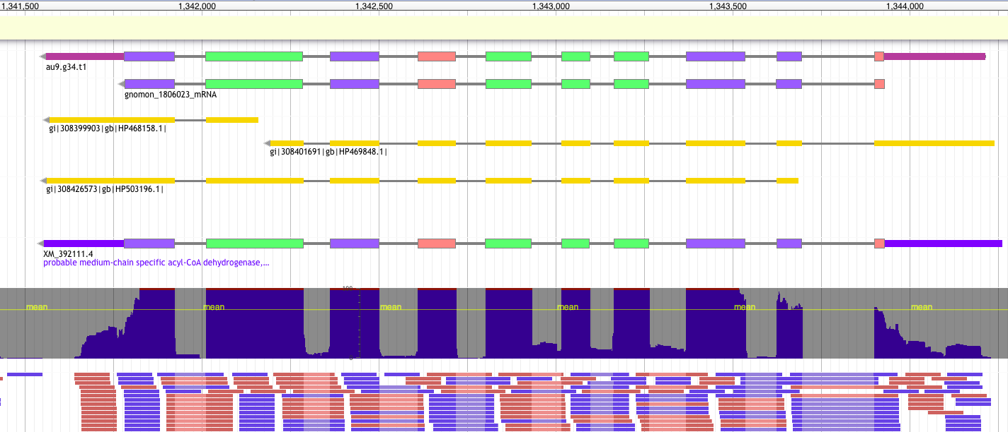
Introduction: Formats
From a genome…
FASTA
…to an annotated gene
GTF/GFF
9 columns
1 feature = 1 line
2. source
4. start
6. score
8. phase
Ctg123 maker Gene 1000 9000 . + . ID=gene1; Name=EDEN
1. sequence id
3. feature type
5. end
7. strand
9. attribute(s)
tag=value

Slide 3
Introduction: Formats
GFF / GTF formats
https://github.com/NBISweden/GAAS/blob/master/annotation/knowledge/gxf.md
Gene Transfer Format
General Feature Finding
GTF
GTF2
GTF2.1
GTF2.2
GTF2.X
GFF
Richard Durbin and David Haussler
2005
2007
2000
2003
Nowadays
1997
2004
2013
GFF2
GFF2.5
GFF3 v1
GFF3 v1.23
General Feature Format
Notes:
In top of that the format has changed a lot through time.
Indeed, the development of this format has not been an easy task.
Facing some limitation using the original specification, GFF has evolved into different flavors depending on the different needs of different laboratories.
In 10 years (97-2007) the format has evolved a lot. The GFF3 is stable stable since many years (2004).

Slide 4
Introduction: Formats: GTF2.X
9 columns
1 feature = 1 line
#!genome-build GRCz11
#!genome-date 2017-05
Ctg123 . Gene 1000 9000 . + . gene_id gene1; name EDEN;
ctg123 . Transcript 1050 9000 . + . gene_id gene1; transcript_id=t1; name EDEN;
ctg123 . Transcript 1050 9000 . + . gene_id gene1; transcript_id=t2; name EDEN;
ctg123 . exon 1300 1500 . + . gene_id gene1; transcript_id=t1; name EDEN;
ctg123 . exon 1050 1500 . + . gene_id gene1; transcript_id=t1; name EDEN;
tg123 . exon 1050 1500 . + . gene_id gene1; transcript_id=t2; name EDEN;
ctg123 . exon 3000 3902 . + . gene_id gene1; transcript_id=t1; name EDEN;
ctg123 . exon 5000 5500 . + . gene_id gene1; transcript_id=t1; name EDEN;
ctg123 . exon 5000 5500 . + . gene_id gene1; transcript_id=t2; name EDEN;
ctg123 . exon 7000 9000 . + . gene_id gene1; transcript_id=t1; name EDEN;
ctg123 . exon 7000 9000 . + . gene_id gene1; transcript_id=t2; name EDEN;
ctg123 . CDS 1201 1500 . + 0 gene_id gene1; transcript_id=t1; name EDEN;
ctg123 . CDS 3000 3902 . + 0 gene_id gene1; transcript_id=t1; name EDEN;
ctg123 . CDS 5000 5500 . + 0 gene_id gene1; transcript_id=t1; name EDEN;
ctg123 . CDS 7000 7600 . + 0 gene_id gene1; transcript_id=t1; name EDEN;
Ctg123 . CDS 1201 1500 . + 0 gene_id gene1; transcript_id=t2; name EDEN;
ctg123 . CDS 5000 5500 . + 0 gene_id gene1; transcript_id=t2; name EDEN;
Ctg123 . CDS 7000 7600 . + 0 gene_id gene1; transcript_id=t2; name EDEN;
Header
2) source
4) start
6) score
8) phase
9) attributes
tag value;
1) sequence id
3) feature type
(9 possibilities)
5) end
7) strand
! Features grouped by a common attribute (gene_id / transcript_id)

Slide 5
Introduction: Formats: GFF3
9 columns
1 feature = 1 line
##gff-version 3.2.1
##sequence-region ctg123 1 1497228
Ctg123 . Gene 1000 9000 . + . ID=gene1;Name=EDEN
ctg123 . mRNA 1050 9000 . + . ID=mRNA1;Parent=gene1;Name=EDEN.1
ctg123 . mRNA 1050 9000 . + . ID=mRNA2;Parent=gene1;Name=EDEN.2
ctg123 . exon 1300 1500 . + . ID=exon1;Parent=mRNA3
ctg123 . exon 1050 1500 . + . ID=exon2;Parent=mRNA1,mRNA2
ctg123 . exon 3000 3902 . + . ID=exon3;Parent=mRNA1
ctg123 . exon 5000 5500 . + . ID=exon4;Parent=mRNA1,mRNA2
ctg123 . exon 7000 9000 . + . ID=exon5;Parent=mRNA1,mRNA2
ctg123 . CDS 1201 1500 . + 0 ID=cds1;Parent=mRNA1;Name=eden1
ctg123 . CDS 3000 3902 . + 0 ID=cds1;Parent=mRNA1;Name=eden1
ctg123 . CDS 5000 5500 . + 0 ID=cds1;Parent=mRNA1;Name=eden1
ctg123 . CDS 7000 7600 . + 0 ID=cds1;Parent=mRNA1;Name=eden1
Ctg123 . CDS 1201 1500 . + 0 ID=cds2;Parent=mRNA2;Name=eden2
ctg123 . CDS 5000 5500 . + 0 ID=cds2;Parent=mRNA2;Name=eden2
Ctg123 . CDS 7000 7600 . + 0 ID=cds2;Parent=mRNA2;Name=eden2
Header
2) source
4) start
6) score
8) phase
9) attributes
tag=value
1) sequence id
5) end
3) feature type
(SO term = 2278 possibilities)
7) strand
! Features are grouped by parent relationship
Notes:
How look a GFF3 file ?
Here One gene
SO sequence ontology term
parent / children relationship provides a mechanism allowing to group features at several hierarchical level allowing representing complex entities like here.
The content can differ a lot according to the tool/group producing the file.
About the feature: One can write transcript instead of mRNA, or say UTR instead of 3’UTR and 5’UTR or the 3/5 number could also be written with letter and so one.
About the attributes: There is actually no limit for naming the tag. You can use what ever you want.

Slide 6
Introduction: Formats: GFF3
/!\ different type of gff: annotation / alignment / other
Match_part
Alignment
Match
(protein1)
Match
(protein2)
DNA
Annotation
gene
Intron, exon, CDS,splice site, UTR, mRNA, isoforms

Slide 7



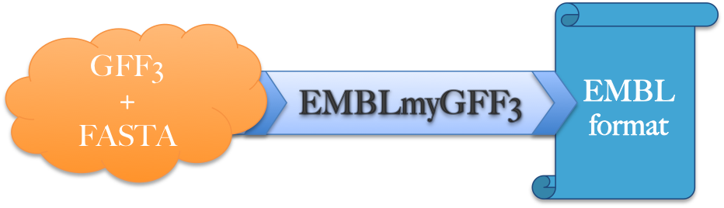

Introduction: Overview
The main steps in genome annotation
1
2
3
4
5
Downstream analysis
Structural annotation
Manual curation
Functional annotation
QC assembly
Submission
EuGene-EP

Slide 8
Before all annotations
Notes:
you did QC on the assembly
let say you have a genome you don't know where it comes form

Slide 9
Introduction: Before annotation
Get the best assembly! The quality of the assembly will heavily influence the quality of the annotation
SNP-errors can change start/stop-codons
Indels can cause frame-shifts
High fragmentation could break loci
missing loci cannot be annotated
=> Annotation tools have difficulties to deal with those problems
Freeze the assembly!
=> Updating assembly ~ annotation from scratch

Slide 10
Introduction: Before annotation
Always check :
Fragmentation (N50, number of sequences, how many small contigs)
Sanity of the fasta file (Ns, IUPAC, lowercase nucleotides)
Completeness / duplication / fragmentation
Presence of Organelles
Other (GC content, how distant from other species)
Notes:
small and many contigs can be a problem to be processed by some tools
mito codon usage

Slide 11
Introduction: BUSCO
BUSCO used on assembly and annotation
Example of output:
# BUSCO version is: 3.0.2
# The lineage dataset is: fungi_odb9 (Creation date: 2016-02-13, number of species: 85, number of BUSCOs: 290)
#
# Summarized benchmarking in BUSCO annotation for file genome.fa
# BUSCO was run in mode: genome
C:98.6%[S:97.9%,D:0.7%],F:0.0%,M:1.4%,n:290
286 Complete BUSCOs (C)
284 Complete and single-copy BUSCOs (S)
2 Complete and duplicated BUSCOs (D)
0 Fragmented BUSCOs (F)
4 Missing BUSCOs (M)
290 Total BUSCO groups searched
Notes:
compare fasta sequence with set core of genes and check which gene will be probably found by annotation

Slide 12
The different approaches
Similarity-based methods :
These use similarity to annotated sequences like proteins, cDNAs, or ESTs
Ab initio prediction :
Likelihood based methods
Hybrid approaches :
Ab initio tools with the ability to integrate external evidence/hints
Comparative (homology) based gene finders :
These align genomic sequences from different species and use the alignments to guide the gene predictions
Chooser, combiner approaches :
These combine gene predictions of other gene finders
Pipelines :
These combine multiple approaches

Slide 13
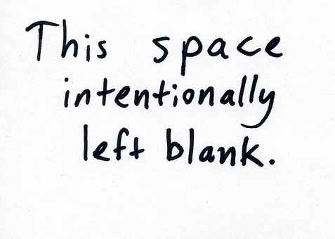
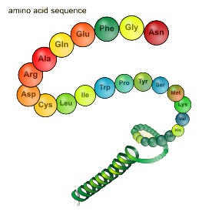
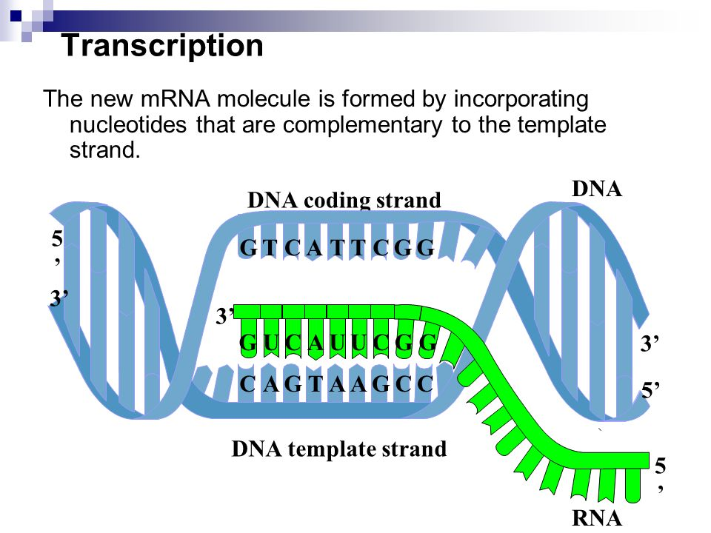
The different approaches
Types data used vs methods
Ø
Proteins
Transcripts
Known amino acid sequences from other organisms
Assembled from RNA-seq or downloaded ESTs
Annotation approach
Similarity |  | X | X
Pure ab initio | X
Hybrid | X | X | X
Comparative | X | X | X
Chooser/combiner | X | X | X
Pipeline | X | X | X

Slide 14
Intrinsic / ab initio
Strengths :
Fast and easy
Annotate unknown genes
Sensitivity ok
Need no external evidence
Limits :
No UTR
No alternatively spliced transcripts (augustus does)
Bad specificity (Over prediction of exons or/and genes)
Training needed (Need external evidence)
Common errors in annotation:
Split single gene into multiple predictions
Fused with neighboring genes
Less accurate than homology based method:
Exon boundaries
Splicing sites
Notes:
augustus can do utr for some species and isoform as well

Slide 15
Exercises
https://nbisweden.github.io/workshop-genome_annotation_elixir/labs/augustus
Notes:
show the exercises
and we will be back at

Slide 16
The different approaches
Similarity-based methods :
These use similarity to annotated sequences like proteins, cDNAs, or ESTs
Ab initio prediction :
Likelihood based methods
Hybrid approaches :
Ab initio tools with the ability to integrate external evidence/hints
Comparative (homology) based gene finders :
These align genomic sequences from different species and use the alignments to guide the gene predictions
Chooser, combiner approaches :
These combine gene predictions of other gene finders
Pipelines :
These combine multiple approaches

Slide 17
The different approaches
Types data used vs methods
Ø
Proteins
Transcripts
Known amino acid sequences from other organisms
Assembled from RNA-seq or downloaded ESTs
Annotation approach
Similarity |  | X | X
Pure ab initio | X
Hybrid | X | X | X
Comparative | X | X | X
Chooser/combiner | X | X | X
Pipeline | X | X | X

Slide 18
Get the data
Genome
Fasta or gff format
Repeats
Fasta or gff format
Proteins
Fasta format
Uniprot/swissprot
Close related species
RNAseq
Fasta or gff format
Same individual best
SRA (Sequence Read Archive)
Notes:
Sequences you believe in
Speak of the format

Slide 19
Repeats
First of all: Repeat Masking
Repeatmodeler to find new repeats
http://www.repeatmasker.org/RepeatModeler/
Repeatmasker to mask known repeats
http://www.repeatmasker.org
+ Save time
+ Increase quality of the gene coding annotation
http://weatherby.genetics.utah.edu/MAKER/wiki/index.php/Repeat_Library_Construction--Basic
https://www.biostars.org/p/411101/
http://weatherby.genetics.utah.edu/MAKER/wiki/index.php/Repeat_Library_Construction-Advanced

Slide 20
Extrinsic data
Proteins :
Related to pre-existing data
Proteins from model organisms often used => bias?
Proteins can be incomplete
Protein can be wrong (PE)
No UTR
RNAseq :
Hard to catch low expressed / peculiar expressed (stage of life, condition, etc…) / isoforms
short-reads:
Transcriptome assembly errors
Long-reads:
error rate / frameshift / indels

Slide 21
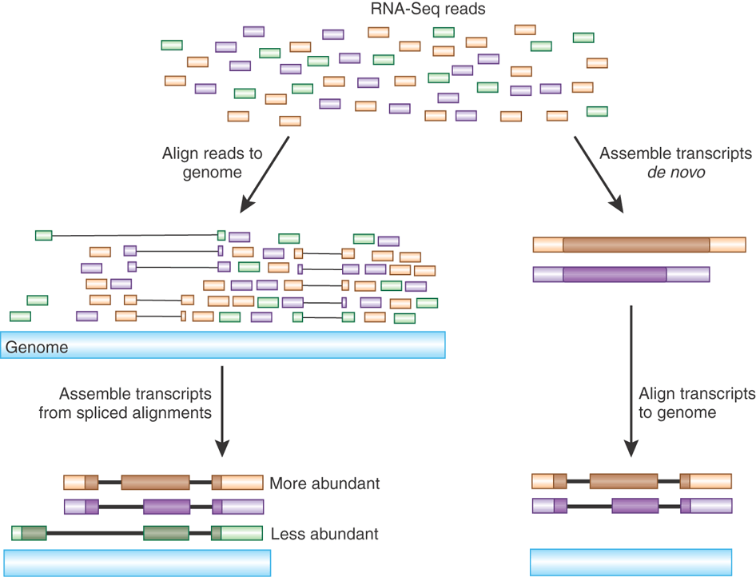
Assembly of transcripts
Haas and Zody, Nature Biotechnology 28, 421–423 (2010)
Notes:
Need to be assemble first
gff and fasta file

Slide 22

De-novo transcriptome assembly
Most used programs (latest release date):
Trinity (March 2021)
SOAPdenovo-Trans (Aug 2017)
Trans-ABySS (Feb 2018)
Velvet+Oases (March 2015)
Originally SOAPdenovo, ABySS and Velvet for de novo genome assembly
“SOAPdenovo-Trans incorporates the error-removal model from Trinity and the robust heuristic graph traversal method from Oases.”
Trinity, Grabherr et al. 2011
Notes:
De bruijn graph

Slide 23
De-novo transcriptome assembly
No reference needed
Many programs available
Lots of potential transcripts. Filter!
Notes:
easy to use expecially trinity

Slide 24
Genome guided transcriptome assembly
For each sample
(tissue/library)
Reads
Trim and clean reads
E.g : trimmomatic, fastp
genome
Reads trimmed
Mapper
E.g : hisat2, star
Mapped reads
Assembler
E.g : stringtie, cufflinks
Assembled transcripts
Notes:
gtf
need to change for gff

Slide 25
Genome-guided transcriptome assembly
Need a very good reference (genome most of the time)
Can use existing annotation (GTF/GFF file) (in option for stringtie)
Can detect novel transcripts
https://github.com/NBISweden/pipelines-nextflow/tree/master/TranscriptAssembly
https://nbisweden.github.io/workshop-genome_annotation/labs/rnaseq_guided_assembly

Slide 26
RNAseq
How does it look
when it does not look good?

Slide 27
RNA-seq noise
Types of data used: RNA-seq
DNA
Exon
Intron
Exon
Intron
Exon
Intron
Exon
UTR
UTR
ATG
Start codon
GT
AG
GT
AG
GT
AG
TAG, TAA, TGA
Stop codon
Transcription
Pre-mRNA
UTR
UTR
AA
ATG
Start codon
TAG, TAA, TGA
Stop codon
AAAAA
Splicing
mRNA
UTR
UTR
AAAAAAAAA
ATG
Start codon
TAG, TAA, TGA
Stop codon
Translation
Notes:
To define transcribed portion ! Conpare to Protein it contains UTR !!

Slide 28
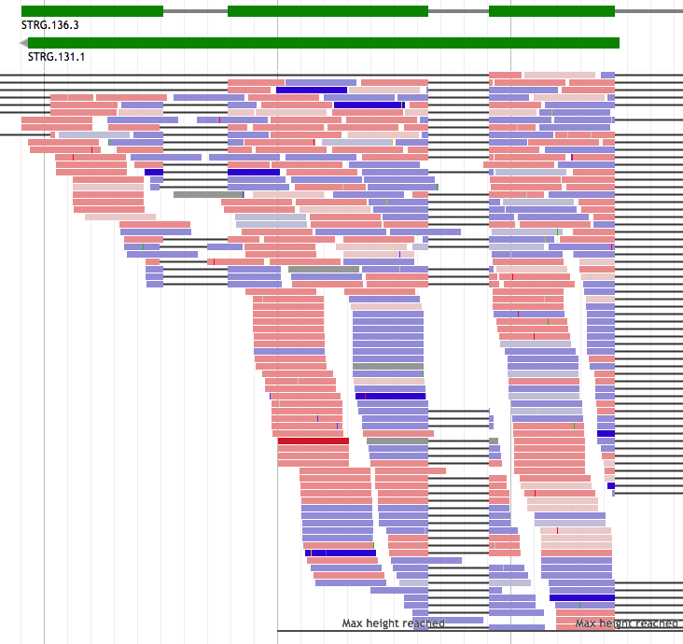
RNA-seq noise
RNA-seq – pre-mRNA noise

Slide 29
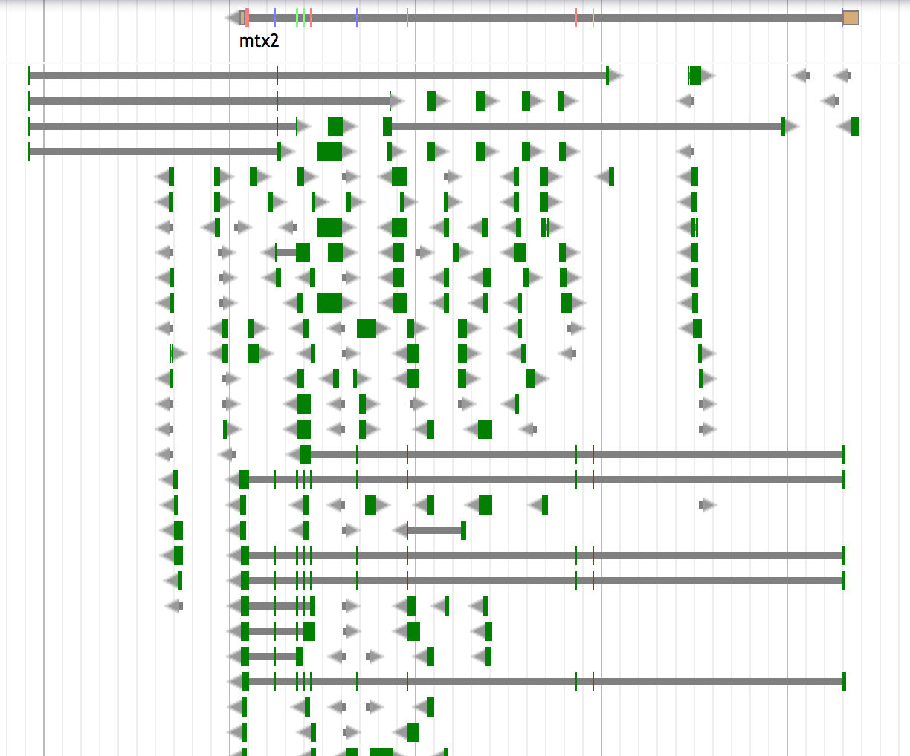
Trinity noise

Slide 30
RNAseq conclusion
RNAseq data should always be included in an annotation project
From the same organism as the genomic data => unbiased
Can be used before annotation or after to improve an annotation already existing
Sample different tissues or life stages if possible
Avoid gonads and brain; muscle is good
/!\ Can be very noisy (tissue/species dependent), can include pre-mRNA
Combining method is best if possible
Notes:
So I put back information here
Noisy for trinity

Slide 31
MAKER lecture
https://nbisweden.github.io/workshop-genome_annotation_elixir/lectures/Structural_annotation_MAKER_Norway2021.pptx
Notes:
Now you got your data so you need to run the tool

Slide 32
Exercises
https://nbisweden.github.io/workshop-genome_annotation_elixir/labs/maker_evidence
https://nbisweden.github.io/workshop-genome_annotation_elixir/labs/augustus_training
https://nbisweden.github.io/workshop-genome_annotation_elixir/labs/maker_abinitio_evidence_driven

Slide 33
After structural annotation
Assessing an annotation

Slide 34
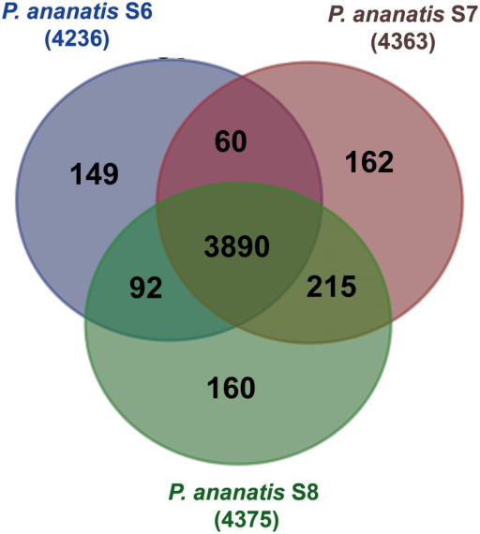
Assessing an annotation
Simple statistics (number genes / number exon per gene)
(and compare against assembly result )
Protein/transcript evidence (AED score in MAKER)
Comparative genomics (OrthoMCL)
Domain / Function attached
Visualization

Slide 35
Assessing an annotation
Selection of most common visualization or/and Manual curation tools
Name | Standalone | Web tool | Manual curation | year | comment
Artemis | X |  | X | 2000 | Can save annotation in EMBL format
IGV | X |  |  | 2011 | Popular
Savant | X |  |  | 2010 | Sequence Annotation, Visualization and ANalysis Tool. enable Plug-ins
Tablet | X |  | X | 2013
IGB | X |  |  | 2008 | enable Plug-ins. Can load local and remote data (dropbox, UCSC genome, etc)
Jbrowse |  | X |  | 2010 | GMOD (successor of Gbrowse)
Web Apollo |  | X | X | 2013 | Active community (gmod). Based on Jbrowse. Real-time collaboration
UCSC |  | X |  | 2000 | A large amount of locally stored data must be uploaded to servers across the internet
Ensembl genome browsers |  | X |  | 2002 | A large amount of locally stored data must be uploaded to servers across the internet
FOR AN EXHAUSTIVE LIST: https://en.wikipedia.org/wiki/Genome_browser

Slide 36
Exercises
https://nbisweden.github.io/workshop-genome_annotation_elixir/labs/annotation_assessment

Slide 37
Closing remarks

Slide 38
Closing remarks
>100 annotation tools – as many methods
(https://github.com/NBISweden/GAAS/blob/master/annotation/knowledge/annotation_tools_genome.md)
6 main class of approaches (Similarity-based, ab initio, hybrid, comparative, combiner, pipeline )
How to choose Method:
Scientific question behind ( need of a conservative annotation vs exhaustive)
Species dependent (plant / Fungi / eukaryotes)
phylogenetic relationship of the investigated genome to other annotated genomes (Terra incognita, close, already annotated).
Data available (hmm profile, RNAseq, etc…)
Depending on computing resources (ab initio ~ hours < vs > pipeline ~ weeks)
Notes:
There is a plethoric choice of methods
conservative will be more based on evidence without ab-initio (Ensembl). <= You want only real/existing gene
Exhaustive will be more ab initio <= you don’t care about over prediction (you will filter … by clusterisation ?)

Slide 39
Closing remarks
Several ab-initio tools together give better result that one alone
(they complement each other)
Pipelines give good results
MAKER2 the most flexible, adjustable
Most methods only build gene models, no functional inference
No annotation method is perfect, they make mistakes !!
Annotation requires manual curation
As for assembly, an annotation is never finished, it can always be improved
=> e.g. Human (to know when to stop)
Submit your annotation in public archive
Notes:
to know how to stop, otherwise you could spend your whole thesis on an annotation. So when is good enough for the scientific question you want to answer, don’t hesitate to stop.

Slide 40
Closing remarks
Effort versus accuracy
accuracy
Effort / time

Slide 41
THE END
https://github.com/NBISweden/GAAS
https://github.com/NBISweden/AGAT
https://github.com/NBISweden/pipelines-nextflow
Notes:
Slide made based on 10.1371/journal.pone0050609.t001
Evaluating High-Throughput Ab Initio Gene Finders to Discover Proteins Encoded in Eukaryotic Pathogen Genomes Missed by Laboratory Techniques. Stephen J. Goodswen, Paul J. Kennedy, John T. Ellis )
CRAIG = abinitio the first CRF (conditional random fields ) (1 CRF). Use only targested genome
Conrad = 2em CRF (not adapted to big genome). Use multi genome, many of its parameters are trained in the same way as GHMM parameters
Contrast = 3em CRF , Use multi genome
FGENESH = widely used for plant
Salzberg says: Integrated approaches. These combine multiple forms of evidence, such as the predictions of other gene finders
Jigsaw, EuGène(graph-based ), Gaze.
Mark Yandell says: GAZE Highly configurable gene predictor (Ab initio tool)
Dans la publication EuGène they say : GAZE: is not a proper gene predictor, because it cannot produce a list of possible coding regions alone.
In another EuGene publication they say about Eugene : We first collect information about splice sites and ATG by submitting the sequence to NetGene2 [20], SplicePredictor [2] and NetStart [13] using a dedicated Perl script.

