Slide 1

Lucile Soler PhD
Nima Rafati PhD
Bacterial
Genome Annotation
https://nbisweden.github.io/workshop-genome_annotation_elixir/labs/prokaryote_annotation
Genome assembly and annotation course
2021

Slide 2
Bacterial genome characteristics
A bacterial genome is a single "circular” DNA molecule with several million base pairs in size
Bacteria can contains plasmids (small and circular DNA molecules, that contain (usually) non-essential genes)
Genomes contain a few thousand genes.
”Gene density” is much higher than in humans, one million base pairs of bacterial DNA contains about 500 to 1000 genes.
bacterial genes have no introns (intron-less),
the average number of codons in bacterial genes is less than in human genes,
neighboring genes are very close together throughout the genome
Notes:
Most bacteria have a genome that consists of a single DNA molecule (i.e., one chromosome) that is several million base pairs in size and is "circular" (doesn't have ends like chromosomes of eukaryotic organisms). In addition, bacteria may have one or more smaller circular DNA molecules, called plasmids, that contain (usually) non-essential genes.
The genome of E. coli (sequenced in 1997) is about 4 million base pairs with about 3000 genes. These numbers are quite average for bacteria; i.e., most have a genome size of several million base pairs containing a few thousand genes. (For example, in a study done here at Lehigh in the 1990's, we found that the pathogenic bacterium Clostridium difficile has a genome size of 4.4 million base pairs ( Norwood and Sands, Gene vol. 201, 159-168 (1997) ). Thus, bacterial genomes are only about 0.1% as big as the human genome, and have about 10% as many genes as we do. A comparison of those two percentages shows immediately that in bacteria the "gene density" (how many genes there are per unit length along the genome) is much higher than in humans. That is, whereas a one million base pair length in us contains on average about 10 genes, one million base pairs of bacterial DNA contains about 500 to 1000 genes. This much greater gene density is due to a combination of factors: (1) bacterial genes have no introns, (2) the average number of codons in bacterial genes is less than in human genes, (3) neighboring genes are very close together throughout the genome; i.e., there are hardly any big regions of non-coding DNA between genes.

Slide 3
Bacterial feature types
protein coding genes and associated features
promoter (-10, -35)
ribosome binding site (RBS)
coding sequence (CDS)
signal peptide, protein domains, structure
terminator
non coding genes
transfer RNA (tRNA)
ribosomal RNA (rRNA)
non-coding RNA (ncRNA)
other
repeat patterns, origin of replication, ...
Notes:
an operon is a functioning unit of DNA containing a cluster of genes under the control of a single promoter.^{[1]} The genes are transcribed together into an mRNA strand and either translated together in the cytoplasm, or undergo splicing to create monocistronic mRNAs that are translated separately, i.e. several strands of mRNA that each encode a single gene product.

Slide 4
Automatic annotation
Two strategies for identifying coding genes:
sequence alignment
find known protein sequences in the contigs
transfer the annotation across
will miss proteins not in your database
may miss partial proteins
ab initio gene finding
find candidate open reading frames
build model of ribosome binding sites
predict coding regions
may choose the incorrect start codon
may miss atypical genes, overpredict small genes
Notes:
a number of tools already exist to annotate genomes of bacteria, most of them are based on homology methods to transfer information from a closely related reference genome to the new sequence. Automatic pipelines can lead to the introduction and propagation of poor annotation and errors, and it is the purpose of the manual curation step to catch and remove these.
Infer genes structure
Best is a mixed of both strategies

Slide 5
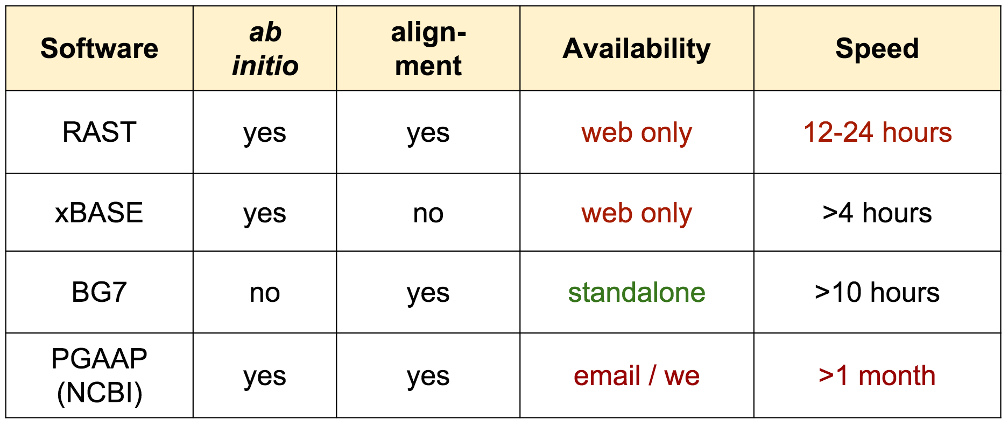
Some good existing tools
Seemann T et al. Bacterial genome annotation, presentation 2016
Notes:
BASys

Slide 6
Prokka
Fast
exploits multi-core computers (aim < 15min)
Convenient
Does structural and functional annotation in one go
Help submitting to NCBI and ENA
Standards compliant
GFF3/GBK for viewing, TBL/FSA for Genbank.
Provenance
Keep record of where/how/why it was annotated
Also annotates archaea, mitochondria, and viruses
https://github.com/tseemann/prokka
Notes:
I am now going to present you prokka as it is the tool that we are using, it is a fast tools
NCBI genbak submitter, ENA submitter

Slide 7
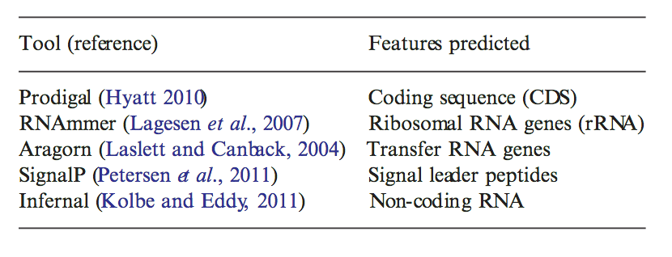
Prokka
Complicated to install
many dependencies (available on conda)
Feature prediction tools used by Prokka :
Seemann T. Prokka: rapid prokaryotic genome annotation. Bioinformatics. 2014 Jul 15;30(14):2068-9. PMID:24642063
Notes:
Just some example

Slide 8
Prokka : method
Prodigal identifies the coordinates of candidates genes
Compares with a database of known sequences
Small trustworthy database: the user provides a set of annotation proteins (optional)
Genus-specific proteome (optional)
Medium-size domain specific database: Uniprot-Swissprot
Curated model of protein families: all proteins from finished bacterial genomes in Refseq
HMMs profile: Pfam, TIGRFAMS (with HMMER)
If nothing is found, is labeled as ‘hypothetical protein’
Notes:
2 stages methods
Facts
searching against smaller databases is faster
searching against similar sequences is faster
Idea
start with small set of close proteins
advance to larger sets of more distant proteins
Prokka
your own custom "trusted" set (optional)
core bacterial proteome (default)
genus specific proteome (optional)
whole protein HMMs: PRK clusters, TIGRfams
protein domain HMMs: Pfam

Slide 9
Prokka pipeline (simplified)
GFF3 GBK
ASN1
Aragorn
tRNA
FASTA
contigs
RNAmmer
rRNA
Output
Infernal
Rfam
ncRNA
Prodigal
CDS
SignalP
sig_peptide
User
BLAST+
Swiss
Pfam
HMMER3
TIGR
protein annotation
protein domains
Seemann T et al. Bacterial genome annotation, presentation 2016
Notes:
Prokka has genus specific databases
aim to capture "genus specific" naming conventions
derived from proteins in completed genomes
proteins are clustered and majority annotation wins
some annotations are rubbish though

Slide 10
Prokka options
Only one parameter mandatory :
Input fasta format
prokka [options] <contigs.fasta>
More than 30 different options available
prokka --help

Slide 11
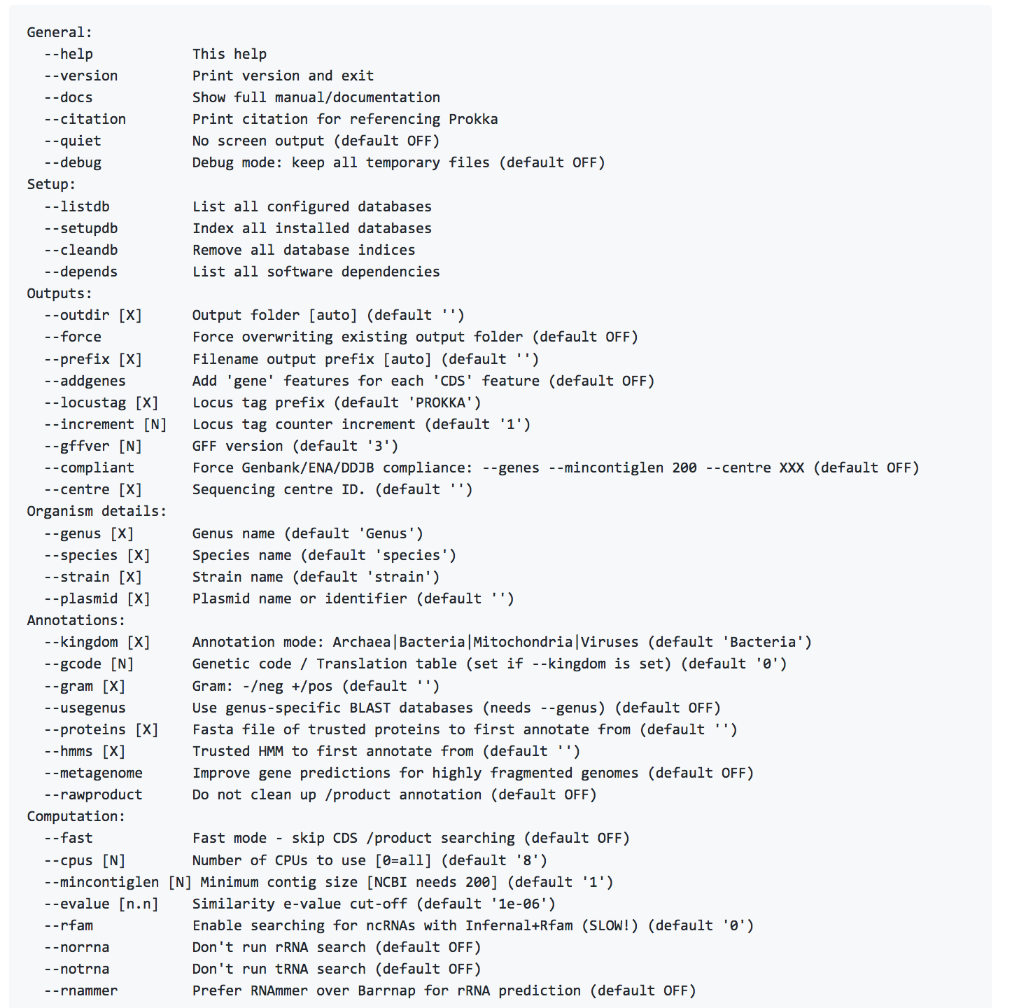
Command line options

Slide 12
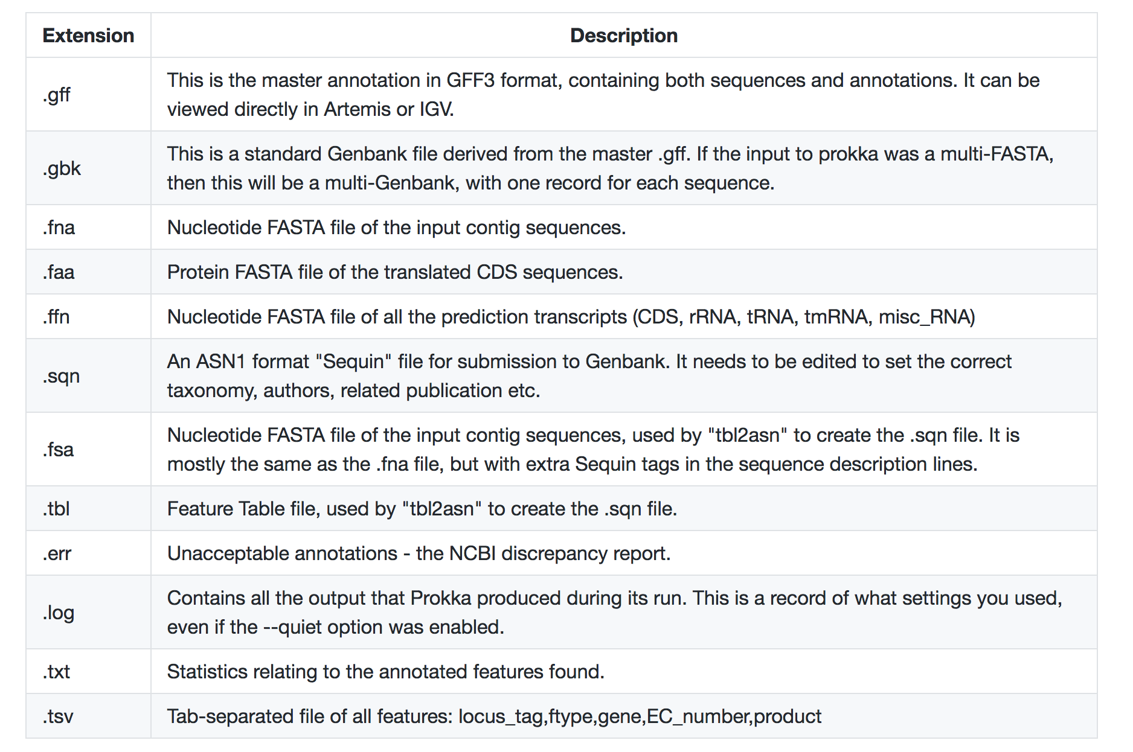
Prokka output
https://github.com/tseemann/prokka#output-files

Slide 13
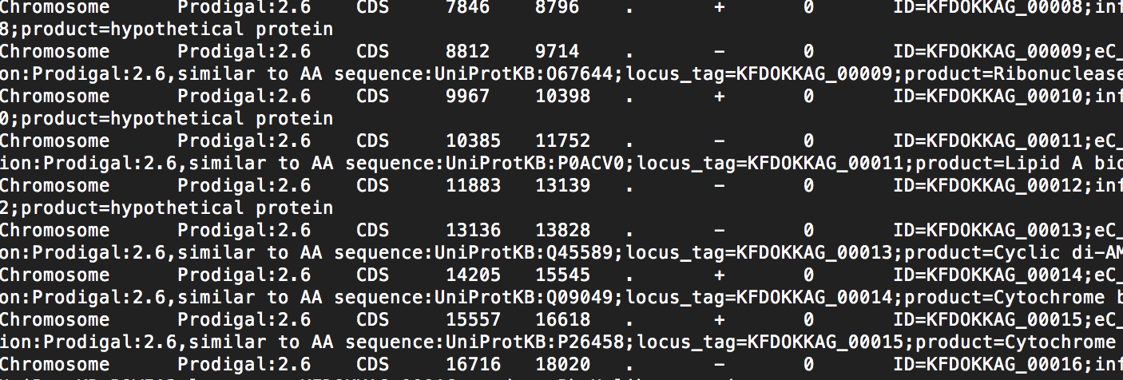
Prokka output
GFF format
Seqid | source | type | start | end | score | strand | phase | attributes
Chr1 | Prodigal | exon | 234 | 1543 | . | + | . | gene_id “gene1”; transcript_id “transcript1”; “prediction:.., protein motif…”
Chr1 | Snap | CDS | 577 | 1543 | . | + | 0 | gene_id “gene1”; transcript_id “transcript1”;
https://github.com/tseemann/prokka#output-files
Notes:
Gff or gtf is often use in annotation tools, 9 columns

Slide 14
Bacterial Genome Annotation
Exercises
Notes:
For sure it comes after structural prediction !

Slide 15
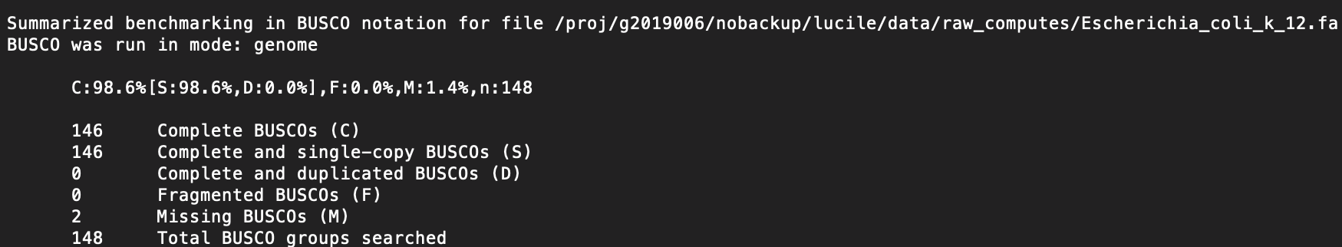
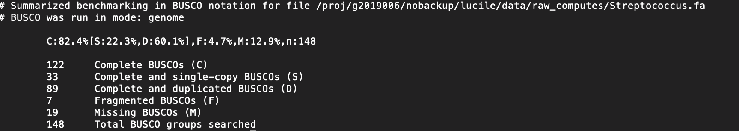
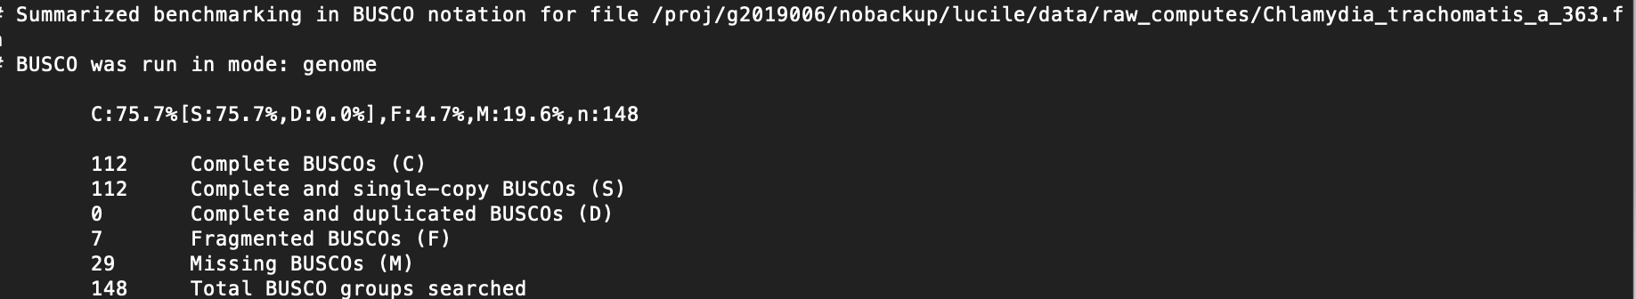

Slide 16
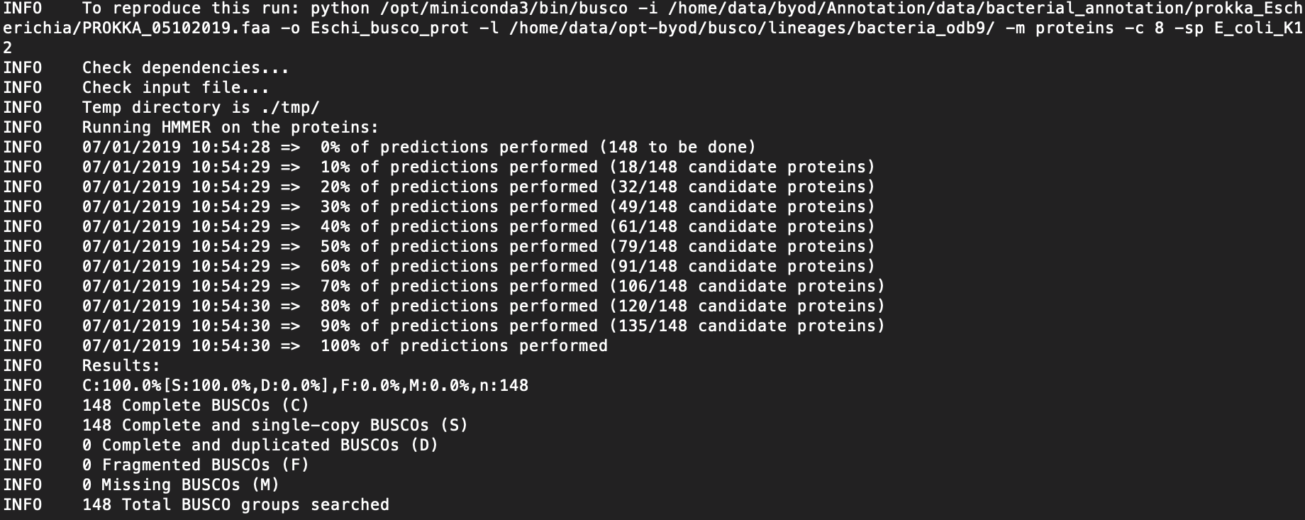

Slide 17
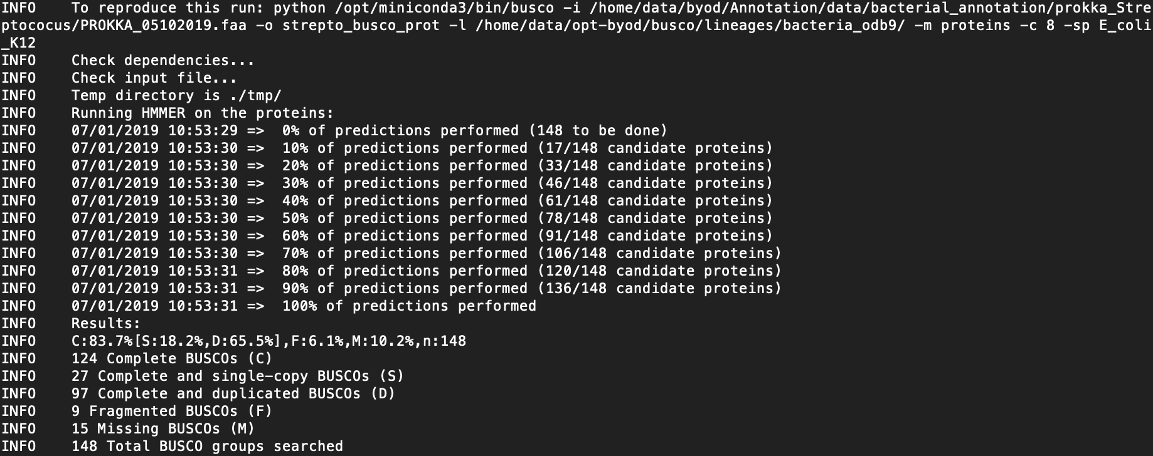

Slide 18
