Slide 1

Lucile Soler, PhD
Jacques Dainat PhD
The genome annotation pipeline
Tromsø – May 2021

Slide 2
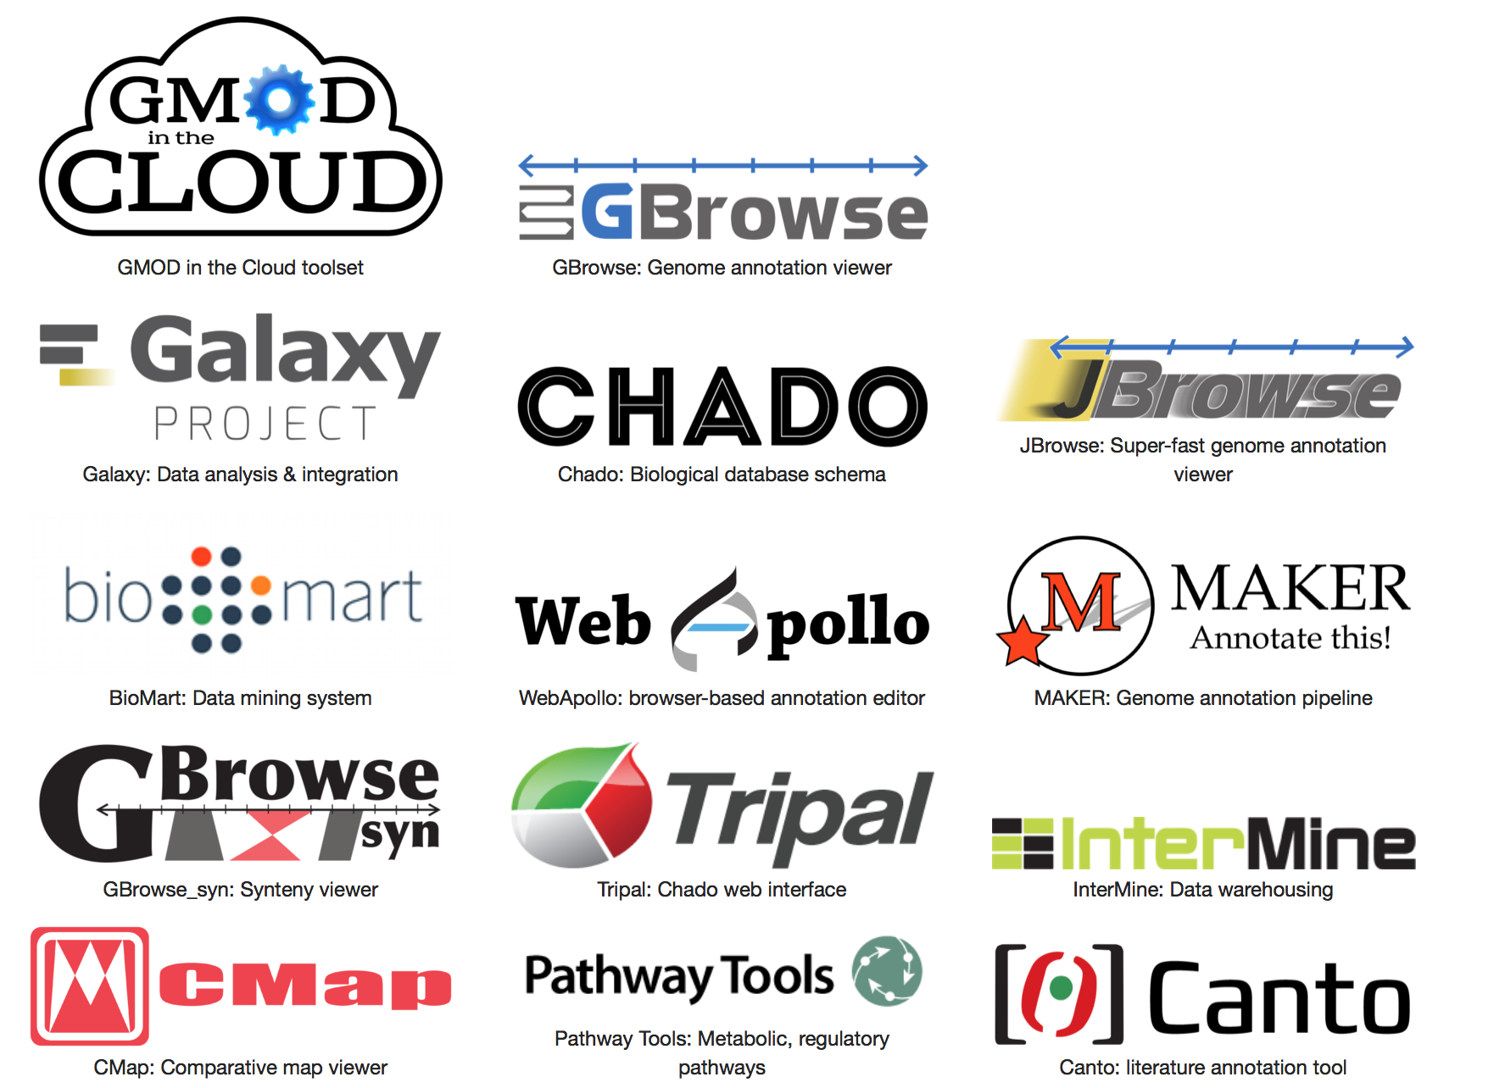
MAKER
Generic Model Organism Database project
GMOD
WORLD
Notes:
GMOD is a collection of open source software tools for managing, visualising, storing, and disseminating genetic and genomic data.
List non-exhaustive of GMOD tools >40 software projects in GMOD
te input and output is often compatible

Slide 3
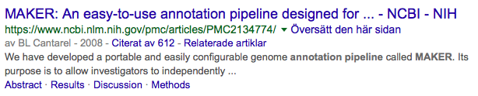
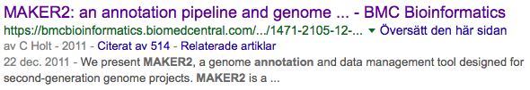
MAKER
Eukaryotic genome annotation
09/2018
MAKER – developed as an easy-to-use alternative to other pipelines

Slide 4
MAKER
Why choose MAKER ?
Easy to use and to configure
Scale to datasets of any size
Multi-threaded and parallelized
Everything is run through one command, no manual combining of data/outputs
Metric for quality control (Annotation Edit Distance )
Distributed with accessory scripts (>30)

Slide 5
MAKER
Capabilities:
Add quality metrics to an annotation (AED)
Locus 1
Locus 2
Locus 3
Annotation
DNA
Evidence aligned
Annotation
Edit Distance
(AED)
AED=0
AED=0.5
AED=1
Perfect
concordance
Complete
absence of support
Notes:
- add UTR when ESTs are supplied.
- Evidence based chooser : select post processed gene model which is most consistent with evidence (protein / EST / RNAseq)
Annotation Edit distance

Slide 6
MAKER
Capabilities:
Merge multiple annotation sets
gene A1
gene A2
gene A3
Annotation A
gene B1
gene B2
gene B3
Annotation B
DNA
gene 4
gene 1
gene 2
gene 3
Merged
Annotation
isoforms
Locus 1
Locus 2
Locus 3
Locus 4
Notes:
- add UTR when ESTs are supplied.
- Evidence based chooser : select post processed gene model which is most consistent with evidence (protein / EST / RNAseq)

Slide 7
MAKER
Capabilities:
Update an annotation in light of new evidence
gene 1
gene 2
Annotation
Evidence
DNA
gene 3
gene 1
gene 2
isoforms
Updated
Annotation
Locus 1
Locus 2
Locus 3
Notes:
- add UTR when ESTs are supplied.
- Evidence based chooser : select post processed gene model which is most consistent with evidence (protein / EST / RNAseq)

Slide 8
MAKER
Capabilities:
Map annotation forwards to a new assembly
Annotation
Assembly 1
DNA
Lift-over on
Assembly 2
DNA

Slide 9
MAKER
Capabilities:
Annotation pure evidence-based
Evidence
DNA
gene 3
gene 1
gene 2
isoforms
Annotation
Locus 1
Locus 2
Locus 3
Suitable for ab-initio training purpose (filtering needed)
Prediction not always complete ! (always_complete option)
Notes:
always_complete=0 #extra steps to force start and stop codons, 1 = yes, 0 = no

Slide 10
MAKER
Capabilities:
Annotation pure ab-initio
DNA
The same as standalone ab-initio ! So why MAKER ?
To take advantage of parallelization !
Can use several ab-initio tools (they can complement each other)

Slide 11
MAKER
Capabilities:
Annotation ab initio evidence-driven
Pure ab-initio
=> Hints from aligned evidence
DNA
ab-initio
Evidence-driven
Ab-initio tools are better when hints are provided
Ab-initio predictions can fill gaps with no evidence
But may still be incomplete / partially wrong
Notes:
I remind you that no prediction approach is perfect, so even if that one is one of the best, there is always errors remaining

Slide 12
MAKER – Use Case
But how does Maker work exactly?
Use case
Ab-initio evidence-driven
Prerequisite:
Evidence (proteins and/or transcripts)
Hmm profile for ab-initio tool(s)
(Augustus comes with some pre-calculated profiles)

Slide 13
MAKER
Step 1 - Repeat masking with repeatmasker
Nucleotide repeats
Transposons/viral proteins
Soft-masking
Hard-masking
ATGCGTTTGacgtttaataattggGCATAGCCCT
ATGCGTTTGNNNNNNNNNNGCATAGCCCT
Masked genome
Notes:
Soft masking excludes these regions from nucleating BLAST alignments (Korf et al. 2003) but leaves them available for inclusion in annotations, as many protein-coding genes contain runs of low complexity sequence.

Slide 14

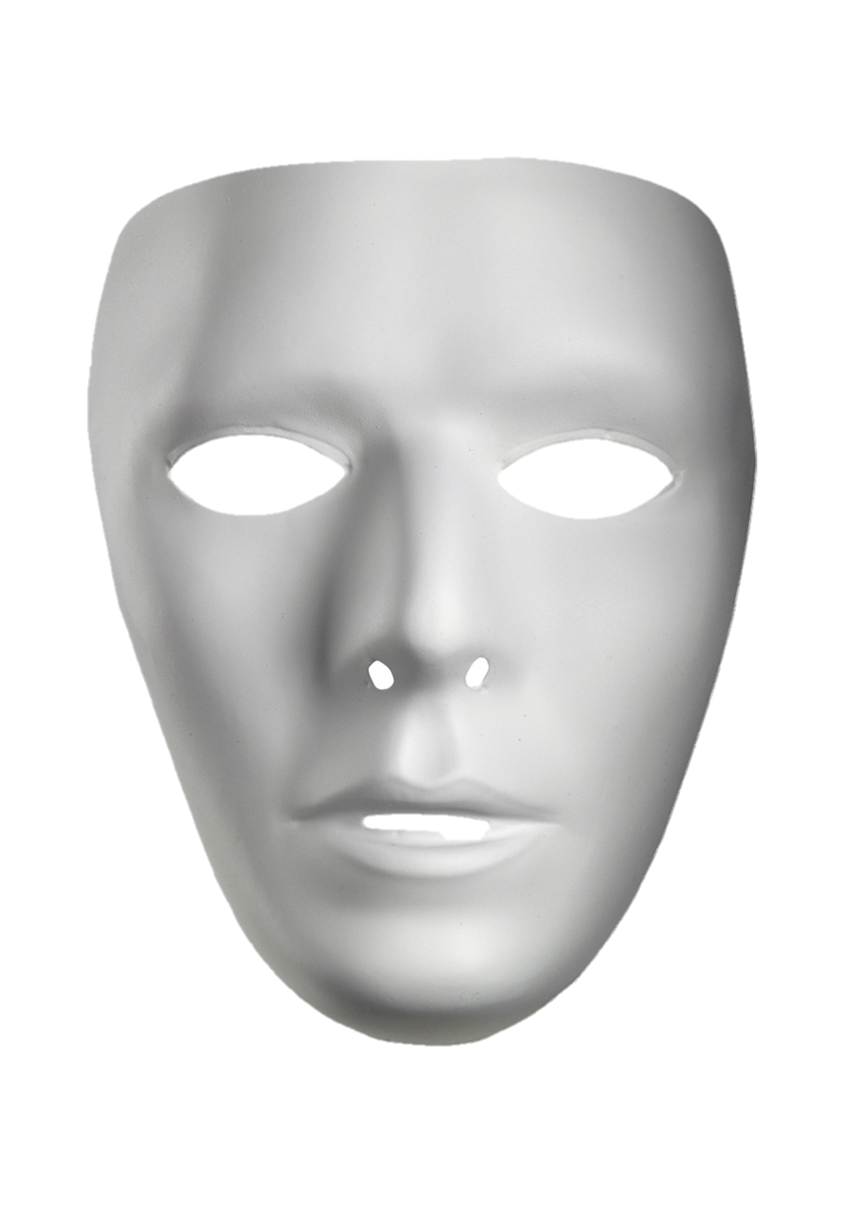
MAKER
Step 2 - Transcript and protein evidence alignment
Proteins
ESTs
Blastx
Blastn
Masked genome

Slide 15
MAKER
Step 3 - Filtering and clustering alignments
Filtering is based on rules defined in the Maker configuration for a given project
Example: EST alignment – 80% coverage and 85% identity
Default settings sensible for most projects, but can be changed!

Slide 16
MAKER
Step 3 - Filtering and clustering alignments
Clustering into ’loci’
Importance of the quality of the data used:
=> Bad data can complicate clustering

Slide 17
MAKER
Step 3 - Filtering and clustering alignments
Amount of data in any given cluster is then collapsed to remove redundancy
Threshold for the collapsing is also user-definable

Slide 18
MAKER
Step 4 - Polishing evidence alignments
Raw:
DNA
ACTTCGCCATGGTGTCTGTCATGTAAAGGTG…..CTGCAGTTAAACTAGTCTCAGCTGTGACACGCTTGT
Blast-based alignments are only approximations, need to be refined
Exonerate is used to create splice-aware alignments
Polished:
ACTTCGCCATGGTGTCTGTCATGTAAAGGTG…..CTGCAGTTAAACTAGTCTCAGCTGTGACACGCTTGT

Slide 19
MAKER
Parenthesis !
In a pure evidence based case, the last step will be the creation of gene model from polished alignments.
ACTTCGCCATGGTGTCTGTCATGTAAAG…..CAGTTAAACTAGTCTCAGCTGTGACACGCTTGT
UTR
CDS
intron
CDS
UTR
exon
exon
Let’s get back on track !
Notes:
this will be the last step once it is splice check

Slide 20
MAKER
Step 5 – Generating hints
DNA
Intergenic
Exon
Intron
Exon
Intergenic
Splice sites
Hints are passed to ab-initio tools that accept them
Notes:
Define exon, intron, intergenic

Slide 21
MAKER
Step 6 - Ab-initio gene prediction (evidence-driven)
Pure ab-initio
=> Hints
DNA
ab-initio
Evidence-driven
Ab-initio predictions are refined when hints are provided
Isoforms accepted if parameter activated

Slide 22
MAKER
Step 7 - Annotation
AED=0.3
Add UTRs
Add quality control metrics
Notes:
Synthesized transcript structures are compared against evidence to find UTRs.
gene prediction ≠ gene annotation
=> gene predictions are gene models.
=> gene annotations are gene models but should include a documented evidence trail supporting the model in addition to quality control metrics.

Slide 23
MAKER
Step 8 – Selecting gene models
selected in agreement with the available evidence
The minimum agreement threshold can be chosen
Evidence
DNA
Gene models
Final MAKER Annotation:
keep_preds=0
Maximum sensitivity
alt_splice=1
keep_preds=1
specificity sensitivity
Notes:
Abinitio evidence-driven give good prediction, and can even fill locus without any evidence. But it can also miss some locus where evidence exist => to catch those case you need to complement this annotation with the evidence-based annotation.
Keep_pred=1 could increase a lot the number of false positive (except fungi, aoomycetes, etc), but can be dramatic in plant an animal !! Can lead to false positive by an order of magnitude or more.

Slide 24
MAKER
Tip - complete the annotation
Evidence
DNA
MAKER ab-initio evidence-driven
+
MAKER evidence based
=> result
Notes:
Even if abinitio evidence-driven gives pretty giood result, it could miss some locus that could have been annotated in apure evidence annotation round. So in order to save some hundreds of gene it can be good to complement the abinitio evidence-driven build by the evidence-based buyld in order to get a nice final build !

Slide 25





MAKER
What next ?
Output = Annotation in gff3 format
…
Genome browser
Downstream analysis
Biological database schema
Submission
Browser-based annotation editor
Tripal: Chado web interface
Notes:
Submission : EBI (EMBLmyGFF3) or NCBI (GAG)
Downstream analysis: comparative genomic, use reference annotation for RNAseq analysis such gene expression analysis, etc….

Slide 26
THE END
https://github.com/NBISweden/GAAS
https://github.com/NBISweden/AGAT
https://github.com/NBISweden/pipelines-nextflow

