Slide 1


Assembly Validation

Slide 2
Gene space statistics
Is my genome assembled good enough?
CEGMA predicted
Genes in genome
CEGMA core proteins
mapping
BUSCO genes in genome
BUSCO profiles
HMM search
Proteins with hit to BUSCO gene set
gmap
ESTs mapped to genome scaffolds
EST / RNA-seq reads
blast
ESTs with blast hit to gene set
Veeckman et al. 2016

Slide 3
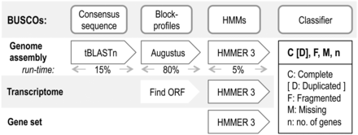
Gene space statistics
BUSCO v3 - Benchmarking Universal Single-Copy Orthologs
Select genes present as single-copy orthologs in 90% of the species
Make multiple sequence alignment and build HMM
Build consensus sequence from HMM

Slide 4
Gene space statistics
BUSCO v3 - Benchmarking Universal Single-Copy Orthologs
Search genome for consensus sequence
Predict genes in candidate regions using block profile (position-specific frequency matrix)
Evaluate if protein sequence is orthologous or just homologous using HMM

Slide 5
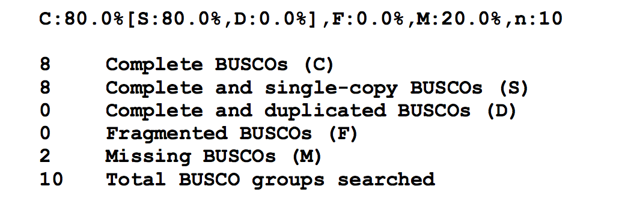
Gene space statistics
Bacteria
Eukaryota
Protists
Metazoa
Fungi
Plants

Slide 6
Gene space statistics
EST / RNA seq reads
Complex if done well
Align de novo assembled transcripts
Evaluate transcripts (e.g. Transrate, Detonate)
Alignment statistics (e.g. gmap)
Align reads
Alignment statistics (e.g HiSat2)
RNA seq has it’s own complications
RNA seq is often a snapshot of time, tissue, treatment, etc.
Is your RNA seq data saturated?
Purity, bias, etc.

Slide 7

Gene space statistics
Annotation
Workshop in Genome Annotation

Slide 8
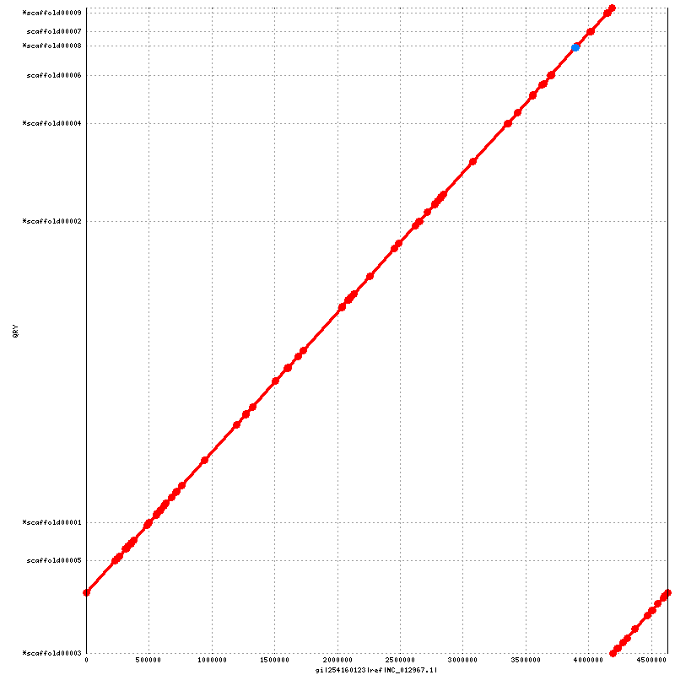
Comparative Alignment
Dot plots (Nucmer, Gepard, etc)

Slide 9
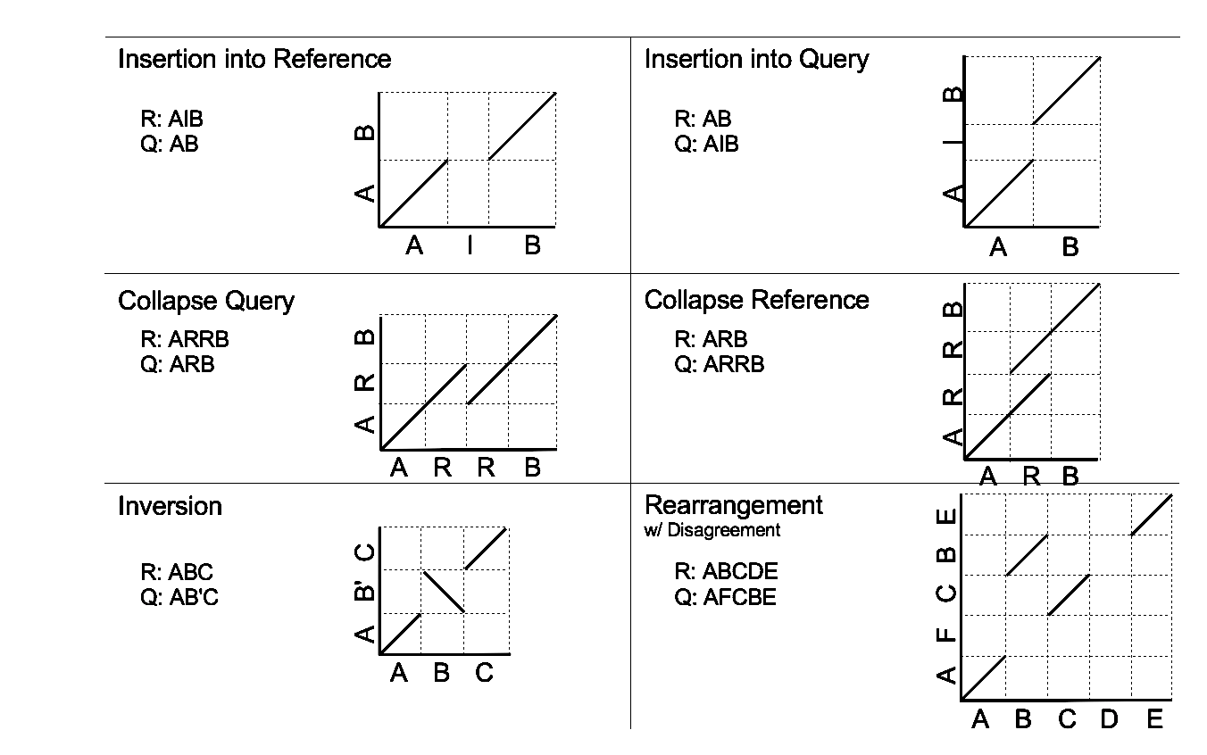
Comparative Alignment
Dot plots

Slide 10
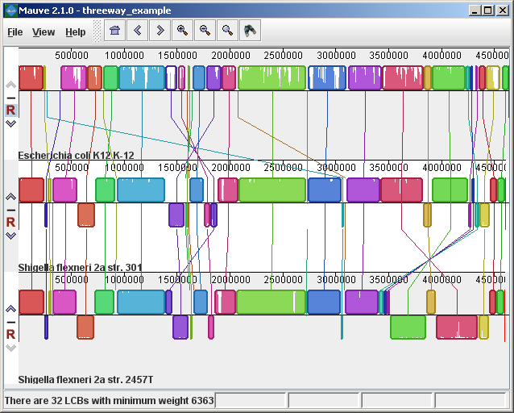
Comparative Alignment
Mauve

Slide 11
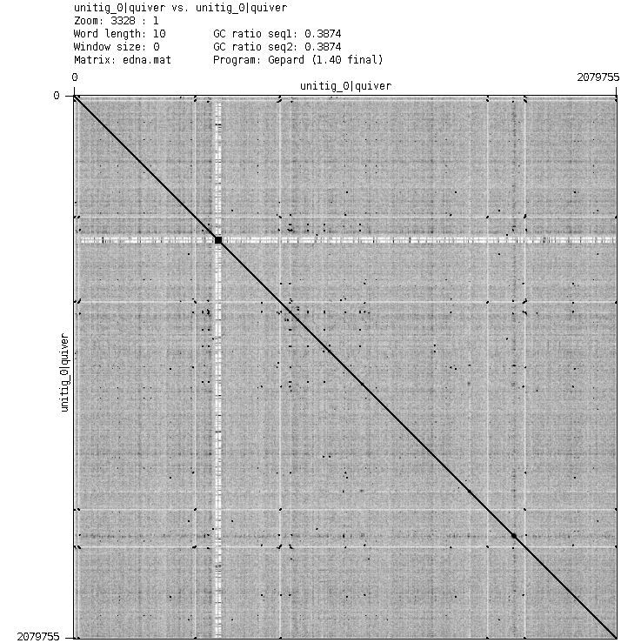
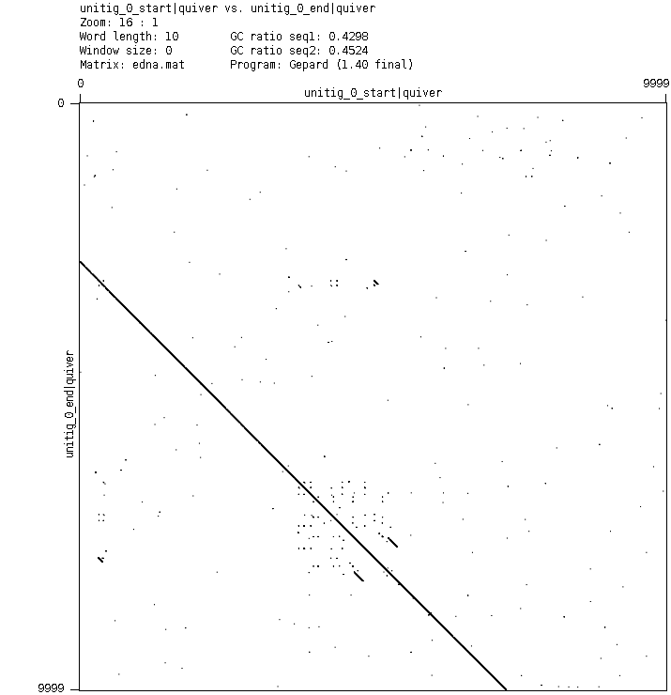
Comparative Alignment
Self comparison
Circular chromosomes
[S1] [E1] [S2] [E2] [LEN 1] [LEN 2] [% IDY] [TAGS]
1 2079756 1 2079756 2079756 2079756 100.00 unitig_0|quiver unitig_0|quiver
...
1 7277 2072451 2079756 7277 7306 99.44 unitig_0|quiver unitig_0|quiver
...

Slide 12
Selecting the best assembly
Illumina (10X Genomics)
Quast
Assemblathon_statistics
KAT
Bandage
Samtools flagstat
FRCBam / Reapr (TigMint)
IGV
Blobtools
Kraken
BUSCO
PacBio / Nanopore
Quast
Assemblathon_statistics
Bandage
Samtools flagstat
TigMint
IGV
Blobtools
Kraken
BUSCO

