Slide 1


Sequence Quality Assessment

Slide 2
Quality Assessment of Sequences
Why does quality assessment matter?
DNA -> Data = lots of processes => Errors can be introduced
Poor understanding of the data => Poor Assembly

Slide 3
Sources of problems
Data corruption
Unexpected data
Missing data
Too little sequence data
Too much sequence data
Contamination
Duplication

Slide 4
Data corruption
Occurs:
Process failure ( software / hardware crash )
Incorrect processing
Integrity:
Checksums
Format validation
Metadata analysis

Slide 5
Checksums
Checksums ensure data are consistent.
MD5
$ md5sum file1.fastq.gz # before 823fc8b0ca72c6e9bd8c5dcb0a66ce9b file1.fastq.gz
$ md5sum -c checksums.md5 # after file1.fastq.gz: OK file2.fastq.gz: OK file3.fastq.gz: FAILED md5sum: WARNING: 1 of 3 computed checksums did NOT match
Calculate file checksums before transfer.
Verify checksums against the transferred files after the transfer.

Slide 6
Format Validation
Understand common file formats
Fastq
Fasta
SAM/BAM
HDF5 ( and Fast5 )
GFA
Understand the meta data.
Description: https://github.com/NBISweden/workshop-genome_assembly/wiki

Slide 7
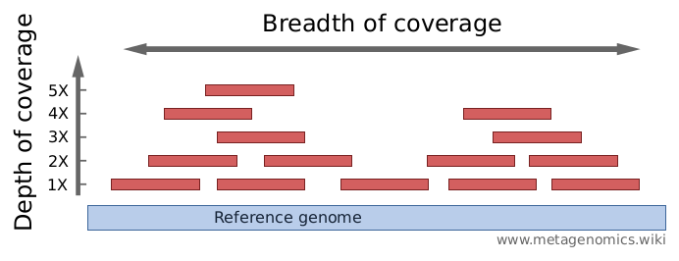
Depth of Coverage
The number of times each base in the genome is covered by a read.

Slide 8
Depth of Coverage
What depth of coverage do I want?
Illumina: 50x ~ 150x
PacBio: 15x ~ 50x (15x > 10kbp)
Oxford Nanopore: 15x ~ 50x (15x > 10kbp)
10X Genomics: 38x - 56x
What is my expected genome size?
Coverage = Number of bases sequenced / Estimated genome size

Slide 9
Calculating data quantity
FastQC / MultiQC summary reports
Third party scripts
Command line calculation (my favourite way)
Can use Seqtk to convert files to fasta
zcat *.fastq.gz | seqtk seq -A [-L 10000] - | grep -v “^>” | tr -dc “ACGTNacgtn” | wc -m
zcat ( concatenates the compressed fastq files into one stream )
seqtk ( converts to fasta format [and drops reads less than 10k] )
grep ( -v excludes lines starting with “>”, i.e. fasta headers )
tr ( -dc removes any characters not in set “ACGTNacgtn” )
wc ( -m counts characters )

Slide 10
Data quantity
Too little data:
More sequencing required.
Too much data:
Above 200X coverage is considered extreme.
Increased computation time and resources.
Assemblies become more fragmented and inaccurate.

Slide 11
Subsampling and Normalization
Short reads (easy):
Use a random fraction of the reads maintaining read pairing.
E.g. Use the same seed (-s) and give the fraction (0.1) in Seqtk. seqtk sample -s100 read1.fq 0.1 > sub1.fq seqtk sample -s100 read2.fq 0.1 > sub2.fq
Normalize uneven coverage (e.g. bbnorm)
bbnorm.sh in=read_1.fastq in2=read_2.fastq out=normalized_1.fastq out2=normalized_2.fastq target=100 min=5

Slide 12
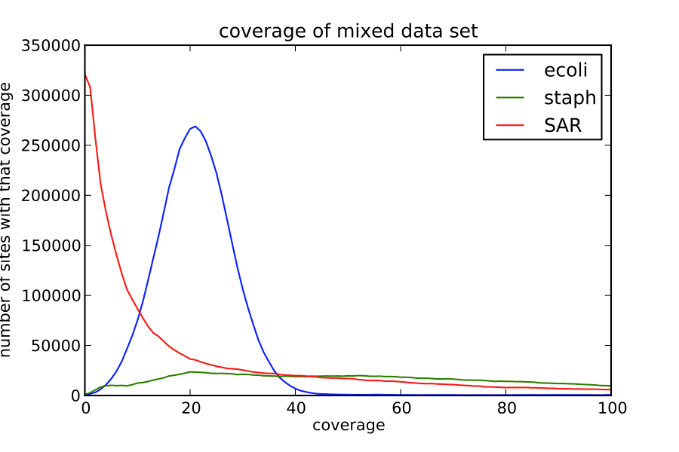
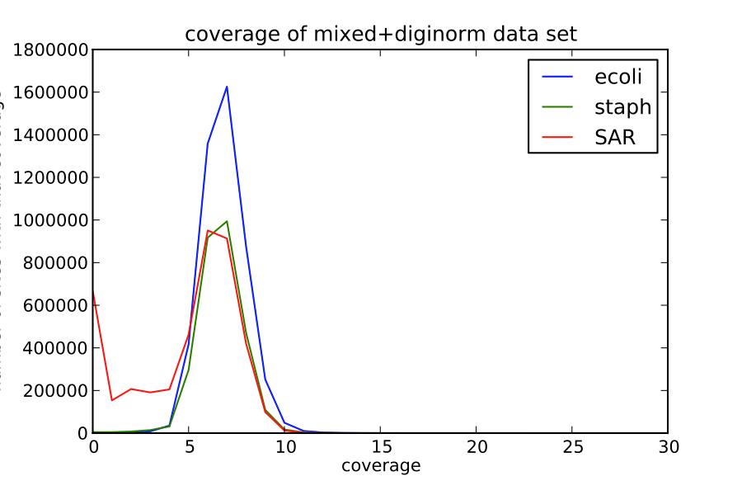
Subsampling and Normalization
http://ivory.idyll.org/blog/what-is-diginorm.html

Slide 13
Subsampling and Normalization
Long reads (trickier):
Want longest reads for contiguity.
Want shortest reads for even coverage (consensus accuracy).
Canu can use weighted subsampling
readSamplingCoverage=1000 readSamplingBias=0
Initial coverage is high as subsequent processing reduces coverage.

Slide 14
Summary
Check your data is complete.
Checksums
Check your data is valid.
Format
Metadata
Check coverage.
More sequence?
Less sequence?
Subsample?
Normalize?

