Slide 1


Small Genome Assembly

Slide 2
Small genome assembly
Aim: Sequence, assemble, and analyze several strains of a bacteria
Method:
How would you design this experiment?
Which sequence technology would you go for?
Would your assembly strategy be the same for all strains?

Slide 3
Small genome assembly
Aim: Sequence, assemble, and analyze several strains of a bacteria
Method:
What I would choose:
Select one or two strains for a pilot study with Illumina.
Analyze properties
Select a few strains that are most important.
De novo assemble w. long reads.
Sequence the rest with Illumina.
Reference guided assembly.

Slide 4
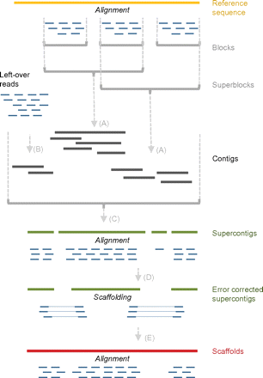
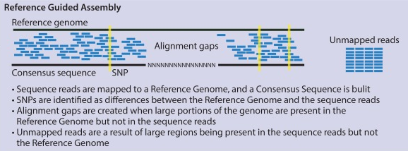
Reference guided assembly
Simple organisms
Align
Call variants
Make consensus
Complex organisms
Align and call blocks
De novo assemble left-overs
Assemble contigs
Ronholm et al. 2016
Schneeberger et al. 2011

Slide 5
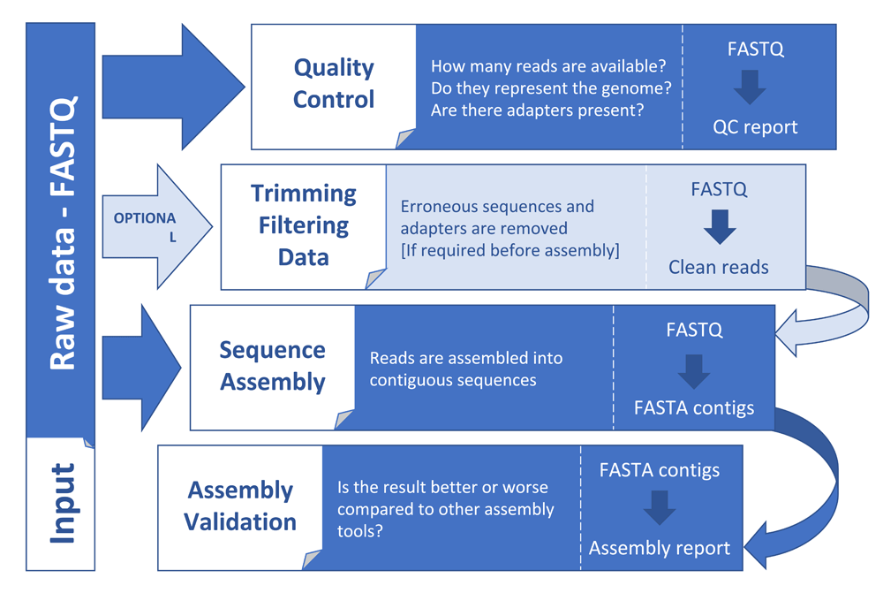
Small genome assembly
Dominguez Del Angel. et al. 2018

Slide 6
Small genome assembly
Additional steps:
Circular assemblies have an overlap at the end
Conventional to start at origin of replication
e.g. between the genes `rpmH` and `dnaA`.
Merge the assembly again at the overlap.

Slide 7
Small genome assembly
Illumina
Subsample
Assemble
Polish
Evaluate unpolished
Pacbio
Subsample
Assemble
Polish
Evaluate polished
Nanopore
Subsample
Assemble
Polish
Ref guided

