Slide 1

Genome properties
Henrik Lantz - NBIS/SciLife/Uppsala University

Slide 2
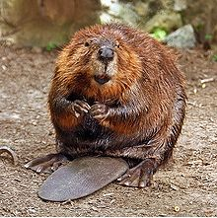

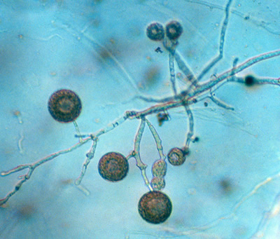
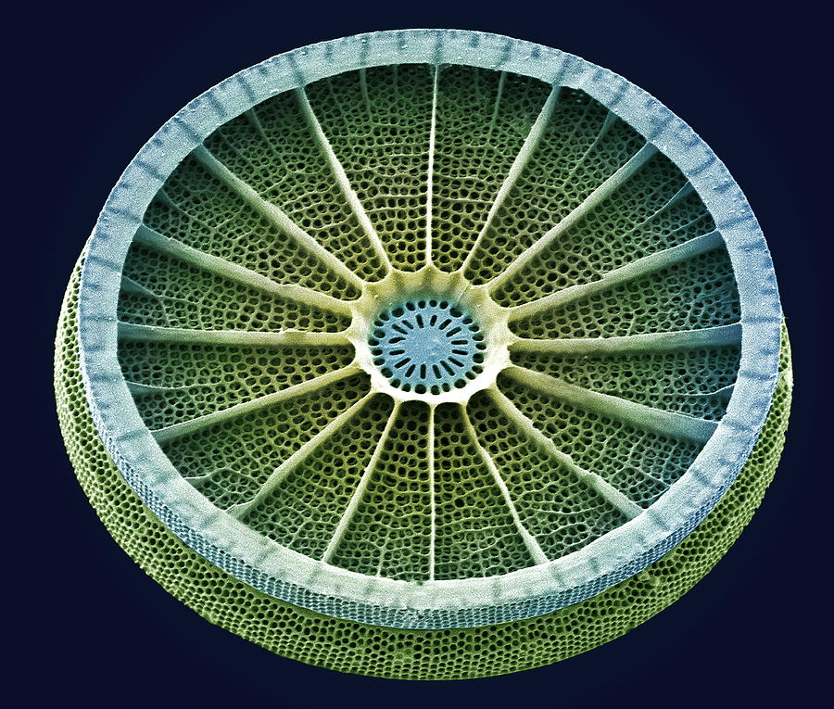
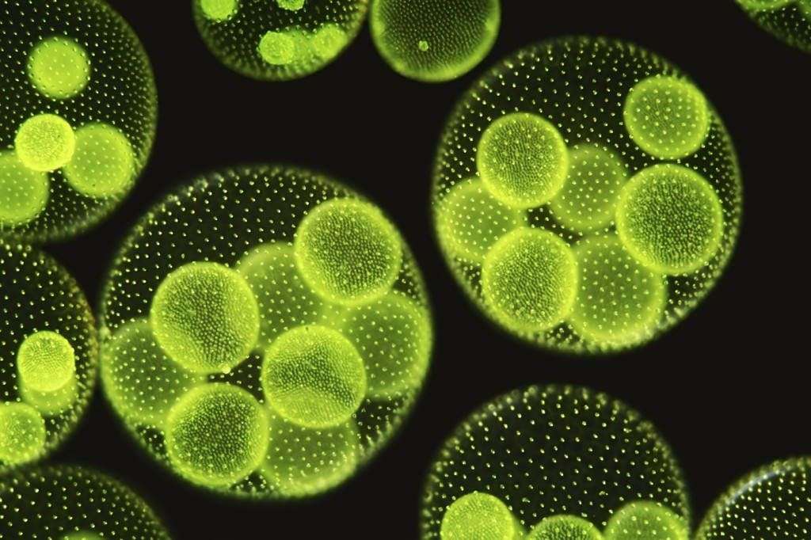
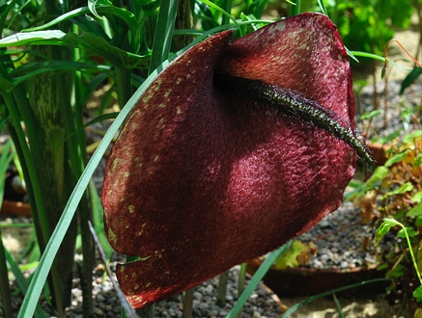
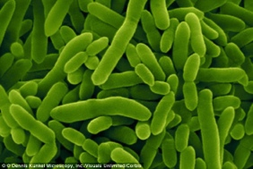
Organisms are different, and so are assembly projects

Slide 3
Genome properties
Genome size
Heterozygosity levels
Repeat-content
GC-content
Secondary structure
Ploidy level

Slide 4
Genome size
Genome sizes range from 100 kbp to 150 Gbp
The larger the genome, the more data is needed to assemble it (>50x usually)
Compute needs grow with increased amount of data (running time and memory)
Note that larger genomes do not necessarily have to be harder to assemble, although empirically this is often the case

Slide 5
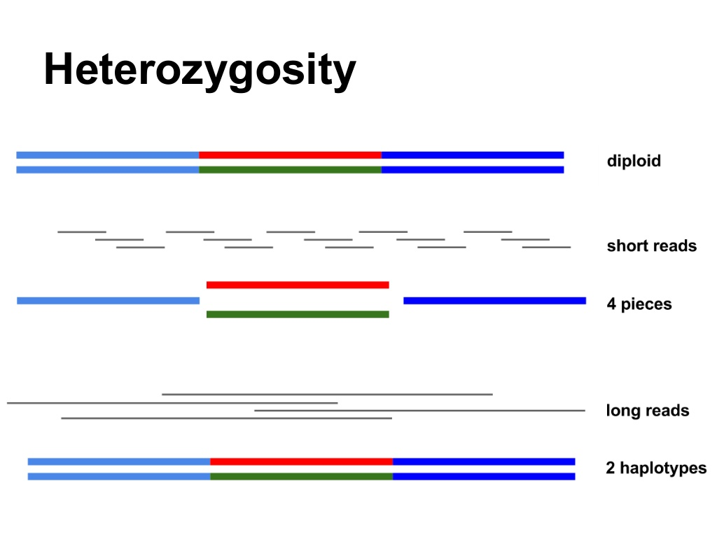
Heterozygosity
(Slide by Torsten Seeman, Victorian Life Sciences Computation Initiative)

Slide 6
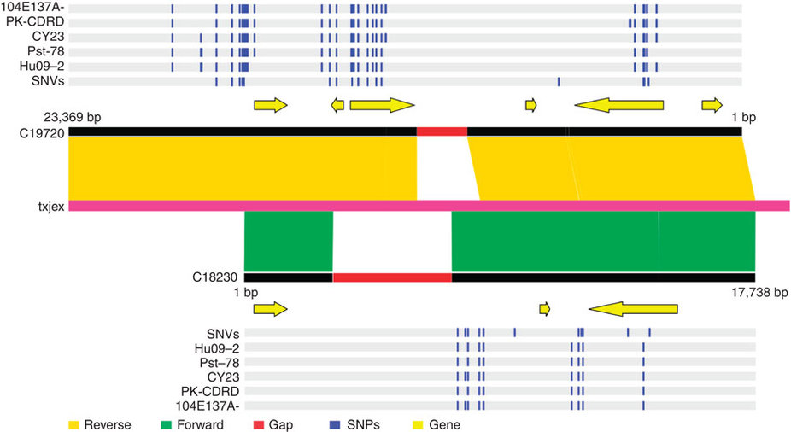
Highly heterozygous fungus
(Zheng et al. (2013) Nature Com.)

Slide 7
Heterozygosity
Highly heterozygous regions tend to be assembled separately
Homologous regions existing in multiple copies in the assembly
Downstream problems in determining orthology for gene based analyses, comparative genomics etc.

Slide 8
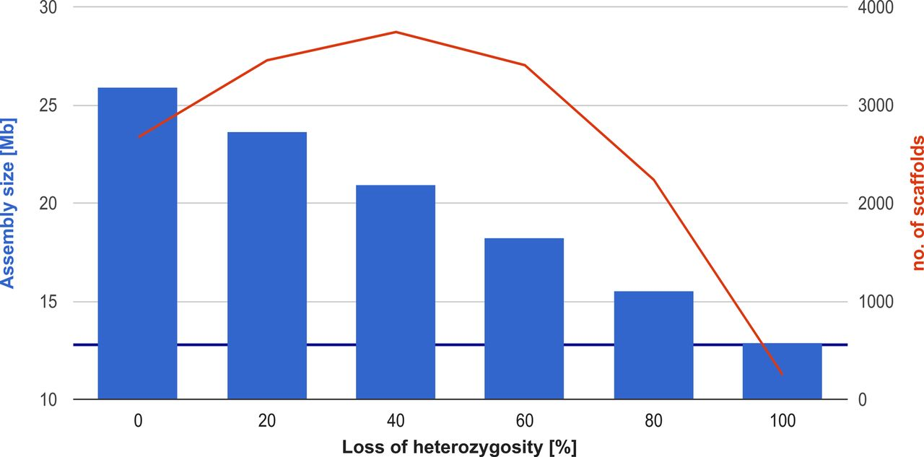
Effect of heterozygosity on assembly size
(Pryszcz and Gabaldon (2016) Nucl. Acids. res.)

Slide 9
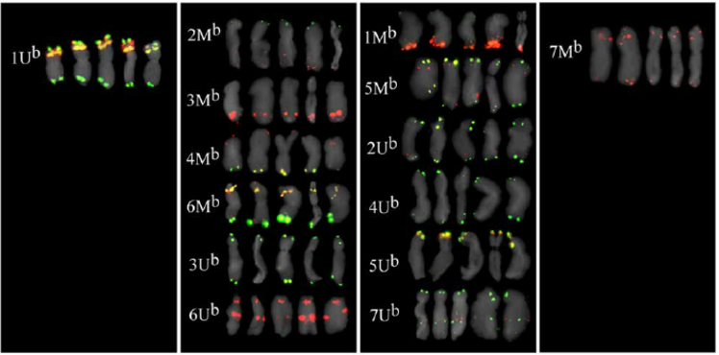
Repeats
Identical, or near identical, regions occurring in multiple copies in a genome
(Istvan et al. (2011), PLoS ONE)

Slide 10
Repeats
Low complexity regions
Regions where some nucleotides are overrepresented, such as in homopolymers, e.g., AAAAAAAAAA, or slightly more complex, e.g., AAATAAAAAGAAAA
Tandem repeats
A pattern of one or more nucleotides repeated directly adjacent to each other, e.g., AGAGAGAGAGAGAGAGAGAG
2-5 nucleotides - microsatellites (e.g., GATAGATAGATA)
    10-60 nucleotides - minisatellite
Complex repeats (transposons, retroviruses, segmental duplications, rDNA, etc.)

Slide 11
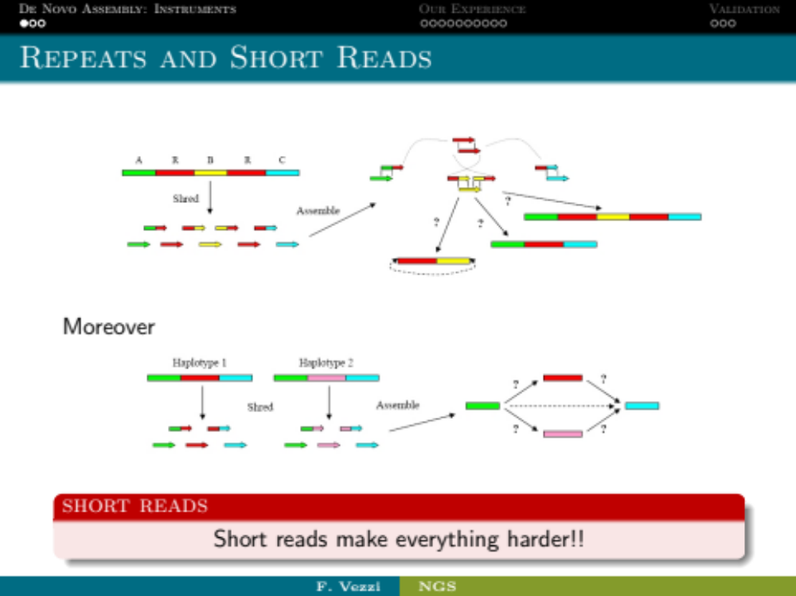
How repeats can cause assembly errors
Mathematically best result:
C
R
A
B

Slide 12
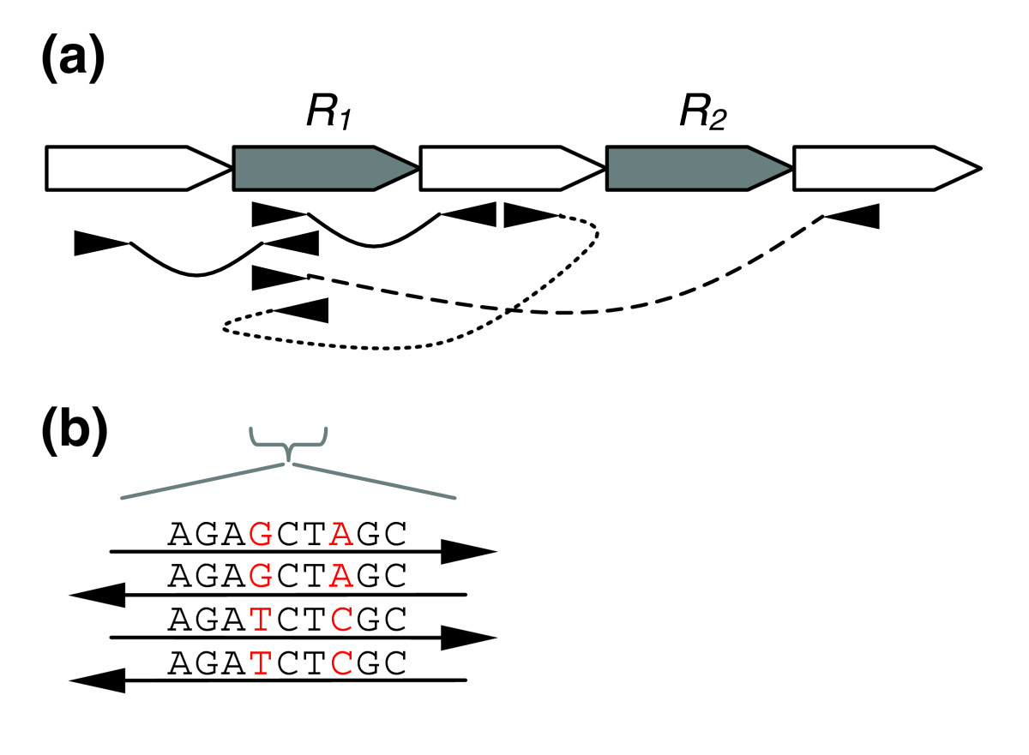
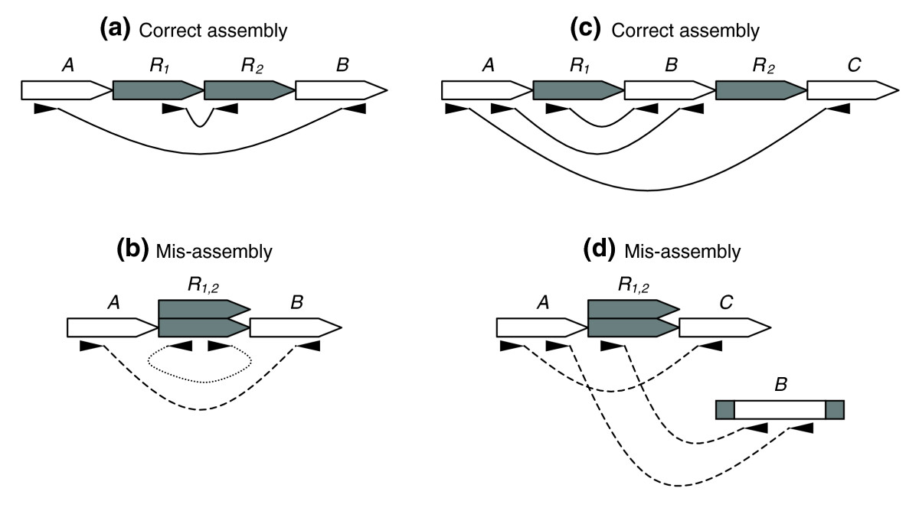
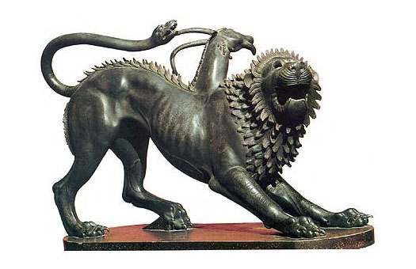
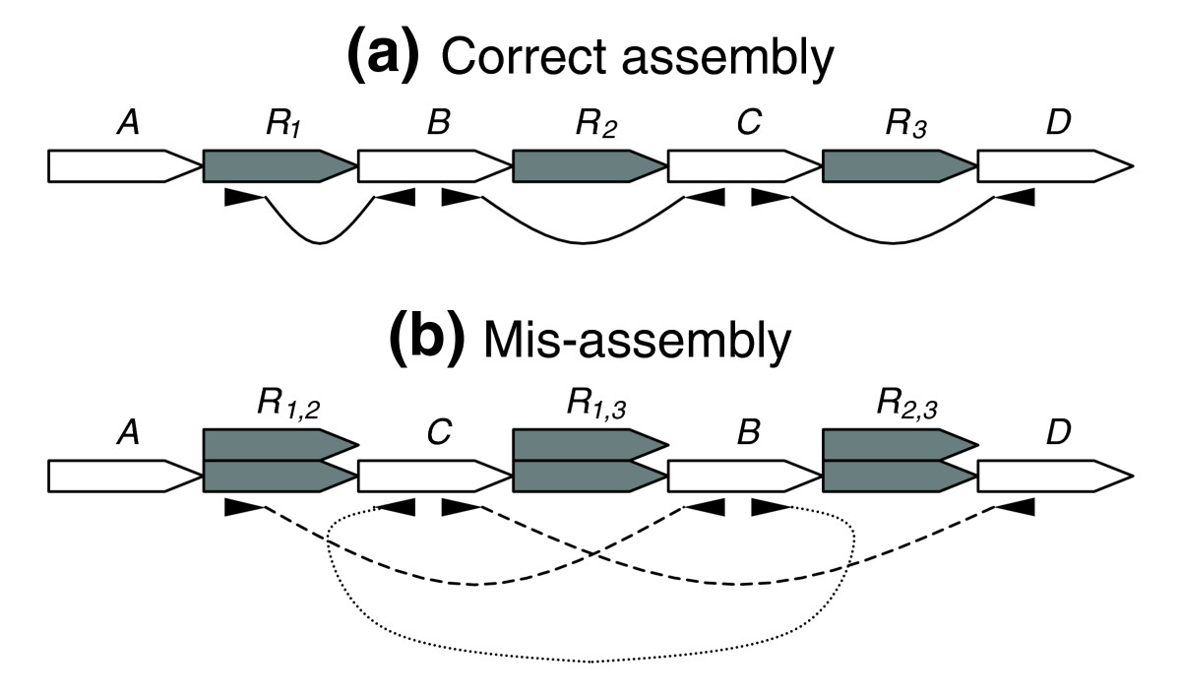
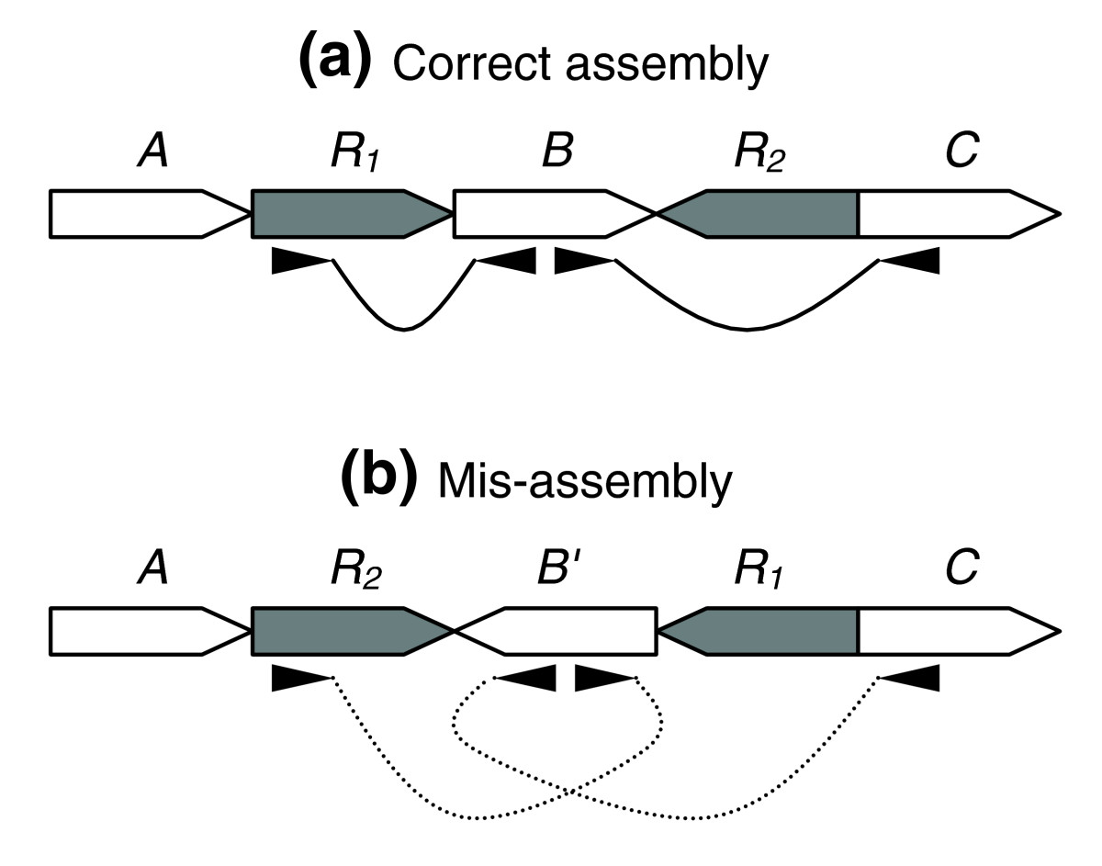
Repeat errors
Overlapping non-identical reads
Collapsed repeats
and chimeras
Wrong contig order
Inversions

Slide 13
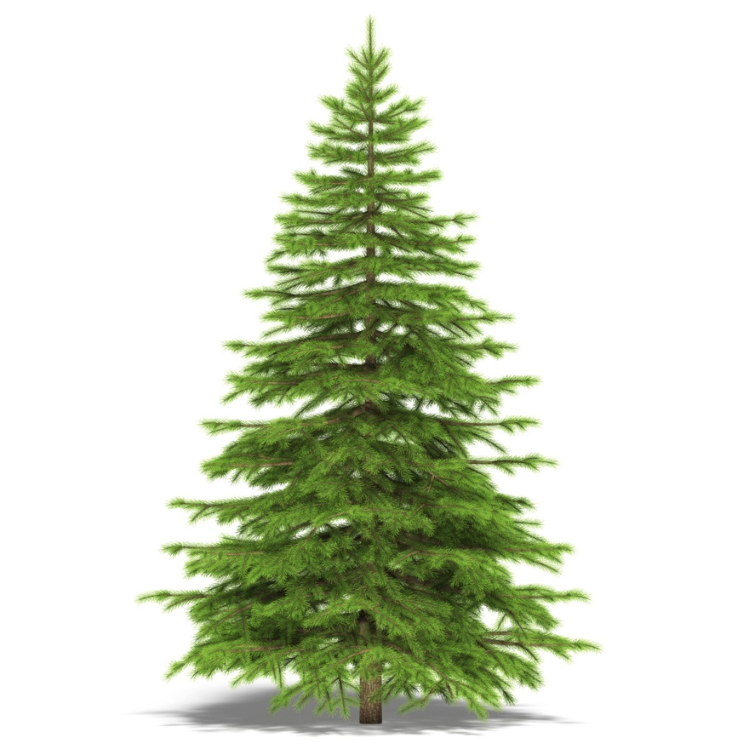
When can I expect repeats to cause a problem?
Always…
Much more common in eukaryotes, in particular plants and many animals
Several conifers have a repeat content of ~75%, mostly simple repeats -> huge genomes

Slide 14
How to deal with repeats
Long range information, e.g., long reads or paired reads with long insert sizes
R1
R2
Short reads

Slide 15
How to deal with repeats
Long range information, e.g., long reads or paired reads with long insert sizes
Long reads

Slide 16
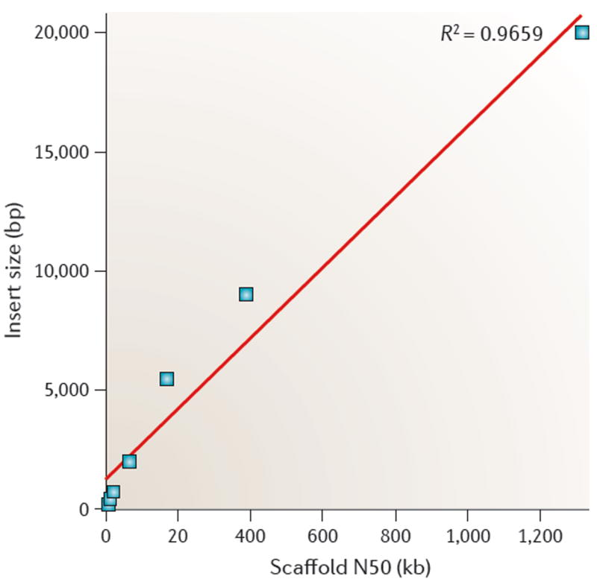
Effect of insert size on scaffold length

Slide 17
Repeat identifcation
These tools allow you find repeats de novo
  Repeatexplorer
  Repeatmodeler
  REPET

Slide 18
Repeatmasker
file name: FILTERED_4_111227_AD07GTACXX_B31_index7_1.sub500k.fa
sequences: 500000
total length: 47417491 bp (47417491 bp excl N/X-runs)
GC level: 45.49 %
bases masked: 18112773 bp ( 38.20 %)
==================================================
number of length percentage
elements* occupied of sequence
--------------------------------------------------
SINEs: 0 0 bp 0.00 %
ALUs 0 0 bp 0.00 %
MIRs 0 0 bp 0.00 %
LINEs: 0 0 bp 0.00 %
LINE1 0 0 bp 0.00 %
LINE2 0 0 bp 0.00 %
L3/CR1 0 0 bp 0.00 %

Slide 19
Repeatmasker
LTR elements: 0 0 bp 0.00 %
ERVL 0 0 bp 0.00 %
ERVL-MaLRs 0 0 bp 0.00 %
ERV_classI 0 0 bp 0.00 %
ERV_classII 0 0 bp 0.00 %
DNA elements: 0 0 bp 0.00 %
hAT-Charlie 0 0 bp 0.00 %
TcMar-Tigger 0 0 bp 0.00 %
Unclassified: 218285 17781419 bp 37.50 %
Total interspersed repeats: 17781419 bp 37.50 %
Small RNA: 0 0 bp 0.00 %
Satellites: 0 0 bp 0.00 %
Simple repeats: 13539 656791 bp 1.39 %
Low complexity: 0 0 bp 0.00 %
==================================================

Slide 20
Genome properties
GC-content
  Regions of low or high GC-content have a lower coverage (Illumina, not PacBio)
Secondary structure
  Regions that are tightly bound get less coverage
Ploidy level
  On higher ploidy levels you potentially have more alleles present

Slide 21
Additional complexity
Size of organism
  Hard to extract enough DNA from small organisms
Pooled individuals
  Increases the variability of the DNA (more alleles)
Inhibiting compounds
  Lower coverage and shorter fragments
Presence of additional genomes/contamination
  Lower coverage of what you actually are interested in, potentially chimeric assemblies

