Slide 1


Genome Assembly

Slide 2
Genome assembly
Illumina
Subsample
Summarize
Assemble
Polish
Evaluate
Evaluate unpolished
Hybrid assembly
Pacbio
Subsample
Summarize
Assemble
Polish
Evaluate
Evaluate polished
Parameter exploration
Nanopore
Subsample
Summarize
Assemble
Polish
Evaluate
Evaluate coverage
Strategy choice

Slide 3
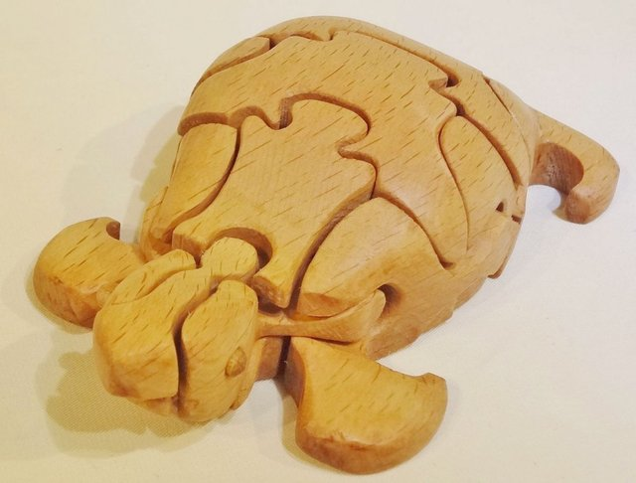
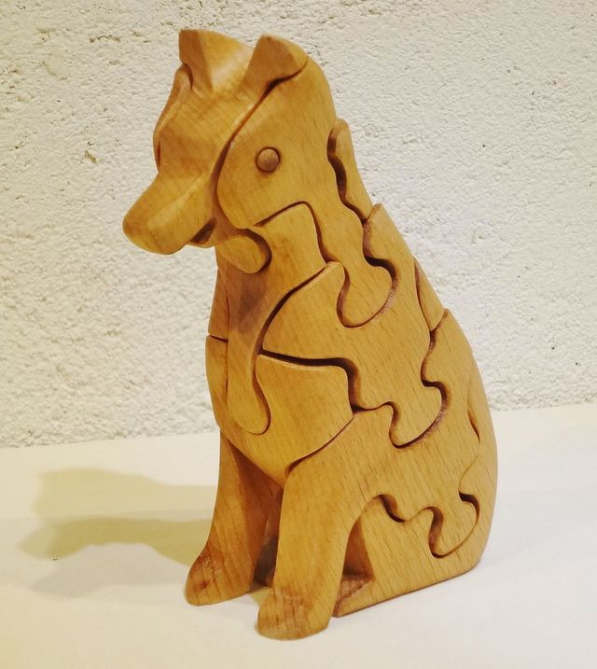
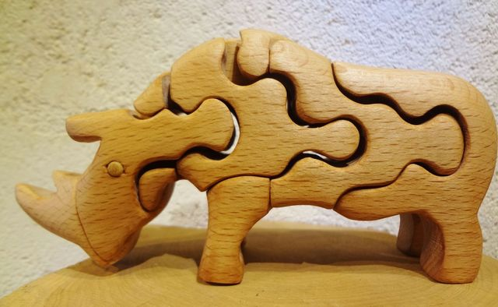
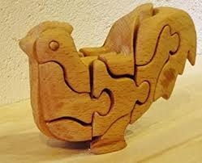
Genome assembly
Turtle
Wolf
Rhino
Rooster

