Slide 1


Genome Assembly

Slide 2
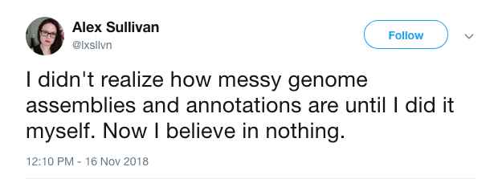
Genome assembly

Slide 3
Genome assembly
Illumina
Subsample
Assemble
Polish
Evaluate unpolished
Pacbio
Subsample
Assemble
Polish
Evaluate polished
Nanopore
Subsample
Assemble
Polish
Ref guided

