Slide 1
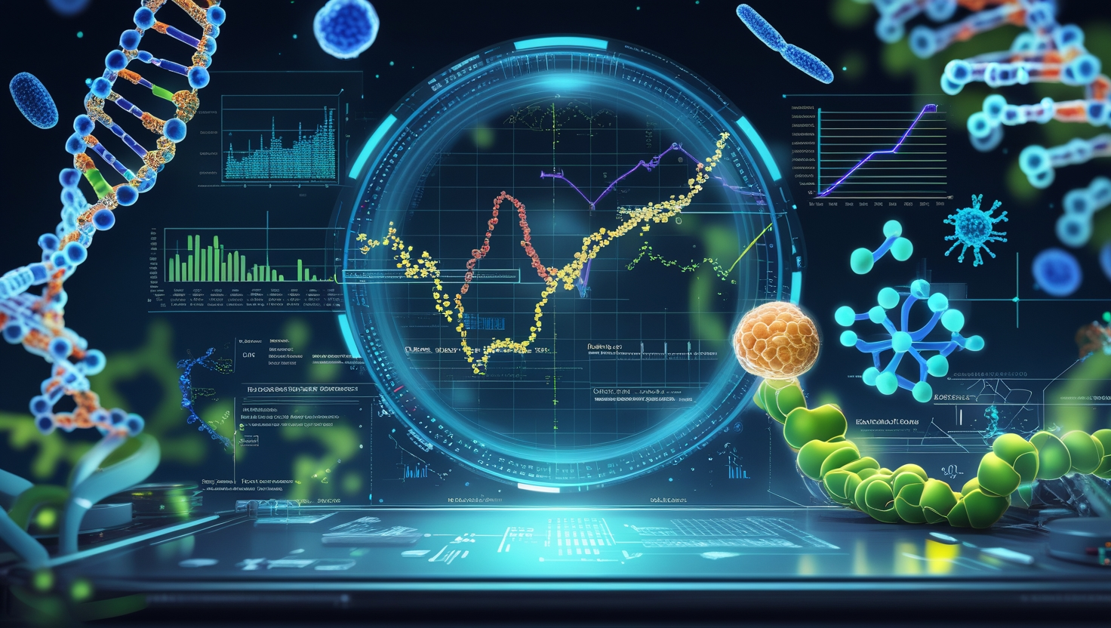
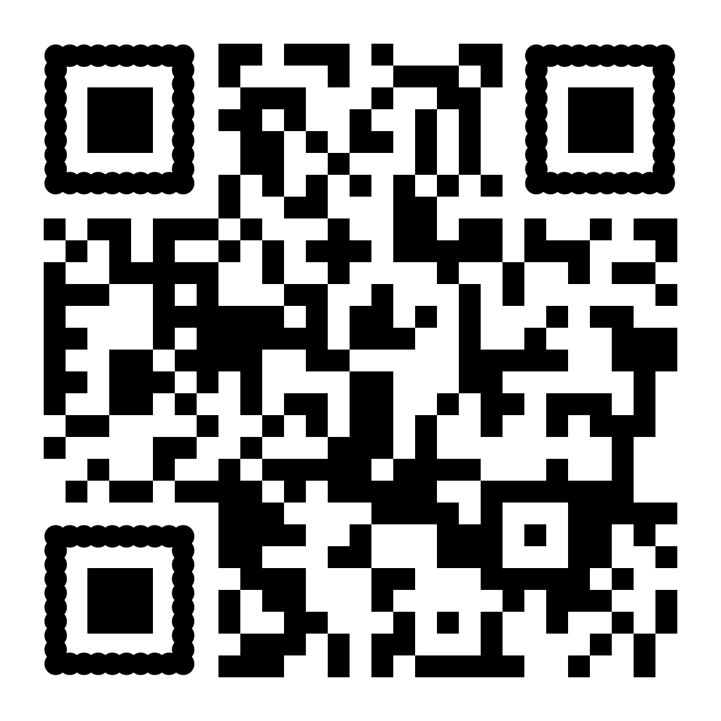


Course
Machine Learning for Life Sciences
October 12th – 16th
BMC, Uppsala
Learn how to apply machine learning to complex biological data - from preprocessing and exploration to predictive modelling, evaluation and interpretation. The course covers dimensionality reduction, clustering, regularised and tree-based models, multi-omics integration and explainable machine learning.
Apply by September 4th
Read more:
https://nbisweden.github.io/ML4Life/
or https://training.scilifelab.se/events

