Slide 1
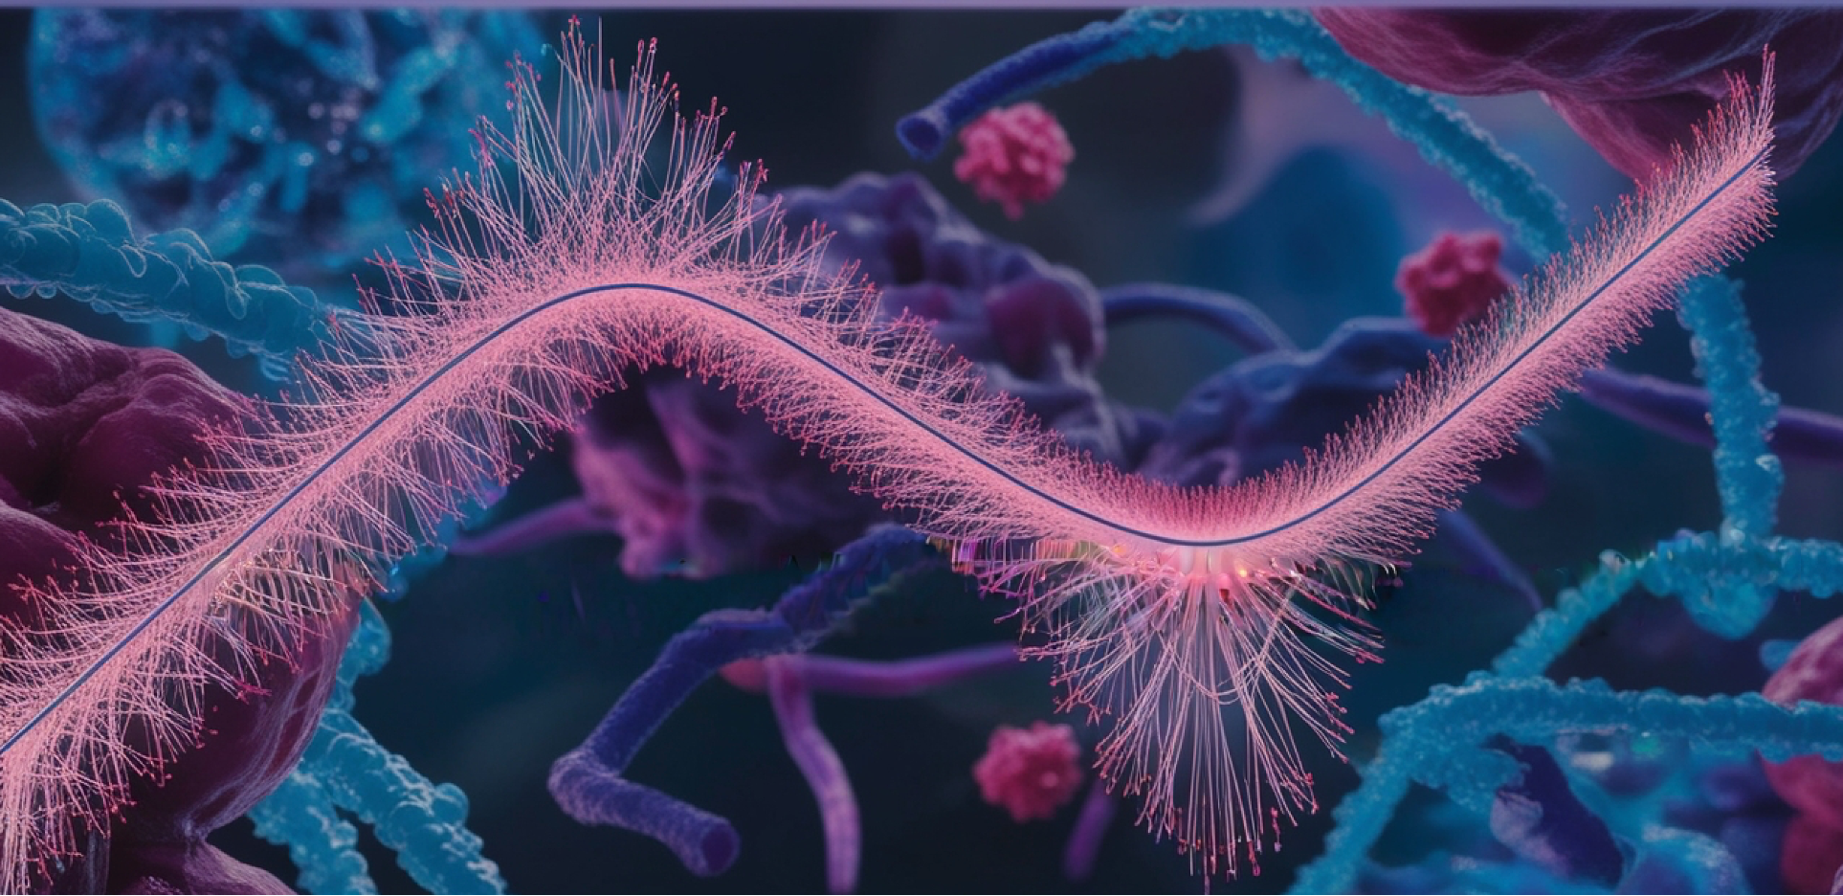


Training
Biostatistics and Machine Learning II
November 25th – 29th
National course for PhD students and researchers who want to deepen their data analysis skills. Learn about dimensionality reduction beyond PCA, mixed-effect models, survival analysis, classification and ensemble methods, PLS for single and multi-omics data sets.
* Apply by October 18th. Everyone is welcome!
BMC Trippelrummet, Uppsala
Sign up: scilifelab.se/events

