Slide 1
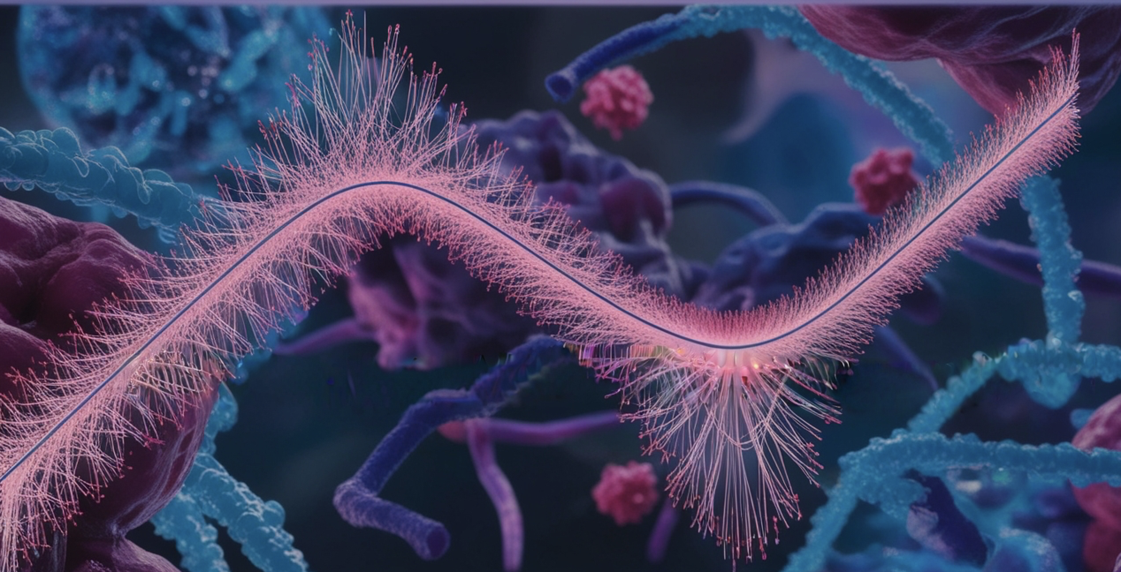
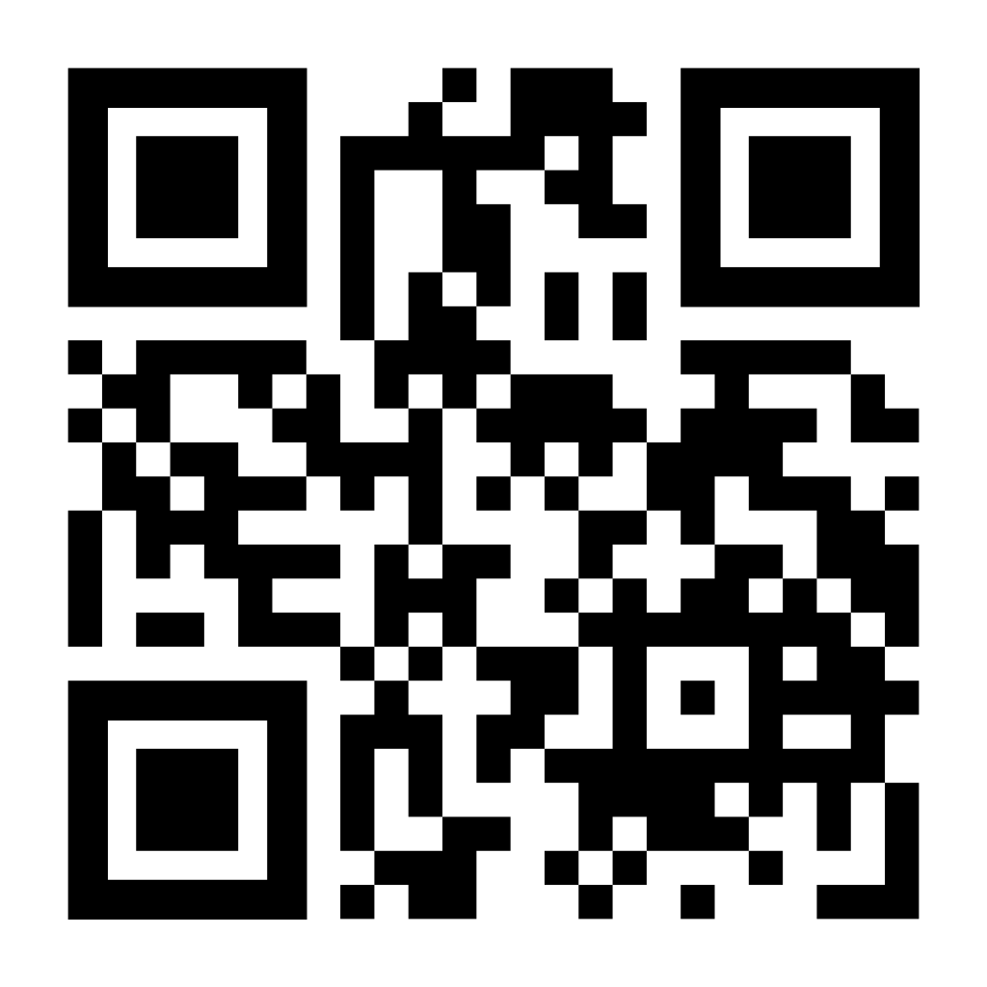


Course
Biostatistics and Machine Learning II
National course for PhD students and researchers who want to deepen their data analysis skills..
Learn more about
dimensionality reduction beyond PCA
mixed-effect models
survival analysis
classification algorithms
ensemble techniques
PLS methods for single and multi-omics
Apply by October 18th
https://www.scilifelab.se/event/biostatistics-and-machine-learning-ii/
* Everyone is welcome to apply. See website for details.
November 25th – 29th
BMC, Uppsala
Husargatan 3, 751 23

