Slide 1
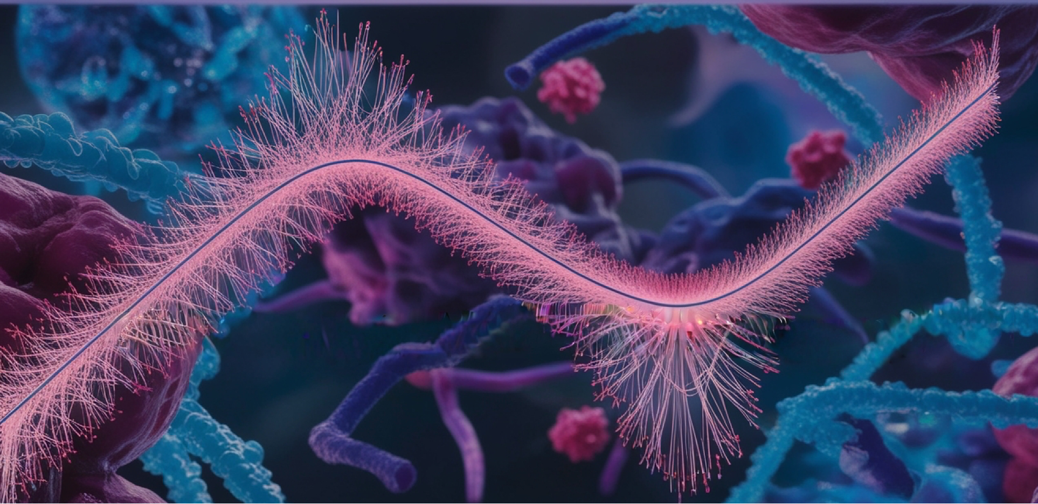
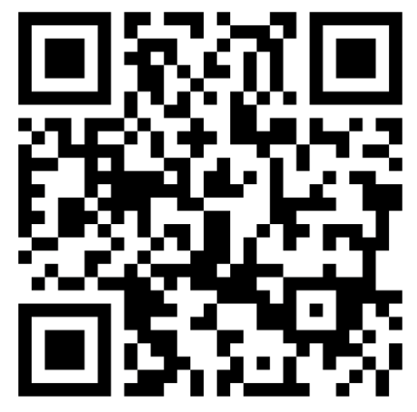
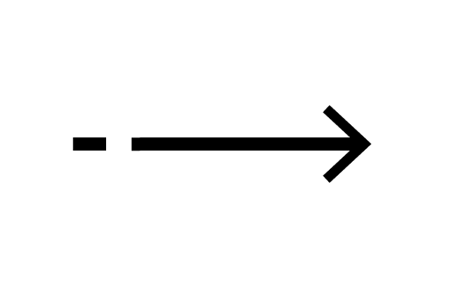

Course
Statistical Methods for Life Sciences
September 07th – 11th
BMC, Uppsala
National course for PhD students, researchers and other employees in need of biostatistical skills. Probability. Sampling and resampling. PCA and clustering. Hypothesis testing. Linear models. GLM. Mixed—effect models for repeated and hierarchical data. Survival analysis for time-to-event data.
Apply by June 26th
Read more:
https://nbisweden.github.io/ML4Life/
or https://training.scilifelab.se/events

