Slide 1
Introduction to Bioinformatics using NGS data

Slide 2
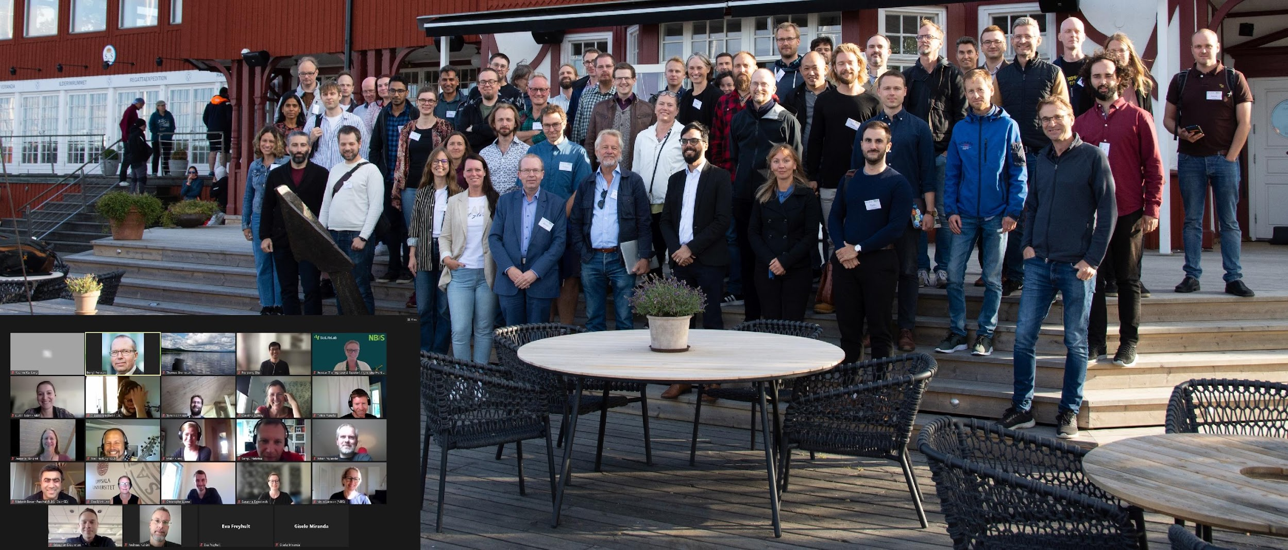
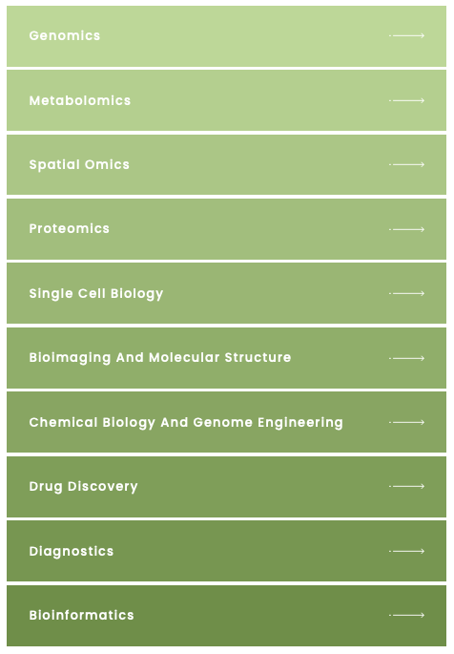
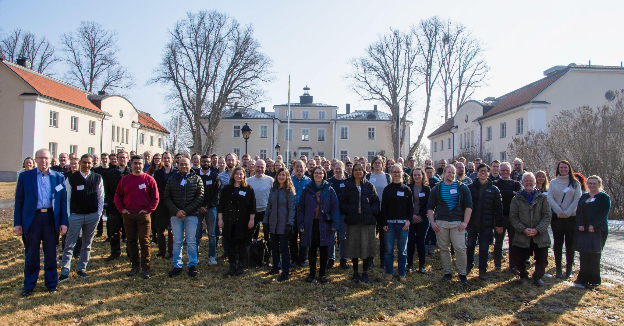
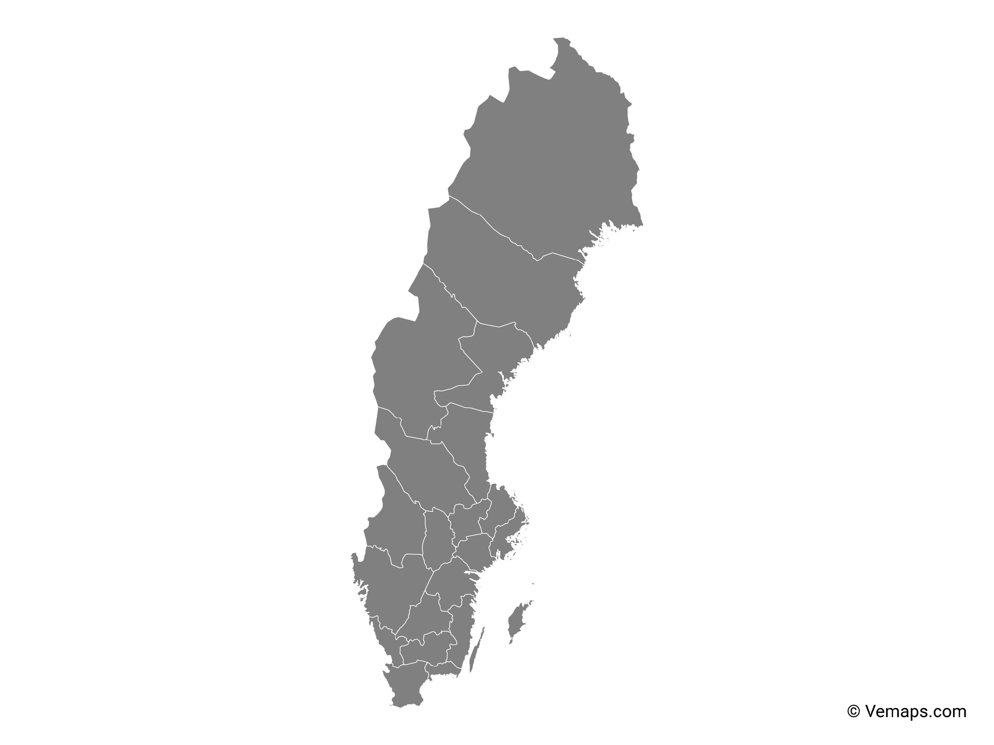

SciLifeLab, NBIS and NGI
SciLifeLab services
Umeå
Staff at six different sites across Sweden with expertise in many different omics-related areas
~120 staff at six different sites across Sweden with expertise in many different omics-related areas
Uppsala
Stockholm
Göteborg
Linköping
Lund
Notes:
This workshop is organized by SciLifeLab: NGI (national genomics infrastructure) is part of the Genomics platform, NBIS is the bioinformatics platform.

Slide 3

Teachers on this workshop are from NBIS and NGI
Publication
Study design
Data generation
Standard analyses
Project-specific analyses
Notes:
Most teachers on this workshop work at NBIS. We are involved in planning of projects and project specific data analysis, and teaching. Teachers on Tuesday afternoon are from NGI; who are involved in producing data and implementing and running standard analyses.

Slide 4
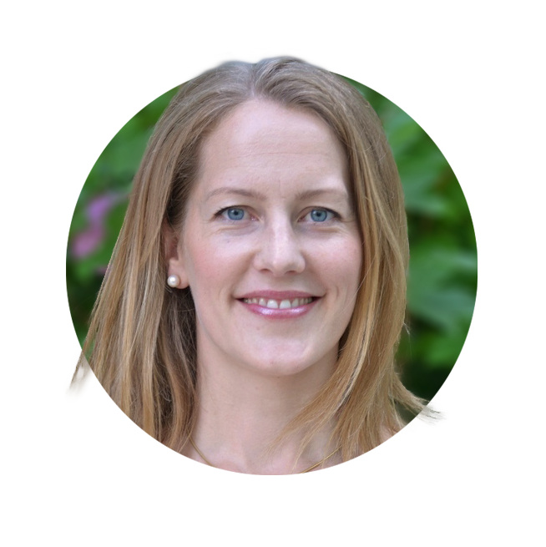
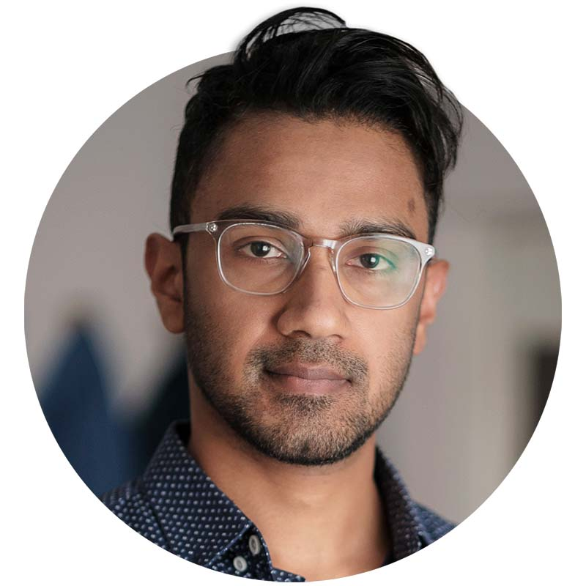
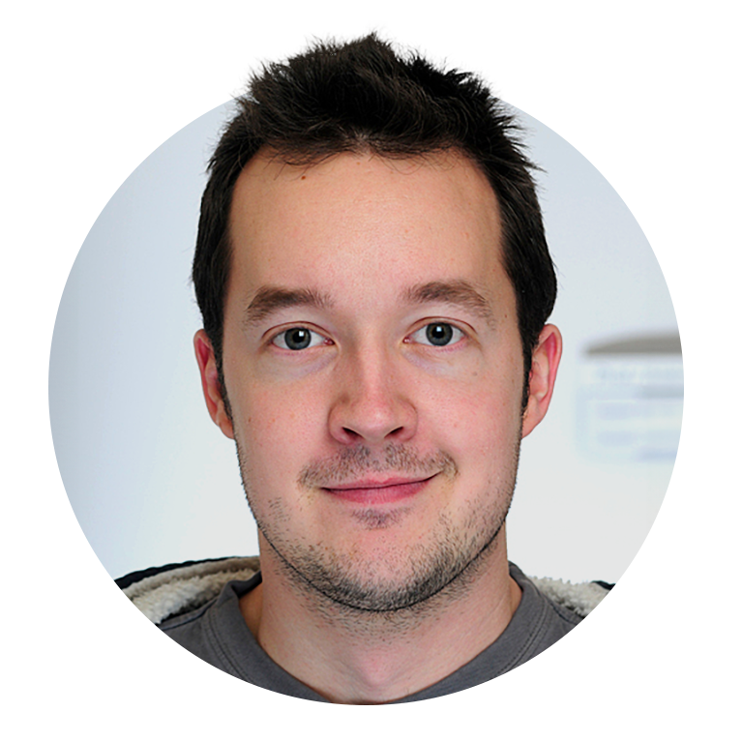
Workshop organizers
Roy Francis
Malin Larsson
Martin Dahlö

Slide 5
Teachers
Jyotirmoy Das
Core Facility, Clinical Genomics SciLifeLab Linköping
Claudio Mirabello
NBIS SciLifeLab Linköping
Johanna Lagensjö
NGI SciLifeLab Uppsala
Adam Ameur
NGI SciLifeLab Uppsala
Diana Ekman
NBIS SciLifeLab Stockholm
Dag Ahren
NBIS SciLifeLab Lund
Elin Kronander
NBIS ScilIifeLab Uppsala

Slide 6
Practical information
Zoom Monday: https://liu-se.zoom.us/j/65307893994
Course web page: https://nbisweden.github.io/workshop-ngsintro/2411/index.html
Lunch ~12:00 every day at Tropikhuset (https://belvederen-tropikhuset.se)
Coffee breaks in the morning and afternoon
Times in schedule may be adjusted slightly depending on breaks. Start time in the morning and after lunch is “fixed”.
Course dinner Thursday 18:00 at PappaGrappa

Slide 7
Attendence and certificate
Those that attend the full workshop* will get a certificate.
*Attendence at all lectures and labs
*Labs done to the basic level
*Let us know if you need to miss a session
The certificate will not state number of credits. It will say that this was a full weeks workshop and what topics were covered.
Please mark your attendance on the sheet in the classroom every day
Notes:
We can add that in case someone needs to miss a part of the workshop please talk with us beforehand. Then we will take note of this and tell you how to compensate for the absence i.e. by watching the prerecorded video and run the lab on your own.

Slide 8
Rackham
https://nbisweden.github.io/workshop-ngsintro/2403/
Uppmax project ID: naiss2024-22-1375

Slide 9
Lunch menu
https://belvederen-tropikhuset.se

Slide 10
Questions?
Please ask questions and take part in discussions trough out the workshop!

