Slide 1
Quality Control of NGS data
Malin Larsson
Malin.Larsson@nbis.se

Slide 2
FastQ files
@HWUSI-EAS100R:6:73:941:1973#0/1
GATTTGGGGTTCAAAGCAGTATCGATCAAATAGTAAATCCATTTGTTCAACTCACAGTTT
+
!''*((((***+))%%%++)(%%%%).1***-+*''))**55CCF>>>>>>CCCCCCC65
1st row: sequence identifier (machine ID, x-y coordinates, additional info)
2nd row: The actual sequence
3rd row: starts with “+” and optionally the same identifier as in the 1st row
4th row: Quality score for each base in read

Slide 3
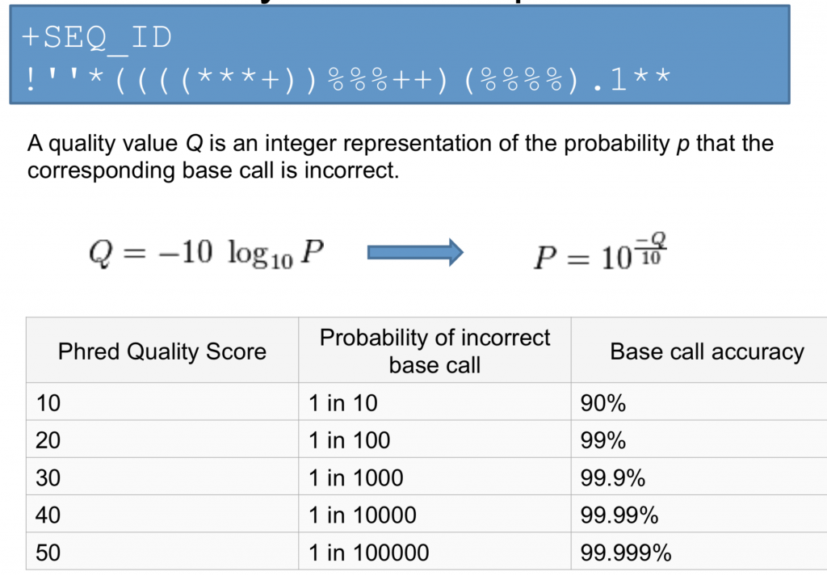
Phred Quality Scores

Slide 4
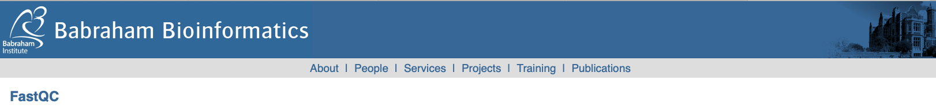
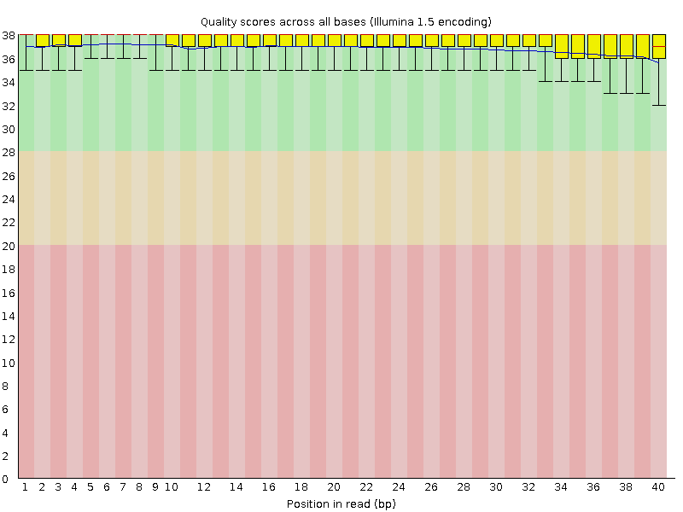
FastQC
Bad qualities: Good qualities:

Slide 5
What is QC?
Different NGS application have their own problem areas and requires their own QC strategy
Today: Focus on QC for whole genome sequencing
For variant calling it is important to look at quality score distribution, sequence length distribution and duplication levels.
Thursday: More details on QC for RNA-seq

Slide 6
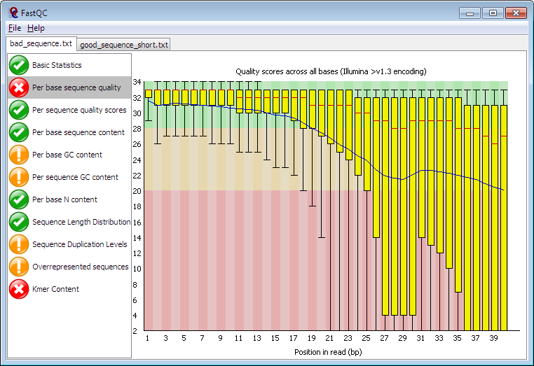
FastQC

Slide 7
FastQC link
https://www.bioinformatics.babraham.ac.uk/projects/fastqc/

